Slide 1
Applications of Information and Communications technology
Jamal Ahmed Khan
Lecture 02

Slide 2
Reference book
Charles S. Parker, Understanding Computers: Today and Tomorrow, Course Technology, 25 Thomson Place, Boston, Massachusetts 02210, USA

Slide 3
Generation of Computers
A generation refers to the state of improvement in the development of a product. This term is also used in the different advancements of computer technology. With each new generation, the circuitry has gotten smaller and more advanced than the previous generation before it. As a result of the miniaturization, speed, power, and memory of computers has proportionally increased. New discoveries are constantly being developed that affect the way we live, work and play.

Slide 4
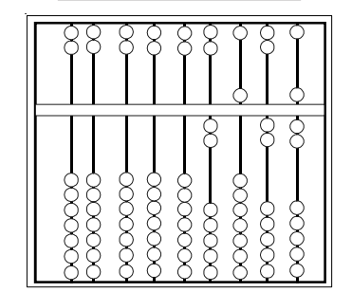
History of Computers
Earlier Computing Devices (3000 BC–1617 AD)
Abacus is a rudimentary first computing device developed in 3000 BC. It consists of a row of wires held in a wooden frame having beads stung on them as shown in Figure. It is used for calculations by sliding the heads along the wires.

Slide 5
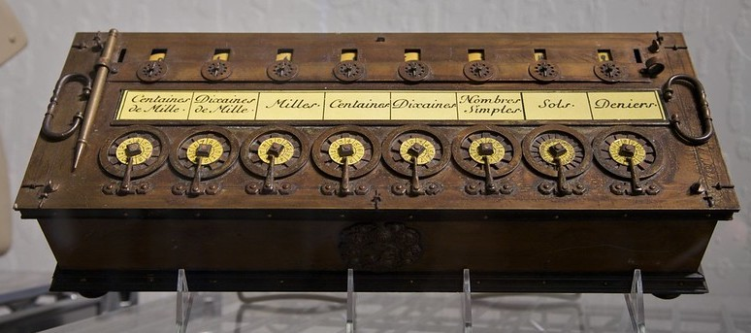
Zeroth Generation Computers (1642–1946)
The zeroth generation of computers (1642–1946) was marked by the invention of mainly mechanical computers. Pascaline was the first mechanical device, invented by Blaise Pascal, a French mathematician in 1642. In this machine, numbers were entered, by dialing a series of number wheels. A series of toothed wheels transferred the movements to a dial and hence 1800, punched card was invented by Jacquard. It is an obsolete computer input device, mode of stiff paper that stores data in columns containing patter of punched holes, showed the results. In 1800, punched card was invented by Jacquard. It is an obsolete computer input device, mode of stiff paper that stores. data in columns containing patter of punched holes.

Slide 6
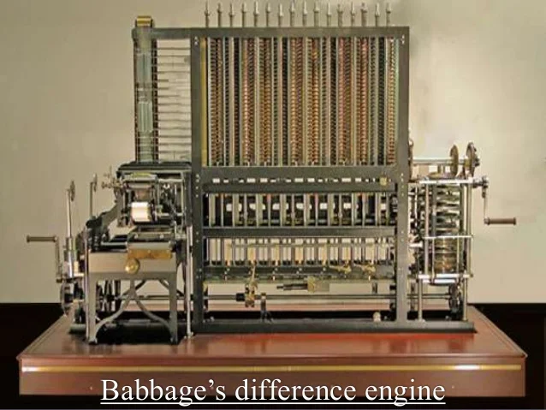
In 1822, Charles Babbage, an English mathematician, designed a machine called Difference Engine to compute tables of numbers for naval navigation. Later on, in the year 1834, Babbage attempted to build a digital computer, called Analytical Engine. The analytical engine had all the parts of a modern computer i.e. it had four components — the store (memory unit), the mill (computation unit), the punched card reader (input unit) and the punched/ printed output (output unit). As all basic parts of modern computers were thought out by Charles Babbage, he is known as Father of Computers. The daughter of the poet Lord Byron, Augusta Ada became Charles Babbage’s most enthusiatic supporter. She wrote programs for the Analytical Engine and made several innovations that are central to programming today.

Slide 7
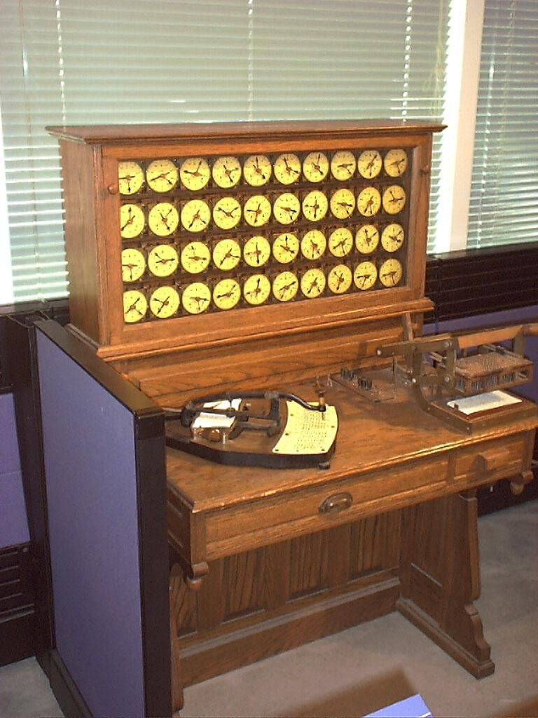
In later years, Herman Hollerith invented a machine for doing counting for 1880 US census, which was called the Tabulating Machine. In 1944, Howard A. Eiken invented first American general purpose electro-mechanical computer, called Mark I and later on its successor, Mark II. The zeroth generation of computers or the era of mechanical computers ended in 1946, when vacuum tubes were invented.

Slide 8
First Generation Computers (1946–1954)
The first generation of computers (1946–1954) was marked by the use of vacuum tubes or valves as their basic electronic component. Although these computers were faster than earlier mechanical devices, they had many disadvantages. First of all, they were very large in size. They consumed too much power and generated too much heat, when used for even short duration of time. They were very unreliable and broke down frequently. They required regular maintenance and their components had also to be assembled manually.

Slide 9
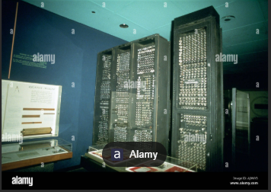
(i) ENIAC (Electronic Numerical Integrator and Calculator).
It was the first electronic computer using vacuum tubes. It was the first stored-program computer, built by John Mauchly and J. Presper Eckert. It took up 1,000 square feet of floor space. Cards, lights, switches, and plugs were the input/output device of this computer as shown in Figure. The speed of this Computer was 5,000 operations per second.

Slide 10
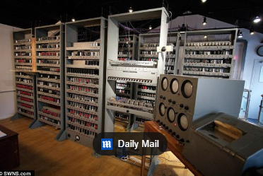
ii) EDSAC (Electronic Delay Storage Automatic Calculator).
It was made by Maurice Wilkes, at Cambrige University. Its speed was 714 operations per second as shown in Figure.
(iii) EDVAC (Electronic Discrete Variable Automatic Computer).
It was successor of EDSAC.

Slide 11
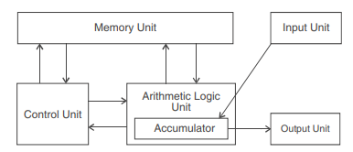
(iv) IAS machine (Princeton’s Institute of Advanced Studies).
It was a new version of the EDVAC, built by von Neumann. The basic design of IAS machine is now known as von Neumann machine, which had five basic parts—the memory, the arithmetic logic unit, the program control unit, the input and output unit as shown in Figure.

Slide 12
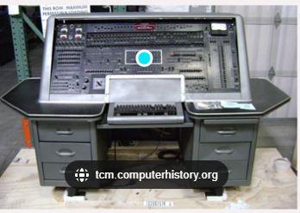
(v) UNIVAC I (Universal Automatic Calculator).
It was the first computer to handle both numeric and textual information as shown in Figure

Slide 13
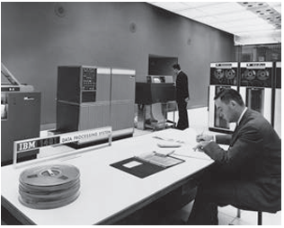
Second Generation Computers (1953–1964)
The first generation of computers became out-dated, when in 1954, the Philco Corporation developed transistors that can be used in place of vacuum tubes. The second generation of computers (1953–64) was marked by the use of transistors in place of vacuum tubes. Transistors had a number of advantages over the vacuum tubes. As transistors were made from pieces of silicon, so they were more compact than vacuum tubes. The second-generation computers, therefore, were smaller in size and less heat generated than first generation computers. Although they were slightly faster and more reliable than earlier computers, they also had many disadvantages. They had limited storage capacity, consumed more power and were also relatively slow in performance. Like first generation computers, they also required regular maintenance and their components had also to be assembled manually. Manual assembly of components was very expensive and later many attempts were made to reduce such manual assembly. It was in 1964, when it was discovered that a number of transistors could be sealed up into a tiny package, called an Integrated Circuit (IC) or a Chip.
IBM 701, IBM’s first electronic large computer

Slide 14
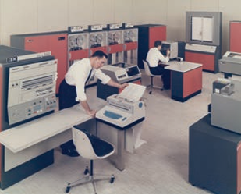
Third Generation Computers (1964–1980)
Second generation computers became out-dated after the invention of ICs. The third generation of computers (1964–978) was marked by use of Integrated Circuits (ICs) in place of transistors. As hundreds of transistors could be put on a single small circuit, so ICs were more compact than transistors. An integrated circuit is a microelectronic semiconductor device consisting of many interconnected transistors and other components. ICs are constructed on a small rectangle cut from a Silicon wafer.
The third generation computers, removed many drawbacks of second generation computers. The third generation computers were even smaller in size, very less heat generated and required very less power as compared to earlier two generation of computers. These computers required less human labour at the assembly stage. Although, third generation computers were also still faster and even more reliable, they also had few disadvantages. They still had less storage capacity, relatively slower performance and thus could not fulfill the requirements of the users and programmers.
1. IBM 360, developed by IBM in 1964 was the first product line designed as a family. 2. PDP-8, developed by DEC in 1965 was the first mass-market minicomputer

Slide 15
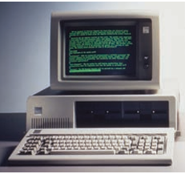
Fourth Generation Computers (1978–Till Date)
The third generation computers became out-dated, when it was found in around 1978 that thousands of ICs could be integrated onto a single chip, called Large Scale Integration (LSI). The fourth generation of computers (1978–till date) was marked by use of large-scale Integrated (LSI) circuits in place of ICs. As thousands of ICs could be put onto a single circuit, so LSI circuits are still more compact than ICs. In 1978, it was found that millions of components could be packed onto a single circuit, known as Very Large Scale Integration (VLSI). VLSI is the latest technology of computer that led to the development of the popular Personal Computers (PCs), also called as Microcomputers. All present day computers are fourth generation of computers. These computers are very powerful having a high memory and a fast processing speed. Today’s PCs are even more powerful than mainframe computers.
Pentium, developed in 1995, has Pentium (80586) memory chip

Slide 16
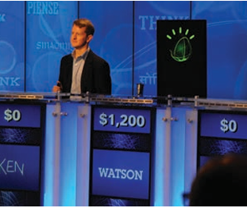
Fifth Generation Computers
Although fourth generation computers offer too many advantages to users, still they have one main disadvantage. The major drawback of these computers is that they have no intelligence on their own. Scientists are now trying to remove this drawback by making computers, which would have artificial intelligence. The fifth generation computers (Tomorrow’s computers) are still under research and development stage. These computers would have artificial intelligence. They will use Ultra Large-Scale Integration (ULSI) chips in place of VLSI chips. One USLI chip contains millions of components on a single IC. The most important feature of fifth generation computers is that they will use an intelligent software. This software will enable the user to tell computer ‘What to do’ and not ‘How to do’ by using intelligent programming and knowledge-based problem solving techniques. So, the programmers or users would not require to give each and every instruction to the computer for solving a problem. These computers will also have user interface in form of speech in natural languages.

Slide 17
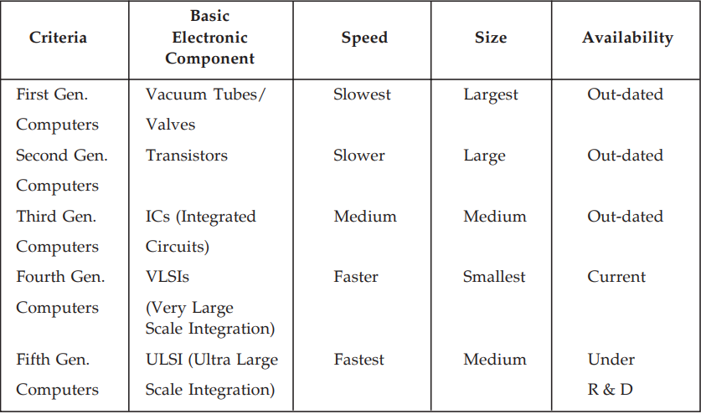

Slide 18
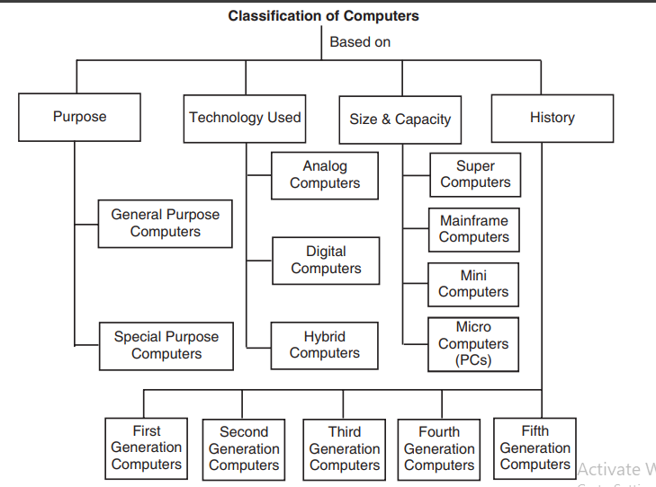

Slide 19
Classification of computers
Based on Purpose
According to the utilisation of computer for different uses, computers are of the following two types :
(i) General Purpose Computers. Computers that follow instructions for general requirements such as sales analysis, financial accounting, invoicing, inventory, management information etc. are called General Purpose Computers. Almost all computers used in offices for commercial, educational and other applications are general purpose computers.
(ii) Special Purpose Computers. Computers that are designed from scratch to perform special tasks like scientific applications and research, weather forecasting, space applications, medical diagnostics, etc. are called Special Purpose Computers.

Slide 20
Based on Technology Used
According to the technology used, computers are of the following three types:
(i) Analog Computers.
Analog computers are special purpose computers that represent and store data in continuously varying physical quantities such as current, voltage or frequency. These computers are programmed for measuring physical quantities like pressure, temperature, speed etc. and to perform computations on these measurements. Analog computers are mainly used for scientific and engineering applications. Some of the examples of analog computers are given below:
Thermometer. It is a simple analog computer used to measure temperature. In thermometer, the mercury moves up or down as the temperature varies.
Speedometer. Car’s speedometer is another example of analog computer where the position of the needle on dial represents the speed of the car.

Slide 21
(ii) Digital Computers. Digital computers are mainly general-purpose computers that represent and store data in discrete quantities or numbers. In these computers, all processing is done in terms of numeric representation (Binary Digits) of data and information. Although the user enters data in decimal or character form, it is converted into binary digits (0’s and 1’s). Almost all the computers used now a days are digital computers and we will discuss the detailed working and components of these computers in subsequent chapters.
(iii) Hybrid Computers. Hybrid computers incorporate the technology of both analog and digital computers. These computers store and process analog signals which have been converted into discrete numbers using analog-to-digital converters. They can also convert the digital numbers into analog signals or physical properties using digital-to-analog converters. Hybrid computers are mainly used in artificial intelligence (robotics) and computer aided manufacturing (e.g. process control).

Slide 22
Based on Size and Storage Capacity
Super Computer
Super computers are the type of computer which works at a faster rate and they are referred to as the fast computers. As these computers are quite fast so they are quite expensive to buy and even they are operated by those people who are particularly specialized in the usage of such computers. This type of computer is also meant for several calculations as it can solve all the problems at a higher speed. The term “super computer” was coined in 1929 by the New York World, referring to tabulators manufactured by IBM. To modern computer users, these tabulators would probably appear awkward, slow, and cumbersome to use, but at the time, they represented the cutting edge of technology. This continues to be true of supercomputers today, which harness immense processing power so that they are incredibly fast, sophisticated, and powerful.

Slide 23
Use
The computer is mainly used for the mathematical and numerical functions as the supercomputers are very strong in calculations so they provide answer to each and every number that had been entered there. The main function of supercomputers is to provide each and everything to the person at the faster rate most of the time that is spent by the supercomputers is in the execution of the programs so that they can be opened at a faster rate. This is one of the most beneficial features which make a huge difference between the supercomputers and the other types of computers that had been invented so far. Super computers are very much efficient in solving all the problems that are complex and are scientific in nature. Problem solving is another main feature of supercomputers. This computer has the fastest power for carrying out different operational activities. On the other hand all sort of problems that are somehow very much difficult for the person but are real in nature, so supercomputers provide solution to it. Different companies had been making different super computers but the most popular supercomputer till now had been invented by IBM which is the Roadrunner. Different activities and applications are found in supercomputers. However Cray Research had been the most famous person who had invented the fasts supercomputer which is used among most of the people.

Slide 24
Mainframe Computer
Mainframes (often colloquially referred to as “big iron” are powerful computers used primarily by corporate and governmental organizations for critical applications, bulk data processing such as census, industry and consumer statistics, enterprise resource planning, and financial transaction processing. The term originally referred to the large cabinets that housed the central processing unit and main memory of early computers. Later the term was used to distinguish high-end commercial machines from less powerful units. Most large-scale computer system architectures were firmly established in the 1960s. Several minicomputer operating systems and architectures arose in the 1970s and 1980s, which were known alternately as mini-mainframes or minicomputers; two examples are Digital Equipment Corporation’s PDP-8 and the Data General Nova. Many defining characteristics of “mainframe” were established in the 1960s, but those characteristics continue to expand and evolve to the present day.

Slide 25
Historically, mainframes acquired their name in part because of their substantial size, and because of requirements for specialized heating, ventilation, and air conditioning (HVAC), and electrical power, essentially posing a “main framework” of dedicated infrastructure. The requirements of high-infrastructure design were drastically reduced during the mid-1990s with CMOS mainframe designs replacing the older bipolar technology. IBM claimed that its newer mainframes can reduce data center energy costs for power and cooling, and that they could reduce physical space requirements compared to server farms.
Mainframes also have execution integrity characteristics for fault tolerant computing. For example, z900, z990, System z9, and System z10 servers effectively execute result-oriented instructions twice, compare results, arbitrate between any differences (through instruction retry and failure isolation), then shift workloads “in flight” to functioning processors, including spares, without any impact to operating systems, applications, or users. This hardware-level feature, also found in HP’s NonStop systems, is known as lock-stepping, because both processors take their “steps” (i.e., instructions) together. Not all applications absolutely need the assured integrity that these systems provide, but many do, such as financial transaction processing.

Slide 26
Personal Computer
A personal computer (PC) is any general-purpose computer whose size, capabilities, and original sales price make it useful for individuals, and which is intended to be operated directly by an enduser with no intervening computer operator. In contrast, the batch processing or time-sharing models allowed large expensive mainframe systems to be used by many people, usually at the same time. Large data processing systems require a full-time staff to operate efficiently. Software applications for personal computers include, but are not limited to, word processing, spreadsheets, databases, Web browsers and e-mail clients, digital media playback, games, and myriad personal productivity and special-purpose software applications. Modern personal computers often have connections to the Internet, allowing access to the World Wide Web and a wide range of other resources. Personal computers may be connected to a local area network (LAN), either by a cable or a wireless connection. A personal computer may be a desktop computer or a laptop, tablet, or a handheld PC.

Slide 27
Netbook
Computers Netbooks (also called mini notebooks or subnotebooks) are a rapidly evolving category of small, light and inexpensive laptop computers suited for general computing and accessing web-based applications; they are often marketed as “companion devices,” that is, to augment a user’s other computer access. Walt Mossberg called them a “relatively new category of small, light, minimalist and cheap laptops.” By August 2009, CNET called netbooks “nothing more than smaller, cheaper notebooks.”. Initially, their primary defining characteristic was the lack of an optical disc drive, requiring it to be a separate and external device. This has become less important as flash memory devices have gradually increased in capacity, replacing the writable optical disc (e.g. CD-RW, DVD-RW) as a transportable storage medium.

