Slide 1


Slide 2
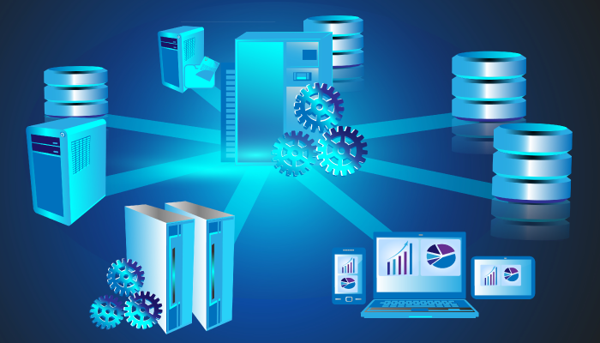

Database Management Sytems (CEN406)
Introduction
Spring-2022

Slide 3
Course Objectives
To familiarize students to
Foundations of database systems
Students will learn Entity relationship, relational model of database management system, data modeling and implementation of query language SQL.
Introduce the core concepts regarding database design and its refinement
Design the database schema for at least a small sized real life application

Slide 4
Course Information
Instructor: Dr. Sarmad Ahmed Shaikh
  Computer Science Department, SMIU
Text book:
  R. Ramez Elmasri and S.B. Navathe, Fundamentals of Database Systems, 7th Edition, 2016.
  Ramakrishnan, Raghu, and Johannes Gehrke. Database Management Systems. 3rd ed. McGraw-Hill, 2002.
  Database Systems, A Practical Approach, 3rd Edition by Connolly & Begg
Class material
      Slides and class activities
Credit Hours:
  3 + 1
Lectures:
  2 per week – 1.5 hours each

Slide 5
Assessment
Quizzes – 10% -
Homeworks – 10%
Project – 15%
Participation – 5%
Midterm1 – 20%
Final – 40%

Slide 6
Grading Policy
All deadlines will be hard.
Regrading can be requested after grade reporting, within following time limits:
  Midterm: 2days
  HWs: 2days
  Quizzes: 2days

Slide 7
Academic Dishonesty
Any form of cheating on exams/homeworks/quizzes is subject to serious penalty.

Slide 8
Course Contents
Introduction to Databases
Basic Concepts and Architecture
Relational Model
SQL
Data Manipulation, Data Definition, Nested Queries
Relational Algebra
Data Modelling using ER Models
Introduction to Normalization
Logical & Physical Database Design
Introduction to Query Processing and Optimizations
Introduction to Transaction Processing

Slide 9
Project
With the project, student will learn all necessary steps on how to implement a database system from the idea phase to the final design and deployment phase.
Group
  Not more than 4 students per group
Submission of proposal
  3rd week of the course
Deliverable
  All project components i.e., coding, graphs, results
  Report (A-Z) in the form of IEEE-paper format
  Final presentation

Slide 10
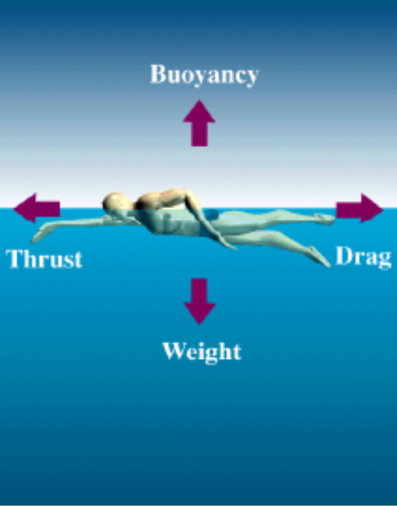
About the Classes
You’re welcome to ask questions.
  – You can interrupt me at any time.
  – Please don’t disturb others in the class.
Our responsibility is to facilitate you to learn.
  You have to make the effort.
Spend time reviewing lecture notes afterwards.
If you have a question on the lecture material after a class, then
  Look up a book! Be resourceful.
  Try to work it out yourself.
  Ask me during the problem class or one of scheduled times of availability.

Slide 11
Introduction to Database Systems

Slide 12
Basic Definitions
Database: A collection of related data.
Or
A database is an organized collection of structured information, or data, typically stored electronically in a computer system.
  the data can then be easily accessed, managed, modified, updated, controlled, and organized
  most databases use structured query language (SQL) for writing and querying data.
Data: Known facts that can be recorded and have an implicit meaning.

Slide 13
Database Management System (DBMS): A software package/ system to facilitate the creation and maintenance of a computerized database.
Examples:
  Oracle
  DB2 (IBM)
  MS SQL Server
  MS Access
  Ingres
  PostgreSQL
  MySQL
Database System: The DBMS software together with the data itself. Sometimes, the applications are also included

Slide 14
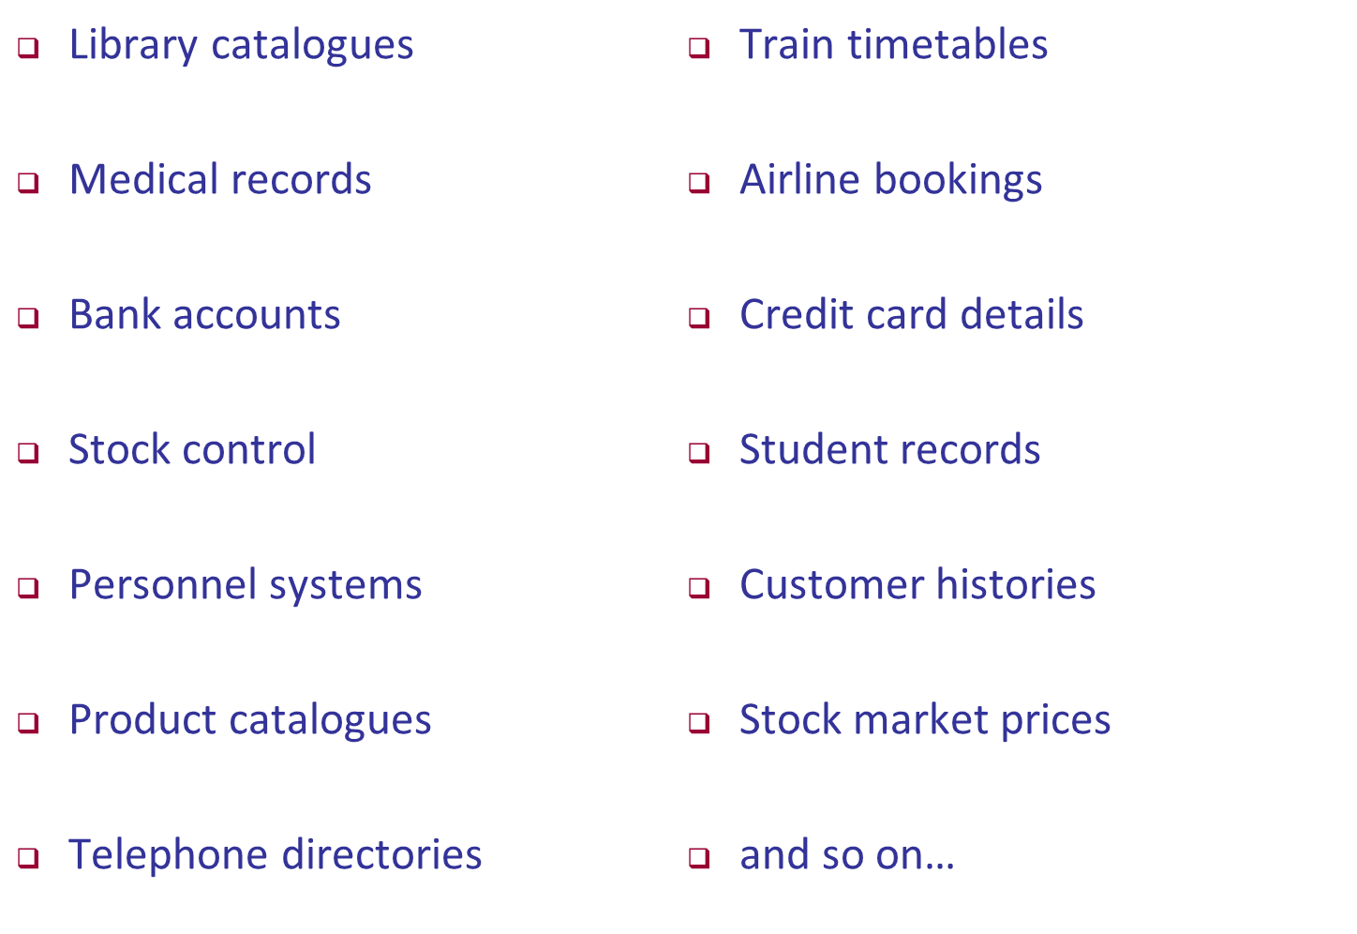
Examples of Databases

Slide 15
Project Options
Some possible options
  University/Student Management DB
  Bank Management DB
  Train/Flight/Bus Reservation Ticketing Management DB
  Cricket Management DB
  IoT/WSN Networking DB
  Mobile Phone Management DB
Each group should not be more than 4 students

Slide 16
CHAPTER 1
Databases and Database Users
Slide 1- <number>

Slide 17
OUTLINE
Types of Databases and Database Applications
Basic Definitions
Typical DBMS Functionality
Example of a Database (UNIVERSITY)
Main Characteristics of the Database Approach
Types of Database Users
Advantages of Using the Database Approach
Historical Development of Database Technology
Extending Database Capabilities
When Not to Use Databases
Slide 1- <number>

Slide 18
What is data, database, DBMS
Data: Known facts that can be recorded and have an implicit meaning; raw
Database: a highly organized, interrelated, and structured set of data about a particular enterprise
  Controlled by a database management system (DBMS)
DBMS
  Set of programs to access the data
  An environment that is both convenient and efficient to use
Database systems are used to manage collections of data that are:
  Highly valuable
  Relatively large
  Accessed by multiple users and applications, often at the same time.
A modern database system is a complex software system whose task is to manage a large, complex collection of data.
Databases touch all aspects of our lives
Slide 1- <number>

Slide 19
Types of Databases and Database Applications
Traditional applications:
  Numeric and textual databases
More recent applications:
  Multimedia databases
  Geographic Information Systems (GIS)
  Biological and genome databases
  Data warehouses
  Mobile databases
  Real-time and active databases
First part of book focuses on traditional applications
A number of recent applications are described later in the book (for example, Chapters 24,25,26,27,28,29)
Slide 1- <number>

Slide 20
Recent Developments (1)
Social Networks started capturing a lot of information about people and about communications among people-posts, tweets, photos, videos in systems such as:
  - Facebook
  - Twitter
  - Linked-In
All of the above constitutes data
Search Engines, Google, Bing, Yahoo: collect their own repository of web pages for searching purposes
Slide 1- <number>

Slide 21
Recent Developments (2)
New technologies are emerging from the so-called non-SQL, non-database software vendors to manage vast amounts of data generated on the web:
  Big data storage systems involving large clusters of distributed computers (Chapter 25)
  NOSQL (Non-SQL, Not Only SQL) systems (Chapter 24)
A large amount of data now resides on the “cloud” which means it is in huge data centers using thousands of machines.
Slide 1- <number>

Slide 22
What is “big data”?
"Big data are high-volume, high-velocity, and/or high-variety information assets that require new forms of processing to enable enhanced decision making, insight discovery and process optimization” (Gartner 2012)
Bottom line: Any data that exceeds our current capability of processing can be regarded as “big”
  Complicated (intelligent) analysis of data may make a small data “appear” to be “big”

Slide 23
Why is “big data” a “big deal”?
Government
Private Sector
  Walmart handles more than 1 million customer transactions every hour, which is imported into databases estimated to contain more than 2.5 petabytes of data
  Facebook handles 40 billion photos from its user base
  Falcon Credit Card Fraud Detection System protects 2.1 billion active accounts world-wide
Science
  Large Synoptic Survey Telescope will generate 140 Terabyte of data every 5 days
  Biomedical computation like decoding human Genome and personalized medicine

Slide 24
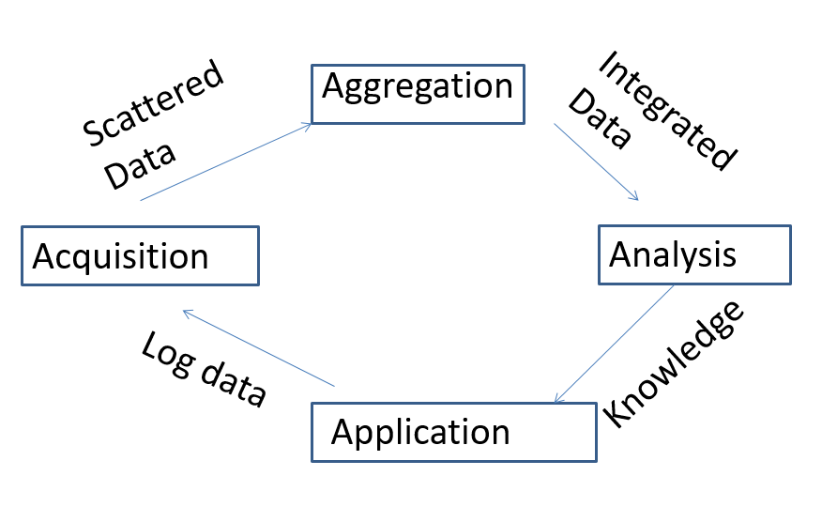
Lifecycle of Data: 4 “A”s
Acquisition
Log data

Slide 25
Computational View of Big Data
Data Visualization
Data Access
Data Analysis
Data Understanding
Data Integration
Formatting, Cleaning
Storage
Data

Slide 26
Big Data & Related Disciplines
Human-Computer Interaction
Data Visualization
Databases
Information Retrieval
Machine Learning
Data Access
Data Analysis
Data Mining
Computer Vision
Speech Recognition
Data Understanding
Data Integration
Natural Language Processing
Data Warehousing
Formatting, Cleaning
Signal Processing
Many Applications!
Storage
Data
Information Theory

Slide 27
Basic Definitions
Database:
  A collection of related data.
Data:
  Known facts that can be recorded and have an implicit meaning.
Mini-world:
  Some part of the real world about which data is stored in a database. For example, student grades and transcripts at a university.
Database Management System (DBMS):
  A software package/system to facilitate the creation and maintenance of a computerized database.
Database system:
  The DBMS software together with the data itself. Sometimes, the applications are also included.
Slide 1- <number>

Slide 28
Impact of Databases and Database Technology
Businesses: Banking, Insurance, Retail, Transportation, Healthcare, Manufacturing
Service industries: Financial, Real-estate, Legal, Electronic Commerce, Small businesses
Education : Resources for content and Delivery
More recently: Social Networks, Environmental and Scientific Applications, Medicine and Genetics
Personalized applications: based on smart mobile devices
Slide 1- <number>

Slide 29
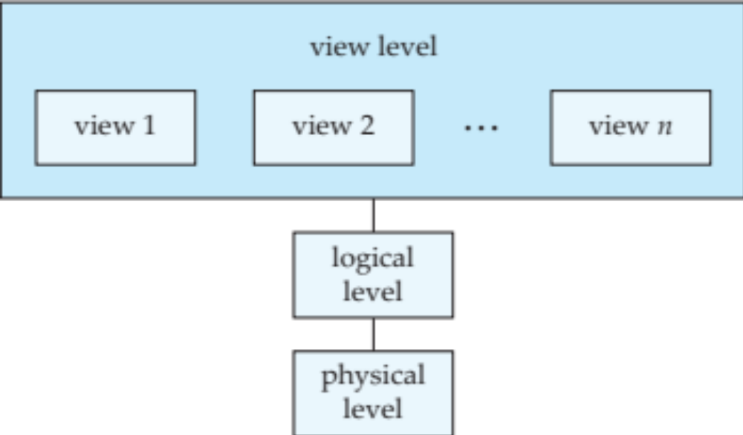
A simplified architecture for a database system
View level: what application programs see; views can also hide information (such as an instructor’s salary) for security purposes.
type instructor = record
ID : string;
name : string;
dept_name : string;
salary : integer;
end;
Physical level: describes how a record (e.g., instructor) is stored.
Slide 1- <number>

Slide 30


A simplified architecture for a database system
Slide 1- <number>

Slide 31

A simplified architecture for a database system
Slide 1- <number>

Slide 32

A simplified architecture for a database system
Slide 1- <number>

Slide 33
What a DBMS Facilitates
Define a particular database in terms of its data types, structures, and constraints
Construct or load the initial database contents on a secondary storage medium
Manipulating the database:
  Retrieval: Querying, generating reports
  Modification: Insertions, deletions and updates to its content
  Accessing the database through Web applications
Processing and sharing by a set of concurrent users and application programs – yet, keeping all data valid and consistent
Slide 1- <number>

Slide 34
Other DBMS Functionalities
DBMS may additionally provide:
  Protection or security measures to prevent unauthorized access
  “Active” processing to take internal actions on data
  Presentation and visualization of data
  Maintenance of the database and associated programs over the lifetime of the database application
Slide 1- <number>

Slide 35
Application Programs and DBMS
Applications interact with a database by generating
  - Queries: that access different parts of data and formulate the result of a request
  - Transactions: that may read some data and “update” certain values or generate new data and store that in the database
Slide 1- <number>

Slide 36
Example of a Database
(with a Conceptual Data Model)
Mini-world for the example:
  Part of a UNIVERSITY environment
Some mini-world entities:
  STUDENTs
  COURSEs
  SECTIONs (of COURSEs)
  (Academic) DEPARTMENTs
  INSTRUCTORs
Slide 1- <number>

Slide 37
Example of a Database
(with a Conceptual Data Model)
Some mini-world relationships:
  SECTIONs are of specific COURSEs
  STUDENTs take SECTIONs
  COURSEs have prerequisite COURSEs
  INSTRUCTORs teach SECTIONs
  COURSEs are offered by DEPARTMENTs
  STUDENTs major in DEPARTMENTs
Note: The above entities and relationships are typically expressed in a conceptual data model, such as the entity-relationship (ER) data or UML class model (see Chapters 3, 4)
Slide 1- <number>

Slide 38
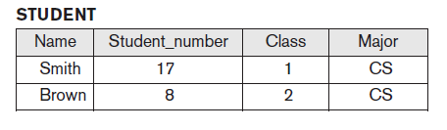

Example of a Simple Database
Slide 1- <number>

Slide 39
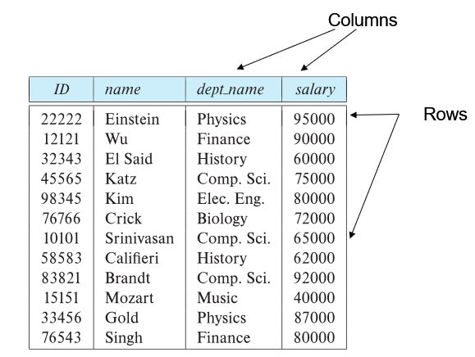

The relational model
E.F. “Ted” Codd
Slide 1- <number>

Slide 40
Main Characteristics of the Database Approach
Self-describing nature of a database system:
  A DBMS catalog stores the description of a particular database (e.g. data structures, types, and constraints)
  The description is called meta-data*.
  This allows the DBMS software to work with different database applications.
Insulation between programs and data:
  Called program-data independence.
  Allows changing data structures and storage organization without having to change the DBMS access programs
Slide 1- <number>

Slide 41

Example of a Simplified Database Catalog
Slide 1- <number>

Slide 42
Main Characteristics of the Database Approach (continued)
Data abstraction:
  A data model is used to hide storage details and present the users with a conceptual view of the database.
  Programs refer to the data model constructs rather than data storage details
Support of multiple views of the data:
  Each user may see a different view of the database, which describes only the data of interest to that user.
Slide 1- <number>

Slide 43
Main Characteristics of the Database Approach (continued)
Sharing of data and multi-user transaction processing:
  Allowing a set of concurrent users to retrieve from and to update the database.
  Concurrency control within the DBMS guarantees that each transaction is correctly executed or aborted
  Recovery subsystem ensures each completed transaction has its effect permanently recorded in the database
  OLTP (Online Transaction Processing) is a major part of database applications; allows hundreds of concurrent transactions to execute per second.
Slide 1- <number>

Slide 44
Database Users
Users may be divided into
  Those who actually use and control the database content, and those who design, develop and maintain database applications (called “Actors on the Scene”), and
  Those who design and develop the DBMS software and related tools, and the computer systems operators (called “Workers Behind the Scene”).
Slide 1- <number>

Slide 45
Database Users – Actors on the Scene
Actors on the scene
  Database administrators
    Responsible for authorizing access to the database, for coordinating and monitoring its use, acquiring software and hardware resources, controlling its use and monitoring efficiency of operations.
  Database designers
    Responsible to define the content, the structure, the constraints, and functions or transactions against the database. They must communicate with the end-users and understand their needs.
Slide 1- <number>

Slide 46
Database End Users
Actors on the scene (continued)
  End-users: They use the data for queries, reports and some of them update the database content. End-users can be categorized into:
    Casual: access database occasionally when needed
    Naïve or parametric: they make up a large section of the end-user population.
      They use previously well-defined functions in the form of “canned transactions” against the database.
      Users of mobile apps mostly fall in this category
      Bank-tellers or reservation clerks are parametric users who do this activity for an entire shift of operations.
      Social media users post and read information from websites
Slide 1- <number>

Slide 47
Database End Users (continued)
Sophisticated:
  These include business analysts, scientists, engineers, others thoroughly familiar with the system capabilities.
  Many use tools in the form of software packages that work closely with the stored database.
Stand-alone:
  Mostly maintain personal databases using ready-to-use packaged applications.
  An example is the user of a tax program that creates its own internal database.
  Another example is a user that maintains a database of personal photos and videos.
Slide 1- <number>

Slide 48
Database Users – Actors on the Scene (continued)
System analysts and application developers
  System analysts: They understand the user requirements of naïve and sophisticated users and design applications including canned transactions to meet those requirements.
  Application programmers: Implement the specifications developed by analysts and test and debug them before deployment.
  Business analysts: There is an increasing need for such people who can analyze vast amounts of business data and real-time data (“Big Data”) for better decision making related to planning, advertising, marketing etc.
Slide 1- <number>

Slide 49
Database Users – Actors behind the Scene
System designers and implementors: Design and implement DBMS packages in the form of modules and interfaces and test and debug them. The DBMS must interface with applications, language compilers, operating system components, etc.
Tool developers: Design and implement software systems called tools for modeling and designing databases, performance monitoring, prototyping, test data generation, user interface creation, simulation etc. that facilitate building of applications and allow using database effectively.
Operators and maintenance personnel: They manage the actual running and maintenance of the database system hardware and software environment.
Slide 1- <number>

Slide 50
Advantages of Using the Database Approach
Controlling redundancy in data storage and in development and maintenance efforts.
  Sharing of data among multiple users.
Restricting unauthorized access to data. Only the DBA staff uses privileged commands and facilities.
Providing persistent storage for program Objects
  E.g., Object-oriented DBMSs make program objects persistent– see Chapter 12.
Providing storage structures (e.g. indexes) for efficient query processing – see Chapter 17.
Slide 1- <number>

Slide 51
Advantages of Using the Database Approach (continued)
Providing optimization of queries for efficient processing
Providing backup and recovery services
Providing multiple interfaces to different classes of users
Representing complex relationships among data
Enforcing integrity constraints on the database
Drawing inferences and actions from the stored data using deductive and active rules and triggers
Slide 1- <number>

Slide 52
Additional Implications of Using the Database Approach
Potential for enforcing standards:
  Standards refer to data item names, display formats, screens, report structures, meta-data (description of data), Web page layouts, etc.
Reduced application development time:
  Incremental time to add each new application is reduced.
Slide 1- <number>

Slide 53
Additional Implications of Using the Database Approach (continued)
Flexibility to change data structures:
  Database structure may evolve as new requirements are defined.
Availability of current information:
  Extremely important for on-line transaction systems such as shopping, airline, hotel, car reservations.
Economies of scale:
  Wasteful overlap of resources and personnel can be avoided by consolidating data and applications across departments.
Slide 1- <number>

Slide 54
Historical Development of Database Technology
Early database applications:
  The Hierarchical and Network models were introduced in mid 1960s and dominated during the seventies.
  A bulk of the worldwide database processing still occurs using these models, particularly, the hierarchical model using IBM’s IMS system.
Relational model-based systems:
  Relational model was originally introduced in 1970, was heavily researched and experimented within IBM Research and several universities.
  Relational DBMS Products emerged in the early 1980s.
Slide 1- <number>

Slide 55
Historical Development of Database Technology (continued)
Object-oriented and emerging applications:
  Object-Oriented Database Management Systems (OODBMSs) were introduced in late 1980s and early 1990s to cater to the need of complex data processing in CAD and other applications.
    Their use has not taken off much
  Many relational DBMSs have incorporated object database concepts, leading to a new category called object-relational DBMSs (ORDBMSs)
  Extended relational systems add further capabilities (e.g. for multimedia data, text, XML, and other data types)
Slide 1- <number>

Slide 56
Historical Development of Database Technology (continued)
Data on the Web and e-commerce applications:
  Web contains data in HTML (Hypertext markup language) with links among pages
  Has given rise to a new set of applications and E-commerce is using new standards like XML (eXtended Markup Language) (see Ch. 13).
  Script programming languages such as PHP and JavaScript allow generation of dynamic Web pages that are partially generated from a database (see Ch. 11).
    Also allow database updates through Web pages
Slide 1- <number>

Slide 57
Extending Database Capabilities (1)
New functionality is being added to DBMSs in the following areas:
  Scientific applications – physics, chemistry, biology, genetics
  Spatial: weather, earth and atmospheric sciences and astronomy
  XML (eXtensible Markup Language)
  Image storage and management
  Audio and video data management
  Time series and historical data management
The above gives rise to new research and development in incorporating new data types, complex data structures, new operations and storage and indexing schemes in database systems.
Slide 1- <number>

Slide 58
Extending Database Capabilities (2)
Background since the advent of the 21st Century:
  First decade of the 21st century has seen tremendous growth in user generated data and automatically collected data from applications and search engines.
  Social Media platforms such as Facebook and Twitter are generating millions of transactions a day and businesses are interested to tap into this data to “understand” the users
  Cloud Storage and Backup is making unlimited amount of storage available to users and applications
Slide 1- <number>

Slide 59
Extending Database Capabilities (3)
Emergence of Big Data Technologies and NOSQL databases
  New data storage, management and analysis technology was necessary to deal with the onslaught of data in petabytes a day (10**15 bytes or 1000 terabytes) in some applications – this started being commonly called as “Big Data”.
  Hadoop (which originated from Yahoo) and Mapreduce Programming approach to distributed data processing (which originated from Google) as well as the Google file system have given rise to Big Data technologies (Chapter 25). Further enhancements are taking place in the form of Spark based technology.
  NOSQL (Not Only SQL- where SQL is the de facto standard language for relational DBMSs) systems have been designed for rapid search and retrieval from documents, processing of huge graphs occurring on social networks, and other forms of unstructured data with flexible models of transaction processing (Chapter 24).
Slide 1- <number>

Slide 60
When not to use a DBMS
Main inhibitors (costs) of using a DBMS:
  High initial investment and possible need for additional hardware
  Overhead for providing generality, security, concurrency control, recovery, and integrity functions
When a DBMS may be unnecessary:
  If the database and applications are simple, well defined, and not expected to change
  If access to data by multiple users is not required
When a DBMS may be infeasible
  In embedded systems where a general-purpose DBMS may not fit in available storage
Slide 1- <number>

Slide 61
When not to use a DBMS
When no DBMS may suffice:
  If there are stringent real-time requirements that may not be met because of DBMS overhead (e.g., telephone switching systems)
  If the database system is not able to handle the complexity of data because of modeling limitations (e.g., in complex genome and protein databases)
  If the database users need special operations not supported by the DBMS (e.g., GIS and location-based services).
Slide 1- <number>

Slide 62
Chapter Summary
Types of databases and database applications
Basic definitions
Typical DBMS functionality
Example of a database (UNIVERSITY)
Main characteristics of the database Approach
Types of database users
Advantages of using the database approach
Historical development of database technology
Extending database capabilities
When not to use databases
Slide 1- <number>

