Slide 1



Sales_insights
View in Power BI
Last data refresh:
16/04/2022 11:12:23 UTC
Downloaded at:
16/04/2022 11:14:54 UTC

Slide 2
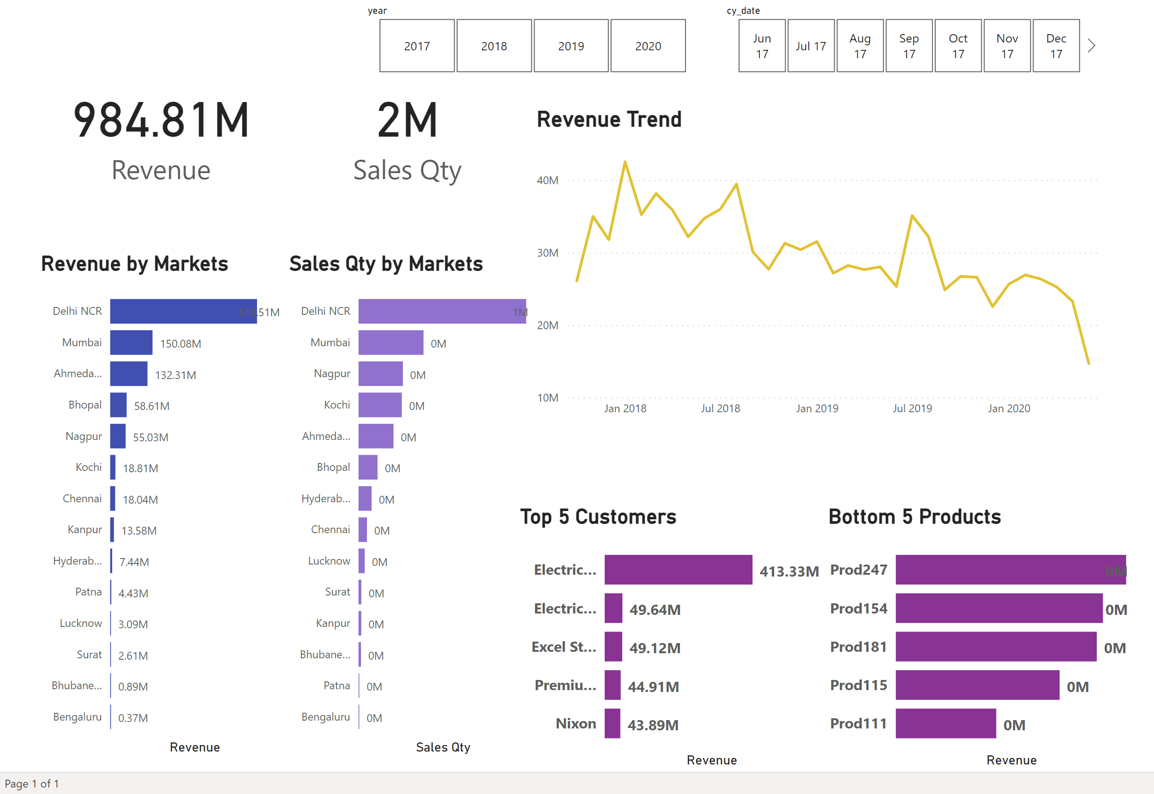
Page 1
Notes:
card
No alt text provided
Revenue by Markets
No alt text provided
card
No alt text provided
Sales Qty by Markets
No alt text provided
slicer
No alt text provided
slicer
No alt text provided
Top 5 Customers
No alt text provided
Revenue Trend
No alt text provided
Bottom 5 Products
No alt text provided

