Slide 1
Coupling a Bi-CNN Encoder and a CNN decoder to automatically simplify English Sentences
Dominik Pfütze, Henny Sluyter-Gäthje,
Simon Untergasser, Tim Patzelt
Notes:
1
- Unfortunately have a cold
- Don’t share cold but share insights gained from our project

Slide 2
Outline
10/29/2018
2
Recap of our approach
Methods and Results
Data
Word embeddings
Models
Results
Conclusion
Notes:
2
- short recap of our idea
- present methods and results
- data
- word embeddings
-encoder
-decoder
- end-2-end model
- conclusion over the whole project

Slide 3
Recap of our approach
Encoder (Siamese) – Decoder
vs. End-to-End
Simple
Decoder,
“Deconvolution”
Encoder (CNN)
Simple
Complex
Encoder (CNN)
Encoder (CNN)
Decoder,
“Deconvolution”
Complex
Simple
10/29/2018
3
Notes:
3
- Overall encoder decoder structure
- Find out if having both a complex and a simple sentence as input for a CNN improves over having only one sentence as input
- Main difference between models in the training procedure:
- encoder trained separately
- decoder mirrors the encoder structure to produce a simple sentence
- Now want to go a little bit more into the details of this part

Slide 4
Recap of our approach
Encoder (Siamese) – Decoder
vs. End-to-End
Simple
Decoder,
“Deconvolution”
Encoder (CNN)
Simple
Complex
Encoder (CNN)
Encoder (CNN)
Decoder,
“Deconvolution”
Complex
Simple
10/29/2018
4
Notes:
4
- siamese encoder = cnn with shared weights
- loss is calculated on output of both encoder

Slide 5
10/29/2018
5
Notes:
5
- encoder should learn to preserve the information distinctive for a simple sentence
- siamese encoder = cnn with shared weights
- Important to note: here we see different dimensions. That’s not the case
- loss is calculated on output of both encoder

Slide 6
Recap of our approach
Complex Sentence | Simple Sentence
A single launch pad can be used for launching all Angara versions except Angara A7 . | All Angara versions can be launched from a single launch pad .
Core Information.
10/29/2018
6
Notes:
6
- Example from the dataset
- Idea is to get a representation of core information
- Could be for example a shorter sentence

Slide 7
Recap of our approach
Complex Sentence | Simple Sentence
A single launch pad can be used for launching all Angara versions except Angara A7 . | All Angara versions can be launched from a single launch pad .
Single launchpad launches all Angara versions.
10/29/2018
7
Notes:
7
- Could also be a mathematical form

Slide 8
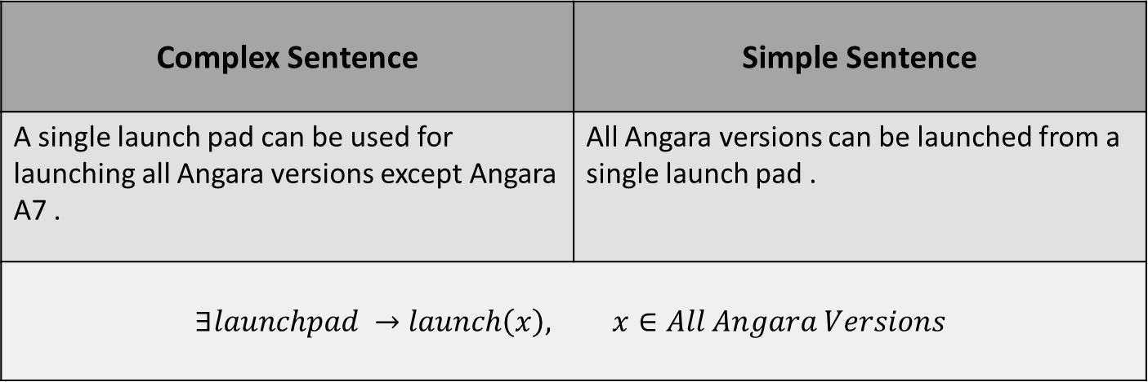
Recap of our approach
Complex Sentence | Simple Sentence
A single launch pad can be used for launching all Angara versions except Angara A7 . | All Angara versions can be launched from a single launch pad .
$$∃launchpad →launch\left(x\right), x∈All Angara Versions$$
10/29/2018
8
Notes:
8
- Now to the data

Slide 9
Recap of our approach
Encoder (Siamese) – Decoder
vs. End-to-End
Simple
Decoder,
“Deconvolution”
Encoder (CNN)
Simple
Complex
Encoder (CNN)
Encoder (CNN)
Decoder,
“Deconvolution”
Complex
Simple
10/29/2018
9
Notes:
9
- siamese encoder = cnn with shared weights
- loss is calculated on output of both encoder
- Contrast for encoder -> not matching sentences

Slide 10
Data
10/29/2018
10
¹ Hwang et al, 2015, Aligning sentences from standard wikipedia to simple wikipedia
Corpus: English and Simple English Wikipedia
284.678 automatically aligned sentences¹
max. length of sentence = 40
Notes:
10
English and Simple english wikipedia corpus with around 285.000 sentences, automatically aligned
- we restricted the length of the sentences to 40 tokens, otherwise they are excluded

Slide 11
Data
10/29/2018
11
¹ Hwang et al, 2015, Aligning sentences from standard wikipedia to simple wikipedia
Notes:
11
- Threshold for length of sentences
- Sentences with additional information
- Neural model can’t create data without information

Slide 12
Word embeddings
10/29/2018
12
¹ Mikolov et al., 2013, Efficient estimation of word representations in vector space
² Bojanewski et al., 2016, Enriching word vectors with subword information
Word2Vec¹ vs. FastText²
With Word2Vec we had a lot of unknowns
Notes:
12
- started with Word2Vec trained on google news corpus
- had a lot of unknowns without word embeddings ,they where replaced by random uniform vectors
- Replaced with fasttext

Slide 13
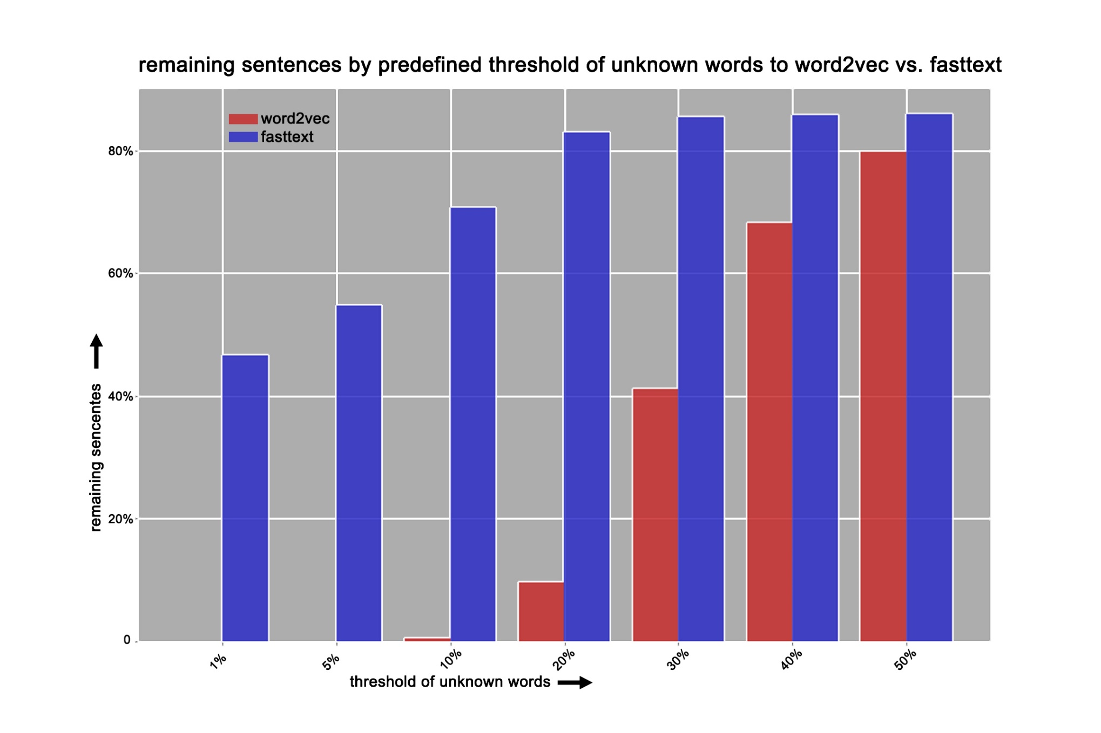
10/29/2018
13
Notes:
13
- red is percentage of remaining sentences using word2vec
- blue percentage of remaining sentences using fasttext
-with word2vec there are at least 5% unknowns in every sentence → not good
-if we allow 10% unknowns we have almost no sentences left with word2vec and around 70% with fasttext

Slide 14
Word embeddings
10/29/2018
14
¹ Mikolov et al., 2013, Efficient estimation of word representations in vector space
² Bojanewski et al., 2016, Enriching word vectors with subword information
Word2Vec¹ vs. FastText²
→ switched to FastText working with character n-grams (3≤n≤6) instead of words
Notes:
14
- we decided to switch to FastText and set the threshold for unknowns to 10% resulting in removing 30% of the sentences
- Going from word embeddings at end of decoder to words

Slide 15
Word embeddings
10/29/2018
15
¹ Mikolov et al., 2013, Efficient estimation of word representations in vector space
² Bojanewski et al., 2016, Enriching word vectors with subword information
FastText Example
Word = <Wo + Wor + ord + rd >
+ <Wor + Word + ord>
+ <Word + Word> + <Word>
Notes:
15
- Only added if they exist
- So with 10% unknowns we result in having 190k sentences

Slide 16
Encoder¹
50 kernels with size 300 X 4 and
Padding = 1.5
50 kernels with size 50 X 4 and
Padding = 1.5
average pooling
(w-ap)
average pooling
(w-ap)
Feature map:
50 X 53
Feature map:
50 X 50
Feature map:
50 X 53
Feature map:
50 X 50
Input: 300 X 40
First convolution layer
Second convolution layer
10/29/2018
16
¹architecture inspired by Yin et al., 2015, Abcnn: Attention-based convolutional neural network for modeling sentence pairs
Notes:
16
-Input=initial word embeddings of size 300x40
- we apply 50 kernels of size 300x4 with 1.5 padding to them, resulting in a 50 x 53 feature map where each row is the result of one kernel slide over the input.
- column wise average pooling is applied to 4 consecutive columns such that the feature map becomes 50 x 50
- after that we apply again 50 kernes but with size 50x50, resulting again in a feature map of dimension 50x53 which is pooled again to 50x50
- the second convolution can be stacked many times because the dimensions of the input are preserved

Slide 17
Encoder¹
Loss: normalized euclidean distance of average pooled feature maps of simple and complex sentence
Layers: 2-4
Best result: mean similarity of 60% with 4 Layers
Similarity(x₁,x₂)= 1-loss(x₁,x₂)
10/29/2018
17
Notes:
17
- we started with the normalized euclidean distance because it is a intuitive measure of how similar vectors are
- the distance is calculated on the 50x50 feature map of the simple and complex sentence
- we experimented with with 2 to 4 layers. yin et al used 3 layers in their paper but we had the best results with 4 layer.
-result not satisfying with 60% similarity

Slide 18
10/29/2018
18
Notes:
18
- encoder should learn to preserve the information distinctive for a simple sentence
- siamese encoder = cnn with shared weights
- Important to note: here we see different dimensions. That’s not the case
- loss is calculated on output of both encoder

Slide 19
Encoder¹
Loss: normalized euclidean distance of average pooled feature maps of simple and complex sentence
Layers: 2-4
Best result: mean similarity of 60% with 4 Layers
Similarity(x₁,x₂)= 1-loss(x₁,x₂)
10/29/2018
19
Notes:
19
- we started with the normalized euclidean distance because it is a intuitive measure of how similar vectors are
- the distance is calculated on the 50x50 feature map of the simple and complex sentence
- we experimented with with 2 to 4 layers. yin et al used 3 layers in their paper but we had the best results with 4 layer.
-result not satisfying with 60% similarity

Slide 20
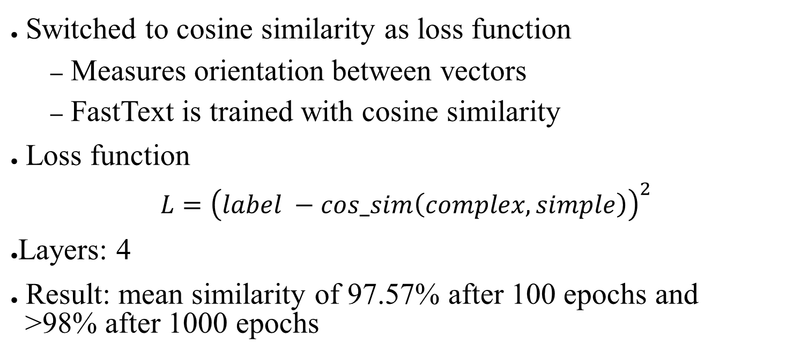
Encoder¹
Switched to cosine similarity as loss function
Measures orientation between vectors
FastText is trained with cosine similarity
Loss function
$L={\left(label −cos_sim\left(complex,simple\right)\right)}^{2}$
Layers: 4
Result: mean similarity of 97.57% after 100 epochs and >98% after 1000 epochs
10/29/2018
20
Notes:
20
- after that we switched to cosine similarity as loss function because we thought it makes more sense to focus on the orientation of vectors and not the magnitude of them in a 300 dimensional space
- furthermore, fasttext is also trained with cosine similarity
- again 4 layers was the best results with 97.57% similarity after 100 epochs and >98% after 1000 epochs

Slide 21
Decoder
Transposed convolution
Input:
50 X 50
Conv. Output = (i - k) + 2p + 1
Deconv. Output = (i' + k) – 2p -1
Feature map:
50 X 50
Feature map:
300 X 40
i=5,
k=4,
p=0,
i’=2
Image taken from: http://deeplearning.net/software/theano/
tutorial/conv_arithmetic.html
10/29/2018
21
Notes:
21
-decoder mirrors the architecture of the encoder
-non-final layers are dimension preserving and the final layer creates a 300x50 feature map
- deconvolution is actually transposed convolution as convolution is not invertible
- deconvolution dimensions = inverse of convolution (but not value wise)
- creating 1 number out of 5 is easy, but the other way round is not trivial
- for me easiest to understand it is to think of padding in between the rows
- calculating convolution output:
- conv: (5-4)+0+1=2
- deconvolution output is just inverted formula
- deconv: (2+4)-0-1=5

Slide 22
Decoder
10/29/2018
22
Loss: cosine similarity of final feature map to word embedding of simple sentence (both 300x40)
Layers: 4 (same as Encoder)
Result: mean similarity of 25%
Notes:
22
- as loss function we compared the final feature map to the initial word embedding of the corresponding simple sentence
- but nevertheless we just reached a similarity of 25% on with 4 layers

Slide 23
Decoder
The work of Müller and his wife with orphans began in 1836 with
the preparation of their own rented home at 6 Wilson Street , Bristol
for the accommodation of thirty girls .
thảm da_id thảm cn/ pofi iró thảm dosimo dosimo dosimo
dosimo thảm dosimo dosimo thảm الشاب ←so ब्रिटिश #radioactive
ಬೆಲ್ಲ sequestra cryolathe interposing toglie stereotypes_of_white_people
liisi thảm dosimo dosimo dosimo dosimo dosimo dosimo dosimo dosimo
dosimo dosimo dosimo thảm thảm
10/29/2018
23
Input:
Output:
Notes:
23
- sample output using the most_similar word method of gensim which looks for the closest vectors
- foreign symbols and languages for what we dont have an explanation
- the values of the word embeddings looks okay, meaning they are not extreme or just zero
thảm vitnamese for carpet
Dosimo greek f
الشاب Arabic for youn
ब्रिटिश Hindu for the british

Slide 24
End-to-End Network
Encoder (CNN)
Decoder,
“Deconvolution”
Complex
Simple
Loss: cosine similarity of feature map of complex sentence and word embedding of simple sentence
Layers: 2-4
Best result: mean similarity of 30% with 4 Layers
10/29/2018
24
Notes:
24
- easier to train because no intermediate step
- used cosine similarity of final feature output of decoder and corresponding simple sentence embedding.
-tried again 2 to 4 layer
- but only archieved 30% similarity with 4 layers → not good

Slide 25
End-to-End Network
The work of Müller and his wife with orphans began in 1836 with
the preparation of their own rented home at 6 Wilson Street , Bristol
for the accommodation of thirty girls .
錘 錘 錘 錘 錘 錘 錘 錘 錘 錘 錘 錘 錘 錘 錘 ᛫ ᛫ 錘 錘 ᛫ ᛫ ᛫ ᛫ ᛫ ᛫ ᛫ ᛫ ᛫ ᛫ 湊 which which which which 湊 湊 湊 湊 bouïnian which garian kiraç seicho megalynarionkiraç mahārāshṭra 堺 何鴻燊 musuh aţ
錘 錘 錘 錘 錘 錘 錘 錘 錘 錘 錘 錘 ᛫ 錘 錘 ᛫ ᛫ ♄ 錘 ᛫ ᛫ 湊 湊 ᛫ ᛫ ᛫ ἕ ᛫ ᛫ 湊 ᛫ 湊 ᛫ 湊 湊 湊 湊 湊 bouïnian which garian kiraç seicho megalynarion kiraç mahārāsh
ṭra 堺 何鴻燊 musuh aţ
~
10/29/2018
25
Input:
Output:
Notes:
25
- Probably embedding problem
錘 chinese for hammer
湊 make something up

Slide 26
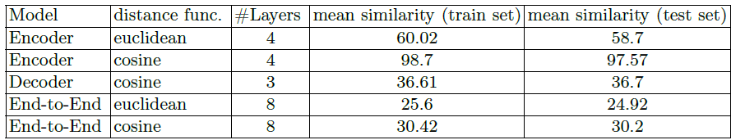
Results
10/29/2018
26
Notes:
26
- Interestingly the Deocder similarity didn’t change for 3 or 4 layers
- 36.7% equals 68.47 degree

Slide 27
Conclusion
10/29/2018
27
Encoder: very similar representation for simple and complex sentence
Decoder: cannot reproduce word embedding of simple sentence from feature map of complex one
End-to-end: cannot produce simple embedding from complex one
Maybe train word embeddings on our data
Data set is noisy!
Additional information (co-reference)
sometimes not really simplified matches
Notes:
27
- Complex and simple have not enough information in common
- another insight is that we should not have used an already existing model but come up with our own structure
-future steps would include:
- training of word embeddings on our own corpus, with smaller dimensions -> faster training, no unknown symbols
- Going from word embeddings at the end of decoder to words does not work
Here would maybe work an additional layer which learns a probability distribution over all words
-

