Slide 1

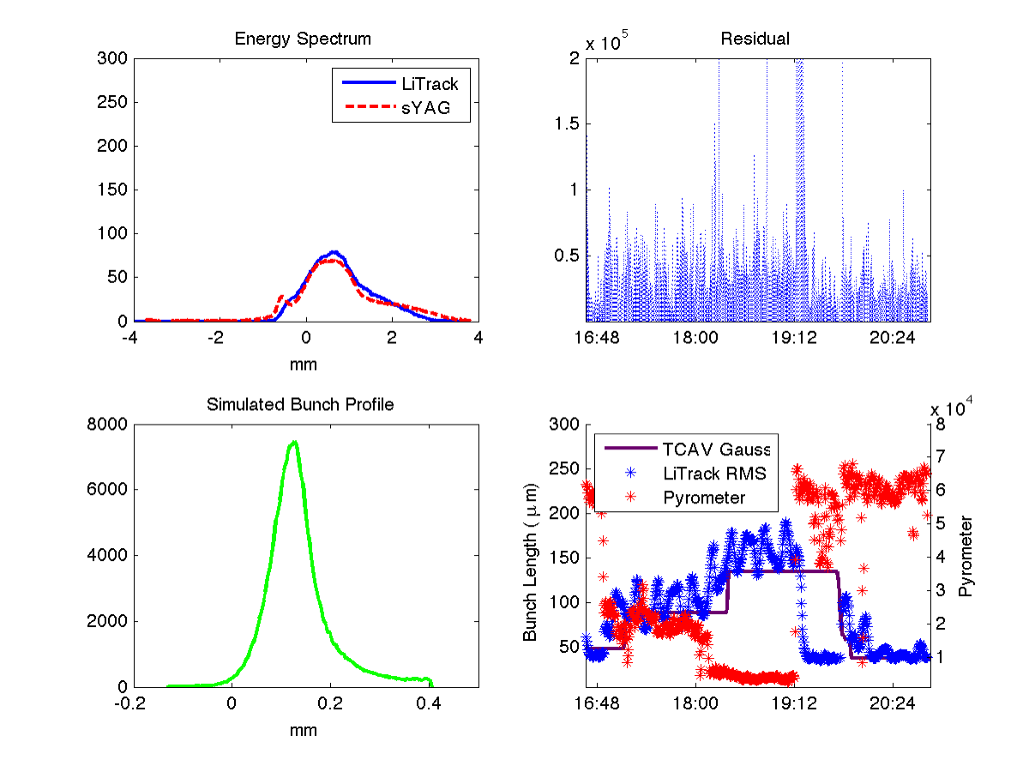
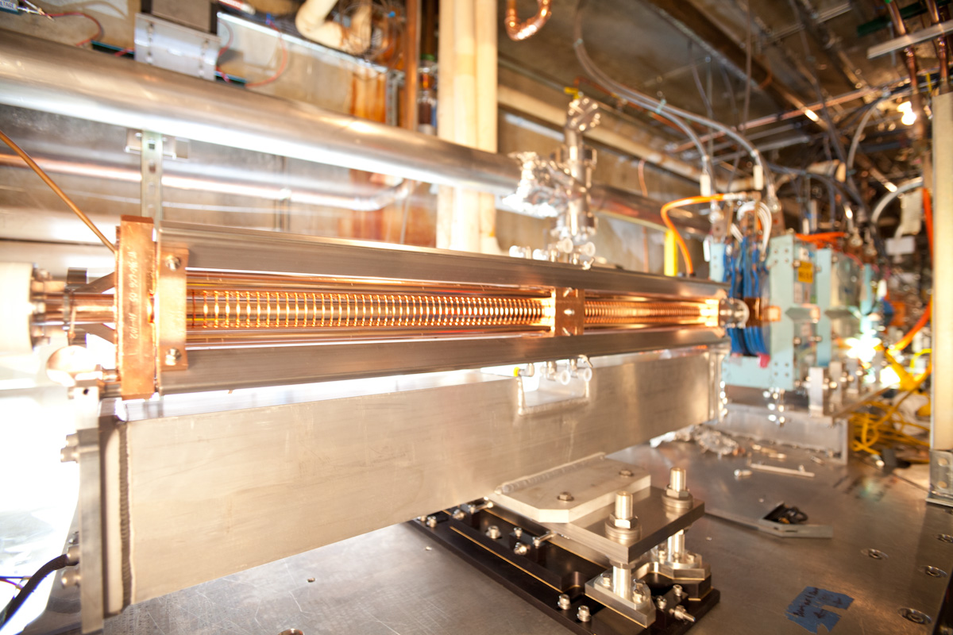
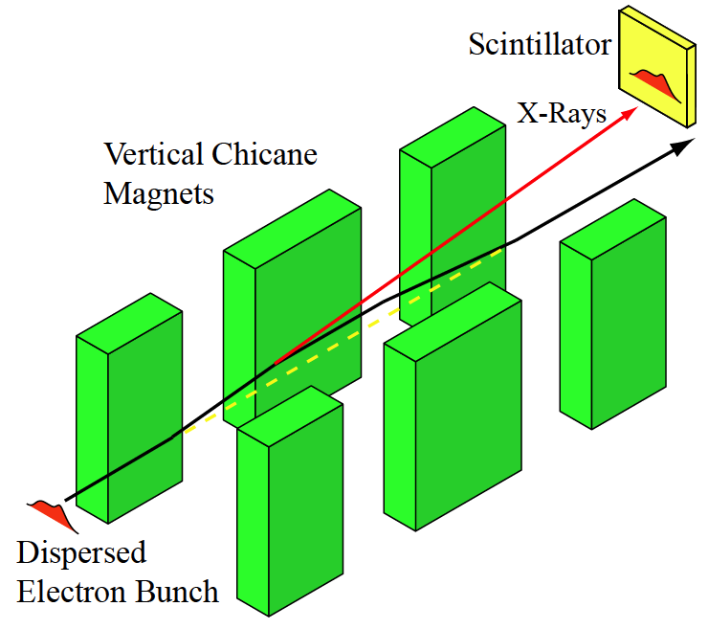
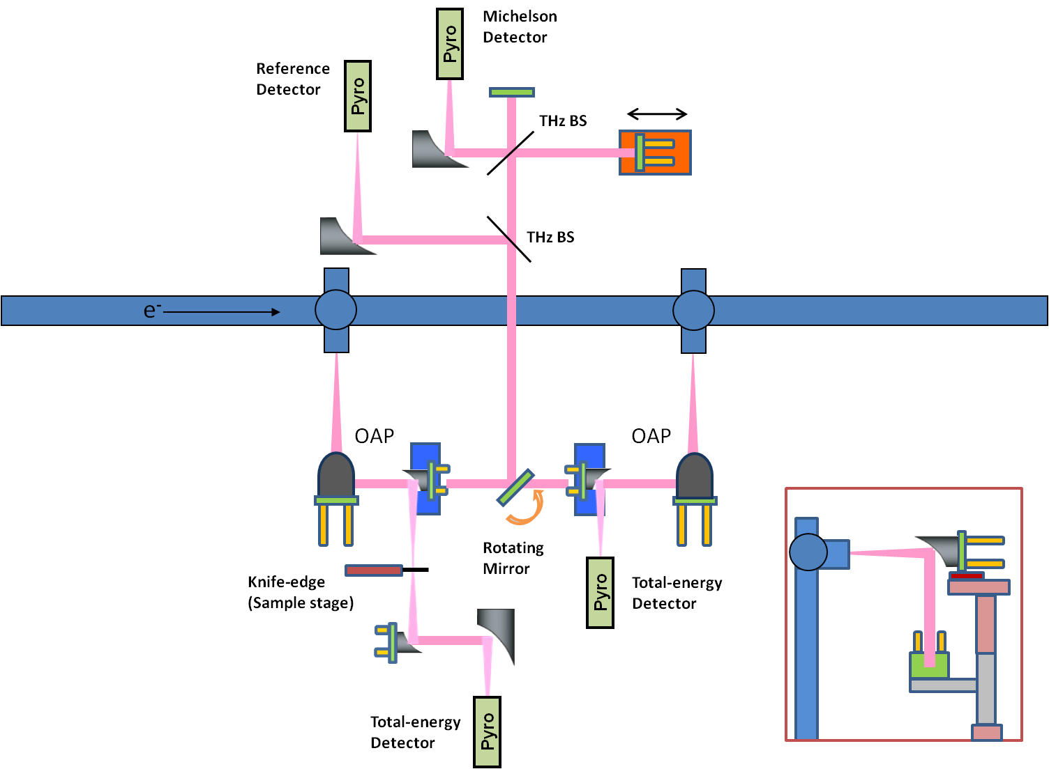
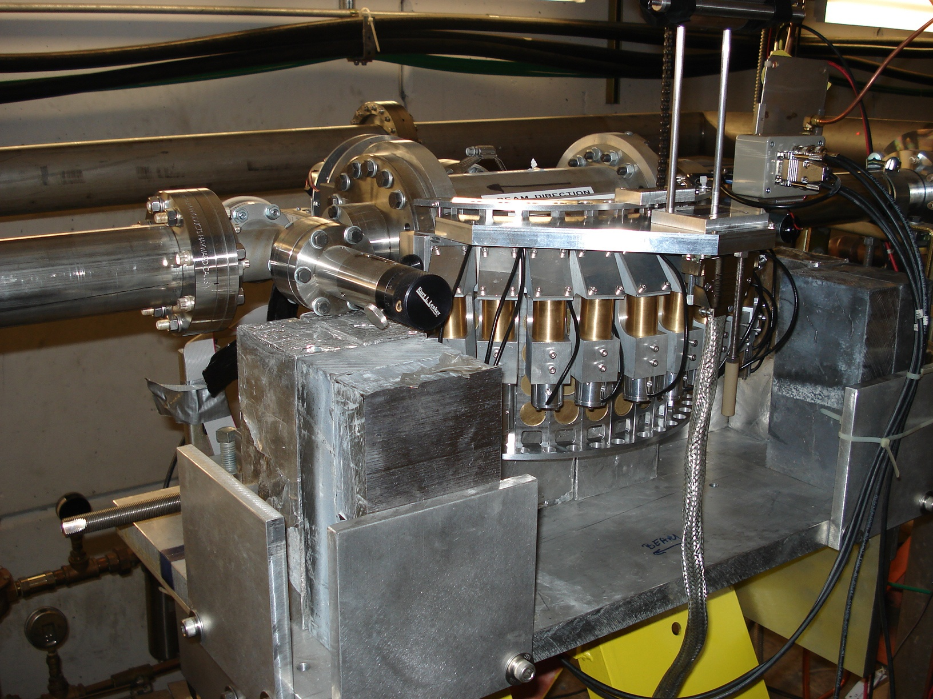
E224 Simulation
Laser probe diffaction through plasma
Introduction
Extremum Seeking
FACET is a unique accelerator facility designed to produce high energy, high peak curent electron bunches. FACET leverages 2 km of accelerating structures from the original SLAC linac to produce a high energy electron beam (typically 20.35 GeV). In addition, FACET has three bunch compressors distributed throughout the linac that allow for precise control of the longitudinal beam profile. FACET is capable of delivering 30 μm long bunches containing 3.2 nC of charge. Diagnosing short bunches is challenging because traditional techniques like streak cameras do not have the required resolution. In addition to producing short bunches with high peak current, FACET can also provide “drive-witness” beams for use in beam driven Plasma Wakefield Acceleration experiments (PWFA). These tailored beam profiles require novel bunch length diagnositic techniques.
We used the ES algorithm with LiTrack to produce a flight simulation of the FACET beamline. The simulations were done in real time and ES guided the parameters to match the simulated energy spectrum to the measured energy spectrum.
When the simulated and measured spectra match, the virtual machine is able to track the real machine as it evolves. LiTrack generates a bunch profiles in real time. TCAV and pyrometer measurements taken in parallel were used to validate the method.
Improvements to LiTrack
LiTrack is a 2D particle tracking code that simulates the longitudinal beam evolution in the linac. It is a very fast code; a complete simulation of the FACET linac takes less than 5 seconds. The most computationally expensive part of the simulation is the wakefield calculation because the wakefield is a collective effect. The function ‘long_wake()’ in the standard LiTrack package goes as N² in the number of wakefield bins and N log N in the number of simulated macro particles. The new function ‘fast_wake()’ takes the opposite approach; N log N in the number of bins and N² in the number of simulated particles. This formulation is advantageous for most LiTrack users. A typical LiTrack run uses 200k particles and 200 bins in the wake calculation. fast_wake() reduces the run time by a factor of 60. This improvement in speed was critical for “flight simulator” implemented at FACET. A complete LiTrack run now takes 0.1 seconds on a Dell R620 with 8 2.6 GHz cores and 24 GB RAM.
Conclusions
The energy spectrum measurement with the LiTrackES package is the only diagnostic at FACET that provides a bunch profile on a shot by shot. This type of diagnostic is a valuable tool for interpreting the results of PWFA experiments at FACET. In addition, we can use LiTrackES to tune the beam in order to produce complex bunch shapes needed for “drive-witness” PWFA experiments. In the coming weeks, we hope to apply the LiTrackES package directly to the machine as a longitudinal feedback in order to stabilize the bunch profile. We also believe that it will be a useful tool for optimizing bunch profile parameters, providing short bunches for single bunch experiments and tailored bunches for two-beam PWFA experiments.
The x-band transverse deflecting cavity (TCAV) streaks the beam vertically. The TCAV is the only device that directly measures bunch profiles, but it is a destructive measurement and not used on every shot.
The wiggler with scintillating YAG crystal is a non-destructive measurement of the beam energy spread. It is located just down stream of the TCAV. The energy spectrum uniquely maps to the beam bunch profile. This measurement is made on every shot.
The beam creates coherent THz radiation as it passes through a metallic foil. Some of that radiation is collected by a pyrometer for a relative bunch length measurement. The rest goes to an interferometer which can reconstruct a bunch profile.
The Smith-Purcell chamber measures the THz radiation produced by the beam as it passes over a metallic grating. The angular spectrum encodes phase information so that the bunch profile can be reconstructed by Fourier Transform.
Acknowledgments
Thank you to Michael Litos, Alan Fisher, Ziran Wu, and the E203 Smith-Purcell collaboration for sharing their bunch length data. Thank you to FACET Ops for providing good beams to study, and thanks to Nate Lipkowitz in particular for the FACET schematic. Thank you to Biggie Smalls for keeping it real. This work was supported by U.S. Department of Energy under contract number DE-AC02-76SF00515

