Slide 1

Japan WG
2019/8/29
OpenChain Japan WG / Licensed under CC0 1.0

Slide 2
Antitrust Policy
Linux Foundation meetings involve participation by industry competitors, and it is the intention of the Linux Foundation to conduct all of its activities in accordance with applicable antitrust and competition laws. It is therefore extremely important that attendees adhere to meeting agendas, and be aware of, and not participate in, any activities that are prohibited under applicable US state, federal or foreign antitrust and competition laws.
Examples of types of actions that are prohibited at Linux Foundation meetings and in connection with Linux Foundation activities are described in the Linux Foundation Antitrust Policy available at http://www.linuxfoundation.org/antitrust-policy. If you have questions about these matters, please contact your company counsel, or if you are a member of the Linux Foundation, feel free to contact Andrew Updegrove of the firm of Gesmer Updegrove LLP, which provides legal counsel to the Linux Foundation.

Slide 3
Confirm permission for photo and publicity use
By publishing the status of activities in the OpenChain Japan WG, following effects can be expected.
It will influence the main body of OpenChain and improve presence of Japan.
It will influence the OpanChain activities in other countries and the whole OpenChain.
In addition, it can be expected that it will be easier to proceed with the activities in your company by deploying the photo.
In order to obtain the above effects, we would like to ask for permission to shoot and publish photos of the meeting.
Please let us know if you do not want to appear in the photo.

Slide 4
Introduction of OpenChain Project

Slide 5
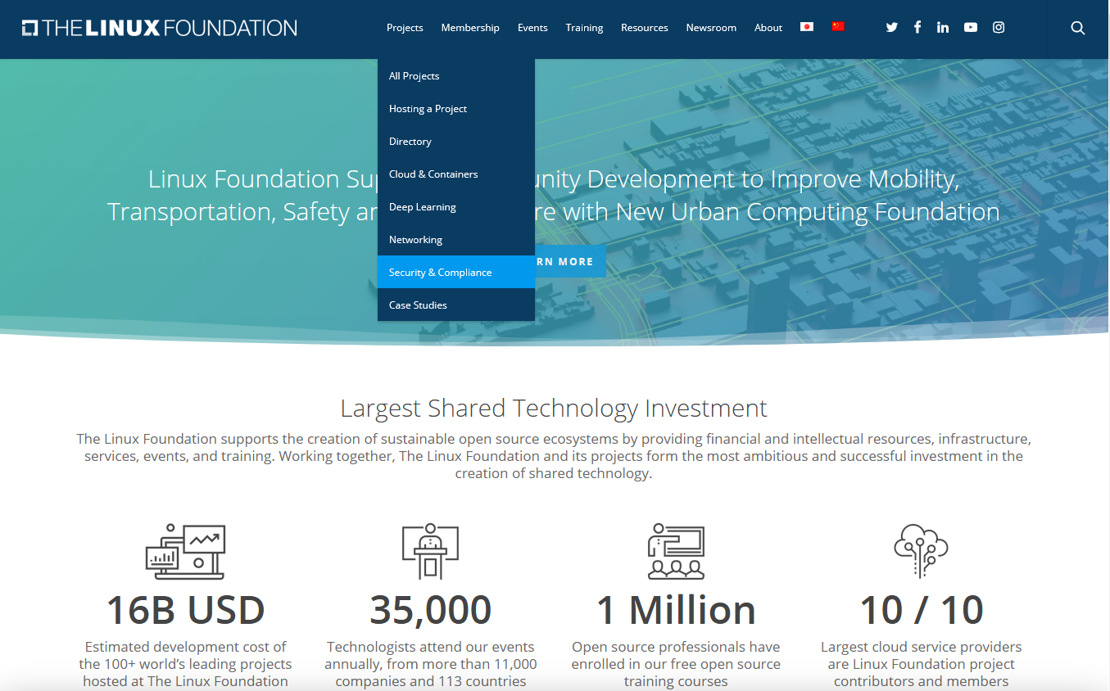
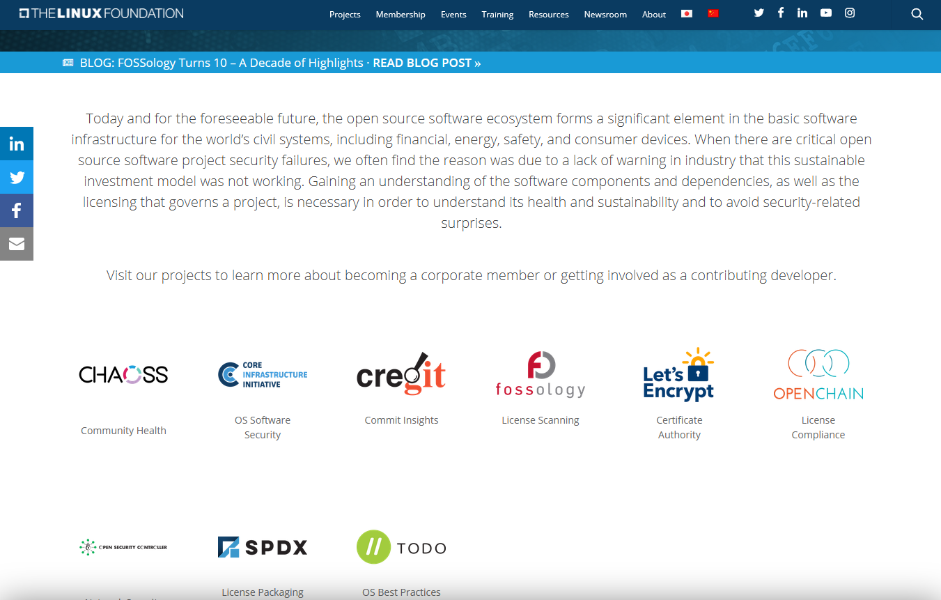
What is OpenChain Project?
OpenChain is the official project of Linux Foundation, which is the largest worldwide OSS community.

Slide 6
Mission of OpenChain Project
In order to build trust across the whole OSS supply chain,
define the requirements of compliance program that organizations in supply chain should establish each self as OpenChain specification and promote it.
In OpenChain Project, the word “Specification” means “Requirements of compliance program”.
OpenChain aims to define and promote the Specification.
Product
IC Chip
IC Chip
OSS
OSS
OSS
License
License
License
Chip
Vendor
OEM/ODM
Vendor
Product
Vendor
OpenChain Certified
OpenChain Certified
OpenChain Certified
OSS Supply Chain (in case of embedded product)

Slide 7
Three pillars of OpenChain
Specification https://www.openchainproject.org/spec
Define the requirements of compliance program that companies should establish within their organization. * Latest Version: 1.2 (in various languages), 2.0 (in only English) https://www.openchainproject.org/translations
Conformance https://www.openchainproject.org/conformance
Answering the questions, you can prove compatibility with the above specification.
In addition, the company name and logo can be displayed on the website.
Curriculum
The collection of PowerPoint slides for use in in-house educational programs.
OpenChain builds trust across the OSS supply chain by three pillars.
① Define the “Specification”,
② and promote its “Conformance” for organizations,
③ moreover, provide the “Curriculum”.

Slide 8

Membership
Platinum Members
Must be the Linux Foundation corporate member
currently 18 companies
Community Members
Non-profit OSS projects and individuals

Slide 9
Board, Committee, Work Team
Governing Board
General Manager: Shane Coughlan
Platinum Member
Representative
Chair: David Marr (Qualcomm)
OpenChain is run by General Manager:
Shane Coughlan
Steering Committee
Outreach Committee
Specification
Work Team
Conformance
Work Team
Curriculum
Work Team
Onboarding
Work Team
Chair:
Mark Gisi
Chair:
Miriam Ballhausen
Chair:
Alexios Zavras
Chair:
Nathan Kumagai

Slide 10
OpenChain Japan Work Group

Slide 11
OpenChain Japan WG
Since 2017/8, Japanese companies (Toyota, Hitachi, Sony) joined the OpenChain.
Do something interesting using the OpenChain framework
Raise compliance awareness in japan!
Raise compliance awareness from Japan to Asia!
Let’s exchange information on compliance issues!
Create a place where we can discuss in Japanese language!
We need to associates for these activites ...
Make a community!
Japan WG is the community of Japanese companies by Japanese language.

Slide 12
Japan WG Meetings
1st meeting 2017/12/27 @Sony (Tokyo)
2nd meeting 2018/2/22 @Hitachi (Tokyo)
3rd meeting 2018/4/19 @Panasonic (Osaka)
Ad hoc meeting 2018/6/8 @Sony (Tokyo)
4th meeting 2018/6/13 @Toyota (Nagoya)
5th meeting 2018/8/31 @Fujitsu (Kawasaki)
6th meeting 2018/10/31 @Toshiba (Kawasaki)
Ad hoc meeting 2018/11/20 @DensoTen (Kobe)
7th meeting 2018/12/5 @Tuv Sud Japan (Tokyo)
8th meeting 2019/2/28 @Mitsubishi Electric (Tokyo)
9th meeting 2019/4/18 @DensoTen (Kobe)
Ad hoc meeting 2019/6/19 @DeNA (Tokyo)
10th meeting 2019/7/16 @Fujitsu (Tokyo)

Slide 13
Sub Groups
Planning Sub Group
FAQ Sub Group
Leaflet Sub Group
Education Materials Sub Group
Exchanging License Information Sub Group
Promotion Sub Group
Tool Sub Group

Slide 14

OpenChain Japan WG ML
(154)
https://www.openchainproject.org/
→ Get Started → → Japanese Mailing List

Slide 15
OpenChain Japan WG
Website: https://www.openchainproject.org/
Get Started → Participate in our Activities
Japan WG Wiki, Japan WG ML
OpenChain Main ML, Specification ML
OpenChain Work Team Conference Call
1st Mondays 9AM, 3rd Mondays 5PM (US West Coast Time)
GitHub: https://github.com/OpenChain-Project/
Japan-WG-General
Onboarding-JWG
Specification-Translations
Slack: https://openchain-japanwg.slack.com/

Slide 16
OpenChain Japan Sub Work Group

Slide 17
OpenCain JPWG Planning WG
Overview
Members
Imada, Endo, Ueda, Kohota, Ouchi, Asaba, Watanabe, Koizumi, Kato, Kusakabe, Aoki
Fukuchi (Reporter)
Activities
Meeting plans
Ad hoc meeting 2019/6/19(Wed) DeNA (Shibuya)
10th meeting 2019/7/16(Tue) Fujitsu (Kamata)
11th meeting 2019/9 Olympus (Tokyo)
12th meeting 2019/12 NEC (Tokyo)
13th meeting 2020/2 DeNA (Shibuya)
F2F meeting (5/29 @Yokohama)
Discussion on how to improve the general meeting
11th agenda draft

Slide 18
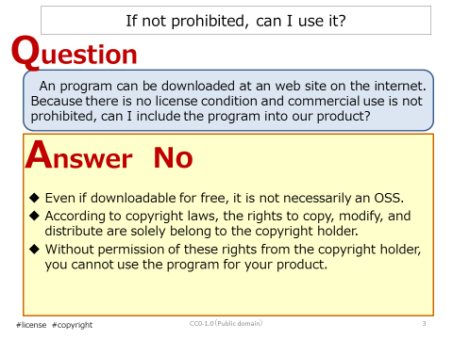
FAQ Sub Group
(Sample)
Activity：make and publish FAQ for OSS license
Kick-off：2018/10/18
Members：25
Output： “Frequent Misunderstandings of OSS license V3” publishing soon (about 20 FAQs)
Principles：
① Contents are general and for beginners
② Do not include contents with unclear license interpretation and that requires judgement for each business
③ Discuss in Slack, and check the contents at meetings before publishing
④ Publish after review by lawyers
⑤ Publish under CC0-V1.0
⑥ Chatham House Rule
participants are free to use the information received, but neither the identity nor the affiliation of the speaker(s), nor that of any other participant, may be revealed.

Slide 19

Leaflet Project SWG:
What is the Goal of OpenChain?
Ensure that accurate information about OSS flows from the upstream timely
Do the same for the downstream
It is necessary for as many people as possible to know the important points about OSS
What is needed, When we need, Why we need …
In the first place, What is OSS?

Slide 20

To know as many people as possible
Make a leaflet (16 pages)
Japanese ver. 2000 copies
English ver. 1000 copies
PDF files by CC-0 are also available
This leaflet is used for not only communication if supply chain, but also in-company education
Plan to distribute in the Open Source Summit Japan
Preparing Chinese ver.

Slide 21
Educational material SWG
1. Overview
Member
Koizumi, Fukuchi
Iwata (Reporter)
Activity
F2F meetings: 4 times 5/13､6/4､6/24､7/9 (@Hitachi)
Discuss and make the simple version of educational materials
meeting coordination

Slide 22
2. Analysis of case studies in 4 companies
Result of analysis
Compliant program description is required to meet Spec.-2.0
Consider the excess and deficiency of Curriculum
The simple version is positioned as the follow-up material of the pamphlet
Consider the common contents of basic education
Proposal of contents of simple version of common educational materials i., ii., ⅲ. are required items the common contents of ⅳ. are emphasized, and some contents of ⅳ. are schematic
An example of “Sharing of roles and clarification of responsibilities” and an example of essential requirements for roles on Spec.-2.0.

Slide 23
3. Create the draft of Simple version of educational materials and schedule
Start with the following chapters from case analysis OSS Overview, Intellectual Property Rights, OSS Utilization, License, Compliant Program, Summary, Contact, Source / Reference Information
Changed to the following chapters through consideration of drafting Intellectual Property Rights, FOSS license, FOSS Compliant Program, Consideration when introducing FOSS, Review, FOSS distribution, Summary, Contact, Source / Reference Information
Upload the first Japanese draft version to GitHub The first English version will be uploaded to GitHub at OSS EU in November

Slide 24
Exchanging license information SWG
Clarify the information needed between companies (core problem of member companies)
Define the information needed as license information
Define the minimum information so as not to increase the burden
Progressing the collaboration with SPDX community : defining SPDX Lite, discussing guideline
SPDX Community
Operations Guide：
Outline of inter-company license processing in commercial development
Created table of contents and started discussion
SPDX Lite definition：
Defines the minimum and required license information necessary for commercial development
Presented to SPDX Community and incorporated into SPDX definition
Operations
Guide
Guideline
Definition of
SPDX Lite
[ Compatible License List ]
[ SW Delivery (w/ License Info.) ]
Set Vendor/
Service Provider
SW PKGs
Supplier
1
Guideline Creation：
Guide the procedure forsupplier to provide license information using SPDX / SPDX Lite
Presenting table of contents to SPDX Community during initial review
SPDX or
SPDX Lite
Supplier
SPDX or
SPDX Lite
Supplier
[ Follow-up Information (security/ver-up) ]
Std. SPDX
Tools
Summarizing License Info
[ Contract Conclusion (w/ Lic. Info.) ]
CC0-1.0

Slide 25
Tooling SWG
Main activity： discussion about tools for OSS supply chain management
Output target
Summarize available information about the tool
Tool introduction and related seminars
Identify the shortage by mapping information distribution process and tools
Suggestions for related communities
Data distribution method managed by the tool
How to work with SPDX tools and the OSS development community
Recent Activities
date | contents | participants
1st 2019/3/13 | Check the CFP Discussing plan of activities | 7 companies 14 persons
2nd 2019/4/25 | Introduction of SPDX Tools SW360 – compliance management tool Introduction of activities in OpenChain Tooling WG | 16 companies 28 persons
3rd 2019/6/20 | Operating SW360 with consideration about OpenChain Specification Brief Introduction into ClearlyDefined Try to use CLI / REST API of FOSSology | 11 companies 19 persons
Next meeting ： 8/29 (under recruiting the participants)

Slide 26

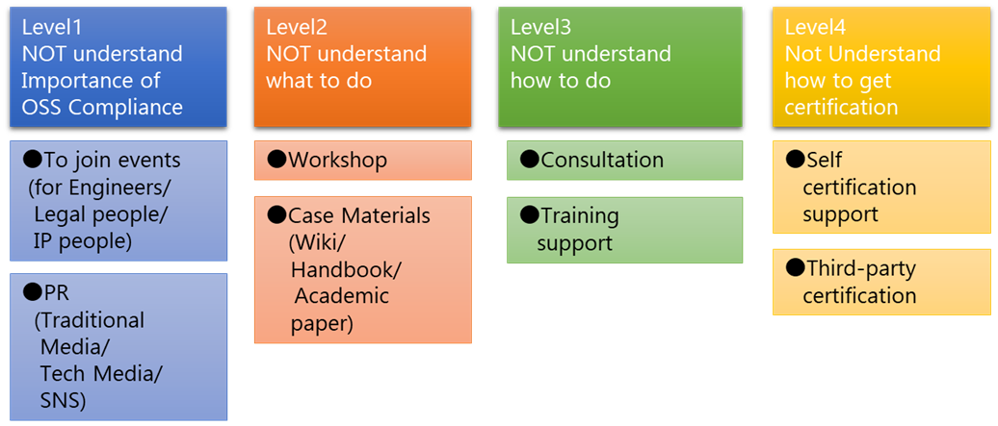
OpenChain JPWG Promotion WG
Strategic promotions to people who are not aware of the importance of OSS compliance in the first place (we are recruiting members!)
Target Levels
Target Duties
Managers
Engineers
Legal affairs/ intellectual property
Government
Media
Academia

