Slide 1
Declaration parser
第八组: 朱河勤, 张思聪, 徐瑞, 詹慧悠

Slide 2
Contents
Lexical Analysis
Syntax Analysis
Code Generation
Interpretation

Slide 3
Lexical analysis
Lexical unit | Regular expression
NAME | [a-zA-Z_][a-zA-Z_0-9]*
NUM | \d*\.\d+|\d+
POINTER | \*
COMMA | \,
SEMICOLON | \;
Open parentheses | \(
Close parentheses | \)
Open Bracket | \[
Close Bracket | \]
White Space | \s+

Slide 4
Syntax analysis
declaration -> declaration_specifiers init_declarator_list ';' ;
init_declarator_list . symType = declaration_specifiers . symType
declaration_specifiers ->type_specifier ;
declaration_specifiers . symType = type_specifie. symType
type_specifier ->VOID | INT ;
type_specifier . symType = lexical value
init_declarator_list ->init_declarator | init_declarator_list ',' init_declarator ;
init_declarator . symType = init_declarator_list . symType

Slide 5
Syntax analysis
declarator -> pointer direct_declarator
declarator. flags = direct_declarator.flags
declarator.flags add (‘pointer’, pointer. num)
direct_declarator -> IDENTIFIER
declarator. flags add (‘id’,identifier)
direct_declarator -> '(' declarator ‘)’
direct_declarator .flags = declarator .flags
direct_declarator -> direct_declarator '[' CONSTANT_INT ‘]’
direct_declarator . flags add (‘array’, CONSTANT_INT. lexical_value)

Slide 6
Code Generation
[('id', 'p'), ('array', 2), ('array', 3), ('pointer', 1), ('type', 'INT’)]
int * p[2][3];
[('id', 'p'), ('pointer', 1), ('type', 'INT’)]
int *p;
[('id', 'j'), ('array', 2), ('pointer', 0), ('type', 'INT’)]
int j[2];

Slide 7
Interpretation
[('id', 'p'), ('array', 2), ('array', 3), ('pointer', 1), ('type', 'INT’)] | $, Size: 0
[('id', 'p'), ('array', 2), ('array', 3), ('pointer’, 1) ] | INT: Size: sizeof(INT)=1
[('id', 'p'), ('array', 2), ('array', 3)] | Pointer(INT): Size: sizeof(Pointer)=1
[('id', 'p'), ('array', 2)] | Array(3,Pointer(INT)): Size: 3*1 =3
[('id', 'p')] | Array(2,Array(3,Pointer(INT))): Size: 2*3 = 6
 | Varible p: Array(2,Array(3,Pointer(INT))): Size :6

Slide 8
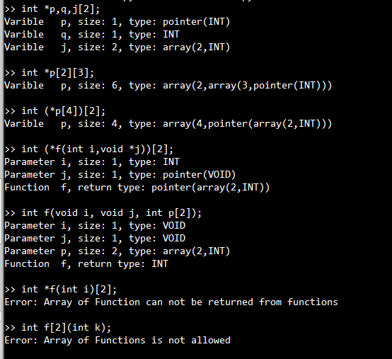
Show
Varibles
Function args
Semantics

Slide 9
Thank you!

