Slide 1

FUN3D
Make FUN3D Great Again

Slide 2
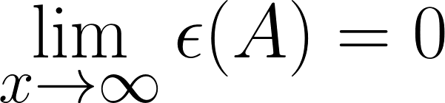
X: number of title slides presented by the FUN3D team
ε: Tolerance for useless nonsense
A: The audience

Slide 3
Outstanding Technical Issues
System issues (Pleiades @ NASA)
No dedicated queue
Queue broken when we got it
gpu_k40 queue contained non-gpu nodes ;-)
Needed special installation recipe for TAU
TAU Profiles
Needed special installation recipe
Collect CUPTI events, not metrics
NVIDIA Profiles
Couldn’t collect metric data
Solution: filter using --kernels flag (before --analysis-metrics)
WIFI dropping / ssh timeout

Slide 4
Kernels
gpu_linearize_integrateInterior, edgejp, dfdup
HUGE (~2k-5k lines, 36 pages / kernel)
Large register state
Course grained parallelism
Low occupancy
Poor data access pattern
blockspmv
cusparse peformance low
Have custom kernel up to 32x32, want larger

Slide 5
Possible solutions
Kernel splitting
Find logical interfaces between code regions
Avoid storing unnecessary state
Recomputing vs. storing
Expose another dimension of parallelism
Loops currently per element, make per node
Vectorize across nodes
To color or not to color?
Atomics
Reroll loops
Reorder loops
Vector becomes a scalar

Slide 6
More possible solutions
blockspmv
New kernel to handle larger blocks
How I learned to love indexing ☺
Before
After

Slide 7
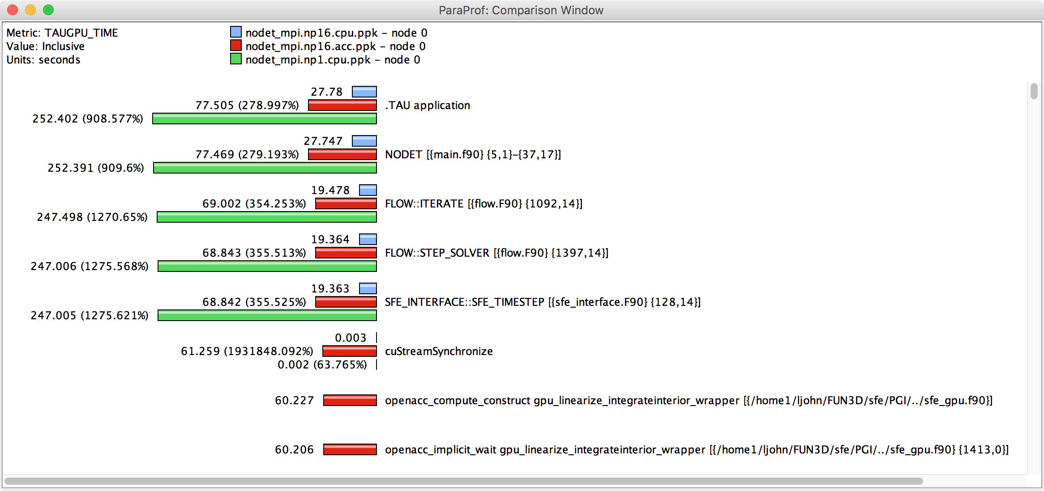
MPI vs. MPS + OpenACC gpu_linearize_integrateInterior

Slide 8
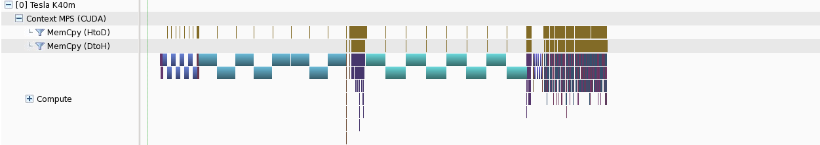
FUN3D Profile
Timestep: 2.6 seconds
zero_out: 160 ms
dfdup: 560 ms
inviscid jacobian: 75 ms
edgejp: 613 ms
point solve: 313 ms
CPU: 857 ms

Slide 9

THANK YOU!

