Slide 1

Introduction to the XC30
For Users of Cray’s
XT5 and XK7
Aaron Vose
10/17/2013

Slide 2
XT5/XK7 to XC30 Changes: Overview
Hardware changes:
CPU:
Move from AMD Istanbul/Interlagos to Intel SNB/IVB
AMD’s CMT versus Intel’s HyperThreading
Interconnect:
XT5’s SeaStar2+ or XE/XK7’s Gemini -> XC30’s Aries
Software and environment is very similar -- some changes

Slide 3
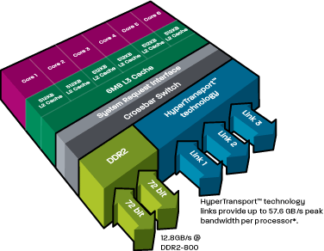
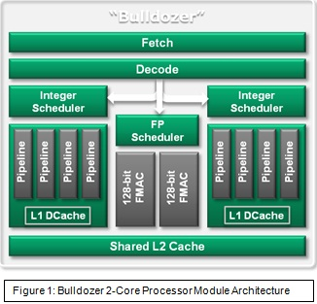
XT5/XK7 AMD CPU Overview
AMD Istanbul
AMD Interlagos
(images: amd.com)

Slide 4
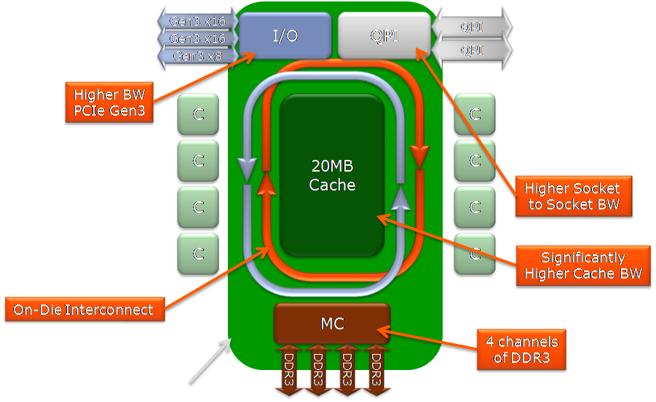
XC30 Intel CPU Overview
Intel Sandy Bridge
(image: intel.com)

Slide 5
AMD and Intel CPU Quick Comparison
 | AMD Istanbul | AMD Interlagos | Intel SandyBridge
System | Kraken (XT5) | Titan (XK7) | Eos (XC30)
Socket/Node | 2 | 1 | 2
FPU/Socket | 6 | 8 | 8
INT/Socket | 6 | 16 | 8
Threads/Core | 1 | 1 | 1 or 2
DP FP/FPU | 4 /clock | 8 /clock | 8 /clock

Slide 6
Intel’s HT versus AMD’s CMT
AMD CPU module contains 2 integer cores sharing an FPU:
Shared FPU (default) by running with 16 threads/CPU
Dedicated FPU per thread by running 8 threads/CPU
Intel CPU can run 2 threads per core with “HyperThreading”:
aprun -j 2 -> Two ranks per core (“DualStream”)
aprun -j 1 -> One rank per core (“SingleStream”) (default: -j 1)

Slide 7
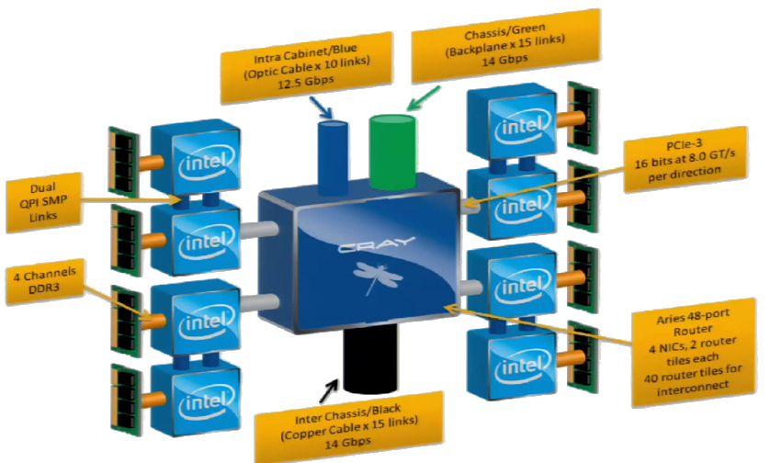
XC30 Aries Interconnect: Nodes

Slide 8
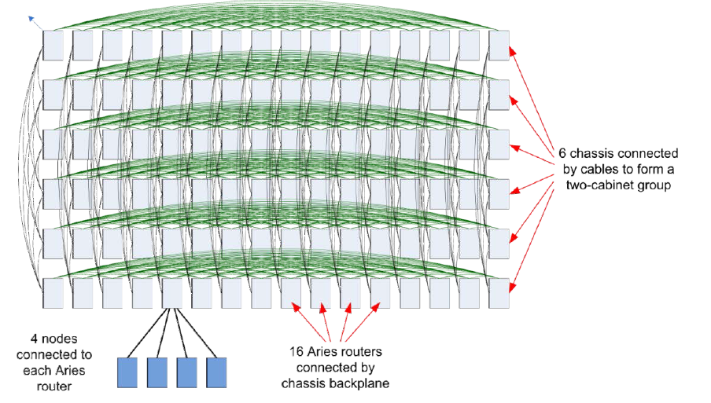
XC30 Aries Interconnect: Rank 1 & 2 Networks

Slide 9
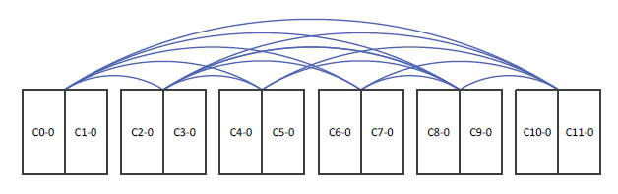
XC30 Aries Interconnect: Rank 3 Network
Each two-cabinet group is connected to all others optically
Similar to other levels, packets travel via intermediate hops

Slide 10
XC30 Aries Interconnect: User Perspective
Switch from 3D Torus to dragonfly network
User Highlights:
Adaptive routing avoids network hotspots
Node placement not as important
Greatly increased global bandwidth
Much more detailed Aries / Cascade presentation:
http://www.youtube.com/watch?v=XEdrIpeXQnw (by Cray’s Nathan Wichmann)

Slide 11
Software Changes: ACML -> MKL
AMD Core Math Library is gone; replaced with:
Intel’s Math Kernel Library
Update code:
call vrda_exp(VL,RF(1,1),RF(1,1)) (ACML)
call vdexp(VL,RF(1,1),RF(1,1)) (MKL)
CCE / GNU / PGI: module load intel and link with:
-L$(MKLROOT)/lib/intel64/ -lmkl_intel_lp64 -lmkl_sequential -lmkl_core

Slide 12
Software Changes: Intel Compiler
Intel Compiler: module load PrgEnv-intel
ftn/cc/CC commands wrap ifort/icc/icpc
man ifort / man icc / man icpc
Useful Flags:
-openmp (Enables OpenMP)
-xAVX (Enables AVX)
-mkl (Enables MKL)
-Qvec_report1 (Report successfully vectorized code)

Slide 13
XT5/XK7 to XC30 Changes: Summary
Hardware:
Move to Intel SandyBridge / IvyBridge
Intel HyperThreading
Aries Interconnect -- Dragonfly Topology
Software and environment:
Intel MKL
Intel Compiler

