Slide 1

NavigateMe
[https://github.com/blackmahub/hs-fulda-gsd-ios-winter17-team10]
Presented By
Mahbubur Rahman
Matrikel Nr: 250154
M.Sc in Global Software Development
Hochschule Fulda University of Applied Sciences

Slide 2
System Overview
Demo(Prototype)
Life-cycle Overview
Architecture & Codes
Frameworks, APIs & Tools

Slide 3
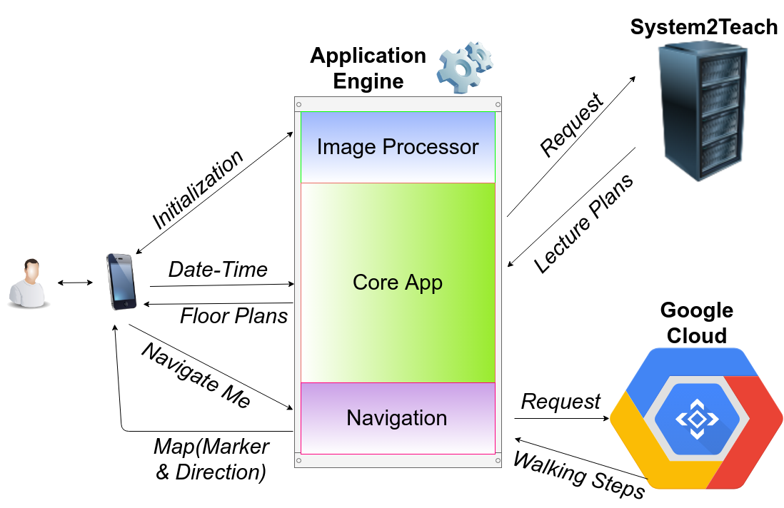
System Overview

Slide 4
Demo(Prototype)

Slide 5
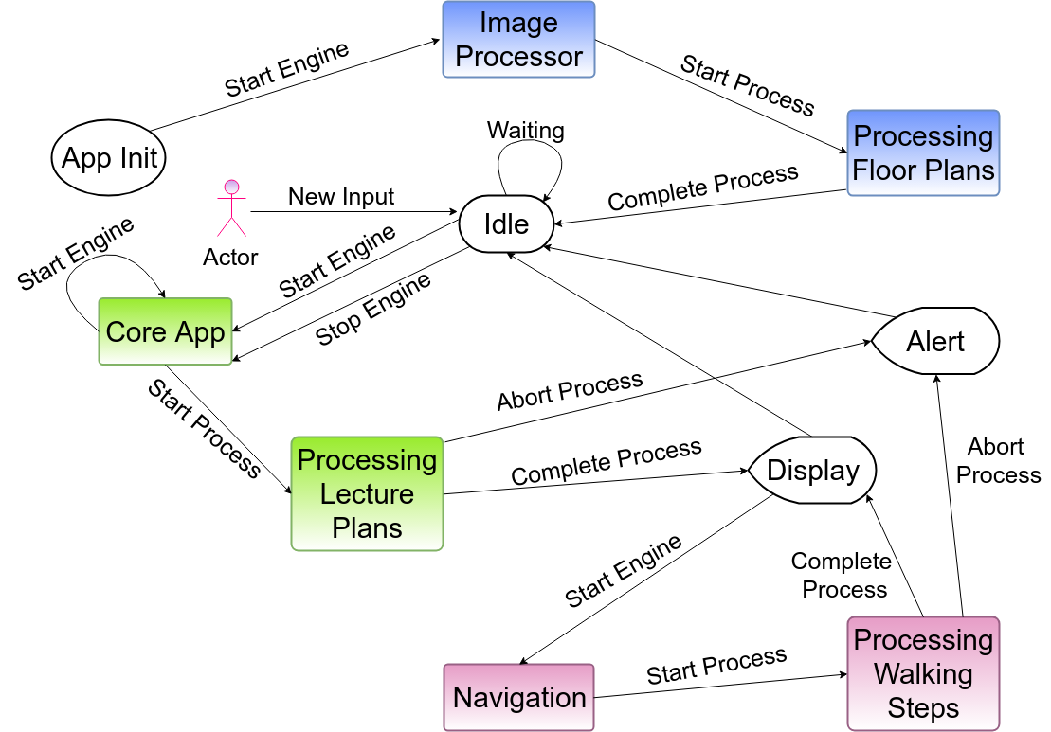
Life-cycle Overview

Slide 6
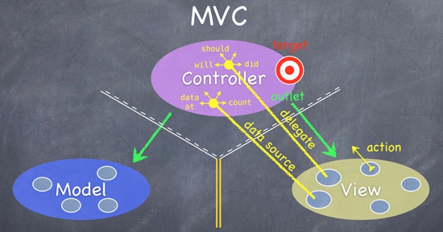
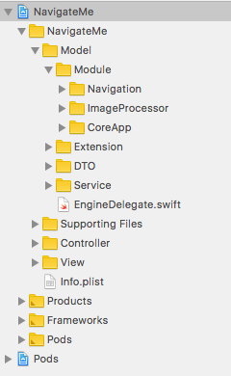
Architecture & Codes

Slide 7
Frameworks, APIs & Tools
Frameworks Apple Swift 4 library UIKit Foundation Core Graphics Core Image Core Location Google Tesseract Maps Places Place Picker | APIs System2Teach Google Directions Google Distance Matrix | Tools Apple Xcode 9.2 LunaPic Online Photo Editor Draw.io

Slide 8
References
1.https://developer.apple.com/documentation
2.https://developer.apple.com/library/content/documentation/Swift/Conceptual/Swift_Programming_Language/TheBasics.html#//apple_ref/doc/uid/TP40014097-CH5-ID309
3.https://developer.apple.com/library/content/documentation/GraphicsImaging/Conceptual/CoreImaging/ci_intro/ci_intro.html#//apple_ref/doc/uid/TP30001185
4.https://developer.apple.com/library/content/documentation/GraphicsImaging/Conceptual/drawingwithquartz2d/Introduction/Introduction.html#//apple_ref/doc/uid/TP30001066
5.https://developer.apple.com/library/content/documentation/UserExperience/Conceptual/LocationAwarenessPG/Introduction/Introduction.html#//apple_ref/doc/uid/TP40009497
6.https://www.raywenderlich.com/163445/tesseract-ocr-tutorial-ios
7.https://developers.google.com/places/ios-api/start
8.https://developers.google.com/maps/documentation/directions/start
9.https://www.draw.io/

Slide 9


Slide 10


