Slide 1
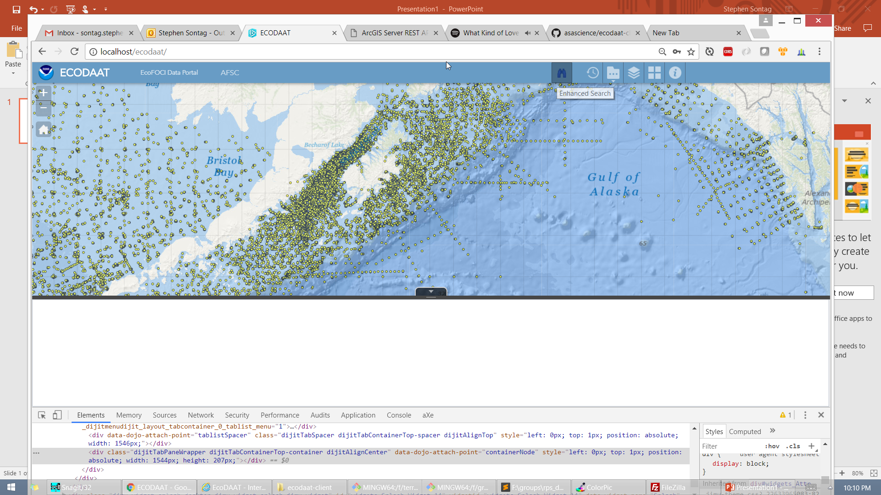

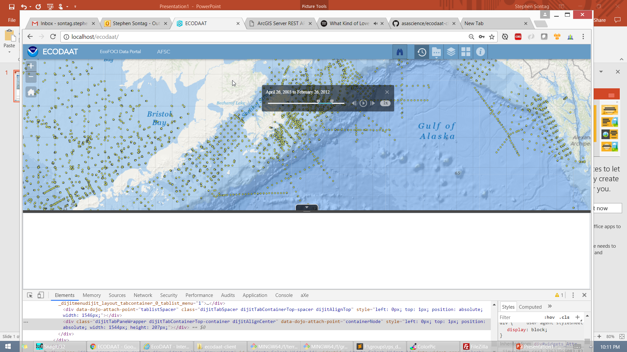
Click the search tool for Data Searching and Download. Use the Time Slider to filter the map data time range.

