Slide 1
Boosting with an emphasis on Adaptive Boosting: Theory & Intuition

Slide 2
Ensemble Learning
Ensemble models are composite models (aka meta-models) that combine individual models with flaws in a group to create a strong(er) final model.
Ensemble learning/Ensemble Methods/Ensemble Models

Slide 3
Ensemble Learning
Ensemble models are composite models that combine individual models with flaws in a group to create a strong(er) final model.
There are different approaches to combining individual models ➢ different flavors of ensembling.
Based on the characteristics of the individual models and the desired characteristics of the meta-model.

Slide 4
Ensemble Learning
Bagging: Individual models have low bias, but high variance (ie, overfitted). We create an equal voting group by bootstrapping our dataset. Eg Random Forests.
Boosting: Individual models have high bias, but low variance (ie, underfitted). We create a sequence of weighed individual models.
Stacking: Individual models are well fitted, and may be of different types. We use another model to determine how to determine the contribution of each model.

Slide 5
Bagging Versus Boosting
Imagine that you are participating in the annual Nathan’s Famous Hot Dog Eating Contest. Your team has to eat 30 hot dogs in 5 minutes. How do you go about getting a team together?

Slide 6
Bagging Versus Boosting: Differences
Bagging (think random forests) relies on individual models having low bias and high variance. So, the decision trees are (usually) as deep as need be.
Boosting relies on individual models having high bias and low variance. So, the decision trees are just stumps.
t
t

Slide 7
Bagging Versus Boosting: Differences
In Bagging approaches, all individual models have an equal vote in the final decision.
In Boosting approaches, different trees have different weights associated with their contributions…based on their accuracy.

Slide 8
Bagging Versus Boosting: Differences
In Bagging approaches, all individual models are trained independently.
In Boosting approaches, the models are trained in sequence…one after the other. The errors of prior models affect the subsequent models’ training.

Slide 9
Adaptive Boosting: AdaBoost

Slide 10
Adaptive Boosting: AdaBoost
X1 | X2 | Y
1 | 1 | c1
0 | 1 | c1
1 | 0 | c1
1 | 1 | c1
0 | 1 | c2
0 | 1 | c2
1 | 0 | c2
1 | 1 | c2
Create a meta-model using Adaboost in conjunction with decision tree stumps to fit this classification problem.

Slide 11
Adaptive Boosting: AdaBoost
X1 | X2 | Y | w
1 | 1 | c1 | 0.125
0 | 1 | c1 | 0.125
1 | 0 | c1 | 0.125
1 | 1 | c1 | 0.125
0 | 1 | c2 | 0.125
0 | 1 | c2 | 0.125
1 | 0 | c2 | 0.125
1 | 1 | c2 | 0.125
Create a meta-model using Adaboost in conjunction with decision tree stumps to fit this classification problem.
Step 0: Assign weights, w, to the data.

Slide 12
Adaptive Boosting: AdaBoost
X1 | X2 | Y | w
1 | 1 | c1 | 0.125
1 | 1 | c1 | 0.125
1 | 0 | c1 | 0.125
1 | 1 | c1 | 0.125
0 | 1 | c2 | 0.125
0 | 1 | c2 | 0.125
1 | 0 | c2 | 0.125
0 | 1 | c2 | 0.125
Create a meta-model using Adaboost in conjunction with decision tree stumps to fit this classification problem.
Step 0: Assign weights, w, to the data.
Step 1: Train “next” model (stump) on the data.
X1
X1=0
X1=1
Y=c2
Y=c1

Slide 13
Adaptive Boosting: AdaBoost
Create a meta-model using Adaboost in conjunction with decision tree stumps to fit this classification problem.
Step 0: Assign weights, w, to the data.
Step 1: Train “next” model (stump) on the data.
Step 2: Total error for model i= Sum of weights of incorrect samples. ei=0.125
X1 | X2 | Y | w
1 | 1 | c1 | 0.125
1 | 1 | c1 | 0.125
1 | 0 | c1 | 0.125
1 | 1 | c1 | 0.125
0 | 1 | c2 | 0.125
0 | 1 | c2 | 0.125
1 | 0 | c2 | 0.125
0 | 1 | c2 | 0.125
X1
X1=0
X1=1
Y=c2
Y=c1

Slide 14
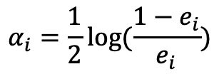
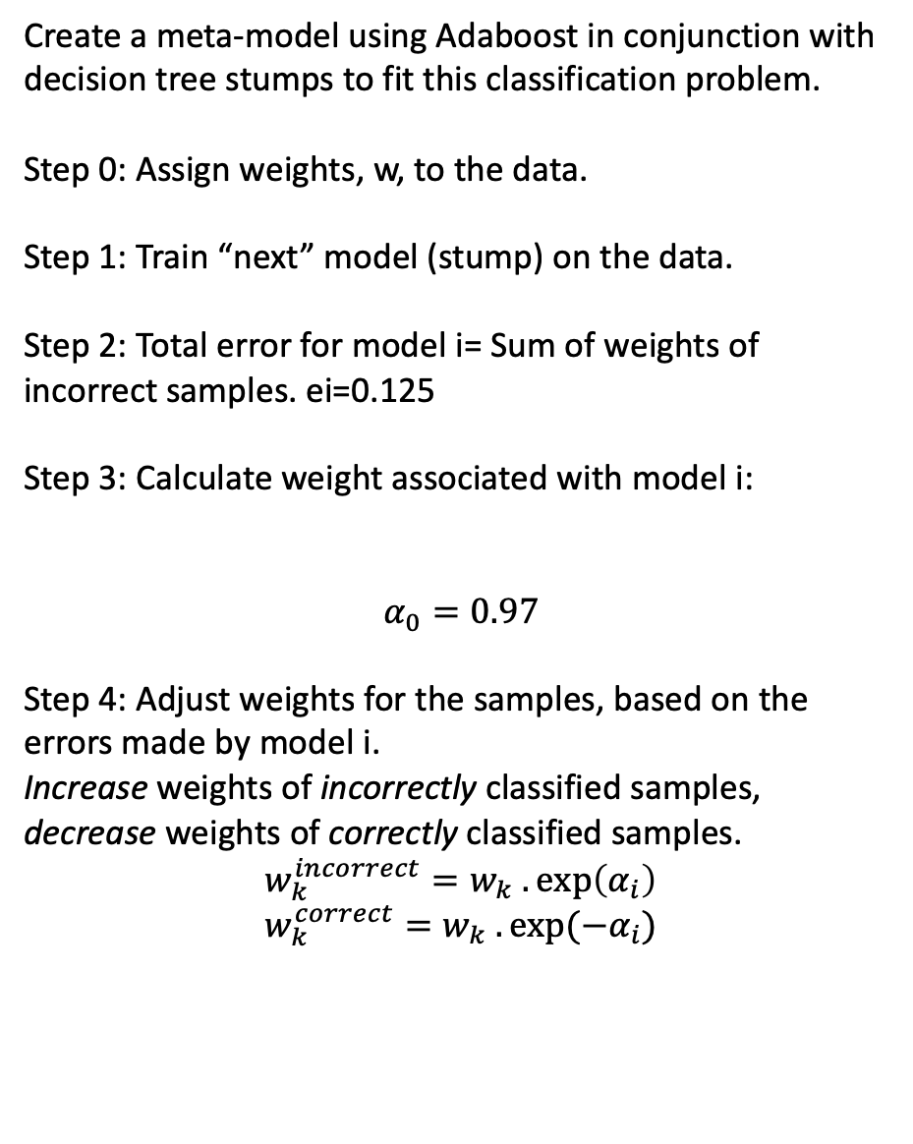
Adaptive Boosting: AdaBoost
Create a meta-model using Adaboost in conjunction with decision tree stumps to fit this classification problem.
Step 0: Assign weights, w, to the data.
Step 1: Train “next” model (stump) on the data.
Step 2: Total error for model i= Sum of weights of incorrect samples. ei=0.125
Step 3: Calculate weight associated with model i:
$$α_{0}=0.97$$
Step 4: Adjust weights for the samples, based on the errors made by model i. Increase weights of incorrectly classified samples, decrease weights of correctly classified samples.
$$w_{k}^{incorrect}=w_{k} .\exp\left(α_{i}\right) \\ w_{k}^{correct}=w_{k} . exp⁡({−α}_{i})$$
X1 | X2 | Y | w | w_new
1 | 1 | c1 | 0.125 | 0.05
1 | 1 | c1 | 0.125 | 0.05
1 | 0 | c1 | 0.125 | 0.05
1 | 1 | c1 | 0.125 | 0.05
0 | 1 | c2 | 0.125 | 0.05
0 | 1 | c2 | 0.125 | 0.05
1 | 0 | c2 | 0.125 | 0.33
0 | 1 | c2 | 0.125 | 0.05
$$α_{i}=\frac{1}{2}log⁡(\frac{1−e_{i}}{e_{i}})$$
X1
X1=0
X1=1
Y=c2
Y=c1

Slide 15
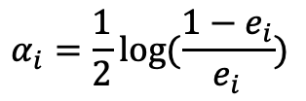
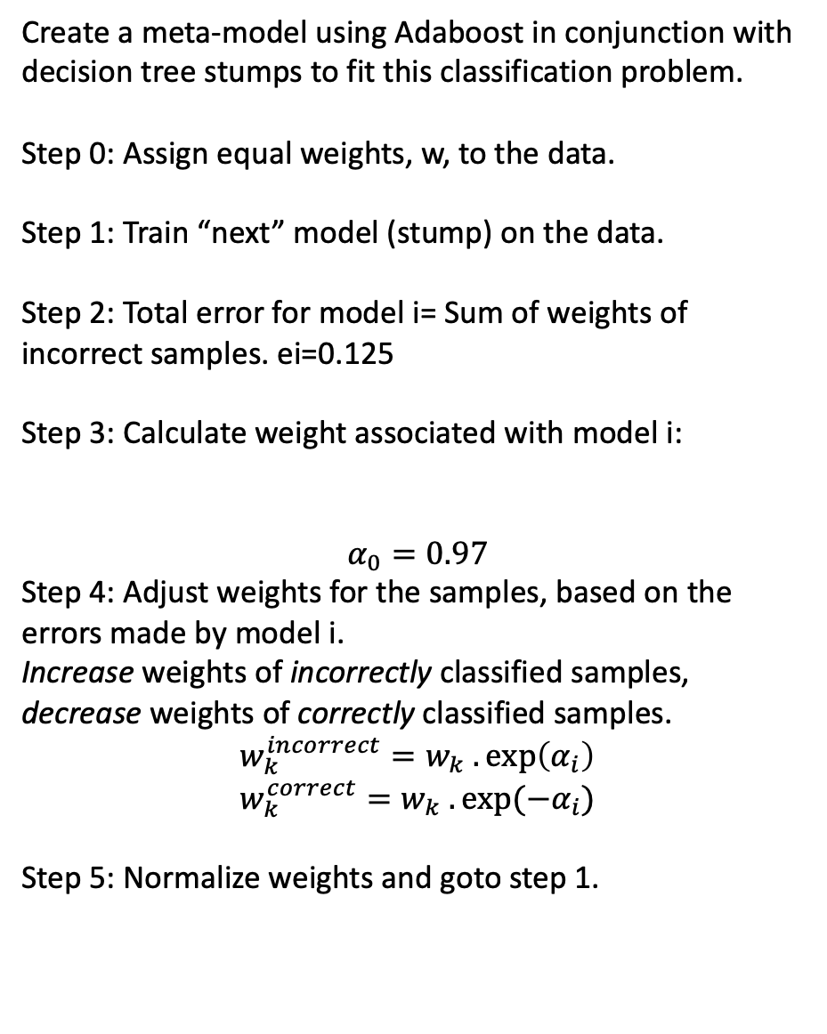
Adaptive Boosting: AdaBoost
Create a meta-model using Adaboost in conjunction with decision tree stumps to fit this classification problem.
Step 0: Assign equal weights, w, to the data.
Step 1: Train “next” model (stump) on the data.
Step 2: Total error for model i= Sum of weights of incorrect samples. ei=0.125
Step 3: Calculate weight associated with model i:
$$α_{0}=0.97$$
Step 4: Adjust weights for the samples, based on the errors made by model i. Increase weights of incorrectly classified samples, decrease weights of correctly classified samples.
$$w_{k}^{incorrect}=w_{k} .\exp\left(α_{i}\right) \\ w_{k}^{correct}=w_{k} . exp⁡({−α}_{i})$$
Step 5: Normalize weights and goto step 1.
X1 | X2 | Y | w | w_new
1 | 1 | c1 | 0.125 | 0.07
1 | 1 | c1 | 0.125 | 0.07
1 | 0 | c1 | 0.125 | 0.07
1 | 1 | c1 | 0.125 | 0.07
0 | 1 | c2 | 0.125 | 0.07
0 | 1 | c2 | 0.125 | 0.07
1 | 0 | c2 | 0.125 | 0.51
0 | 1 | c2 | 0.125 | 0.07
$$α_{i}=\frac{1}{2}log⁡(\frac{1−e_{i}}{e_{i}})$$
X1
X1=0
X1=1
Y=c2
Y=c1

