Slide 1

#ReWRITE
New York
April 7, 2019
T3 – V2K | Karen Bennett • Vivian Chen • Kelly Rainey

Slide 2
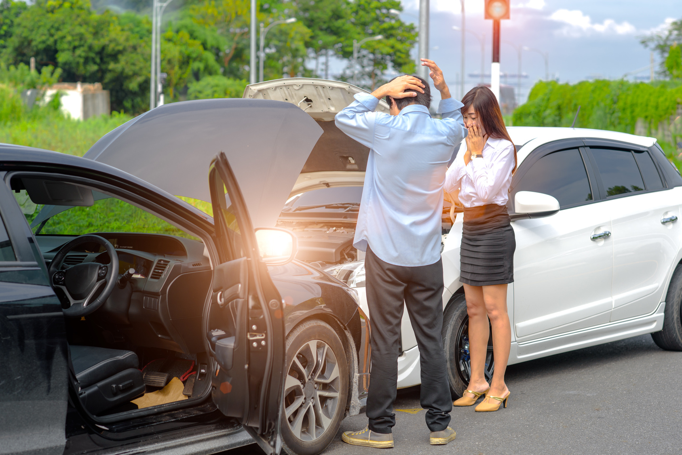
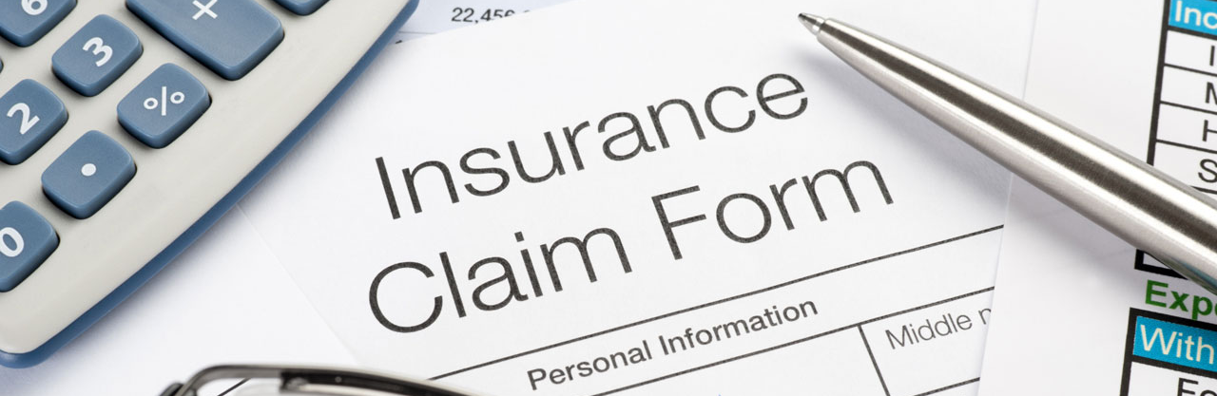
Why Are We Here Today?
More than 6% of insured drivers file an insurance claim each year
Auto insurance claims can take anywhere from 5-8 days for smaller claims, or up to a month if someone was hurt
Many factors can contribute to delayed resolutions
NOW WHAT?
Notes:
STATISTICS
More than 6% of insured drivers file an insurance claim each year
In 2017, $167 million dollars of claims were filed
Insurance claims can take anywhere from 5-8 days for a roadside assistance claim or glass replacement claim, or up to a month for a total loss claim
Automobile accident claims with hurt individuals can take even longer
Factors that can impact how long a claim takes to process include:
Poor communication / availability to connect with parties
Coverage discrepancies
Not happy with repairs to vehicles
Related to a nature disaster claim
It is forecasted to cost property and casualty insurance carriers around the globe $9billion on IT to support claims from 2011 to 2015.
It is estimated to be between $588-$734 million on call centers for personal claims
One study, done by Accenture, stated that claims adjudicators spent 44–49% of their time on non-core activities.
The same study showed that field adjusters spent 41% of their time on non-core activities.
**Timelines, resources, quantify, how much as a firm we are paying to support (white paper about insurance facts – gartner, Marsh)

Slide 3


Filing A Claim Involves A Lot of People
Notes:
FILING A CLAIM
Whether by phone, email, online form or fax, there are multiple conversations happening
Insured individual A needs to contact their carrier; the same for insured individual B
From there carriers may handle in-house with a claims rep, hire a third party administrator and outsource the claim, or have an in-house (or hired) claims adjuster sort out the details for them.
Throughout the process communications are happening among parties to figure out the value of damages and who is paying for what damages

Slide 4
Filing An Insurance Claim Is Inefficient
It is time-consuming. It is very manual.
Efforts are duplicated and stress is high for insured individuals.
Improved technology has the opportunity to reshape the insurance claims process.
We Can Make It Better
Notes:
FILING AN INSURANCE CLAIM IS INEFFICIENT
It is time consuming
It is very manual
Efforts are duplicated
Stress is high
Improved technology has the opportunity to reshape the insurance claims process
We can make it better

Slide 5

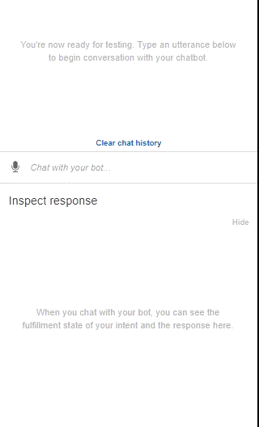
Meet Meadow® by Marsh
A mobile-friendly chat bot, powered by blockchain, computer vision, and artificial intelligence, whose only priority is streamlining your next insurance claim with the touch of a button.
Notes:
MEET MEADOW
A mobile-friendly chat bot
Powered by block chain and artificial intelligence
Whose only priority is streamlining your next insurance claim with the touch of a button

Slide 6
Meadow® Functionality
The app is free
Scan the other person’s information
Record statements
Text for assistance or to start your claim
Relies on block chain, computer vision and AI
Notes:
MEET MEADOW
A mobile-friendly chat bot
Powered by block chain and artificial intelligence
Whose only priority is streamlining your next insurance claim with the touch of a button
Scanning
Speaking
Text

Slide 7
Meadow® Benefits for the Policy Holder
Self-service anytime and anywhere
Easy-to-use interface
Faster claims submissions / settlement
Master repository
Upload images and documents
Accesses secure data via blockchain
Notes:
jj

Slide 8






Meadow® Benefits for Insurance Carriers
Streamlines administrative tasks
Acts as single source of truth
Promotes quicker resolution
Limits caseloads and time span of claim
Standardizes data among insurance carriers
Notes:
jj

Slide 9




Scenario
1
2
Helen Reports FNOL
Auto Policy Card
Matt White
Policy: PolicyNum321
Drivers License: MD123455
[ ]
3
Matt Updates Information
Notes:
The insured doesn’t have to talk to a claim representative.
Enter it once into the ledger.
The insurance company doesn’t have to waste effort reaching out to each party involved to receive all the information needed to process the claim.

Slide 10
Meadow® Demo
[Demo]
3
View all claim info
1
2
Each Insured Party Inputs their claim Information.
Information captured in the distributed ledger, shared to all relevant participants
Insurance company accesses all
information needed.
Notes:
The insured doesn’t have to talk to a claim representative.
Enter it once into the ledger.
The insurance company doesn’t have to waste effort reaching out to each party involved to receive all the information needed to process the claim.

Slide 11


Before and After Workflow
Incident
$
Reimbursement
Incident
$
Reimbursement

Slide 12
How Can Meadow® Scale?
Commercial use cases (ex: property management / leasing)
National and global integration of blockchain data
Applications in healthcare / merging with EMR data
Incorporating databases (ex: police) for additional information

Slide 13
How to Roll Out Meadow®
Incentivize use of Meadow® among policy holders in exchange for reductions in policy premiums
Disrupt the marketplace and make Meadow the new norm
Invite iOS and Android to build into emergency mobile functionality
Educate carriers that Meadow® will minimize the number of claims reps handling administrative tasks and refocus them on assignments requiring strategy

Slide 14
Reference Links
https://www.nerdwallet.com/blog/insurance/auto-home-insurance-claims-reports/
https://www.consumerreports.org/cro/2012/04/insurance-claims/index.htm
https://www.nerdwallet.com/blog/insurance/whose-auto-insurance-provider-to-use-after-accident-2/
https://www.theatlantic.com/national/archive/2011/07/the-geography-of-how-we-get-to-work/240258/
https://www.thebalance.com/how-long-does-an-insurance-claim-take-527095
https://www.cisco.com/c/dam/en/us/solutions/collateral/collaboration/ClaimsManagementWhitepaper.pdf
https://www.citrix.com/content/dam/citrix/en_us/documents/white-paper/insurance-wp.pdf
https://risk.lexisnexis.com/insights-resources/white-paper/2019-future-of-claims-study
https://www.esurance.com/info/claims/third-party-car-insurance-claims

Slide 15
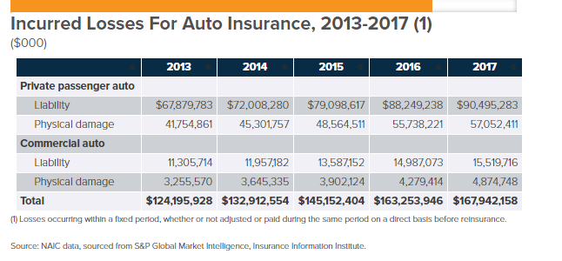
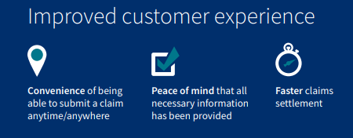
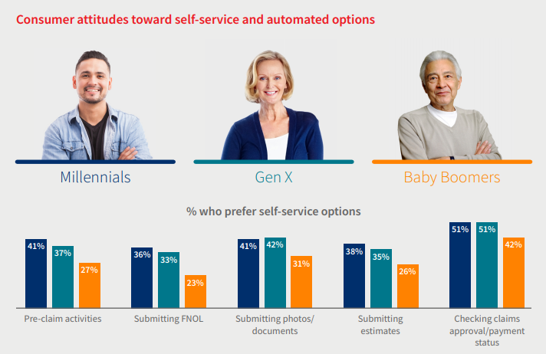
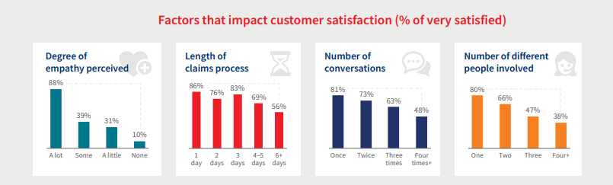
Reference Charts

Slide 16
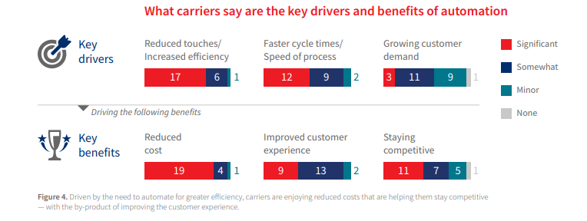
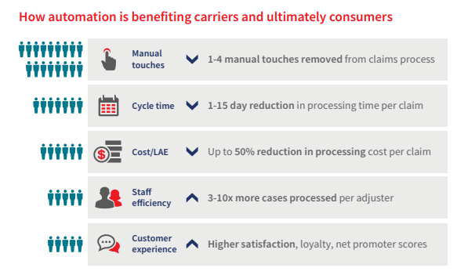
Reference Charts

