Slide 1
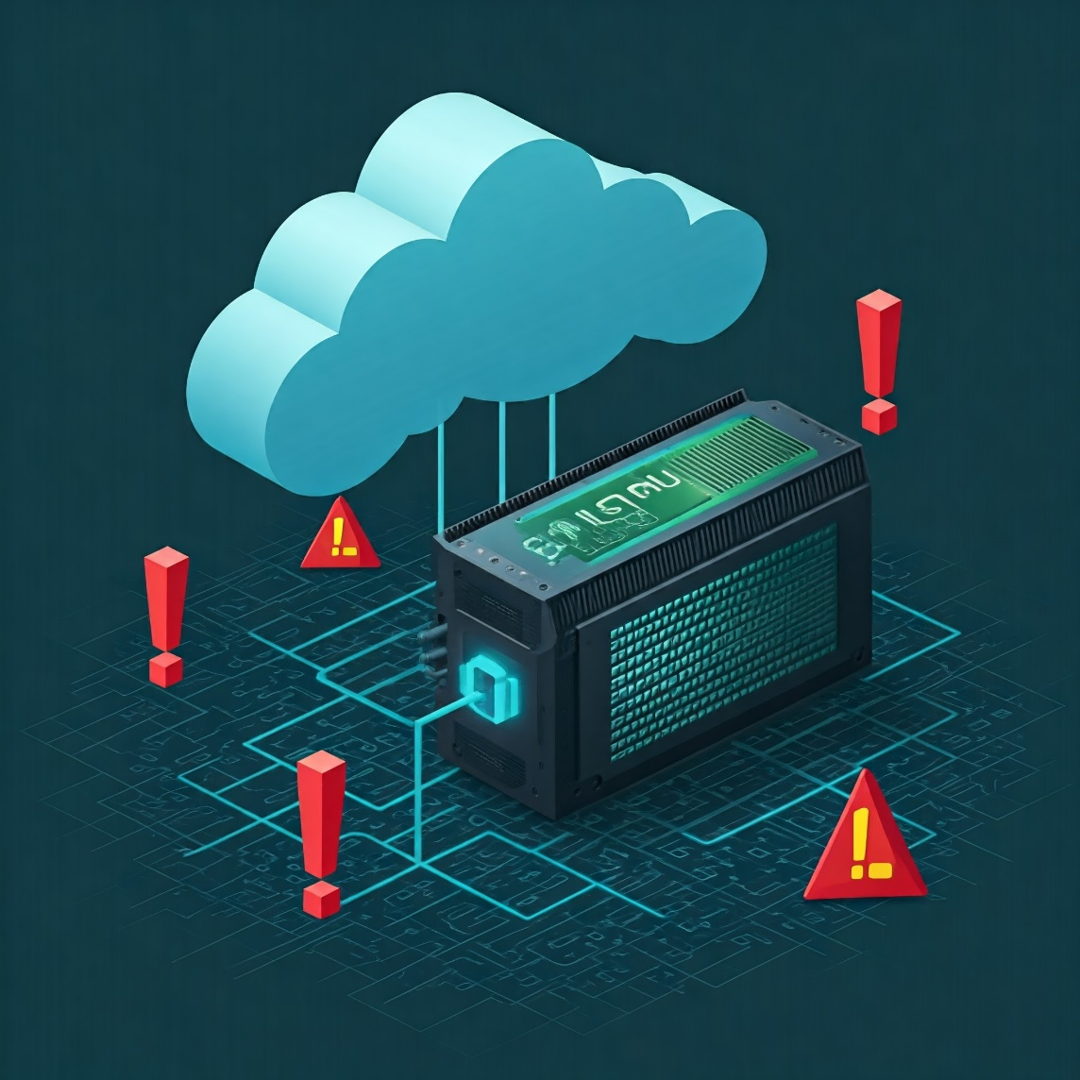
Analysis of GPU Malware Evidence in Virtualized GPU Cloud Computing Services
Thomas Williamson
Graduate Student in Computer Science
College of Charleston

Slide 2
Importance of GPU Cloud Computing
GPU based cloud computing is critical due to its ability to efficiently handle computationally intensive tasks. Due to this ability GPU cloud computing has become indispensable across various fields.
Artificial Intelligence (AI) and Machine Learning (ML)
Deep Learning: GPUs excel at matrix operations and parallel processing. These are critical parts of training deep neural networks. Access to GPUs have fostered a renaissance in areas like image recognition, natural language processing, and recommendation systems.
Training Large Models: It allows researchers to train AI models that were previously impractical due to hardware limitations. It has led to advancements in generative AI, computer vision, and speech recognition to name a few.
Scientific Research
Computational Biology: GPUs can significantly accelerate simulations and analyses in genomics, proteomics, and drug discovery.
Climate Modeling: Complex climate models require immense computational power, which GPU cloud computing can provide.
High-Performance Computing (HPC): GPU cloud computing offers a scalable and cost-effective solution for HPC applications, such as simulations, data analysis, and scientific visualization.

Slide 3
GPU as a Service Market Valuation is around $3 Billion as of 2023 ^{1,2}
GPU as a Service Market Valuation is projected to grow to $47 to 50 Billion as of 2032^{1,2}
Security concerns are listed as a primary restraining factor in GPU as a Service ^{1,2}
Fortune Business Insights: GPU as a Service Market Size, Share & Industry Analysis, By Deployment Model (Private GPU Cloud, Public GPU Cloud, and Hybrid GPU Cloud), By Enterprise Type (Small & Medium-sized Enterprises and Large Enterprises), By Pricing Model (Pay-as-you-go and Subscription-based), By Application (Healthcare, BFSI, Manufacturing, IT & Telecommunication, Automotive, and Others), and Regional Forecast, 2024-2032
Credence Research: Cloud GPU Market Size, Growth & Forecast to 2032
Importance of GPU Cloud Computing
Notes:
This is the question that your experiment answers

Slide 4
Importance of this Research
The Billions in current market valuation does not represent the value of what is being computed, but only on the service of providing such computation.
Economics would dictate that if the service is worth Billions, then the products being generated from said service must be of greater value now or in the future to the users of said service.
(I am not an economist, but this would seem to be a reasonable, if simplistic, logical conclusion)
This then means that those products make a lucrative target.
My literature searches have not uncovered any analytic surveys of current malware evidence in GPU Cloud Computing.

Slide 5
Importance of this Research
Threat Type | Risk Level | Likelihood | General Impact | Cloud Impact | AI Impact | HPC Impact
GPU Side-Channel Attacks | High | Medium Attacks are possible, but not trivial to execute. | High Potential for significant data leakage and security breaches. | High Potentially exposes data across users in shared environments. | High Risk of leaking sensitive inference data or insights into model internals. | High Could lead to the disclosure of sensitive computation or simulation results.
GPU Rootkits | Medium | Low Sophisticated attacks, less frequent in well-monitored environments. | High Can have far-reaching effects through system compromise. | High Can evade detection and persistently compromise cloud services. | High Threatens the integrity of AI models and the confidentiality of proprietary information. | Medium Possible disruption to HPC tasks; the impact varies by the specific use case.
API Abuse and Kernel Manipulation | High | Medium Vulnerabilities can exist, and attackers might leverage them. | High Potential for severe system compromise and data manipulation. | Medium Potential for exploiting vulnerabilities, mitigated by cloud platform securities. | High Direct manipulation could compromise AI models and data. | High Directly affects the integrity and execution of computational tasks.
Denial-of-Service Attacks | High | High These attacks are common and can be easily launched. | High Disrupt service availability, potentially causing significant losses. | High Directly impact service availability, affecting multiple users. | High Can render AI services inoperative, critically affecting availability. | High Severely restrict access to computational resources, disrupting operations.
GPU Malware for Crypto mining | Medium | High Malware is prevalent and targets any accessible resources. | Medium Mainly impacts system performance and costs. | High Consumes computational resources, leading to increased costs and degraded performance. | Low Mainly a resource drain; indirect impact unless AI tasks are severely resource constrained. | Low Similar to AI, mainly a resource drain with limited direct impact.
Exploiting Vulnerabilities in GPU Drivers | High | Medium Vulnerabilities exist, but patching and mitigations are common. | High Compromise can have severe consequences for system and data integrity. | Medium Cloud platforms might mitigate some risks, but vulnerabilities can lead to system compromise. | High Potentially compromises the integrity and confidentiality of AI processes. | High Unauthorized access or disruption of tasks is a significant threat.
GPU Assisted Code Obfuscation | Medium | Low Requires specialized techniques, not as common as basic malware. | Medium Can hinder security analysis and delay incident response. | Medium Complicates malware detection within the cloud infrastructure. | Medium Can obscure malicious activities affecting AI model integrity. | Medium Could hide the presence of unauthorized computations or data manipulations.
Overdrive Fault Attacks | Medium | Low Requires physical access or specialized manipulation techniques. | Medium Can impact accuracy and reliability, more targeted in nature. | Low Rare in controlled cloud environments but could occur through hardware manipulation. | Medium Specific attacks might subtly alter the outcomes of AI models. | High Precision tasks might be compromised, affecting critical results.
Memory Snooping/Cross-Virtual Machine (VM) Attacks in vGPU Environments | High | Medium Attacks are possible on virtualized GPUs, especially if not properly configured. | High Potential for major data breaches and loss of confidentiality. | High Breaks isolation between users, undermining cloud security. | High Unauthorized access to AI datasets and models poses a serious confidentiality risk. | High Data leakage is a major concern, especially in shared computational environments.
Compromised AI Models/Trojaning | High | Medium Attacks rely on model distribution channels and user trust. | High Can lead to incorrect or malicious outputs with significant consequences. | Medium Cloud infrastructure might not be directly impacted but facilitates model distribution. | High Directly affects model integrity, leading to incorrect or malicious decisions. | Medium Indirect impact initially, but a growing concern during model deployment impacting HPC.
N. a. L. P. a. R. R. a. P. C. Huq, "A Survey of Cloud-Based GPU Threats and Their Impact on AI, HPC, and Cloud Computing," 2024.

Slide 6
Literature References
K. D. Duy, T. Noh, S. Huh and H. Lee, "Confidential Machine Learning Computation in Untrusted Environments: A Systems Security Perspective," in IEEE Access, vol. 9, pp. 168656-168677, 2021, doi: 10.1109/ACCESS.2021.3136889.
Y. Albabtain and B. Yang, "The Process of Reverse Engineering GPU Malware and Provide Protection to GPUS," 2018 17th IEEE International Conference On Trust, Security And Privacy In Computing And Communications/ 12th IEEE International Conference On Big Data Science And Engineering (TrustCom/BigDataSE), New York, NY, USA, 2018, pp. 1669-1673, doi: 10.1109/TrustCom/BigDataSE.2018.00248.
Fatemeh Deldar and Mahdi Abadi. 2023. “Deep Learning for Zero-day Malware Detection and Classification: A Survey.” ACM Comput. Surv. 56, 2, Article 36 (February 2024), 37 pages. https://doi.org/10.1145/3605775
Di Pietro, Roberto, Flavio Lombardi, and Antonio Villani. "CUDA leaks: Information leakage in GPU architectures." arXiv preprint arXiv:1305.7383 (2013).
Huq, Numaan, Philippe Lin, Roel Reyes, and Charles Perine. "A Survey of Cloud-Based GPU Threats and Their Impact on AI, HPC, and Cloud Computing.“
To Review
Kim, Chiho, Sang-Yoon Chang, Jonghyun Kim, Dongeun Lee, and Jinoh Kim. "Zero-day malware detection using threshold-free autoencoding architecture." In 2021 IEEE International Conference on Big Data (Big Data), pp. 1279-1284. IEEE, 2021.
C. Kim, S. -Y. Chang, J. Kim, D. Lee and J. Kim, "Automated, Reliable Zero-Day Malware Detection Based on Autoencoding Architecture," in IEEE Transactions on Network and Service Management, vol. 20, no. 3, pp. 3900-3914, Sept. 2023, doi: 10.1109/TNSM.2023.3251282.

Slide 7
Progress
Methodology
Begin gathering data.
Formulate and develop an approach to DNN Anomaly detection based on literature.
Analyze the Results
Each of the above will be reviewed in the following slides.
Procedures
Project source stored in GitHub repo.
Keep research notes in GitHub wiki to track my thoughts and process.
Did not formalize this until late September.
Notes:
Summarize your research in three to five points.

Slide 8
Progress Update: Data Gathering Overview
Step 1
Gather Machine Under Test (MUT) information.
Step 2
Capture GPU Memory / ROM / Registers
Step 3
Upload to a central data repository.
Step 4
Basic MUT data analysis?
Notes:
List all of the steps used in completing your experiment.
Remember to number your steps.

Slide 9
Progress Update: Data Gathering Step 1
Gather Machine Under Test (MUT) information. Started – near complete.
This portion is done, just needs script polish and aggregation into multiple delivery methods (shell, Jupyter Notebook)
Captures Runtime Information
OS Info
Environment Variables
Proc info
uptime info
Cuda version info
GPU Information
XML dump of nvidia-smi
CPU/Machine Information
JSON dump from lscpu
May need to review the data to be sure I am capturing all metrics I may want – CPU Temperature, mem utilization, etc..
Notes:
Summarize your research in three to five points.

Slide 10
Progress Update: Data Gathering Step 2
Capture GPU Memory / ROM / Registers. Started – unknown progress amount.
Memory – Started – Needs work / research.
Method: Copy GPU state, Write GPU data/code, Validate written data/code.
This portion has had two different attempts made but is unsuccessful so far on getting Memory data.
Direct Copy Host driven.
Direct Copy GPU code driven.
Possible Approaches
GPU Code Approach – Minimal allocation – Search for address space bounds, OOB access, Stream to host Memory
GPU Code Approach – GPU Direct access via Vulcan API.
GPU Code Approach – GPU File streaming.
Cuda-Gdb Approach – See if minimal allocation with OOB access can work from a debugged exe.
ROM - Not Tested
Registers – Started - Preliminary access tested via cuda-gdb. Successfully got some if not all register data. Need to determine how to validate totality of data gathered.
Notes:
Summarize your research in three to five points.

Slide 11
Progress Update: Data Gathering Step 3
Upload to a central data repository. Complete – some polish may be needed.
Uses Google Apps Script to provide a web app
MUT Starts with notifying the web app it has started.
MUT Sends zipped b64 encoded data files to web app.
Stores MUT data in organized folders of a root folder in my Google Drive.
The reason the web app approach was taken was that many of these environments are not considered safe for confidential information (API Keys) and are not uniform in support.
Notes:
Summarize your research in three to five points.

Slide 12
Progress: DNN AD
Formulate and develop an approach to DNN Anomaly detection based on literature. NOT STARTED
Create an approach appropriate to the available sample data/research data.
Generate sample data.
Create DNN AD
Test DNN AD on reserved sample set.
May be able to use my code that harvests data as a sample anomaly.
Reserve some available sample data outside of DNN AD input for testing.
Test DNN AD on research data.
Review and re-formulate based on analysis: can drive research data gathering or DNN AD creation.
Notes:
Summarize your research in three to five points.

Slide 13
Progress
Analyze the Results Cannot Start
Notes:
Summarize your research in three to five points.

