Slide 1
Snacking on Code CS 172 Final Project
Tucker Dane Walker
Cassidy Stevick
Mark Franklin
Abby Richardson

Slide 2
Project Problem & Requirements

Slide 3
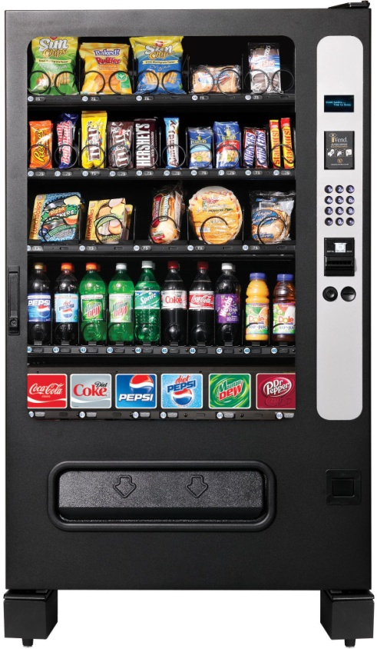
The Task
Design a new vending machine using object-oriented software simulators

Slide 4
Challenges with the Program

Slide 5
The Different Parts
Design the machine with multiple coils that each hold 10 items
Two modes of operation
Restock
Vending
Different Functions
Set price for each spring of coils
Refill coils
Empty cash box
Refill cash box

Slide 6
Solution to the Problem

Slide 7
What We Did
Multiple classes to control the different parts
Break up code to make it more manageable
Self-contained objects

Slide 8
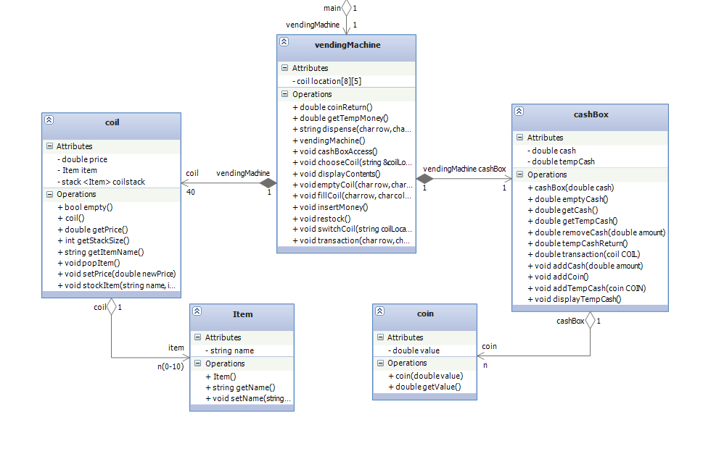
UML Diagram

Slide 9
The “Cool” Factor

Slide 10
Object-Orientation
Code almost entirely Object-Oriented
Each function of the code located in a different class
Most of code resides outside of the main

Slide 11
Demonstration Of The Program

