Slide 1
Caravan Control
Connor Brashar – Estimation Engineer
Tucker Haydon – Control Engineer

Slide 2
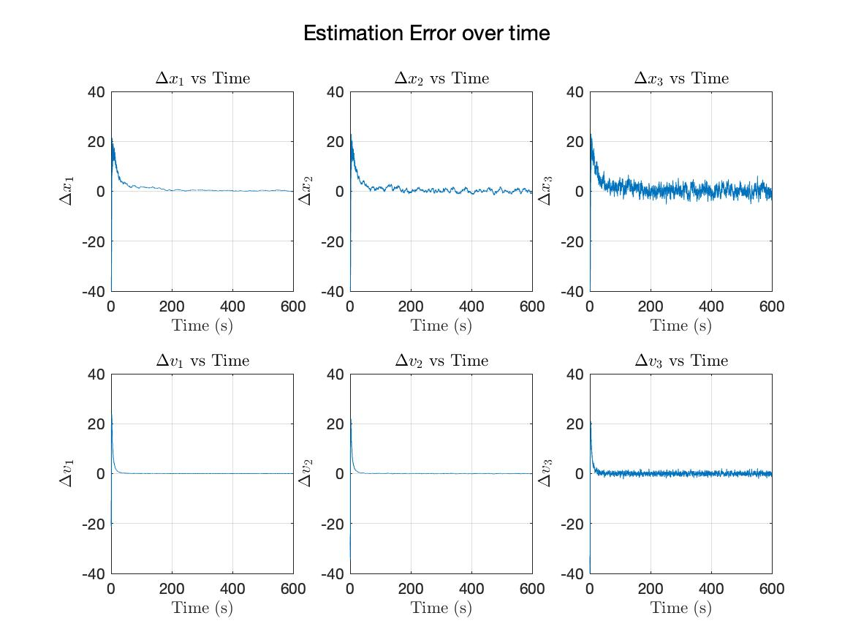

Slide 3
