Slide 1
CS 350 – Mini Project
By: Tucker Mogren

Slide 2
The Idea
Create an application that can be used to add and display information related to doctor, hospitals, patients, and prescriptions.
Accomplish this through the use of Python and MySQL as well as AWS.

Slide 3
Python
Application written in the Language Python
Text based user interface
Prompts with entering the database password then displays the main menu
If database password is entered incorrect, program informs the user and then quits.
Then the main menu is displayed
9 Different options
Options 1 – 3 are for data to be inserted into the database
Options 4 – 7 allow for data to be looked up from the database\
Option 8 allows for all the data in the database to be displayed through the use of a JOIN statement.
Option 9 allows for the program to be quit.

Slide 4
MySQL & AWS
All tables were implemented using MySQL
One Database
Four Tables
SQL Query statements are handled within Python and then sent to the database
SQL Query statements are not typed by the user directly, the user is prompted to enter in data points and then those data points are used inside the SQL Queries to either read or write to the database.
Database was hosted via a student account through Amazon Web Services
This allows for anyone with an internet connection to run the code and be able to access the data within the database to allow the program to be operational.

Slide 5
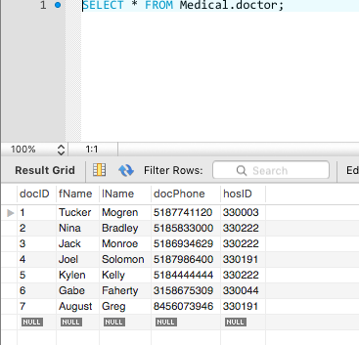
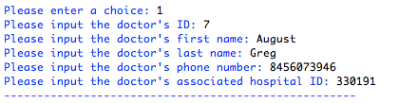
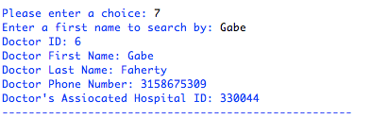
Examples
Data being entered by the user using the Python application.
Here, we can see that the data that was entered into the Python application was inserted into the database.
Then we can see that data was also displayed from the database to the user using the Python application.

Slide 6
The end

