Slide 1
Image segmentation with saliency maps
Course: Neural Networks
Student: Tudor Buzu

Slide 2
Work plan
Select a pretrained CNN (Inception v3, VGG16, etc.);
Choose an image segmentation dataset (CMU-Cornell iCoseg);
Compute saliency maps (three approaches: backprop, deconv, guided backprop) on the selected dataset;
Evaluate saliency maps using F-Measure, IOU;
Combine the best technique of saliency map generation with a segmentation NN.

Slide 3
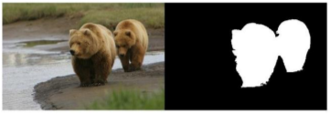
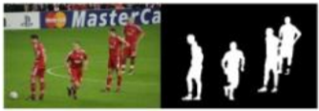
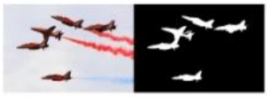
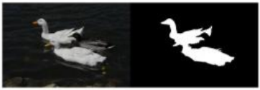
Datasets
CMU-Cornell iCoseg dataset

Slide 4
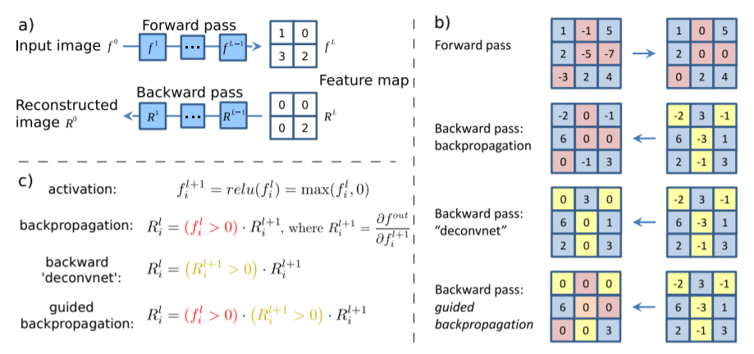
Saliency map approaches

Slide 5
References
Visualizing and Understanding Convolutional Networks (Zeiler and Fergus, 2013) (https://arxiv.org/abs/1311.2901)
Deep Inside Convolutional Networks: Visualising Image Classification Models and Saliency Maps (Simonyan et al., 2014) (https://arxiv.org/abs/1312.6034)
Striving for Simplicity: The All Convolutional Net (Springenberg et al., 2015) (https://arxiv.org/abs/1412.6806)
Grad-CAM: Visual Explanations from Deep Networks via Gradient-based Localization (Selvaraju et al., 2016) (https://arxiv.org/abs/1610.02391)
https://raghakot.github.io/keras-vis/visualizations/saliency/

