Slide 1
Graph Attention Networks (Velickovic et. al)
Tudor-Andrei Dumitrascu

Slide 2
Graph Neural Networks
Topics
  Message passing
  Aggregate & Update
  Attention mechanism

Slide 3
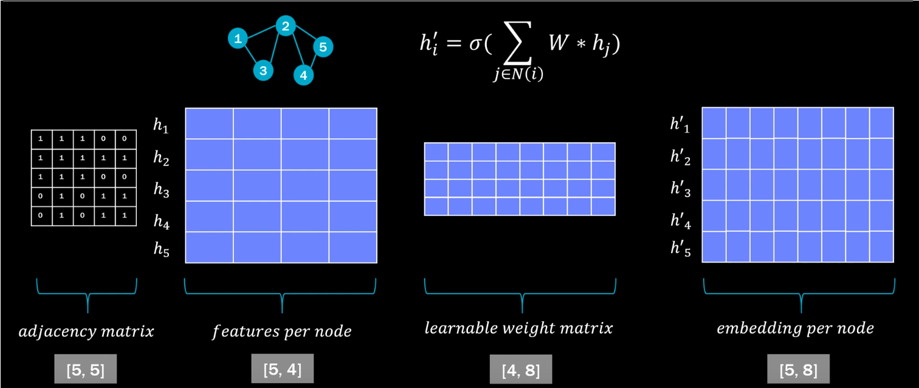
Graph Neural Networks

Slide 4
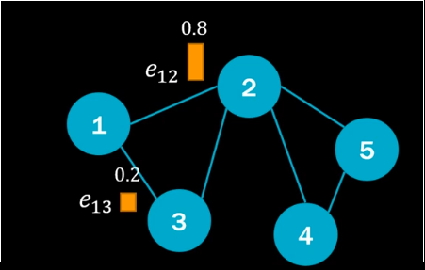
Graph Neural Networks

Slide 5
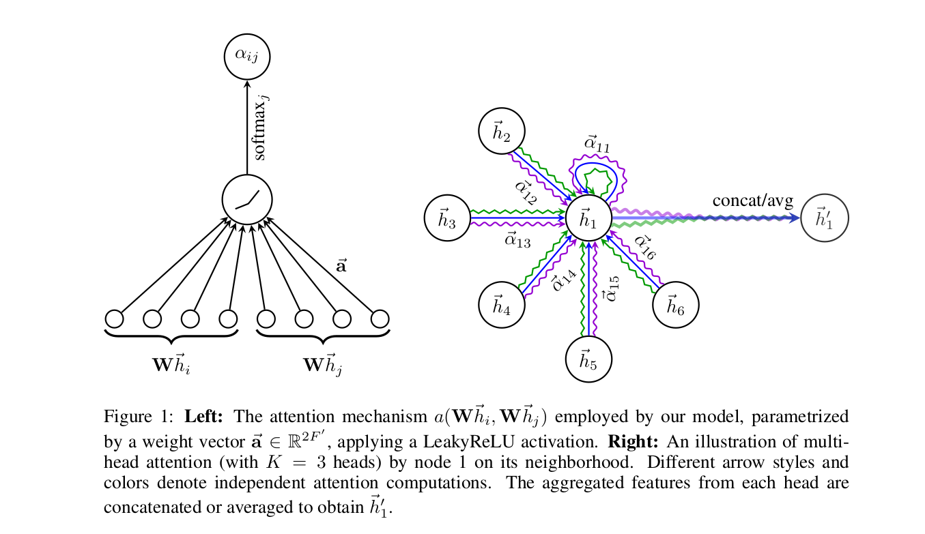
Graph Neural Networks

Slide 6
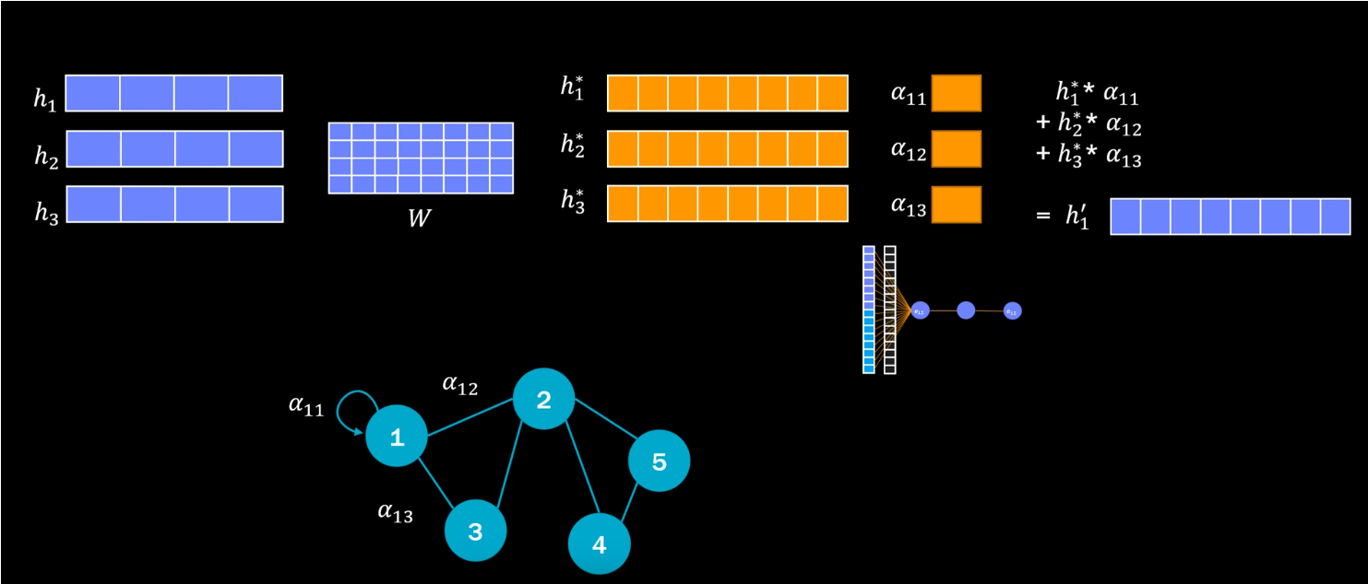
Graph Neural Networks

Slide 7
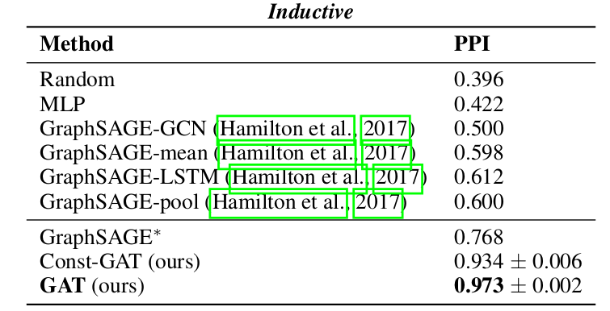
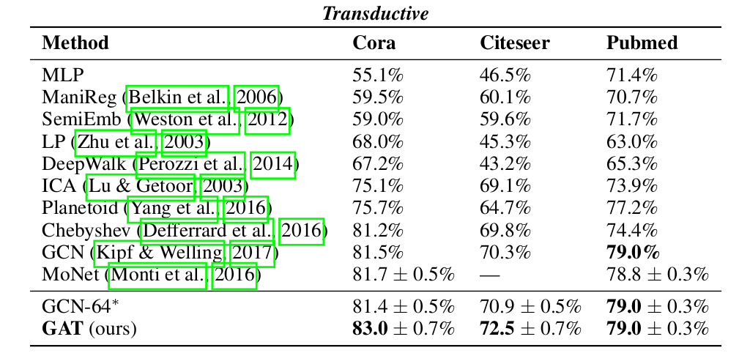
Graph Neural Networks

Slide 8
Conclustions
Efficient ( the operation of self-attention can be parallelized across all edges and the output feature can be parallelized across all nodes)
Does not depend on the whole graph structure
State of the art (transductive and inductive)

