Slide 1
Seq2Seq Attention

Slide 2
Dataset
  One Dataset class that handles both datasets
        Easier to change encodind method
    Encoding: one index for each word.
    4 special tokens:
      UNK
      EOS, SOS
      PAD
  Padding to the length of the longest sentence

Slide 3
Dataset
  Issues:
      The dataset is too large for local training:
        Trimmed the used dataset (webnlg: Only one File - University, Semeval: 150/98 train/val)

Slide 4
Enc-Dec model
  test

Slide 5
Enc-Dec Attention
  Added the Attention mechanism to the model
  Very slow to train
  Poor performance (?)

Slide 6
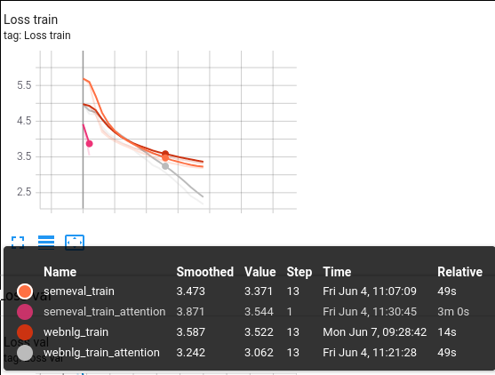
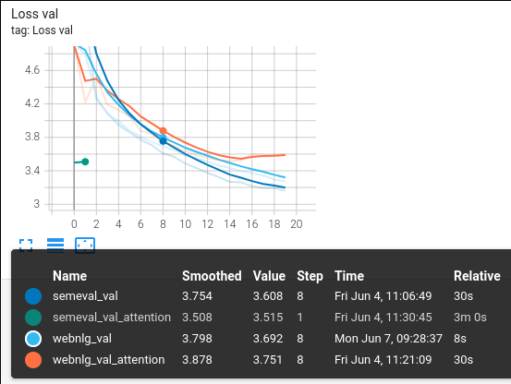
Performance
  Added the Attention mechanism to the model

Slide 7
Thank you!

