Slide 1
XTAI Lab 2
Tudor-Andrei Dumitrascu 2682776

Slide 2
Overview
Introduction
Seq2Seq
Graph Attention
Conclusion

Slide 3
Introduction
Goal: Knowledge extraction and Inference with Attention Mechanism
Phase 1: Sequential Models
  Extracting triplets of data from sentences
Phase 2: Graph Neural networks
  Predict the relation between two words

Slide 4
Seq2Seq
Theory:
  Sutskever et. al. (2014) - Sequence to Sequence Learning with Neural Networks
  Vaswani et. al. (2017) - Attention Is All You Need
Intuition:
  DNN cannot handle sequenced input (text/audio)

Slide 5
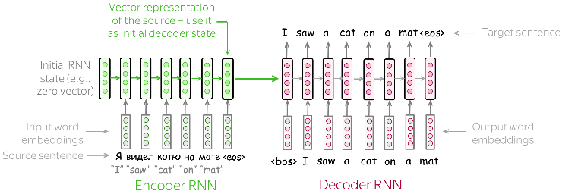
Seq2Seq
Encoder-Decoder architecture
LSTM cells
State of the art over Statistical Machine Translation Models
Image Source

Slide 6
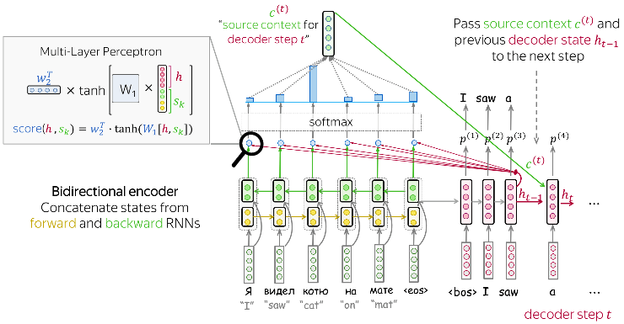
Seq2Seq + Attention
Intuition:
  Bottleneck
  Find relevant info for predicting the target word in the input sequence.

Slide 7
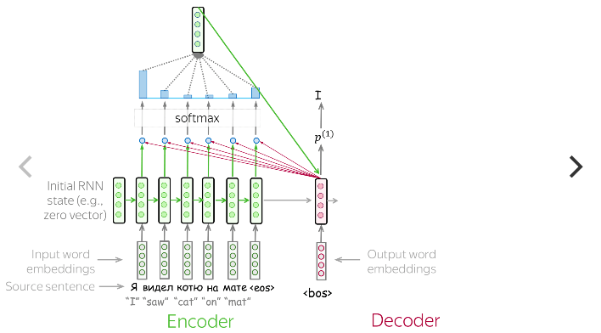

Slide 8
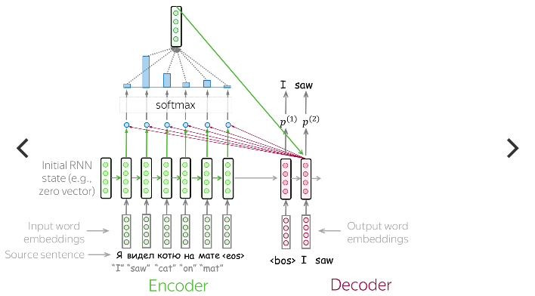

Slide 9
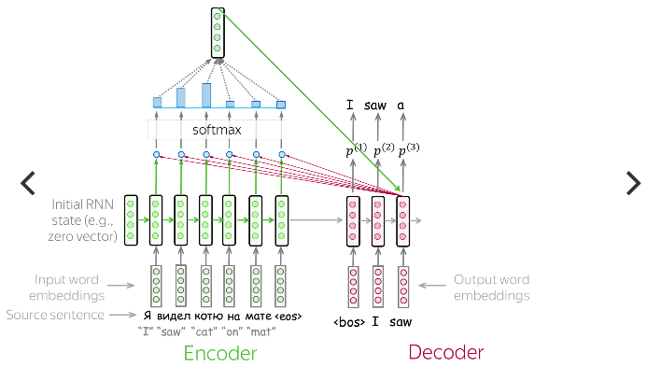

Slide 10
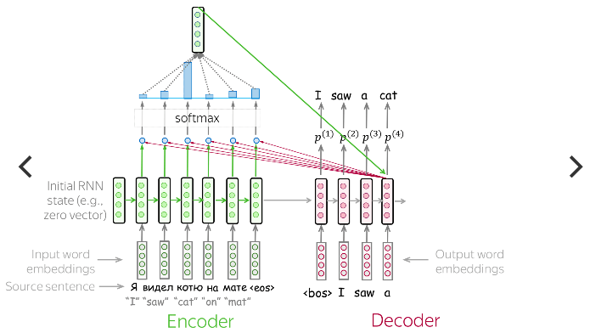

Slide 11
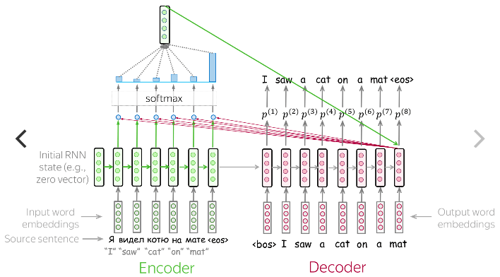

Slide 12
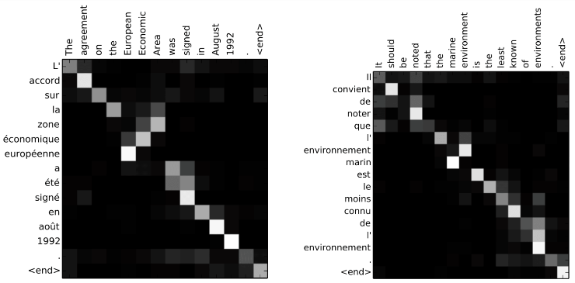

Slide 13

Datasets
WebNLG
  Contains RDF Triplets
SemEval2010
  Semantic Paris Between paris of nominals
  Strongly defined relations (9 + Other)

Slide 14
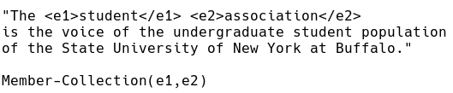
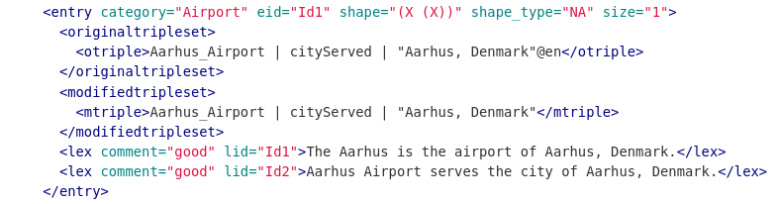

Slide 15
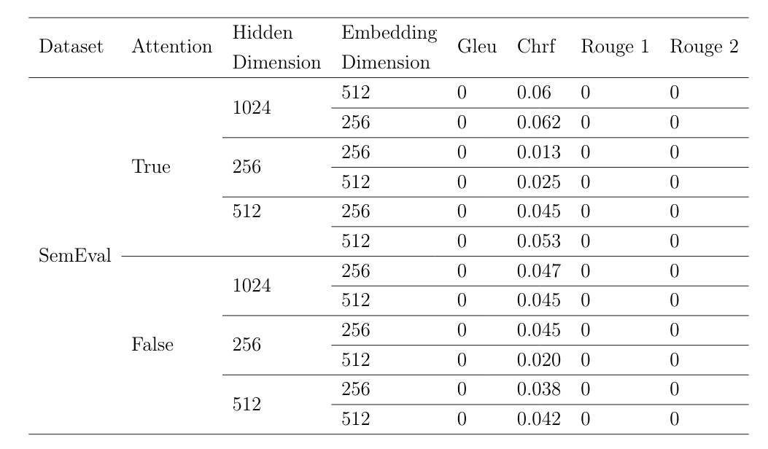
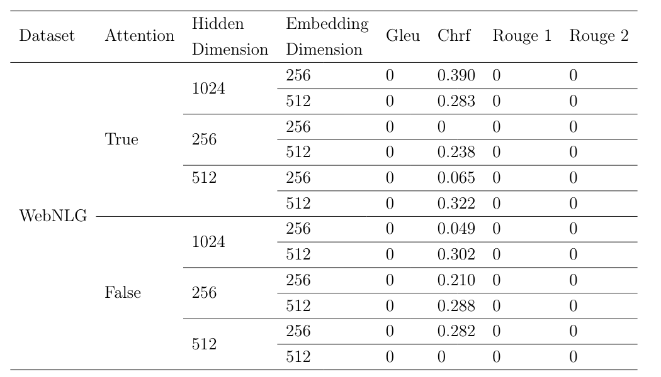
Results

Slide 16
Future Improvements
Beam-search Algorithm
OOV handling
Data Augmentation
  Synonims using WordNet
  Generate more sentences from the other tiplets

Slide 17
Graph Neural Networks
Goal:
  Predict a relation between two words (Link Prediction Task on the ConceptNet datset)
  Embedd the knowledge graph using Graph Neural Networks
  Extend the Relational Graph Convolution with the Attention Mechanism
Theory:
  Veličković et. al. (2017) - Graph Attention Networks

Slide 18
Graph Neural Networks
Graph Dataset
Graph Neural Networks
Graph Convolutions
Relational Graph Convolutions
Graph Attention
Relational Graph Attention Networks

Slide 19
Graph Neural Networks
ConceptNet Dataset ~1.9M edges
  Knowledge Graph
  Nodes: words
  Edges: relation between two nodes
Node features:
  0 initial features
  ConceptNet NumberBatch pretrained embeddings
Edge features:
  edge_weight: the strength of the relation

Slide 20
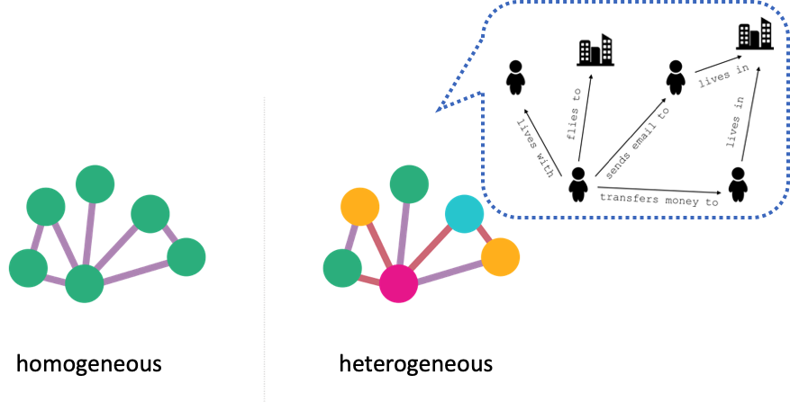
Graph Neural Networks
Graph Dataset:

Slide 21
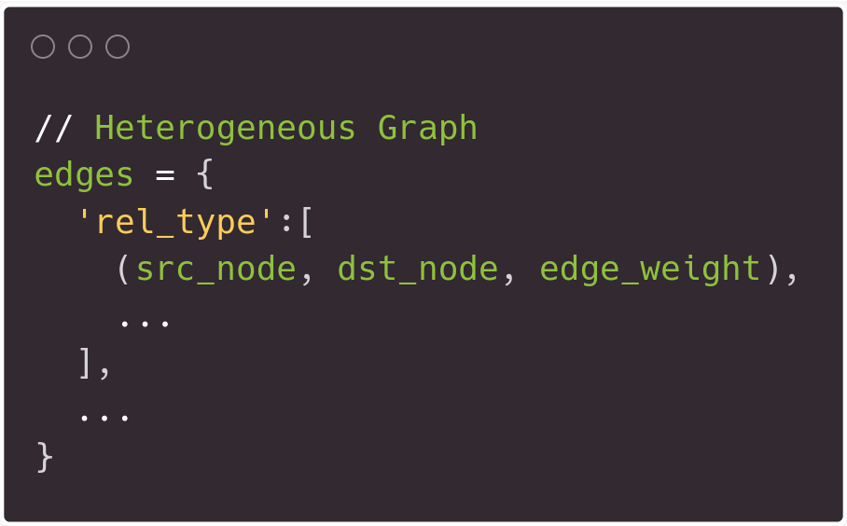
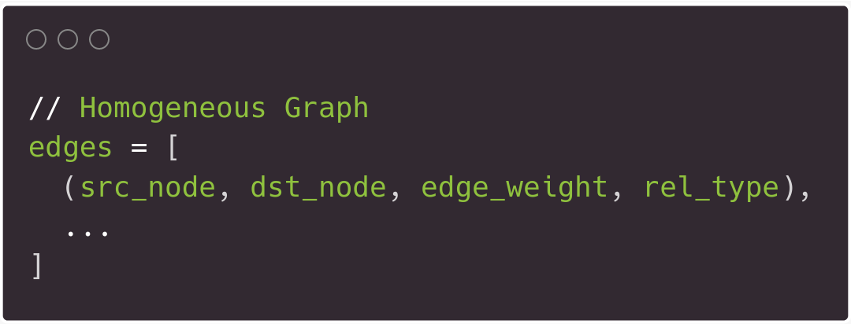
Graph Neural Networks

Slide 22
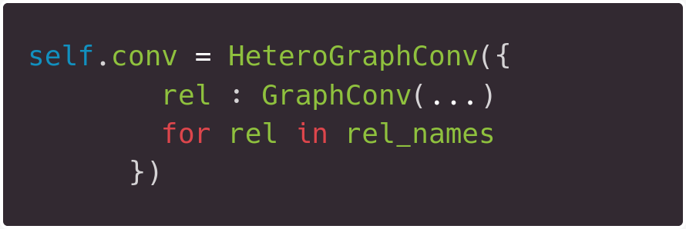
Graph Neural Networks

Slide 23
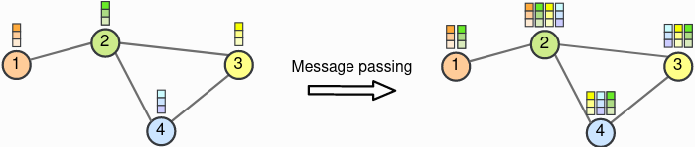
Graph Neural Networks
Graph Neural Networks
  Message Passing

Slide 24
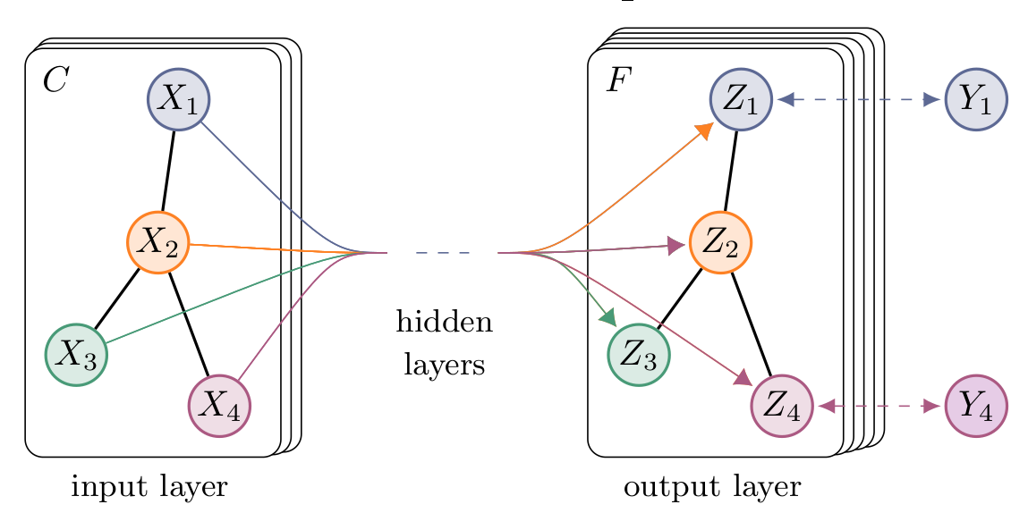
Graph Neural Networks
Graph Convolution
  Message passing + Linear Layer
  Encode the local graph structure and features of nodes

Slide 25
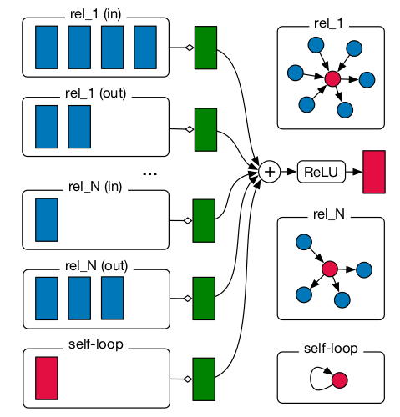
Graph Neural Networks
Relational Graph Convolution

Slide 26
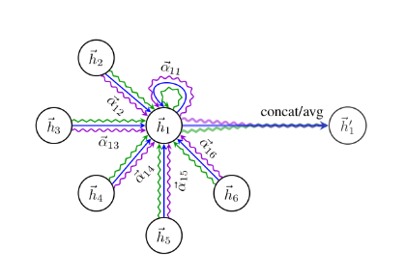
Graph Neural Networks
Graph Attention Networks

Slide 27
Graph Neural Networks
Graph Attention Networks (for Heterogeneous Graphs)

Slide 28
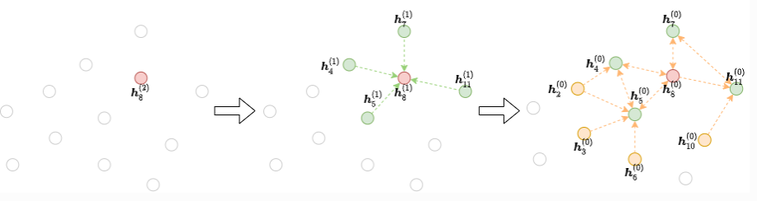
Graph Neural Networks
Neighbourhood Sampling

Slide 29
Graph Neural Networks
Loss Function – Margin Loss

Slide 30
Graph Neural Networks
General Issues
  Multi objective loss function
  Sampling the Graph
  Inference
    Performing inference
    Selecting the highest score

