Slide 1

MASTER THESIS DEFENSE
A Cloud-Based Closed-Loop Payment System with Hybrid On-Chip Reconciliation
Keeping the festival wallet alive when the network has a bad moment
Tudor Esan
Supervisor: Assoc. Prof. Christian Sacărea, PhD
MSc Advanced Information Systems
Notes:
~15 min total incl. demo. Set the scene: cashless festivals are normal now, but they break in a specific way. My thesis is about that failure mode and a pragmatic fix.

Slide 2






ROADMAP
What I'll walk you through
The problem
01
Closed-loop & the field
02
Why festivals break the usual payment playbook
What it means, who already does it, what they hit
My approach
03
How it works
04
Goals, the options I weighed, the model I chose
The two-counter ledger, with a worked example
The system
05
Security & demo
06
Admin portal, attendee & vendor apps, tech & data
NFC trust, honest limits, then a live walkthrough
Hybrid On-Chip Reconciliation for Closed-Loop Festival Payments
Tudor Esan · 2
Notes:
30-second roadmap. Don't read it out — just signpost the six beats.

Slide 3


1 · INTRODUCTION
Tens of thousands of people, where the internet barely works
Festivals went cashless on RFID wristbands — load money, tap to pay. It is faster and harder to steal than cash.
An independent meta-analysis of 71 studies (Schomburgk, 2024) finds a small but real lift in spending from removing the friction of physical cash (g = 0.135).
THE RESEARCH QUESTION
Can we build a payment system that works reliably at a festival — and does not fall apart when the network has a bad moment?
But every cashless system shares one weakness:
100×–5,000×
Download 2015
Cellular collapse under crowds is a capacity limit, not a config bug — portable towers and free Wi-Fi did not fix it.
more connection failures around a crowded venue vs a routine day (Shafiq et al., 2013) — up to 10 miles out
first major UK festival to go fully cashless — the RFID system failed, attendees couldn't buy food; cashless-only was dropped the next year
Hybrid On-Chip Reconciliation for Closed-Loop Festival Payments
Tudor Esan · 3
Notes:
Anchor on the research question. Shafiq shows cellular collapses under crowds (capacity, not config); Download 2015 is the cautionary tale. Schomburgk is the one spending number you can actually trust.

Slide 4





2 · CONCEPT
What a closed-loop payment is
The operator is both issuer and acquirer. Money stays inside the operator's own perimeter — from top-up to refund — instead of crossing banks, card schemes and processors the merchant doesn't control (the open-loop / Visa–Mastercard world).
Why festivals lean closed-loop
Connectivity
All authorization logic lives inside the operator's own infrastructure — no dependence on distant external hosts.
Fees
External fees are paid once, at top-up — not interchange on every single tap.
ONE EXTERNAL TOUCHPOINT
Real money only enters the loop once — at top-up (via Stripe). Everything after that is internal tokens. Nothing leaves the venue.
Regulation
Prepaid tokens redeemable only on-site fit the PSD2 limited-network exemption.
Top-up → tokens → tap to spend → settle, all in-house
Control
Operator sets limits, refunds, vendor approvals and settlement timing — no card scheme dictating terms.
Hybrid On-Chip Reconciliation for Closed-Loop Festival Payments
Tudor Esan · 4
Notes:
Define closed-loop crisply: same operator is issuer AND acquirer. The single external touchpoint is top-up. Four reasons festivals choose it.

Slide 5


3 · THE FIELD
Who already does this — and what they run into
Commercial festival platforms
Tappit
Intellitix
Weezevent
Glownet
The closest working analog: transit cards
Common architecture: RFID wristband + an on-site server + vendor terminals on a private network + a back office for top-ups and reporting.
Suica · Oyster · Octopus
Fare is deducted locally at the gate via an encrypted read-write — about 0.1 s, no network round-trip.
FeliCa mutual authentication makes a fresh session key per tap; the chip's secret never leaves secure memory, so cloning is hard.
“Offline at the point of sale, online for the back office.”
Weak chips persist
Many deployments still use MIFARE Classic, whose CRYPTO1 cipher was broken in practice (Garcia et al., 2008). DESFire fixes it but costs more.
Opaque & undocumented
Architectures are proprietary; public failures (Download 2015) are reconstructed from press, not published post-mortems.
Hybrid On-Chip Reconciliation for Closed-Loop Festival Payments
Tudor Esan · 5
Notes:
Name the incumbents (Tappit, Intellitix, Weezevent, Glownet). Their model = on-site server + private network. Transit cards (Suica/Oyster/Octopus) are the working analog: local deduction, batch reconciliation.

Slide 6




4 · FIELD INPUT
There is no public data — so I asked people who run one
What that told me
Reliable venue Wi-Fi is itself a hard infrastructure problem — not a deployment detail you can assume away.
Conversations with payment-infrastructure people at Untold — one of Romania's largest festivals — added the piece no paper had.
The on-site-server model puts the balance on a remote box every tap must reach. When the link degrades, money visibly stops moving.
Even with on-site servers and a private network, top-up sync delays of two to four hours across terminals were common once Wi-Fi coverage degraded.
This is the lesson that pushed me off that pattern — toward the cloud as source of truth and the chip as a local fallback.
Hybrid On-Chip Reconciliation for Closed-Loop Festival Payments
Tudor Esan · 6
Notes:
The honest slide: no public data exists, so I talked to Untold. The 2-4h sync delay number is the pivot — it's why I abandoned the on-site-server pattern.

Slide 7




5 · OBJECTIVES
What I set out to achieve
Architecture
O1
Wallet service
O2
THE GOAL
An MVP closed-loop wallet that is online by default, and stays usable through short outages — without splitting the code into separate online and offline systems.
One codebase that survives short outages — no forked online/offline build.
Top-ups online-only; debits work online and offline, queued for later.
Reconciliation
O3
Core service
O4
A model that converges after offline windows with no ad-hoc conflict rules.
Vendors, products, users and events — the administrative backbone.
Same vendor flow up or down; chip and server take turns as the local source of truth.
Client apps
O5
Verify trade-offs
O6
One mobile app that adapts to attendee / vendor, plus a web dashboard.
Test against what a real festival actually needs.
Hybrid On-Chip Reconciliation for Closed-Loop Festival Payments
Tudor Esan · 7
Notes:
Objectives O1-O6. The headline (dark card) is the one to land: one codebase, online by default, survives short outages.

Slide 8
6 · DESIGN SPACE
The options I weighed — and why I rejected the extremes
Where does the balance live?
Server-only balance
Chip-only balance
Two-counter hybrid
Chip is a pure cache. Simple online — but once offline, two terminals can't detect a double-spend.
Pure transit-card style. Sidesteps double-spend — but credit handling moves onto a machine, and festival top-ups happen in the app with no chip nearby.
Chip caches the balance and owns debits; server owns credits. Each side leads based on what's actually available.
Rejected
Rejected
Chosen
Also weighed:
Local-first / CRDTs — converge but can't enforce “balance ≥ 0”; kept only as a read cache. Connectivity: private LTE & phone mesh too fragile → Starlink + redundant topology, nothing to deploy at the venue.
Hybrid On-Chip Reconciliation for Closed-Loop Festival Payments
Tudor Esan · 8
Notes:
Walk the three options. Reject both extremes for concrete reasons, land on the hybrid. Bottom strip: also rejected CRDTs and fragile connectivity; chose Starlink.

Slide 9

7 · THE SOLUTION
Online by default, with the wristband as a bounded fallback
The offline path almost never fires. So I don't build everything around it — the cloud is the source of truth via Starlink, and the chip carries just enough state to keep the rare offline tap safe.
Four components, nothing installed at the venue
Cloud backend
Mobile app
Web dashboard
NFC wristband
One multi-tenant service for every festival
Both attendees and vendors, one binary
Organizers run the event from a browser
Carries the token balance + counters
Borrowed deliberately: transit cards → on-chip spend cache · EMV → offline always trades availability for capped risk · event sourcing → every movement is an immutable row.
Hybrid On-Chip Reconciliation for Closed-Loop Festival Payments
Tudor Esan · 9
Notes:
Core insight: offline almost never fires, so don't architect around it. Four components, nothing at the venue. Borrowed from transit/EMV/event-sourcing.

Slide 10



8 · WHY IT WORKS
Single writer per lane — and physics does the hard part
One writer per lane = no merge conflict
Double-spend is stopped by physics, not consensus
CREDITS — only the server writes Top-ups, refunds, adjustments. Increment credit_counter.
The wristband is one physical object the customer carries. Only one terminal can touch it at a time, and the on-chip decrement is atomic. Two terminals cannot hold the same chip in the same instant.
DEBITS — only the chip writes Every spend decrements balance + bumps debit_counter, atomically.
Two monotonic counters, one owner each. Reconciliation is just the union of two non-conflicting streams.
Server-first when online
cheapest place to enforce invariants.
Chip-first when offline
the only place the invariant can hold at all.
Hybrid On-Chip Reconciliation for Closed-Loop Festival Payments
Tudor Esan · 10
Notes:
Two ideas: single-writer-per-lane (no merge conflict) and double-spend stopped by physics (one chip, atomic decrement). Server-first online, chip-first offline.

Slide 11
9 · THE LEDGER
Who holds the debits and the credits
CREDITS
top-ups flow server → chip
WRISTBAND (chip)
SERVER (source of truth)
balance
balance
cached spendable balance
the canonical balance
debit_counter
DEBITS
credit_counter
WRITES — +1 each spend
spends sync chip → server
WRITES — +1 each top-up
credit_counter_seen
debit_counter_seen
last credit it has acknowledged
last chip debit reconciled
Balance is one integer in minor units (cents) on each side — not classic double-entry. The counters give the integrity that paired rows would.
Hybrid On-Chip Reconciliation for Closed-Loop Festival Payments
Tudor Esan · 11
Notes:
The 'who holds debits and credits' chart. Credits flow server->chip; debits sync chip->server. One integer each side; counters give integrity.

Slide 12
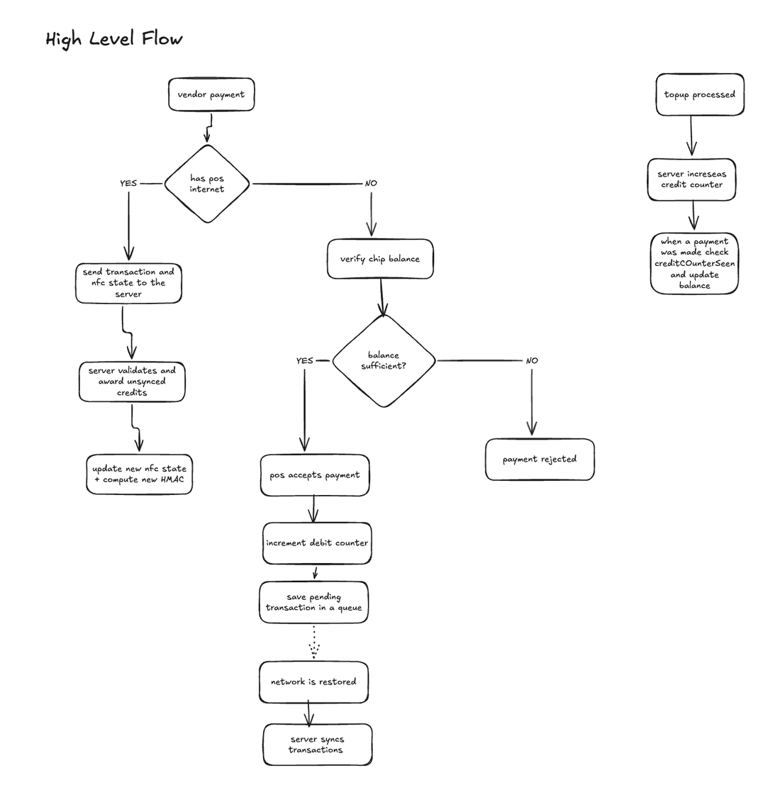



9 · THE LEDGER
One tap, two paths: the decision flow
Reading the flow
POS has internet?
Yes → send the tap + chip state to the server, which validates and awards any unseen credits, then writes back new chip state + a fresh HMAC.
No internet?
Verify the chip's own balance locally. Enough? Accept, bump the debit counter, queue the signed debit.
Network restored
The queue drains; the server reconciles the offline debits idempotently.
Top-up (always online)
Server raises balance + credit counter; the chip picks it up on its next tap.
Hybrid On-Chip Reconciliation for Closed-Loop Festival Payments
Tudor Esan · 12
Notes:
Walk the flowchart slowly. Has internet -> server path. No internet -> chip path + queue. Restore -> reconcile. Top-up always online.

Slide 13
10 · WORKED EXAMPLE
Two offline terminals, one real chip
Start state — both sides agree
chip ( balance 50, debit 0, credit_seen 0 ) = server ( balance 50, credit 0, debit_seen 0 )
1
Terminal A taps first
2
Terminal B taps next
3
No bad window exists
User spends 30. A writes ( 20, 1, 0 ) to the chip before terminal B ever sees it.
B reads ( 20, 1, 0 ) — not the stale 50. It can only authorize against the remaining 20.
There is never an instant where both terminals read balance = 50. The single physical chip prevents the joint over-spend — no server involved.
( 20, 1, 0 )
reads 20
safe
This is the double-spend case — and it resolves itself.
Hybrid On-Chip Reconciliation for Closed-Loop Festival Payments
Tudor Esan · 13
Notes:
Worked example 1 — the scary case. Two offline terminals. It resolves itself because there's one physical chip. No server needed.

Slide 14
10 · WORKED EXAMPLE
The normal path: an offline spend, a top-up, an online spend
1
Offline spend of 10
chip → ( 40, 1, 0 ); terminal queues a debit of 10 at counter 1
chip 40
2
Top-up of 20 (online)
server → ( 70, 1, 0 ); credit counter advances to 1
server 70
3
Online spend of 5
terminal reads ( 40,1,0 ); server sees chip is ahead + a credit unseen → spendable = 40 + 20 = 60, capped at 70. After −5: balance 55. Chip ← ( 55, 2, 1 )
balance 55
4
Offline debit syncs later
server already absorbed that spend → it does NOT subtract 10 again. Kept as a history row for settlement. Balance stays 55.
no double-count
Both sides converge — without blocking the online purchase on another device's sync timing.
Hybrid On-Chip Reconciliation for Closed-Loop Festival Payments
Tudor Esan · 14
Notes:
Worked example 2 — the everyday mix. Key beat is step 4: the late offline debit is NOT subtracted twice. Convergence without blocking.

Slide 15
11 · THE SYSTEM
Four moving parts
Cloud backend
Admin portal
Mobile app
NFC wristband
Endow API
“Endow”
SoftPOS
the wallet
NestJS service: wallets, vendors, events, top-ups, reconciliation. Single multi-tenant deployment.
React web dashboard for organizers — run the whole event from a browser.
One React Native binary that switches role: attendee, event-staff, or vendor POS.
Plain NTAG chip carrying a signed 28-byte balance record + counters.
Hybrid On-Chip Reconciliation for Closed-Loop Festival Payments
Tudor Esan · 15
Notes:
Quick component map before the screenshots. Name the products: Endow (backend+admin), SoftPOS (mobile), the wristband.

Slide 16
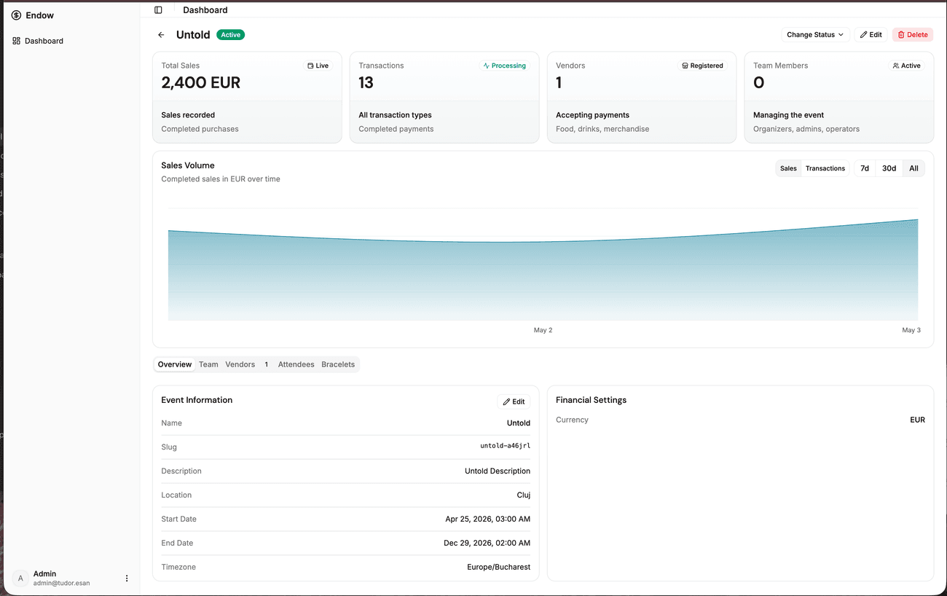



12 · ADMIN PORTAL
What organizers can do from the browser
Event lifecycle
Create events; drive draft → setup → active → settlement → closed. Set the token-to-currency rate.
Vendors
Onboard and approve vendor stands, set commission rates, manage cashiers.
Team & attendees
Add staff with roles; issue ticket invites (QR by email).
Bracelets
Link, revoke and replace wristbands; pull an offline sync bundle.
Live monitoring
Sales volume, transaction counts and settlement totals per event.
Event dashboard — live sales, vendors, attendees and bracelet inventory in one view.
Hybrid On-Chip Reconciliation for Closed-Loop Festival Payments
Tudor Esan · 16
Notes:
Admin portal tour. Point at the screenshot: event lifecycle, vendors+commissions, attendees, bracelets, live sales.

Slide 17
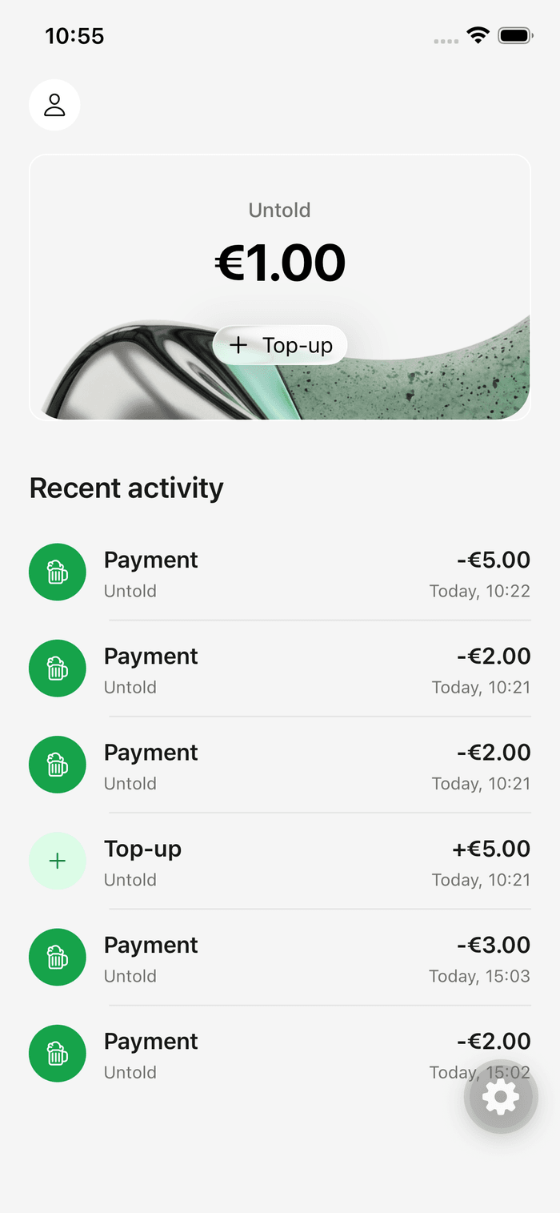
13 · ATTENDEE APP
The wallet in the attendee's pocket
A read-mostly consumer wallet — the attendee never touches the protocol underneath.
See balance & history
Their event balance and every payment / top-up, per wristband.
Top up by card
Stripe Payment Sheet → balance credited to that exact bracelet (online only).
Balance is event-scoped
Lives on the event_bracelet, not a global wallet — leftover credit can't leak across festivals.
Hybrid On-Chip Reconciliation for Closed-Loop Festival Payments
Tudor Esan · 17
Notes:
Attendee app — deliberately simple. Balance, history, card top-up. Stress balance is event-scoped, not a global wallet.

Slide 18
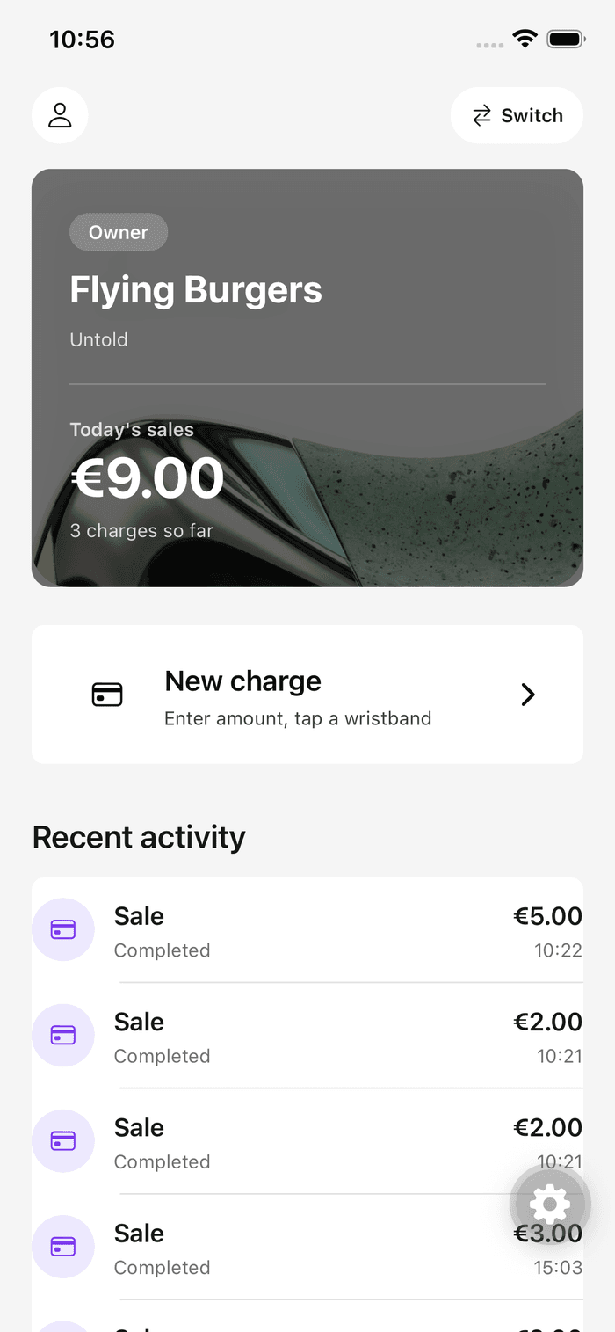

14 · VENDOR POS APP
The point of sale that keeps working offline
Same binary, vendor scope. “Enter amount, tap a wristband.” The charge flow is offline-capable.
Charge a bracelet
Online: server authorizes and returns the new chip state to write back.
Offline: chip is truth
Decrement on-chip, bump the debit counter, append a signed debit to a persistent queue.
Auto-sync on reconnect
NetInfo flushes the queue; debits replay idempotently, sorted by counter.
Bounded risk
Caps of 50 queued debits × €100 — the festival's pre-accepted worst case per dead terminal.
Hybrid On-Chip Reconciliation for Closed-Loop Festival Payments
Tudor Esan · 18
Notes:
Vendor POS — the interesting one. Online authorizes server-side; offline the chip is truth + signed queue + auto-sync. Mention the 50 x EUR100 risk cap.

Slide 19
15 · ENGINEERING
One TypeScript codebase, end to end
Backend
Mobile (SoftPOS)
Admin portal
NestJS 11 + Drizzle ORM
PostgreSQL (serverless Neon)
Better Auth — email OTP, bearer
Stripe SDK + signed webhooks
DigitalOcean App Platform
React Native + Expo
react-native-nfc-manager (NTAG)
@noble/hashes — HKDF + HMAC
expo-file-system offline queue
TanStack Query + Axios
React 19 + Vite + TypeScript
shadcn/ui on Radix + Tailwind
TanStack Query, React Hook Form
Recharts, Better Auth
Vitest + Testing Library + MSW
Shared types across chip ↔ terminal ↔ server catch mismatches at build time. Verified by end-to-end reconciliation tests on real Postgres (Testcontainers).
Hybrid On-Chip Reconciliation for Closed-Loop Festival Payments
Tudor Esan · 19
Notes:
Tech stack. One TS codebase end to end; shared types catch bugs at build. Verified by e2e reconciliation tests on real Postgres.

Slide 20
15 · DATA MODEL
The tables that carry the money
event_bracelets
transactions
payment_intents
balance the wallet, cents (≥ 0)
type debit | credit
providerIntentId Stripe id, unique
debit_counter_seen chip debits applied
amount always positive, cents
eventBraceletId credit this bracelet
credit_counter server-owned, top-ups
debit_counter set on debit rows
amount / status top-up tracking
wristbandUid physical NFC chip id
credit_counter set on credit rows
transactionId → ledger row on ok
status active / revoked / repl.
idempotencyKey unique — stops replays
TOP-UPS — real money in
offline queued vs live
THE WALLET — balance is event-scoped
THE LEDGER — append-only journal
How it ties together
events → event_bracelets → transactions. Everything is reachable from the event row — multi-tenancy without a tenant column on every table. Guards: balance ≥ 0 CHECK · partial-unique indexes (one active bracelet per UID & per user) · unique Stripe intent id.
Hybrid On-Chip Reconciliation for Closed-Loop Festival Payments
Tudor Esan · 20
Notes:
Three tables that carry the money. event_bracelets = wallet; transactions = append-only ledger; payment_intents = real money in. Relations + DB guards at the bottom.

Slide 21
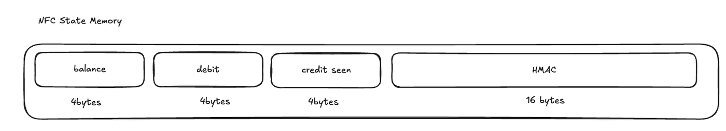


16 · SECURITY
NFC trust: what plain NTAG gives — and what DESFire would
On-chip layout — 28 bytes in NTAG user memory
HMAC-SHA256 key = HKDF(master, salt = chip UID). Anyone can read; only the key holder can forge an accepted record.
What I shipped: plain NTAG
The upgrade: MIFARE DESFire
Cheap, no secure element. The HMAC gives integrity — a fabricated balance fails verification on the next read.
But the chip holds no secret, so it can't prove it's the original. A full clone carries a valid signed state.
EV2/EV3 has a secure element with AES-128 mutual authentication and diversified keys.
The chip proves possession of a secret during the tap — so only trusted devices that pass the handshake can read or write it. Cloning stops being viable.
The reconciliation model doesn't change — only the terminal's read/write path adds the handshake.
Hybrid On-Chip Reconciliation for Closed-Loop Festival Payments
Tudor Esan · 21
Notes:
Security 1. Be upfront: I used plain NTAG. HMAC gives integrity, not anti-cloning. DESFire would add mutual auth so only trusted devices read/write. Model unchanged.

Slide 22


16 · SECURITY
Honest limitations — and where they go next
Master key in the app bundle
Plain NTAG cloning
Expo inlines EXPO_PUBLIC_* into the JS. Pull the APK and you can derive every bracelet key. This is the load-bearing weakness.
A clone is usable during one offline window before counters disagree. Bounded by the copied balance, not zero.
→ Per-event keys via a short-lived channel; ultimately a DESFire secure element.
→ DESFire mutual auth removes cloning entirely.
No platform attestation
No festival-scale numbers
A vendor phone rooted after whitelisting exposes both the token and the key.
Evaluation is qualitative — no tap latency, throughput or load test yet.
→ Device attestation + fast revoke of lost terminals.
→ Measurement at scale is the headline future work.
Hybrid On-Chip Reconciliation for Closed-Loop Festival Payments
Tudor Esan · 22
Notes:
Security 2 — the honest slide examiners reward. Lead with master-key-in-bundle. Each limitation has a concrete next step. Admit: no scale measurements yet.

Slide 23

LIVE DEMO
Let's see it tap
1 Top up a wristband in the app 2 Charge it at a vendor stand 3 Go offline, tap again, watch it sync
Hybrid On-Chip Reconciliation for Closed-Loop Festival Payments
Tudor Esan · 23
Notes:
DEMO (~4-5 min). Top up -> charge -> go offline -> tap -> reconnect -> watch sync. Have the wristband and two phones ready.

Slide 24
IN ONE LINE
When the network is mostly there, treating offline as a bounded fallback — not the foundation — is simpler to build and easier to operate, as long as the chip carries enough state to keep the rare offline path safe.
Thank you — questions welcome.
Tudor Esan
MSc Advanced Information Systems · Supervisor: Assoc. Prof. Christian Sacărea, PhD
Notes:
Close on the one-line thesis. Invite questions.

