Slide 1
Ticket Shop Application
Author: Giuroiu Tudor

Slide 2
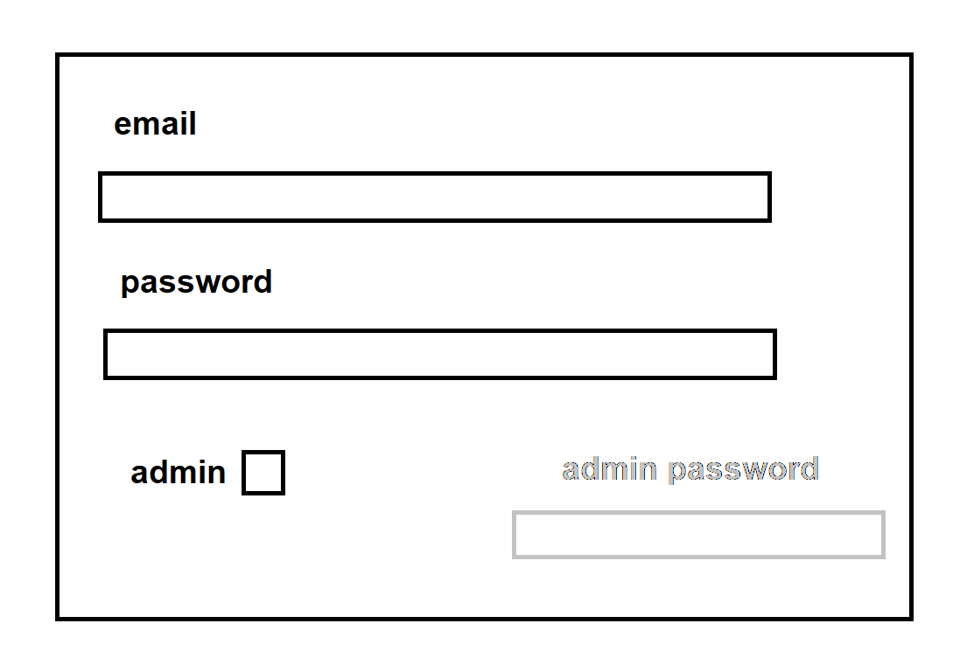
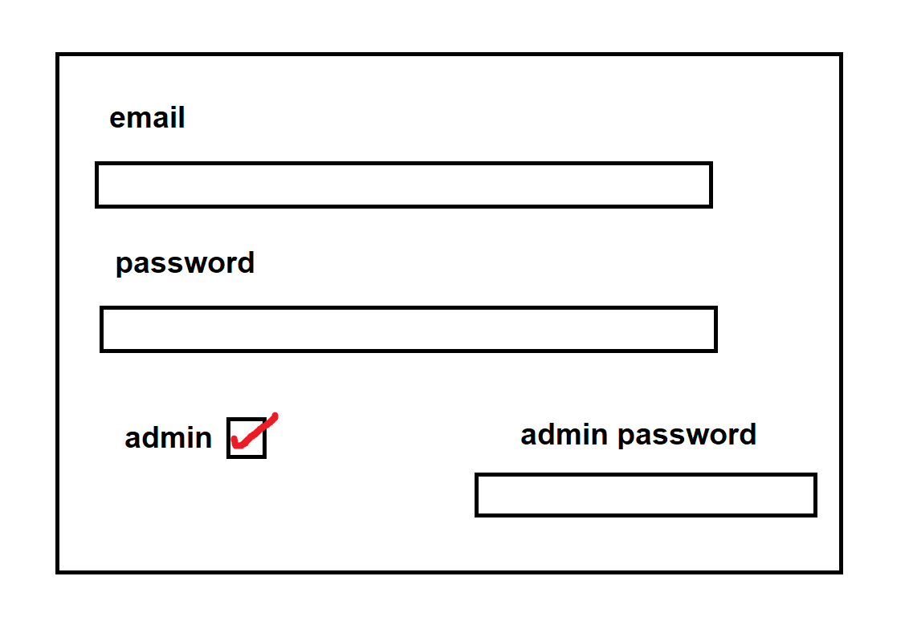
Login Screen

Slide 3
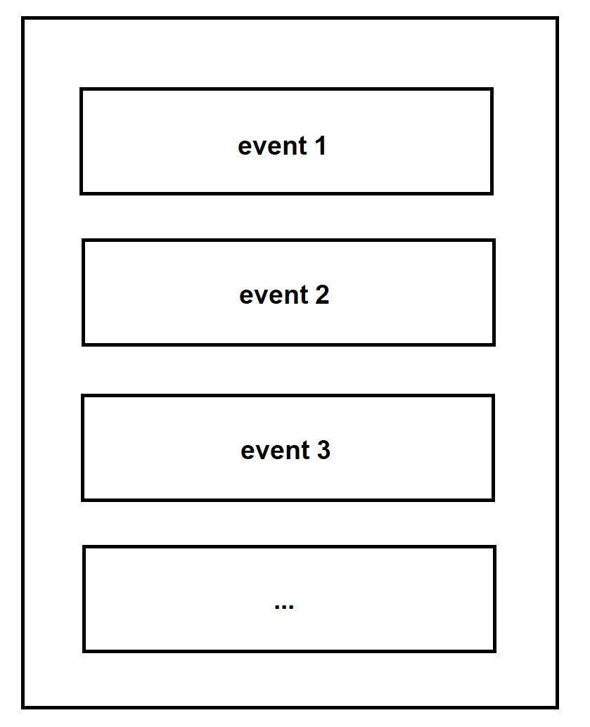
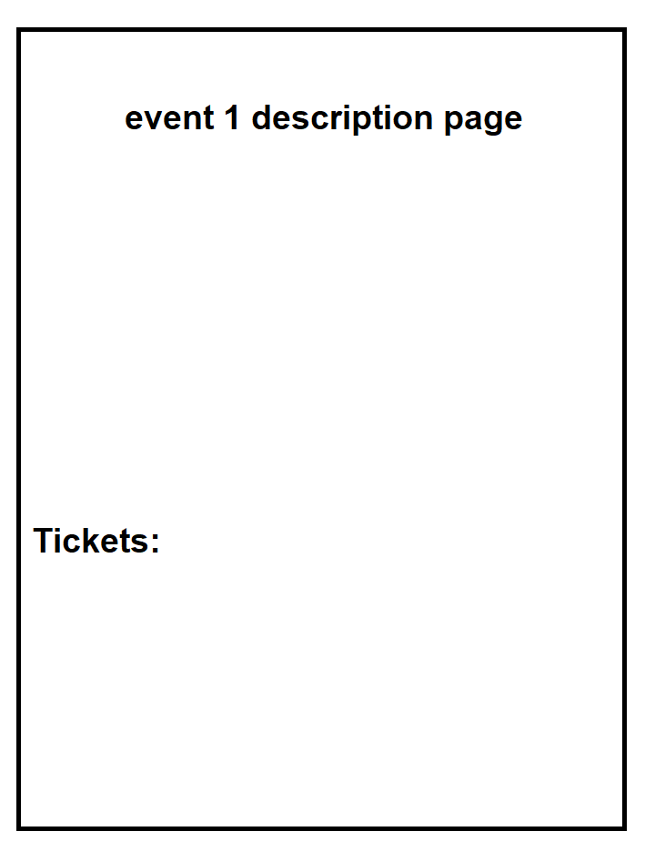
Events Tab
Clickable

Slide 4
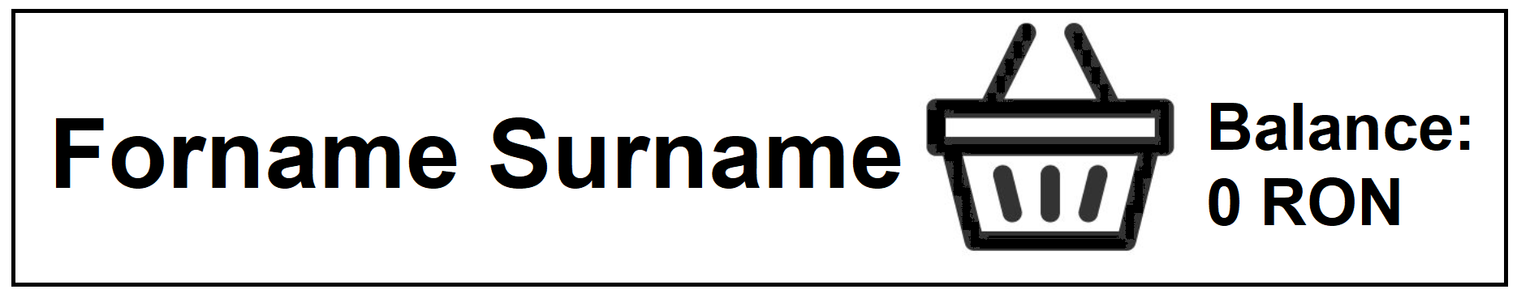
Customer Account
Customer name
Basket with Tickets
Added money

Slide 5
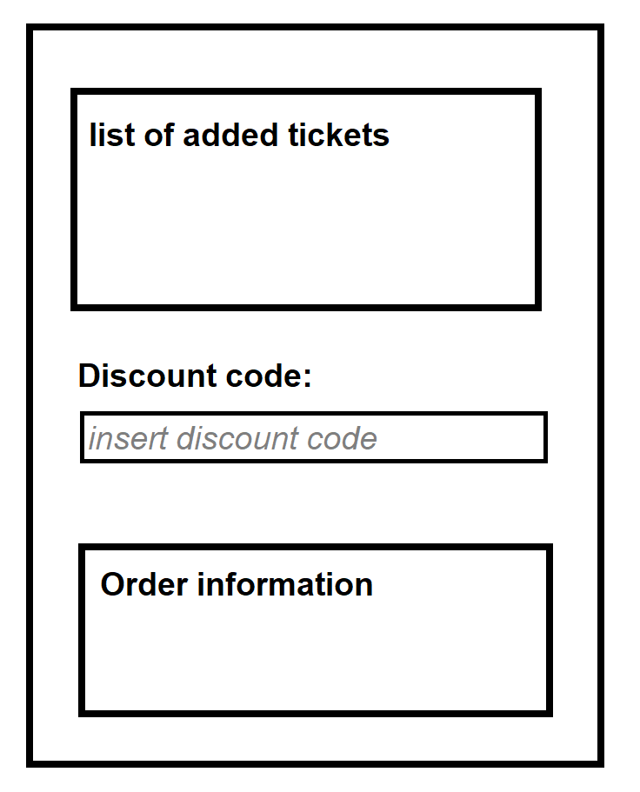
Purchase Page
The user can enter discount codes which, if there are any tickets with available discounts, will reduce the total price of the order.
Payment

Slide 6
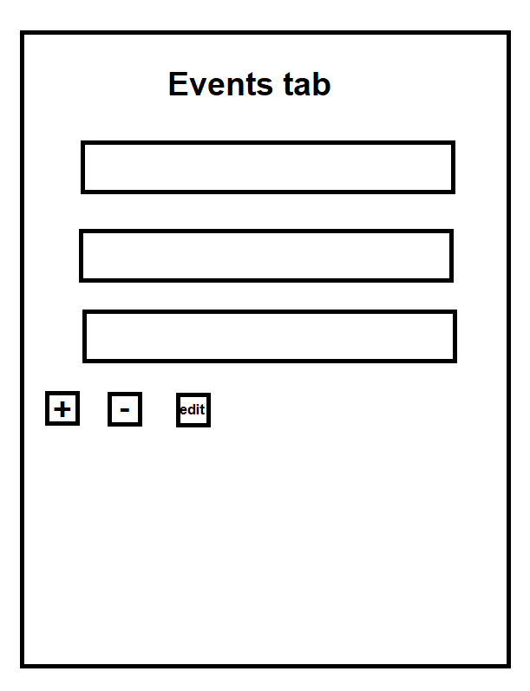
Administrator Privileges
Admins are allowed to perform CRUD operations on the events.
Also they cand modify ticket prices and details, event information and discount codes.

Slide 7
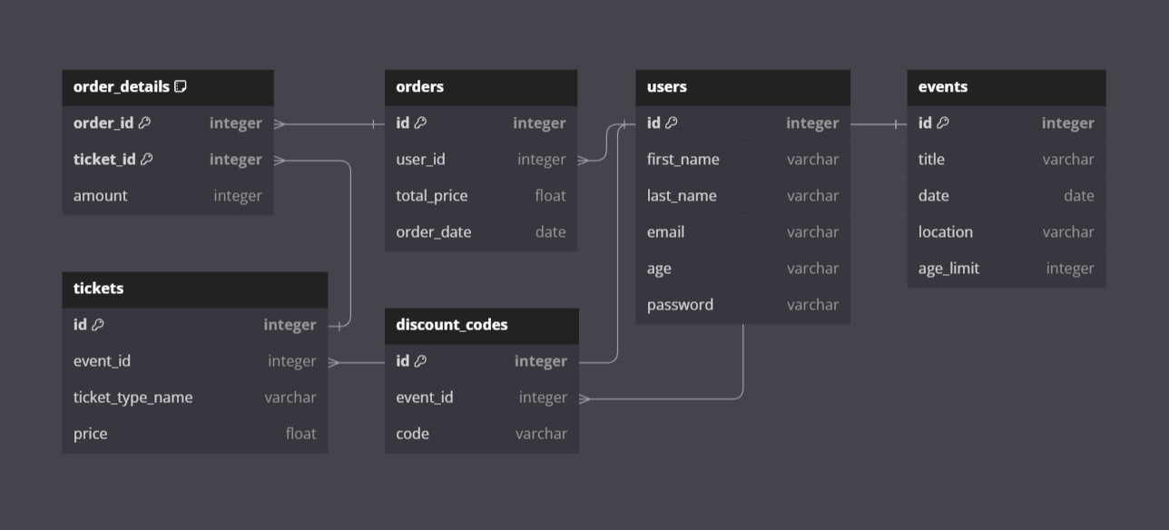
Database

