Slide 1
The Evolution of Automated
Fake News Detection
From TF-IDF Baselines to Bidirectional LSTMs and BERT
Author: Tudor [Surname]
Coordinator: Lect. Dr. Alina-Delia Călin
Master's Programme — High Performance Computing and Big Data Analytics
2026

Slide 2
Why Does This Matter?
The fake news problem at scale
The Problem
Our Approach
▸ Misinformation spreads 6× faster than true news on social media
▸ Systematically compare three generations of NLP methods
▸ 2016 US election: fake stories outpaced real news in Facebook engagement
▸ Shared benchmark: ISOT Fake News Dataset (~45 000 articles)
▸ Public health crises amplified by vaccine and pandemic misinformation
▸ Fair evaluation under identical preprocessing conditions
▸ Manual fact-checking cannot scale to millions of posts per day
▸ Document the accuracy vs. complexity trade-off
▸ Automated detection is no longer optional — it is essential
Classical ML → Deep RNN / LSTM → BERT

Slide 3
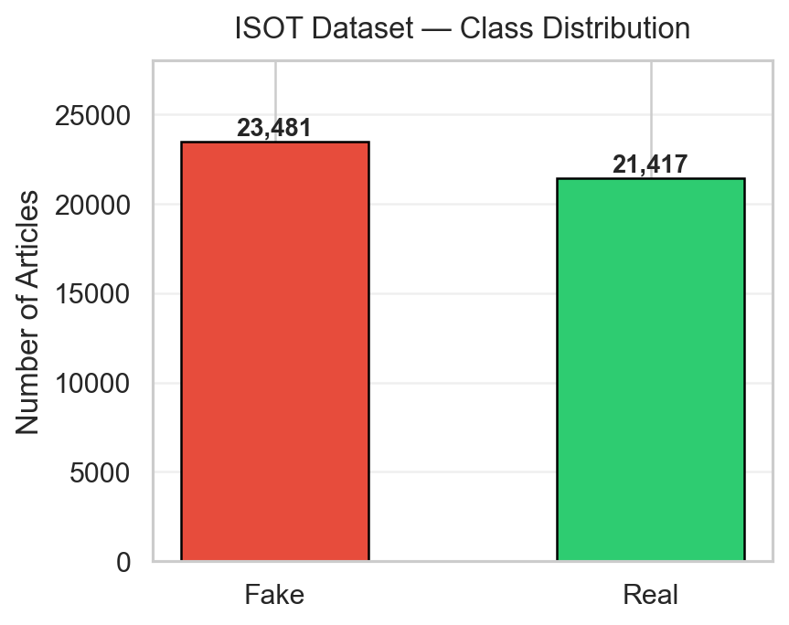
Dataset: ISOT Fake News Corpus
University of Victoria — publicly available on Kaggle
Dataset at a Glance
▸ 44 898 labelled news articles
▸ 21 417 real articles (Reuters, 2015–2018)
▸ 23 481 fake articles (Politifact-flagged sources)
▸ Fields: title, text, subject, date
▸ Near-balanced classes → no imbalance bias
Preprocessing Pipeline
▸ Lowercase → Remove URLs
▸ Strip non-alphabetic characters → Collapse whitespace
▸ NLTK stopword removal (classical ML only)
▸ Vocabulary capped at 15 000 tokens (deep models)
▸ Sequences truncated / padded to 150 tokens

Slide 4
Three Generations of Detection Methods
Generation 1 Classical ML
Generation 2 Deep Recurrent
Generation 3 BERT Transformer
▸ TF-IDF bag-of-words features
▸ Learned word embeddings
▸ Pre-trained on 3.3B words
▸ Naive Bayes
▸ Vanilla RNN (vanishing ∇)
▸ Self-attention (full context)
▸ Logistic Regression
▸ Bidirectional LSTM (gates)
▸ WordPiece tokenisation
▸ Random Forest (100 trees)
▸ 500-sample quick-mode run
▸ 110M parameters fine-tuned
▸ Full 36k training set
▸ PyTorch from scratch
▸ Test Accuracy: 99.87% ✓
All models evaluated on the same 4 489-sample stratified test set

Slide 5
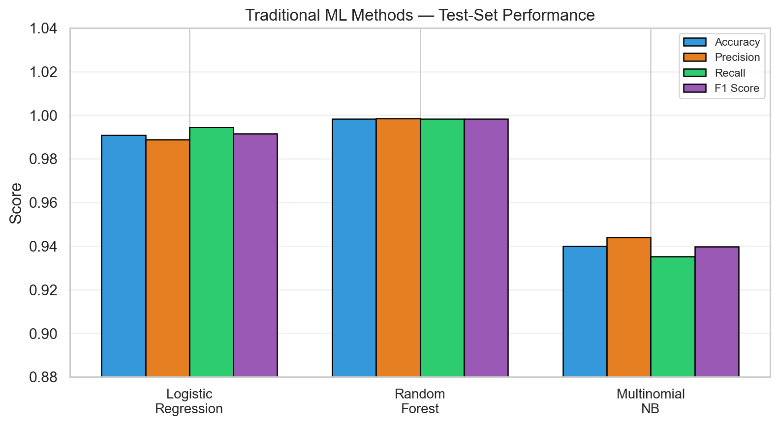
Classical ML Results
TF-IDF + Sklearn, 8 980-sample test set
Key Numbers
Naive Bayes Acc.
Log. Regression
94.0 %
99.1 %
Random Forest
RF mis-classified
99.8 %
15 / 8 980
Takeaway
Strong stylistic signals in the ISOT corpus let even a bag-of-words model exceed 94 %. Random Forest is near-perfect at 99.8 % — but has zero understanding of language semantics.

Slide 6
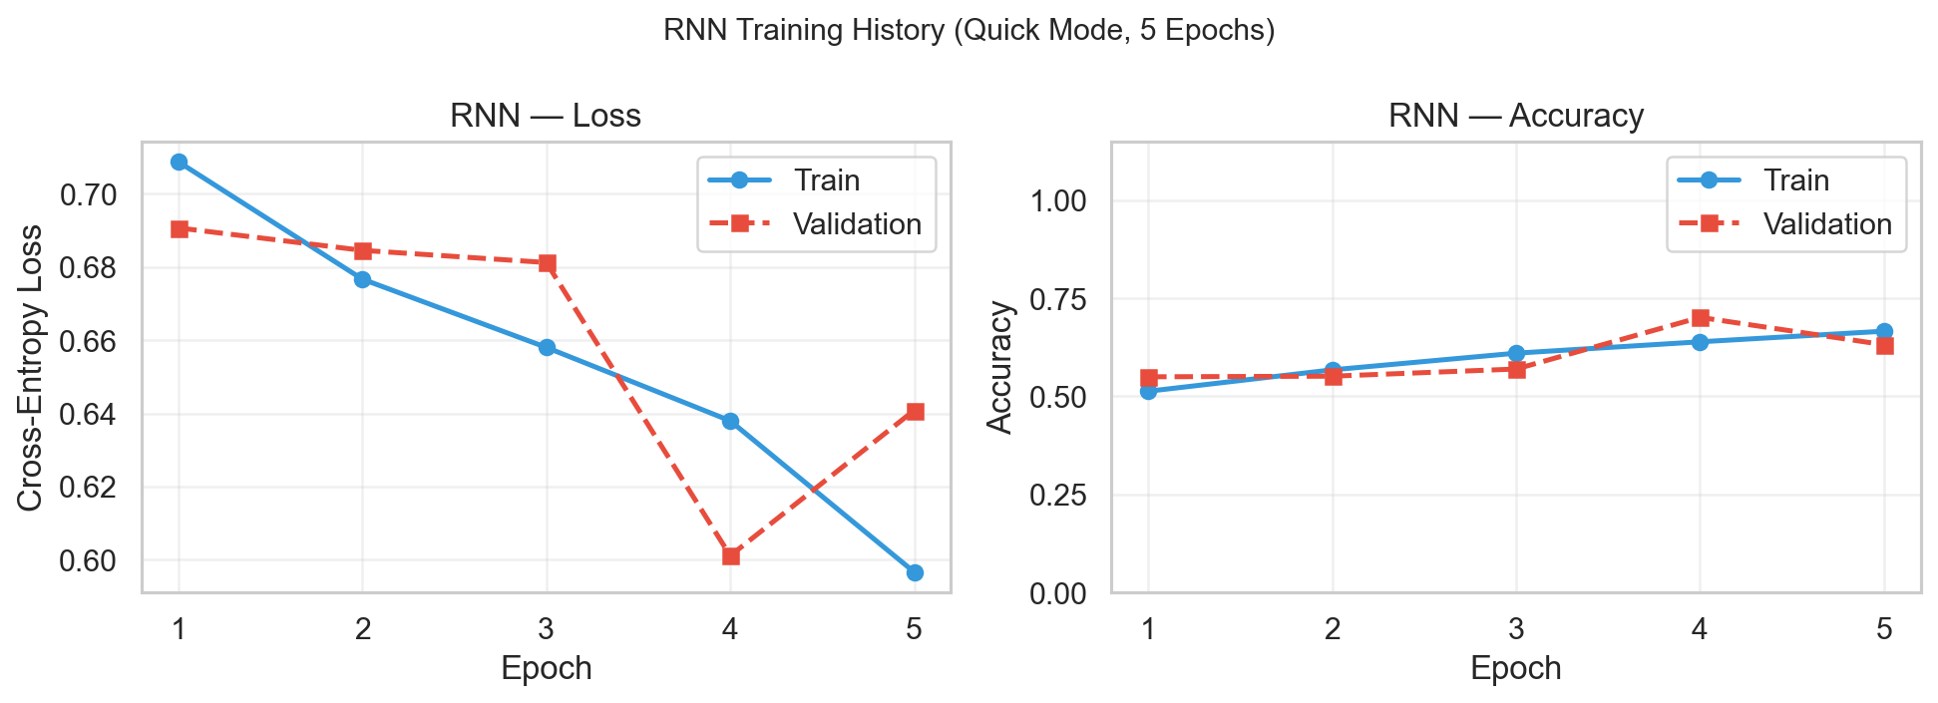
Vanilla RNN — Architecture & Results
2 000 training samples · 5 epochs · CPU quick mode
How it works
Test Results
hₜ = tanh( Wₕₕ · hₜ₋₁ + Wₓₕ · xₜ + b )
Accuracy
70.3 %
▸ Processes tokens one at a time, left → right
▸ Hidden state carries memory of the whole prefix
F1 Macro
▸ Vanishing gradients → forgets early tokens
0.702
▸ Pipeline: Embedding → RNN → Dropout → Linear
Low accuracy expected: • Only 2 000 training samples • Vanishing gradients on ~150-token sequences • Fluctuating loss curve confirms instability

Slide 7
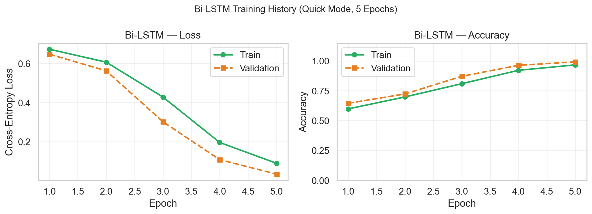
Bidirectional LSTM — Architecture & Results
2 000 training samples · 5 epochs · CPU quick mode
LSTM Gates (solving vanishing gradients)
Test Results
Forget
fₜ = σ(Wf · [hₜ₋₁, xₜ])
What to erase from memory
Accuracy
99.04 %
Input
iₜ = σ(Wᵢ · [hₜ₋₁, xₜ])
What new info to write
Output
oₜ = σ(Wₒ · [hₜ₋₁, xₜ])
What to expose as hₜ
F1 Macro
0.9904
Bidirectional: h = [ forward_hT ; backward_h₁ ] → full context
Misclassified
43 / 4 489
Trained on just 2 000 samples — same accuracy as Random Forest (36k samples). Gate mechanism eliminates vanishing gradients; steady convergence over 5 epochs.

Slide 8
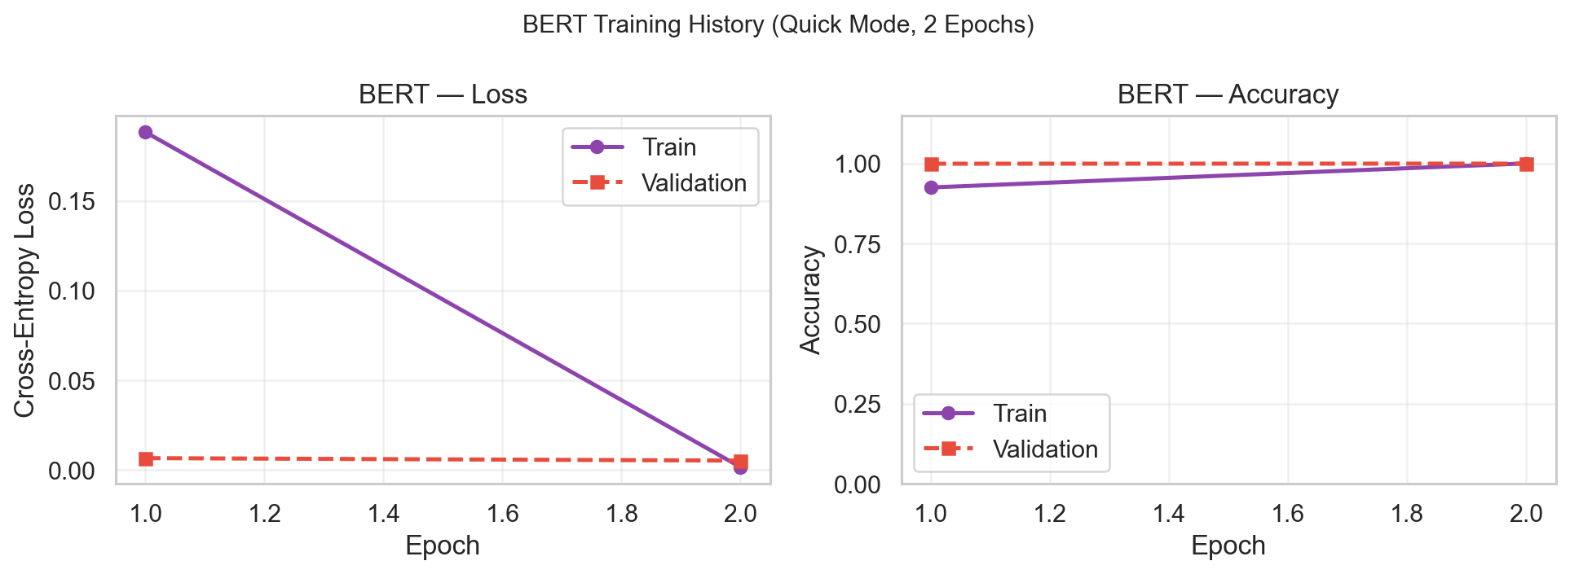
BERT — Transformer Fine-tuning
bert-base-uncased · 2 000 training samples · 2 epochs
Architecture
Test Results
▸ 12 Transformer layers, 768 hidden dims, 12 attention heads
Accuracy
F1 Macro
99.87 %
0.9987
▸ Pre-trained on BookCorpus + Wikipedia (3.3B words)
▸ Self-attention: every token attends to every other
Misclassified
Epochs
6 / 4 489
2
▸ Fine-tuned end-to-end with AdamW (lr = 2×10⁻⁵)
After just 1 epoch: val acc = 99.91% After 2 epochs: train loss → 0.0017 BERT's pre-trained representations need minimal fine-tuning — the [CLS] token learns near-perfect linear separation in 2 epochs. Best result across all 6 models.
▸ Classification head on [CLS] token → Linear(768, 2)
▸ Max 128 tokens · WordPiece tokeniser · no OOV words
▸ Linear warm-up + decay over 2 epochs

Slide 9
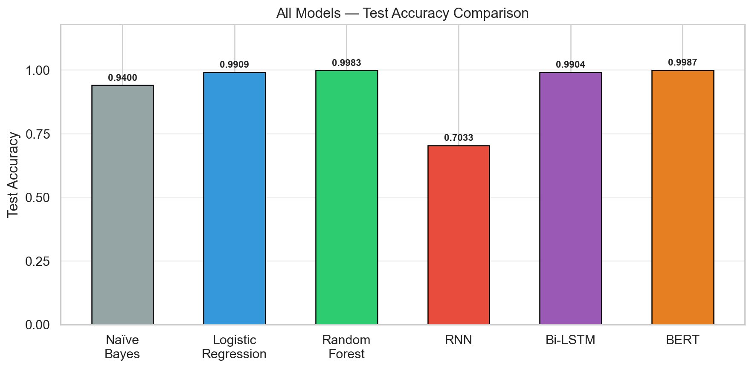
Model Comparison
All results on the ISOT test set
Summary Table
Model
Accuracy
Naive Bayes
94.0 %
Logistic Regression
99.1 %
Random Forest
99.8 %
RNN
70.3 %
Bi-LSTM
99.0 %
BERT
99.87 %

Slide 10
Conclusions & Future Work
Key Findings
Future Work
▸ ISOT corpus has strong stylistic signals — even Naive Bayes hits 94 %
▸ Test on noisier / cross-domain datasets
▸ Random Forest (TF-IDF) achieves 99.8 % — best classical result
▸ Multilingual fake news detection
▸ Vanilla RNN struggles: vanishing gradients on 150-token sequences → 70.3 %
▸ Multimodal models (text + images + metadata)
▸ Bi-LSTM solves this via gates: 99.04 % accuracy from only 2 000 samples
▸ Model explainability (LIME / SHAP / BertViz)
▸ BERT achieves 99.87 % — the best result — in just 2 epochs of fine-tuning
▸ Graph-based propagation modelling
▸ Architecture quality > dataset size when the signal-to-noise ratio is high
▸ Lightweight distillation for real-time deployment

