Slide 1
Aerial Mobile Gateway for
Wireless Sensor Networks utilizing drones
Bachelor Presentation - September 2014
Ioan Deaconu
As.Drd.Ing. Andrei Voinescu
As.Drd.Ing. Dan Dragomir

Slide 2
Introduction
Wireless Sensor Networks
  small devices
  wireless communication
  gather data from environment
  long battery life
Bachelor Presentation - September 2014

Slide 3
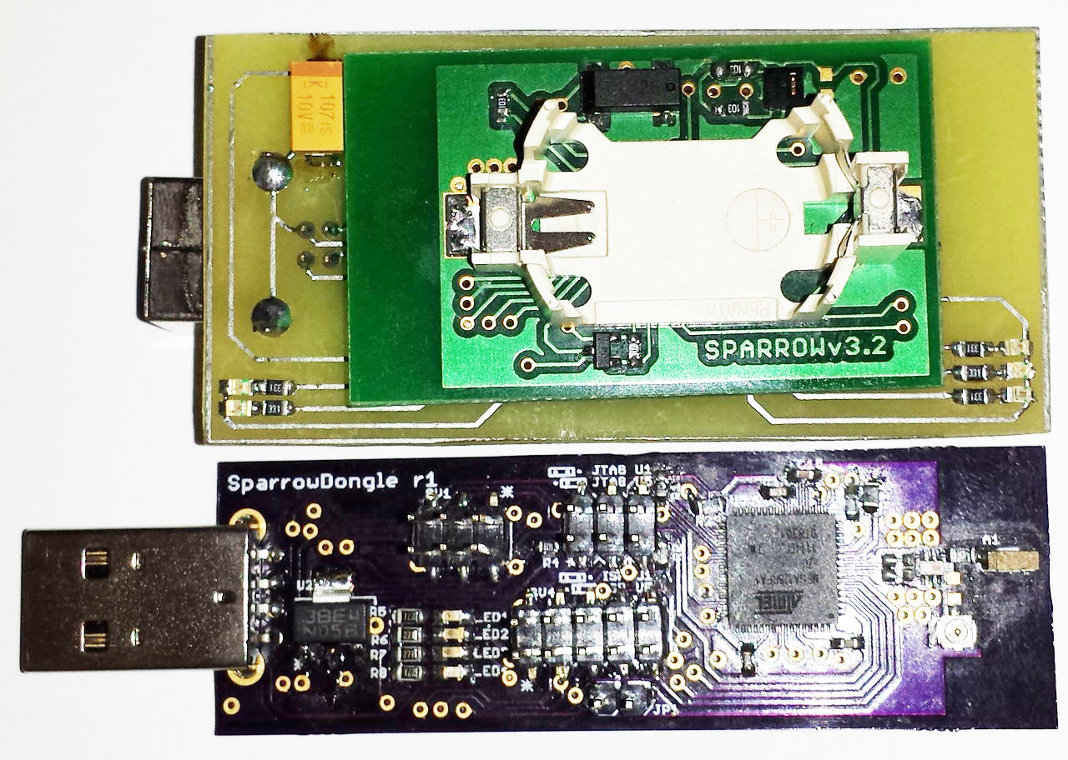
Sparrow Family
Atmel ATmega32U4 for USB communication
Atmel ATmega128RFA1 with 2.4 GHz transceiver
Bachelor Presentation - September 2014

Slide 4
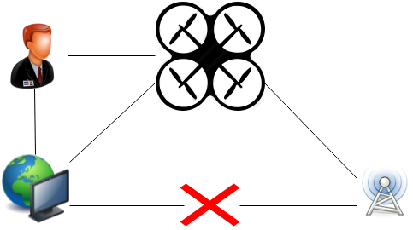
Why?
Location of the network
Rapid deployment
Dynamic environment
Bachelor Presentation - September 2014

Slide 5
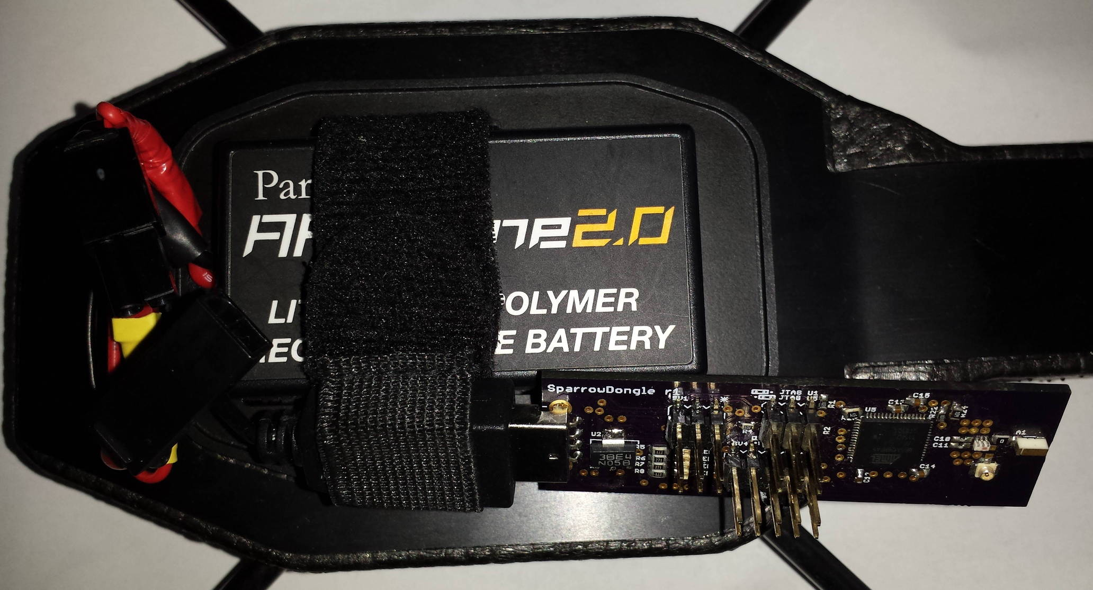
Parrot AR.DRONE 2.0
Linux
USB 2.0
Wi-Fi
1GHz ARM V8
Bachelor Presentation - September 2014

Slide 6
Features
Ease of interaction
Proximity function
Energy Saving
Latest Data always saved
Fault Tolerance
Bachelor Presentation - September 2014

Slide 7
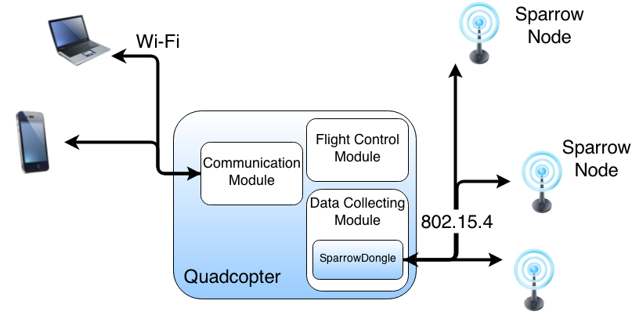
System Architecture
Sparrow Module
Data Collecting Module
Communication Module
Android Application
Bachelor Presentation - September 2014

Slide 8
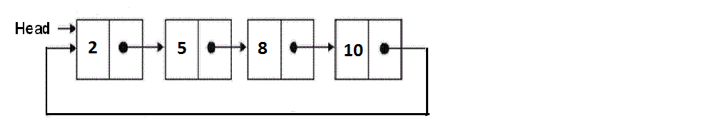
Sparrow Module
Handles node communication
Saves data in a circular list
Replaces the oldest data with new data
Bachelor Presentation - September 2014

Slide 9
Data Collecting Module
Detects the presence of a gateway
Saves the data received from the gateway into files
File name composed of timestamp and node id
Parses the data to obtain node information
Bachelor Presentation - September 2014

Slide 10
Communication Module
Creates JSON object with the nodes information
Sends the object through port 8888
Listens for new connection if current one is lost
Bachelor Presentation - September 2014

Slide 11
Drone Modifications
Added USB CDC ACM kernel module
FTP server on port 4242 for data download
Carved hull
External antenna mounted
Counter weight for stability
Bachelor Presentation - September 2014

Slide 12
AR Drone SDK 2.0.1
Modified Android version of FreeFlight 2.0 from AR Drone SDK 2.0.1
Added option to locally download data on the phone
Modified Piloting zone of the application
Bachelor Presentation - September 2014

Slide 13

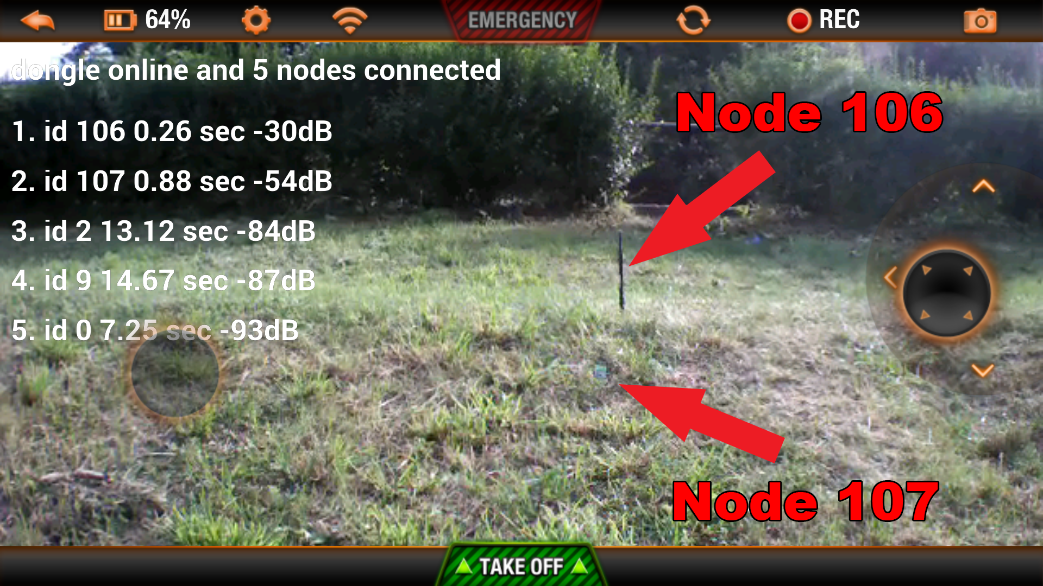
Piloting Zone
Bachelor Presentation - September 2014

Slide 14
Results
All data saved successfully
Communication distance - 300 meters with external 8dBi antenna and clear line of sight
Stability – affected by the modifications
Packet Loss
  small for an external 8dBi antenna
  high for a small -1 dBi SMD antenna
Bachelor Presentation - September 2014

Slide 15
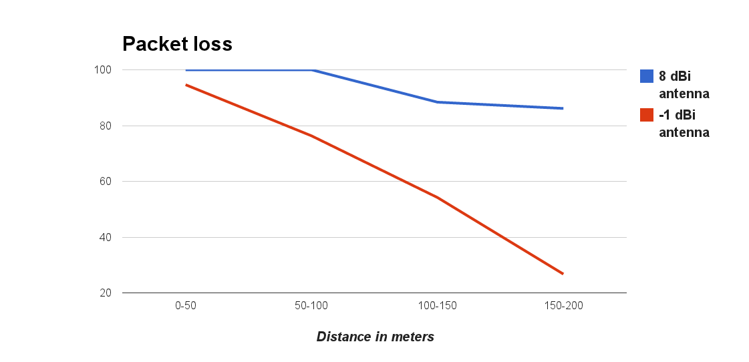
Packet loss
Bachelor Presentation - September 2014

Slide 16
Conclusions
System is functional – drone successfully deployed in gathering data
from remote WSN
Good transmission distance – up to 300 meters
A WSN deployed in a wide area can be serviced with a single drone
This work was accepted and presented at the 13th RoEduNet International Conference in Chișinău, Republic of Moldova
Bachelor Presentation - September 2014

