Slide 1
Aerial Mobile Gateway for
Wireless Sensor Networks utilizing drones
RoEduNet - September 2014
Ioan Deaconu
ioan.deaconu@cti.pub.ro
As. Drd. Ing. Andrei Voinescu

Slide 2
Introduction
Wireless Sensor Networks
  small devices
  wireless communication
  gather data from environment
  long battery life
RoEduNet - September 2014

Slide 3
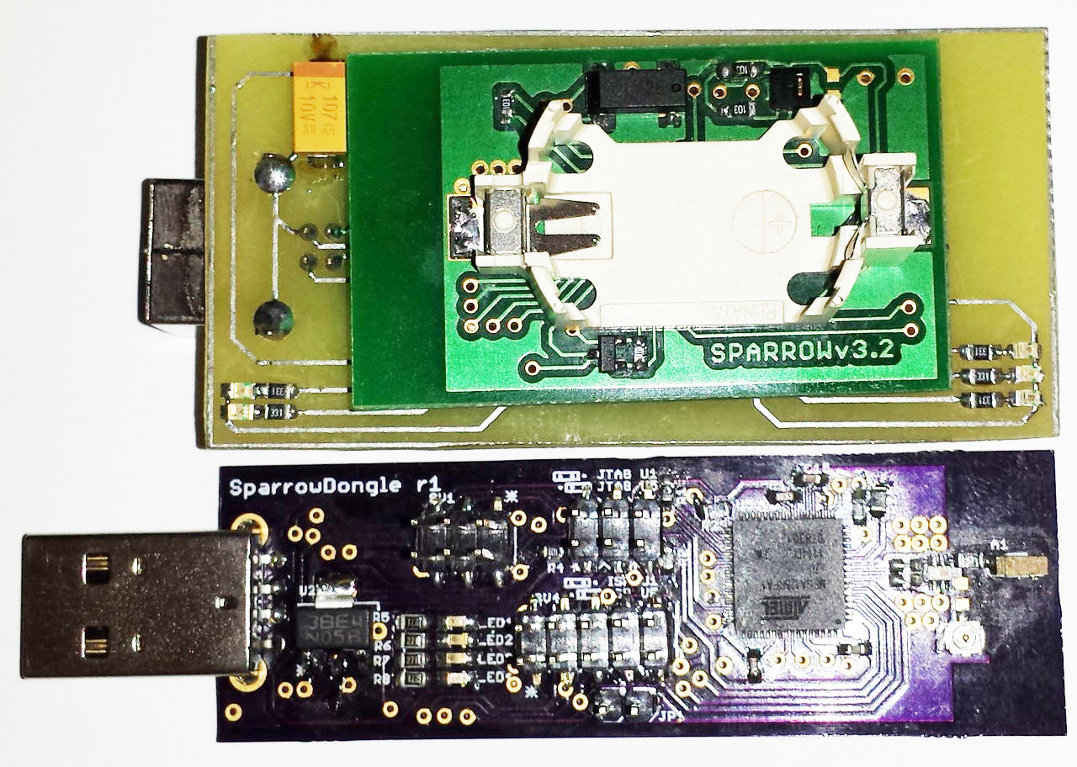
Sparrow Family
Atmel ATMega32U4 for usb communication
Atmel ATMega128RFA1 with 2.4 GHz transceiver
RoEduNet - September 2014

Slide 4
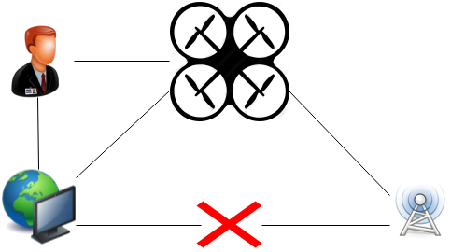
Why?
Location of the network
Rapid deployment
Dynamic environment
RoEduNet - September 2014

Slide 5
Features
Ease of interaction
Proximity function
Energy Saving
Latest Data always saved
Fault Tolerance
RoEduNet - September 2014

Slide 6
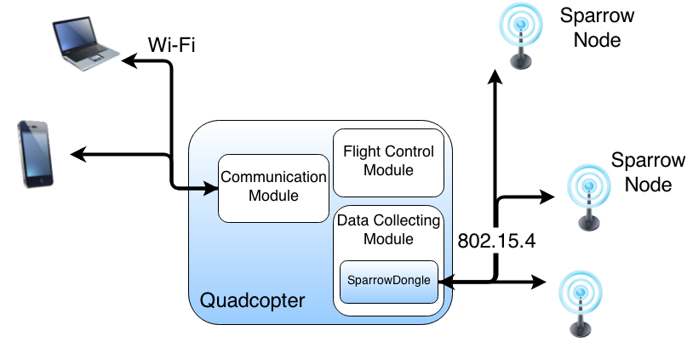
System Architecture
Sparrow Module
Data Collecting Module
Communication Module
Android Application
RoEduNet - September 2014

Slide 7
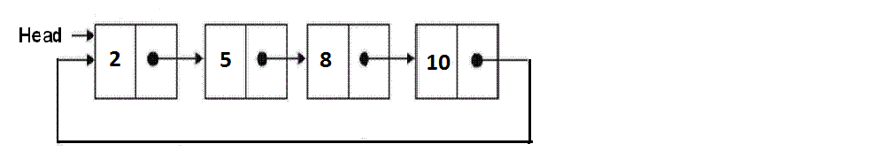
Sparrow Module
Handles node communication
Saves data in a circular list
Replaces the oldest data with new data
RoEduNet - September 2014

Slide 8
Data Collecting Module
Detects the presence of a gateway
Saves the data received from the gateway into files
Parses the data to obtain node information
RoEduNet - September 2014

Slide 9
Communication Module
Creates JSON object with the nodes information
Sends the object through port 8888
Listens for new connection if current one is lost
RoEduNet - September 2014

Slide 10
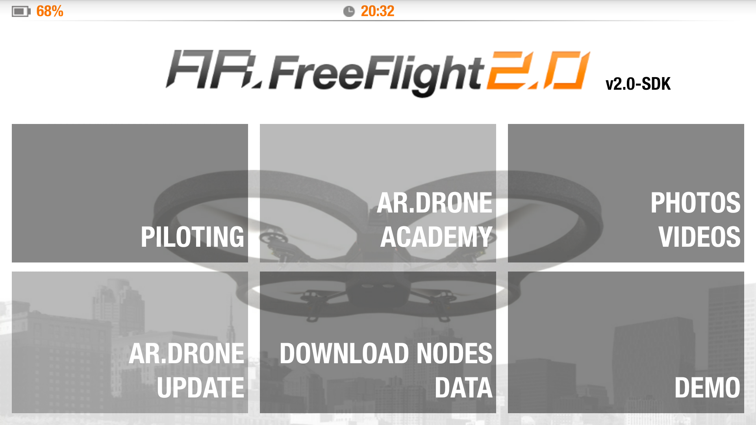
Android Application
Modified FreeFlight 2.0
RoEduNet - September 2014

Slide 11
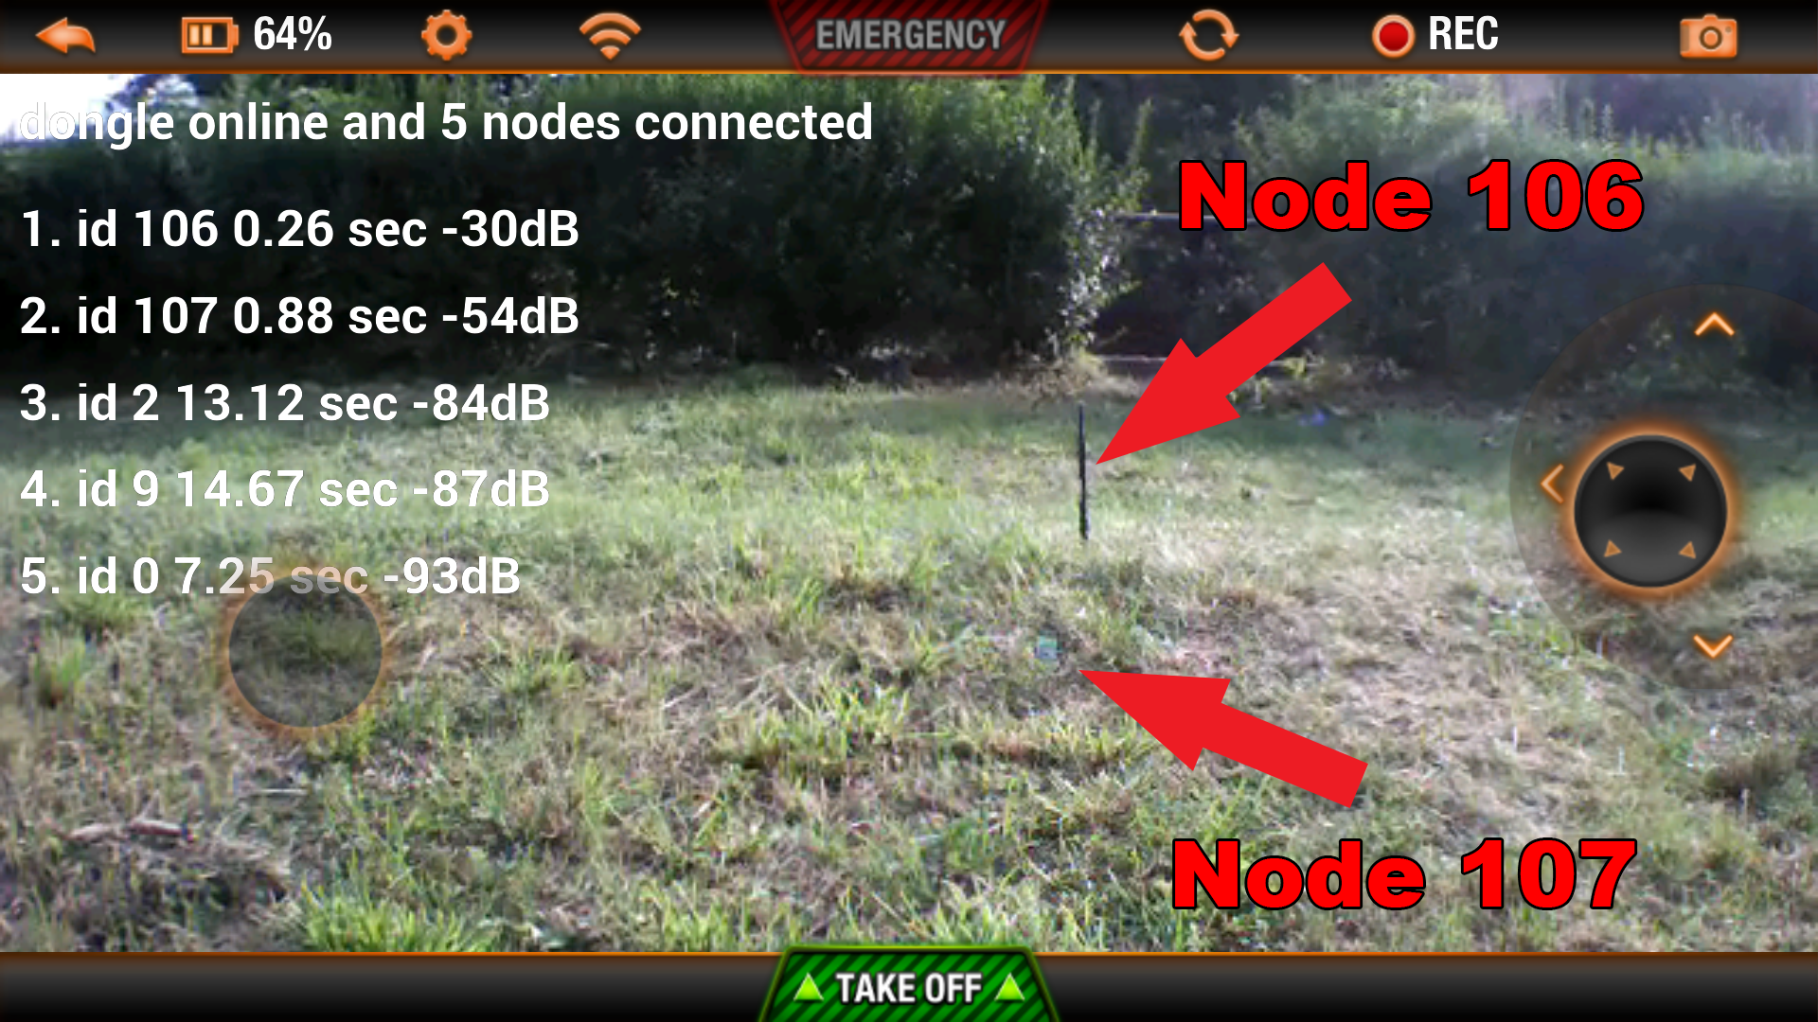
Node Informations
RoEduNet - September 2014

Slide 12
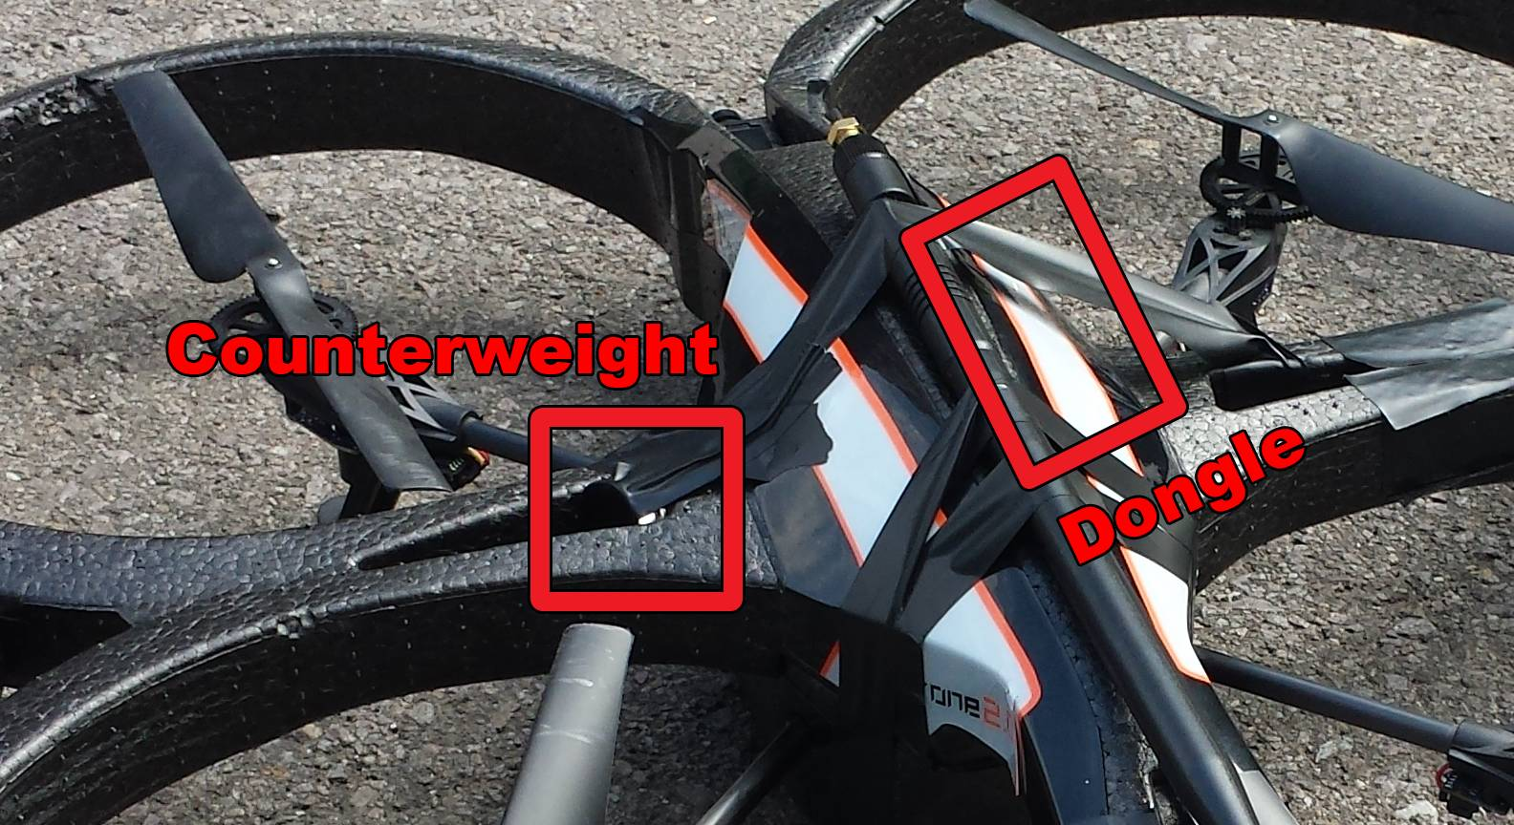
Drone Modifications
RoEduNet - September 2014

Slide 13
Results
All data saved successfully
Communication distance - 300 meters with external 8dBi antenna
Stability – affected by the modifications
Packet Loss
  small for an external 8dBi antenna
  high for a small -1 dBi smd antenna
RoEduNet - September 2014

Slide 14
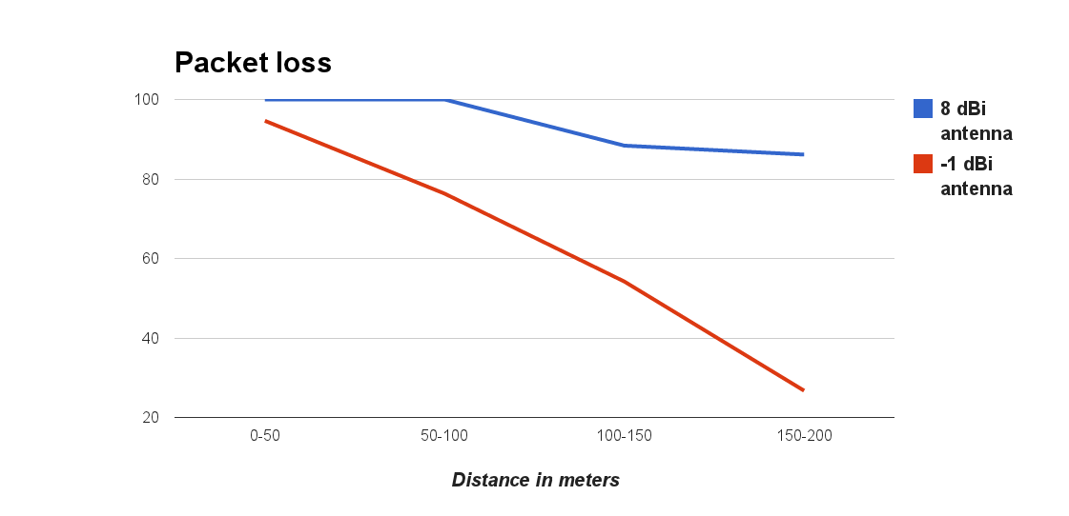
Packet loss
RoEduNet - September 2014

Slide 15
Conclusions
System is functional
Good transmission distance – up to 300 meters
Simple to use
RoEduNet - September 2014

Slide 16
Questions
?
RoEduNet - September 2014

