Slide 1
Aerial Mobile Gateway for
Wireless Sensor Networks utilizing drones
RoEduNet - September 2014
Ioan Deaconu
Andrei Voinescu

Slide 2
Introduction
Wireless Sensor Networks
  small devices
  wireless communication
  gather data from environment
  long battery life
RoEduNet - September 2014

Slide 3
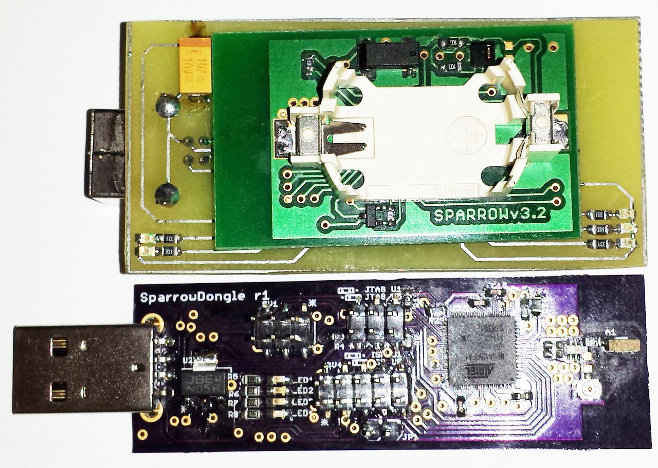
Sparrow Family
Atmel ATmega32U4 for USB communication
Atmel ATmega128RFA1 with 2.4 GHz transceiver
RoEduNet - September 2014

Slide 4
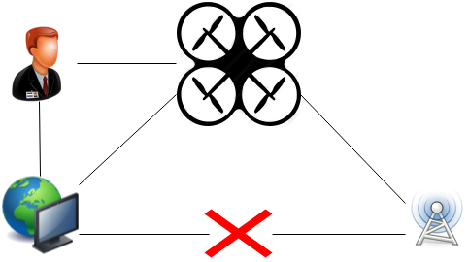
Why?
Location of the network
Rapid deployment
Dynamic environment
RoEduNet - September 2014

Slide 5
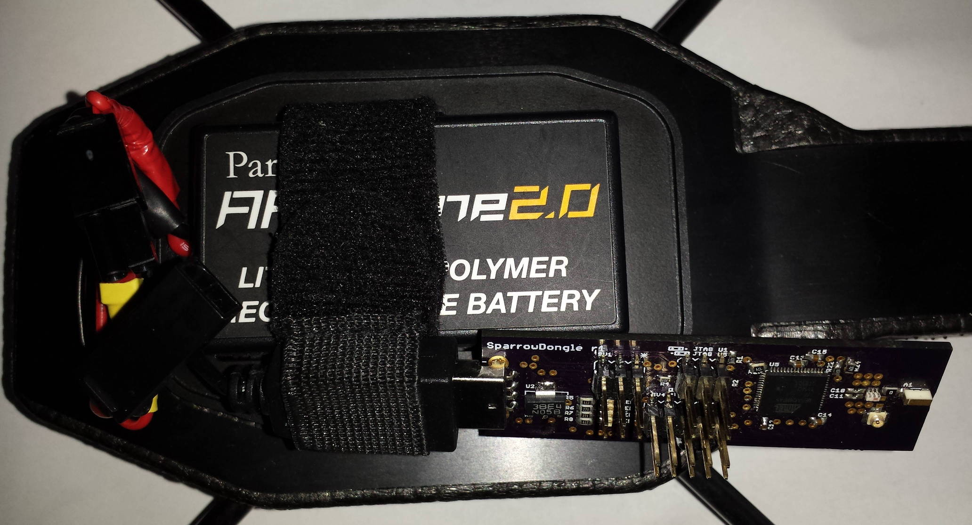
Parrot AR.DRONE 2.0
Linux
USB 2.0
Wi-Fi
1GHz ARM V8
RoEduNet - September 2014

Slide 6
Features
Ease of interaction
Proximity function
Energy Saving
Latest Data always saved
Fault Tolerance
RoEduNet - September 2014

Slide 7
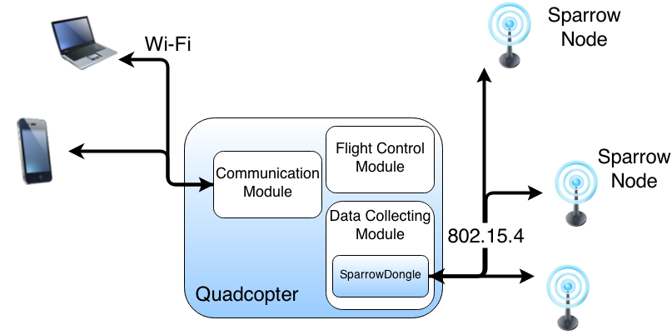
System Architecture
Sparrow Module
Data Collecting Module
Communication Module
Android Application
RoEduNet - September 2014

Slide 8
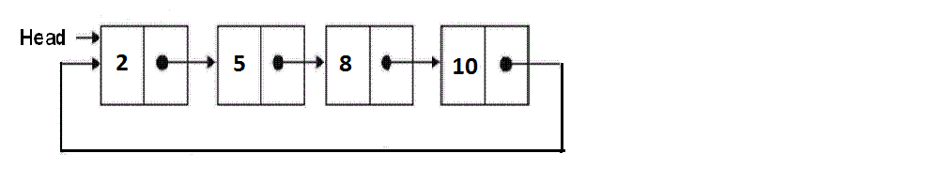
Sparrow Module
Handles node communication
Saves data in a circular list
Replaces the oldest data with new data
RoEduNet - September 2014

Slide 9
Data Collecting Module
Detects the presence of a gateway
Saves the data received from the gateway into files
File name composed of timestamp and node id
Parses the data to obtain node information
RoEduNet - September 2014

Slide 10
Communication Module
Creates JSON object with the nodes information
Sends the object through port 8888
Listens for new connection if current one is lost
RoEduNet - September 2014

Slide 11
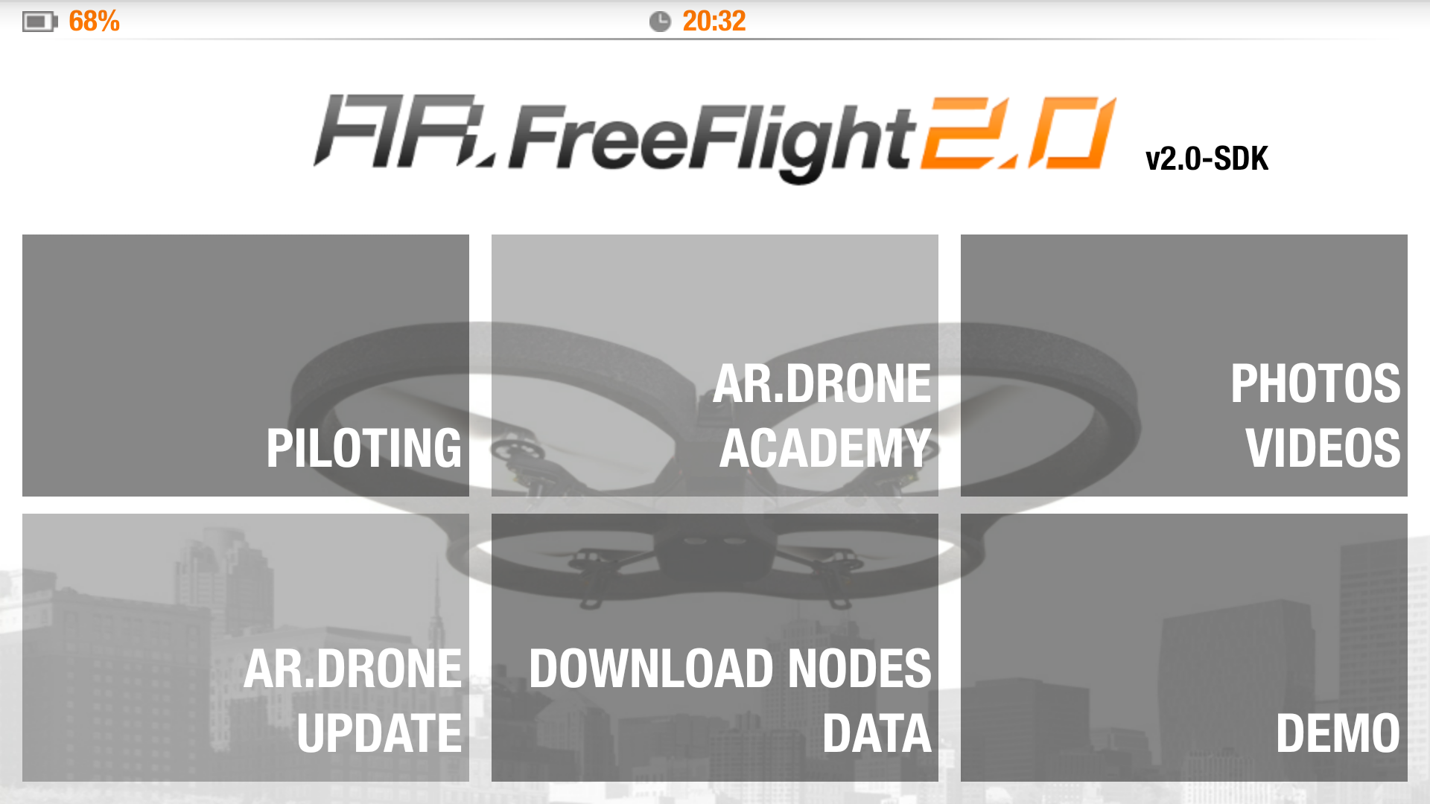
Android Application
Modified FreeFlight 2.0
RoEduNet - September 2014

Slide 12
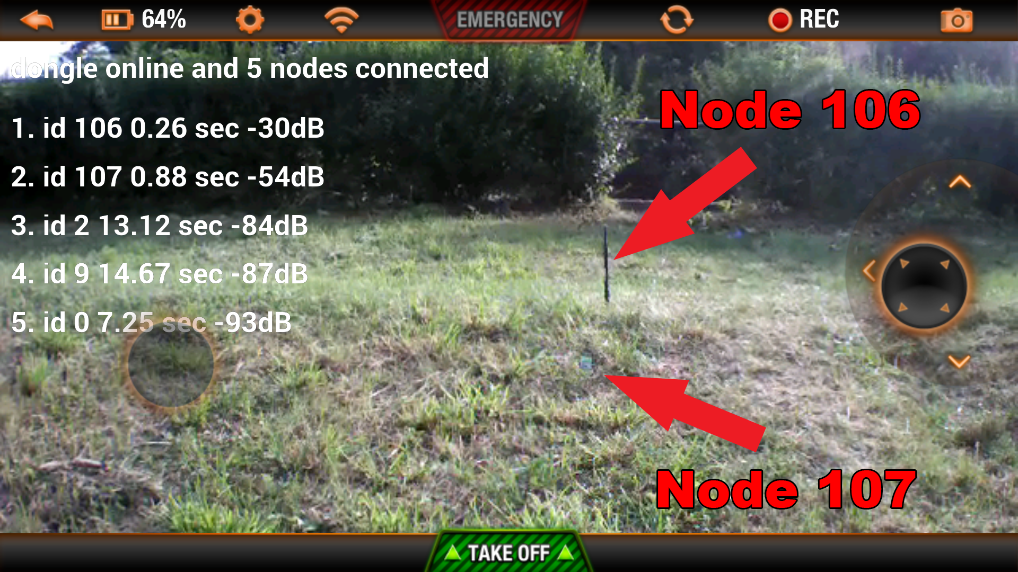
Node Information
RoEduNet - September 2014

Slide 13
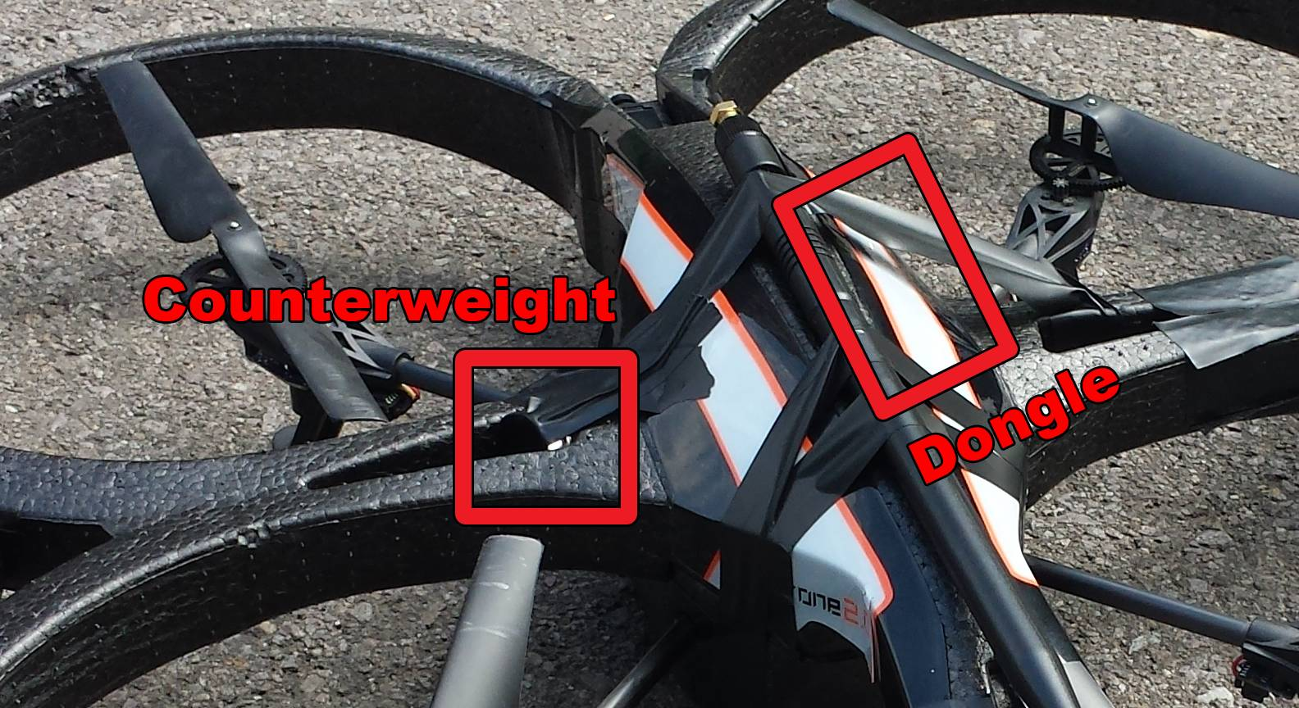
Drone Modifications
RoEduNet - September 2014

Slide 14
Results
All data saved successfully
Communication distance - 300 meters with external 8dBi antenna
Stability – affected by the modifications
Packet Loss
  small for an external 8dBi antenna
  high for a small -1 dBi SMDantenna
RoEduNet - September 2014

Slide 15
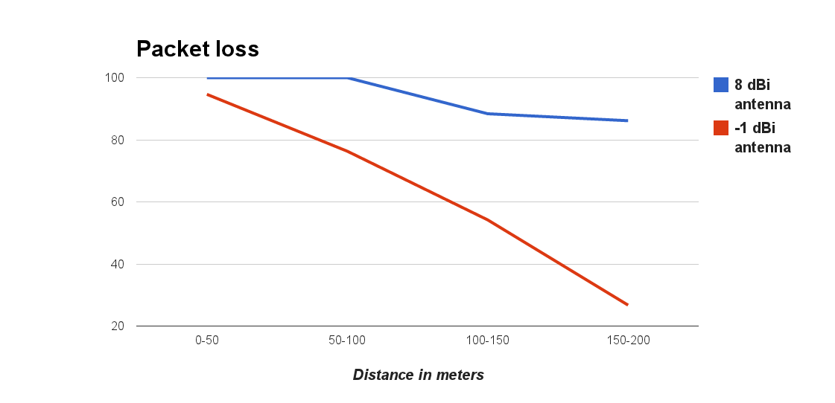
Packet loss
RoEduNet - September 2014

Slide 16
Conclusions
System is functional – drone successfully deployed in gathering data
from remote WSN
Good transmission distance – up to 300 meters
A WSN deployed in a wide area can be serviced with a single drone
Simple to use
RoEduNet - September 2014

Slide 17
Questions
?
RoEduNet - September 2014

