Slide 1
Diagram Generation Using Genetic Algorithms and Orthogonal Routing
Bachelor Thesis – September 2014
Andrei-Alexandru Mușat
As.Drd.Ing. Andrei Voinescu
As.Drd.Ing. Dan Dragomir

Slide 2
Introduction
Diagrams are used as a tool to represent data and concepts
Frequently utilised in software and hardware development
Computing a proper drawing is a difficult task
15.09.2014
Bachelor Thesis – September 2014

Slide 3
Problem
NP-complete
Classic algorithms have limitations
Available software presents various drawbacks
Difficult to satisfy every user request
15.09.2014
Bachelor Thesis – September 2014

Slide 4
Task Description
Embed a graph in the plane
Ensure planarity, clarity, orthogonality
Optimize performance
Allow user customization
15.09.2014
Bachelor Thesis – September 2014

Slide 5
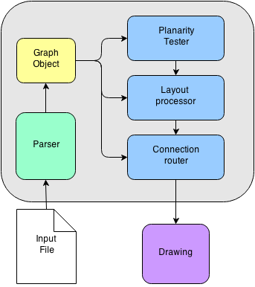
System Architecture
Four main modules
Parser computes graph data from input files
Planarity tester using Chiba-Nishizieki algorithm
Layout processor based on genetic algorithms
Edge router with orthogonal connectors
15.09.2014
Bachelor Thesis – September 2014

Slide 6
Implementation
Modules implemented using Java language
Eclipse Draw 2D used as graphical library
Application integrated with the Eclipse IDE
15.09.2014
Bachelor Thesis – September 2014

Slide 7
Planarity
Planar graphs have no intersecting edges
Kuratowski's Theorem defines planar graphs
Constant time algorithm tests necessary condition
Booth-Lueker testing algorithm which runs in linear time
15.09.2014
Bachelor Thesis – September 2014

Slide 8
Graph layout
Traditional methods: grid layout, tree layout, force-directed placing
Experimental approach combines ideas
Utilizes genetic algorithms
Result is more clear and straightforward
15.09.2014
Bachelor Thesis – September 2014

Slide 9
Edge Routing
Paths represented by orthogonal connectors
Ensures clarity but occupies more space
Advantageous for properly layed out graphs
15.09.2014
Bachelor Thesis – September 2014

Slide 10
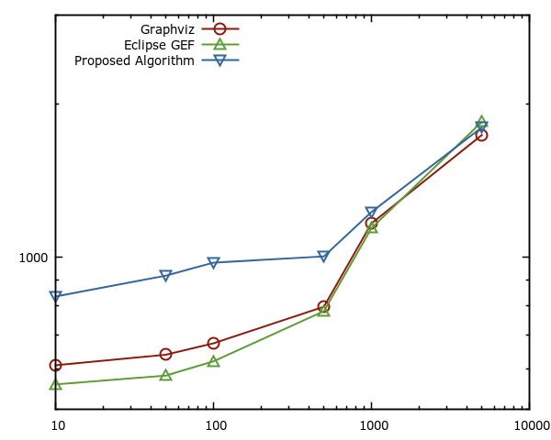
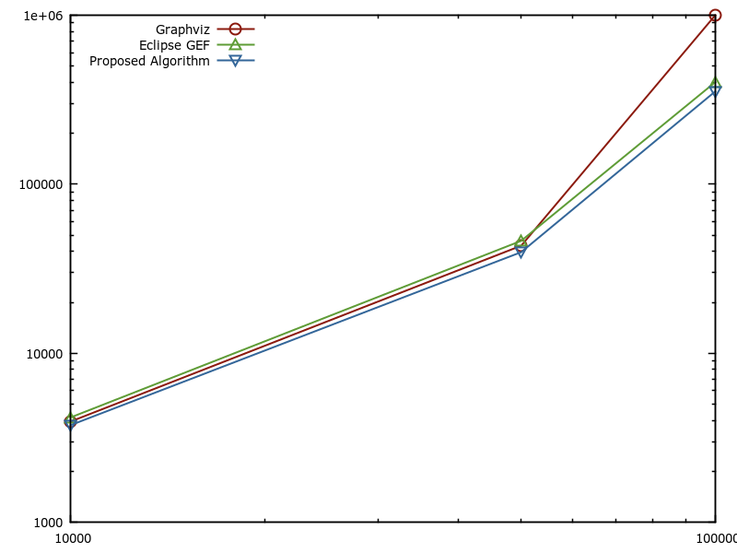
Results - Benchmarking
Benchmarking for main processing modules
Available open-source software: Graphviz dot and Eclipse Gef used as reference
Benchmarking for graphs under 10000 nodes in logrithmic scale
Benchmarking for graphs over 10000 nodes in logrithmic scale
15.09.2014
Bachelor Thesis – September 2014

Slide 11
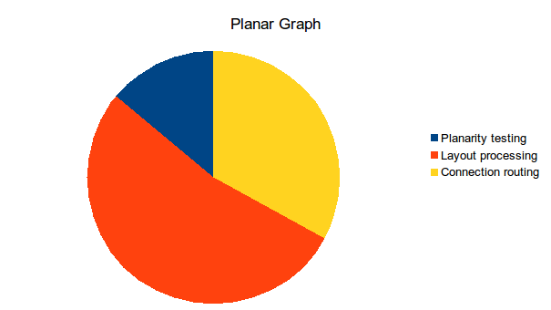
Performance Testing
Identify intensively used module
Possibility for optimization
15.09.2014
Bachelor Thesis – September 2014

Slide 12
User Oriented Features
Interaction with final drawing
Posibility of adjusting position of nodes
On the fly routing for obstructed paths
Pin elements
15.09.2014
Bachelor Thesis – September 2014

Slide 13
Conclusions
Modern approach to a classic problem
Using genetic algorithms improves performance
Modularisation favours optimization
Possibility of manual user adjustments of computed diagram provide insight for further improvements
This work was accepted and presented at the 13th RoEduNet International Conference in Chișinău, Republic of Moldova
15.09.2014
Bachelor Thesis – September 2014

