Slide 1
Introduction to .NET
Florin Olariu
“Alexandru Ioan Cuza”, University of Iași
Department of Computer Science

Slide 2
Agenda
Kata
Big O notation
Generic dictionaries
LINQ
Interview questions

Slide 3
Generic dictionaries

Slide 4
Big O notation

Slide 5
Big O notation
“In computer science, big O notation is used to classify algorithms according to how their running time or space requirements grow as the input size grows.^{[3]} In analytic number theory, big O notation is often used to express a bound on the difference between an arithmetical function and a better understood approximation; a famous example of such a difference is the remainder term in the prime number theorem.” - Wikipedia

Slide 6
Big O notation
Demo

Slide 7
Generic dictionaries
What is a dictionary?
How can we manipulate a dictionary?

Slide 8
Generic dictionaries
What is a dictionary?
It is a data structure that enables us to access an element based on a specified key.

Slide 9
Generic dictionaries
What is a dictionary?
It is a data structure that enables us to access an element based on a specified key.
It is a strongly typed collection of keys and values.

Slide 10
Generic dictionaries
What is a dictionary?
It is a data structure that enables us to access an element based on a specified key.
It is a strongly typed collection of keys and values.
Key

Slide 11
Generic dictionaries
What is a dictionary?
It is a data structure that enables us to access an element based on a specified key.
It is a strongly typed collection of keys and values.
Key
Must be unique

Slide 12
Generic dictionaries
What is a dictionary?
It is a data structure that enables us to access an element based on a specified key.
It is a strongly typed collection of keys and values.
Key
Must be unique
Must not be changed

Slide 13
Generic dictionaries
What is a dictionary?
It is a data structure that enables us to access an element based on a specified key.
It is a strongly typed collection of keys and values.
Key
Must be unique
Must not be changed
Cannot be null

Slide 14
Generic dictionaries
Declaration

Slide 15
Generic dictionaries
Declaration
Dictionary<TKey, TValue>
Notes:
TKey = type of element key
TValue = type of element value
The dictionary is located to : System.Collections.Generic.
Dictionaries are also known as hash tables or maps.
The main feature of dictionaries is fast lookup based on keys.
You can also add and remove items freely, a bit like a List<T>, but without the performance overhead of having to shift subsequent items in memory.

Slide 16
Generic dictionaries
Declaration
Dictionary<TKey, TValue>
Samples
Dictionary<int, int>
Dictionary<int, string>
Dictionary<string, Product>
Notes:
TKey = type of element key
TValue = type of element value

Slide 17
Generic dictionaries
Initialization
Dictionary<string, string> states;
states = new Dictionary<string, string>();
Dictionary<string, string> states = new Dictionary<string, string>();
var states = new Dictionary<string, string>();
Notes:
It is a reference type.
We should use new keyword.

Slide 18
Generic dictionaries
Manipulating a dictionary
states.Add("NY", "New York");
var states = new Dictionary<string, string>
{
{"NY", "New York"},
{ "CA", "California"}
};
states.Remove("CA");
Notes:
Note: always the “add” method add a new element to the dictionary to the end of dictionary.
C# 6 defines a new syntax to initialize dictionaries at declaration.

Slide 19
Generic dictionaries
Demo

Slide 20
Generic dictionaries
Performance

Slide 21
Generic dictionaries
Performance
Many collection classes offer the same functionality as others; for example, SortedList offers nearly the same features as SortedDictionary.
Notes:
The MSDN documentation often provides performance hints about methods of the collection, giving you information about the time the operation requires in big-O notation:
O(1)
O(log n)
O(n)
O(1) means that the time this operation needs is constant no matter how many items are in the collection. For example, the ArrayList has an Add method with O(1) behavior. No matter how many elements are in the list, it always takes the same amount of time when adding a new element to the end of the list. The Count property provides the number of items, so it is easy to find the end of the list.
O(n) means it takes the worst-case time of N to perform an operation on the collection. The Add method of ArrayList can be an O(n) operation if a reallocation of the collection is required. Changing the capacity causes the list to be copied, and the time for the copy increases linearly with every element.
O(log n) means that the time needed for the operation increases with every element in the collection, but the increase of time for each element is not linear but logarithmic. SortedDictionary < TKey, TValue > has O( log n) behavior for inserting operations inside the collection; SortedList < TKey, TValue > has O(n) behavior for the same functionality. Here, SortedDictionary < TKey, TValue > is a lot faster because it is more efficient to insert elements into a tree structure than into a list.

Slide 22
Generic dictionaries
Performance
Many collection classes offer the same functionality as others; for example, SortedList offers nearly the same features as SortedDictionary.
However, often there’s a big difference in performance. Whereas one collection consumes less memory, the other collection class is faster with retrieval of elements.
Notes:
The MSDN documentation often provides performance hints about methods of the collection, giving you information about the time the operation requires in big-O notation:
O(1)
O(log n)
O(n)
O(1) means that the time this operation needs is constant no matter how many items are in the collection. For example, the ArrayList has an Add method with O(1) behavior. No matter how many elements are in the list, it always takes the same amount of time when adding a new element to the end of the list. The Count property provides the number of items, so it is easy to find the end of the list.
O(n) means it takes the worst-case time of N to perform an operation on the collection. The Add method of ArrayList can be an O(n) operation if a reallocation of the collection is required. Changing the capacity causes the list to be copied, and the time for the copy increases linearly with every element.
O(log n) means that the time needed for the operation increases with every element in the collection, but the increase of time for each element is not linear but logarithmic. SortedDictionary < TKey, TValue > has O( log n) behavior for inserting operations inside the collection; SortedList < TKey, TValue > has O(n) behavior for the same functionality. Here, SortedDictionary < TKey, TValue > is a lot faster because it is more efficient to insert elements into a tree structure than into a list.

Slide 23
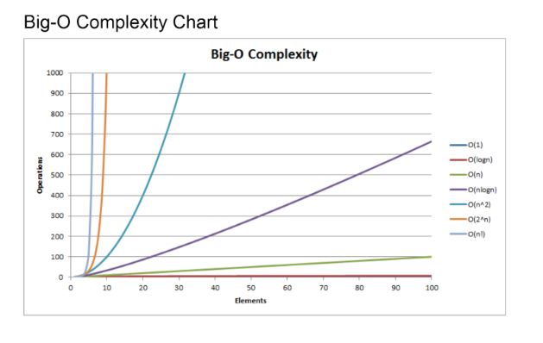
Generic dictionaries
Details about big O algorithm complexity in attached pdf for the course.

Slide 24
LINQ

Slide 25
LINQ
Intro
Building a LINQ query using Query syntax - Demo
Building a LINQ query using Method syntax - Demo
Lambda expression in action - Demo
Using LINQ with collections

Slide 26
LINQ
Stands from Language INtegrated Query

Slide 27
LINQ
Stands from Language INtegrated Query
Definition

Slide 28
LINQ
Stands from Language INtegrated Query
Definition
A way to execute queries against a data source directly from .NET

Slide 29
LINQ
Stands from Language INtegrated Query
Definition
A way to execute queries against a data source directly from .NET
Data sources :
LINQ to objects => should implement an IEnumerable interface
LINQ to SQL => works with SQL databases
LINQ with Entities => works with Entity Framework
LINQ to XML => works with any XML Document
…

Slide 30
LINQ
There are 2 ways to express queries in LINQ:

Slide 31
LINQ
There are 2 ways to express queries in LINQ:
Query syntax:

Slide 32
LINQ
There are 2 ways to express queries in LINQ:
Query syntax:
var product = from p in products
where p.Name == productName
select p;
Method syntax

Slide 33
LINQ
There are 2 ways to express queries in LINQ:
Query syntax:
var product = from p in products
where p.Name == productName
select p;
Method syntax
var product = products.Where(p => p.Name == productName).FirstOrDefault(); or

Slide 34
LINQ
There are 2 ways to express queries in LINQ:
Query syntax:
var product = from p in products
where p.Name == productName
select p;
Method syntax
var product = products.Where(p => p.Name == productName).FirstOrDefault(); or
var product = products.FirstOrDefault(p => p.Name == productName);

Slide 35
LINQ
Delegate

Slide 36
LINQ
Delegate
Is a type that represents a reference to a method with a specific parameter list and a return type.

Slide 37
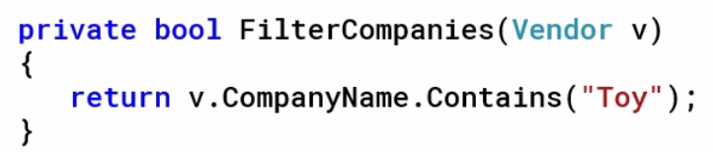
LINQ
Delegate
Is a type that represents a reference to a method with a specific parameter list and a return type.

Slide 38
LINQ
Delegate
Is a type that represents a reference to a method with a specific parameter list and a return type.

Slide 39
LINQ
Lambda expression

Slide 40
LINQ
Lambda expression
Is a method that can be passed as an argument to a method when that argument is expecting a delegate type.

Slide 41
LINQ
Demo – Query syntax vs Method syntax and Lambda expressions

Slide 42
LINQ
LINQ with collections
DO | AVOID
Use LINQ! | Iterating the collections multiple times
Consider using method syntax over query syntax | Use FirstOrDefault and LastOrDefault instead of First and Last
Wait to cast a result after all queries are defined

Slide 43
What’s next …
Entity Framework Core

Slide 44
Interview questions
Notes:
Web development
Web forms – Web MVC

Slide 45
One more thing…
“Always code as if the guy who ends up maintaining your code will be a violent psychopath who knows where you live” ― John Woods

Slide 46
Questions
Do you have any other questions?

Slide 47
Thanks!
See you next time! ☺

