Slide 1
Introduction to .NET
Florin Olariu
“Alexandru Ioan Cuza”, University of Iași
Department of Computer Science

Slide 2
Agenda
Unit testing – shortcut to expert level
Entity Framework Core – part1

Slide 3
Unit testing – shortcut to expert level

Slide 4
Unit testing – shortcut to expert level
Why unit testing?
Benefits of unit tests
What is a unit test?
Unit test life cycle
What makes a good unit test?
Best practices

Slide 5
Why unit testing?
Notes:
Cine a scris macar 10 teste in ultima saptamana? (exceptand cei care au fost in concediu)
Cine a scris macar 50 de teste in ultima luna?
Cine scrie teste, ca si cum ar fi un common behavior? De ce?

Slide 6
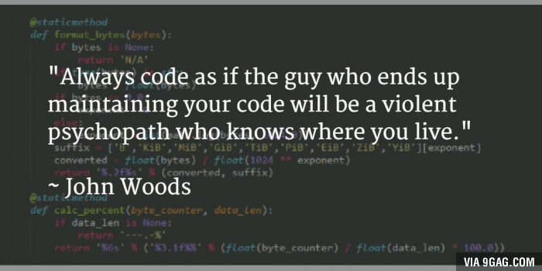
Why unit testing?

Slide 7
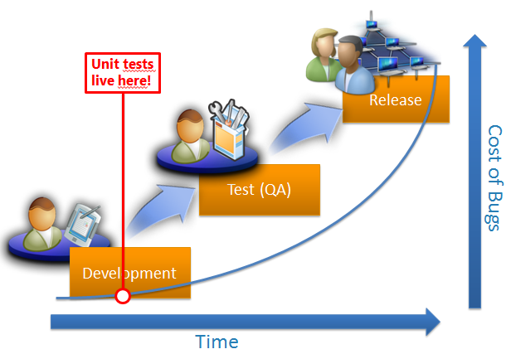
Why unit testing?
Notes:
*Este oarecum “general acceptat” ca, costurile de rezolvare a bugurilor sunt mult mai scazute daca acestea sunt “descoperite” in faza initiala -> in development
*Unit testele trebuie sa apara in aceasta zona pentru ca ele testeaza codul scris de developeri
*Odata descoperite bugurile in “development” costurile pentru rezolvarea lor va fi mult mai mic
*QA in acest fel se poate orienta catre functionalitate + “hard-to-find bugs”

Slide 8
Why unit testing?
Benefits of unit testing
Find defects early
Prevent regressions
Provide living documentation (source code)
Automate testing efforts

Slide 9
Why unit testing?
Benefits
Find defects early
Prevent regressions
Provide living documentation (source code)
Automate testing efforts
Requires tests to be as complete as possible and to be run as early and often as possible

Slide 10
What is a Unit Test?

Slide 11
What is a Unit Test?
Definition 1

Slide 12

What is a Unit Test?
Definition 1
“A unit test is a piece of code (usually a method) that invoke another piece of code and checks the correctness of some assumptions afterwards.”
“The art of unit testing”

Slide 13
What is a Unit Test?
Definition 2

Slide 14
What is a Unit Test?
Definition 2
Essentially, a unit test is a method that instantiates a small portion of our application and verifies its behavior independently from other parts.

Slide 15

Unit test representation
Unit Test
(code)
Act
Assert
No human interaction!
Code under Test

Slide 16
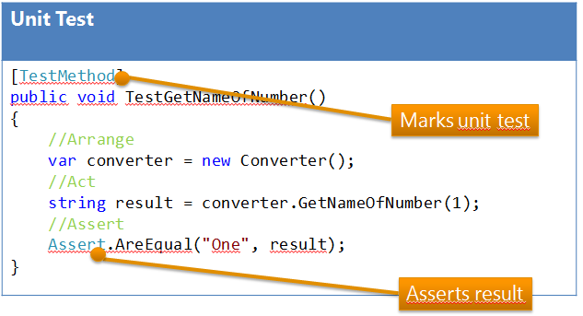
Unit test example
Notes:
A typical unit test contains 3 phases: First, it initializes a small piece of an application it wants to test (also known as the system under test, or SUT), then it applies some stimulus to the system under test (usually by calling a method on it), and finally, it observes the resulting behavior.
If the observed behavior is consistent with the expectations, the unit test passes, otherwise, it fails, indicating that there is a problem somewhere in the system under test.
These three unit test phases are also known as Arrange, Act and Assert, or simply AAA.
SUT => stands from System Under Test, Code Under test or Class Under Test

Slide 17
What Makes a Good Unit Test?
Notes:
Ce credeti ca face un unit test sa fie considerat “bun”?

Slide 18
What Makes a Good Unit Test?
Easy to write
Notes:
1 Easy to write -> Developers typically write lots of unit tests to cover different cases and aspects of the application’s behavior, so it should be easy to code all of those test routines without enormous effort.

Slide 19
What Makes a Good Unit Test?
Easy to write
Readable
Notes:
Easy to write -> Developers typically write lots of unit tests to cover different cases and aspects of the application’s behavior, so it should be easy to code all of those test routines without enormous effort.
Readable -> The intent of a unit test should be clear. A good unit test tells a story about some behavioral aspect of our application, so it should be easy to understand which scenario is being tested and — if the test fails — easy to detect how to address the problem. With a good unit test, we can fix a bug without actually debugging the code!

Slide 20
What Makes a Good Unit Test?
Easy to write
Readable
Reliable
Notes:
Easy to write -> Developers typically write lots of unit tests to cover different cases and aspects of the application’s behavior, so it should be easy to code all of those test routines without enormous effort.
Readable -> The intent of a unit test should be clear. A good unit test tells a story about some behavioral aspect of our application, so it should be easy to understand which scenario is being tested and — if the test fails — easy to detect how to address the problem. With a good unit test, we can fix a bug without actually debugging the code!
Reliable. Unit tests should fail only if there’s a bug in the system under test. That seems pretty obvious, but programmers often run into an issue when their tests fail even when no bugs were introduced. For example, tests may pass when running one-by-one, but fail when running the whole test suite, or pass on our development machine and fail on the continuous integration server. These situations are indicative of a design flaw. Good unit tests should be reproducible and independent from external factors such as the environment or running order.

Slide 21
What Makes a Good Unit Test?
Easy to write
Readable
Reliable
Fast
Notes:
Easy to write -> Developers typically write lots of unit tests to cover different cases and aspects of the application’s behavior, so it should be easy to code all of those test routines without enormous effort.
Readable -> The intent of a unit test should be clear. A good unit test tells a story about some behavioral aspect of our application, so it should be easy to understand which scenario is being tested and — if the test fails — easy to detect how to address the problem. With a good unit test, we can fix a bug without actually debugging the code!
Reliable. Unit tests should fail only if there’s a bug in the system under test. That seems pretty obvious, but programmers often run into an issue when their tests fail even when no bugs were introduced. For example, tests may pass when running one-by-one, but fail when running the whole test suite, or pass on our development machine and fail on the continuous integration server. These situations are indicative of a design flaw. Good unit tests should be reproducible and independent from external factors such as the environment or running order.
Fast. Developers write unit tests so they can repeatedly run them and check that no bugs have been introduced. If unit tests are slow, developers are more likely to skip running them on their own machines. One slow test won’t make a significant difference; add one thousand more and we’re surely stuck waiting for a while. Slow unit tests may also indicate that either the system under test, or the test itself, interacts with external systems, making it environment-dependent.

Slide 22
Best practices
A test should be:

Slide 23
Best practices
A test should be:
Isolated
Notes:
1. Isolated: Each Unit Test Should Be Able to Run Independently
Generally in a project, all the tests are run at one time. The order in which the tests are run cannot be determined; for this reason, the tests should be independent of each other. In the preceding example, either a positive scenario or the negative scenario can get executed first.

Slide 24
Best practices
A test should be:
Isolated
Test Only One Condition at a Time
Notes:
1. Isolated: Each Unit Test Should Be Able to Run Independently
Generally in a project, all the tests are run at one time. The order in which the tests are run cannot be determined; for this reason, the tests should be independent of each other. In the preceding example, either a positive scenario or the negative scenario can get executed first.
2. There should only be one assert statement for each test method. In the preceding example, there are two test methods: one to verify the positive and one for the exception scenario. Now, when the tests are run, each scenario is validated separately. Explicit assertion for every method gives an instant insight of the failed tests and helps analyze the scripts easily.

Slide 25
Best practices
A test should be:
Isolated
Test Only One Condition at a Time
Repeatable
Notes:
1. Isolated: Each Unit Test Should Be Able to Run Independently
Generally in a project, all the tests are run at one time. The order in which the tests are run cannot be determined; for this reason, the tests should be independent of each other. In the preceding example, either a positive scenario or the negative scenario can get executed first.
2. Test only one condition at a time : There should only be one assert statement for each test method. In the preceding example, there are two test methods: one to verify the positive and one for the exception scenario. Now, when the tests are run, each scenario is validated separately. Explicit assertion for every method gives an instant insight of the failed tests and helps analyze the scripts easily.
3. Repeatable
The tests should return the same result whenever and how many times it's executed. The result shouldn't change from one execution to another.

Slide 26
Best practices
A test should be:
Isolated
Test Only One Condition at a Time
Repeatable
Thorough
Mock external references
Notes:
1. Isolated: Each Unit Test Should Be Able to Run Independently
Generally in a project, all the tests are run at one time. The order in which the tests are run cannot be determined; for this reason, the tests should be independent of each other. In the preceding example, either a positive scenario or the negative scenario can get executed first.
2. Test only one condition at a time : There should only be one assert statement for each test method. In the preceding example, there are two test methods: one to verify the positive and one for the exception scenario. Now, when the tests are run, each scenario is validated separately. Explicit assertion for every method gives an instant insight of the failed tests and helps analyze the scripts easily.
3. Repeatable
The tests should return the same result whenever and how many times it's executed. The result shouldn't change from one execution to another.
4. Thorough Thorough testing is related to how many units of code are verified. Code coverage gives a good indication of how much testable code is verified. A code coverage of 80% and above is a good indication that most of the code is covered by unit test scripts.
5. Mock External References
Mock external references, the test script, when run should not depend on external entities such as connection to a database or WCF or a configuration file. Mocking external references essentially means that it's assumed that the expected data is returned from the source and the testable code only verifies the actions that are performed on that data.

Slide 27
Unit test life cycle

Slide 28
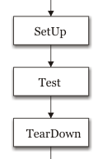
Unit test life cycle
Notes:
Setup => Use SetUp to run code before you run each test
TearDown => Use TearDown to run code after each test has run
Atributele difera functie de framework:
Microsoft.VisualStudio.TestTools.UnitTesting
[ClassInitialize()] Use ClassInitialize to run code before you run the first test in the class.
[ClassCleanUp()] Use ClassCleanup to run code after all tests in a class have run.
[TestInitialize()] Use TestInitialize to run code before you run each test.
[TestCleanUp()] Use TestCleanup to run code after each test has run.

Slide 29
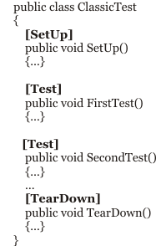
Unit test life cycle
Notes:
Setup => Use SetUp to run code before you run each test
TearDown => Use TearDown to run code after each test has run
Atributele difera functie de framework:
Microsoft.VisualStudio.TestTools.UnitTesting
[ClassInitialize()] Use ClassInitialize to run code before you run the first test in the class.
[ClassCleanUp()] Use ClassCleanup to run code after all tests in a class have run.
[TestInitialize()] Use TestInitialize to run code before you run each test.
[TestCleanUp()] Use TestCleanup to run code after each test has run.

Slide 30
Entity Framework Core – part1

Slide 31
Entity Framework Core – part1
Introduction in Entity Framework
Entity Framework code first
Conventions
Attributes
Fluent API
Creating models with Entity Framework code first/Creating Context class with Entity Framework – from scratch sample
Transactions
Manipulating data(Inserting entities, Updating entities, Deleting entities, querying entities)

Slide 32
Introduction in Entity Framework

Slide 33
Introduction in Entity Framework
What is Entity Framework?
Short history
Pros/Cons in using EF Core

Slide 34
Introduction in Entity Framework
What is Entity Framework?
Short history
Pros/Cons in using EF Core

Slide 35
Introduction in Entity Framework
What is Entity Framework?
Short history
Pros/Cons in using EF Core
It is an ORM => object relational
mapping tool from Microsoft.

Slide 36
Introduction in Entity Framework
What is Entity Framework?
Short history
Pros/Cons in using EF Core

Slide 37
Introduction in Entity Framework
Was first released as part of
.NET Framework 3.5 with
Service Pack 1 back in late 2008.
What is Entity Framework?
Short history
Pros/Cons in using EF Core

Slide 38
Introduction in Entity Framework
The version included with
Visual Studio 2015 is
Entity Framework 6.1.3 (EF6).
What is Entity Framework?
Short history
Pros/Cons in using EF Core

Slide 39
Introduction in Entity Framework
What is Entity Framework?
Short history
Pros/Cons in using EF Core
It is mature, stable, and supports
the "old" EDMX design-time way

Slide 40
Introduction in Entity Framework
What is Entity Framework?
Short history
Pros/Cons in using EF Core

Slide 41
Introduction in Entity Framework
What is Entity Framework?
Short history
Pros/Cons in using EF Core
Pros | Cons

Slide 42
Introduction in Entity Framework
What is Entity Framework?
Short history
Pros/Cons in using EF Core
Pros | Cons
Is available for .NET Core => can be used for Mac, Linux or Windows

Slide 43
Introduction in Entity Framework
What is Entity Framework?
Short history
Pros/Cons in using EF Core
Pros | Cons
Is available for .NET Core => can be used for Mac, Linux or Windows
Supports modern cloud-based, non-relational databases(Azure Table Storage, Redis)

Slide 44
Introduction in Entity Framework
What is Entity Framework?
Short history
Pros/Cons in using EF Core
Pros | Cons
Is available for .NET Core => can be used for Mac, Linux or Windows | Does not support the old EDMX design time
Supports modern cloud-based, non-relational databases(Azure Table Storage, Redis)

Slide 45
Introduction in Entity Framework
What is Entity Framework?
Short history
Pros/Cons in using EF Core
Pros | Cons
Is available for .NET Core => can be used for Mac, Linux or Windows | Does not support the old EDMX design time
Supports modern cloud-based, non-relational databases(Azure Table Storage, Redis) | Does not support yet complex inheritance models

Slide 46
Introduction in Entity Framework
What is Entity Framework?
Short history
Pros/Cons in using EF Core
Pros | Cons
Is available for .NET Core => can be used for Mac, Linux or Windows | Does not support the old EDMX design time
Supports modern cloud-based, non-relational databases(Azure Table Storage, Redis) | Does not support yet complex inheritance models
Tip: Use EF6 for Windows platform applications until EF Core becomes more stable and implements more features. Use EF Core for cross-platform development.

Slide 47
Entity Framework code first

Slide 48
Entity Framework code first - conventions

Slide 49
Entity Framework code first - conventions
If a connection string exists with the same name as the class derived from DbContext, then it is loaded and used to connect to the database automatically.

Slide 50
Entity Framework code first - conventions
If a connection string exists with the same name as the class derived from DbContext, then it is loaded and used to connect to the database automatically.
The name of a table is assumed to match the name of a DbSet <T> property in the DbContext class, for example, Customers.

Slide 51
Entity Framework code first - conventions
If a connection string exists with the same name as the class derived from DbContext, then it is loaded and used to connect to the database automatically.
The name of a table is assumed to match the name of a DbSet <T> property in the DbContext class, for example, Customers.
The names of the columns are assumed to match the names of properties in the class, for example, CustomerID.

Slide 52
Entity Framework code first - conventions
If a connection string exists with the same name as the class derived from DbContext, then it is loaded and used to connect to the database automatically.
The name of a table is assumed to match the name of a DbSet <T> property in the DbContext class, for example, Customers.
The names of the columns are assumed to match the names of properties in the class, for example, CustomerID.
The string .NET type is assumed to be an nvarchar type in the database.

Slide 53
Entity Framework code first - conventions
If a connection string exists with the same name as the class derived from DbContext, then it is loaded and used to connect to the database automatically.
The name of a table is assumed to match the name of a DbSet <T> property in the DbContext class, for example, Customers.
The names of the columns are assumed to match the names of properties in the class, for example, CustomerID.
The string .NET type is assumed to be an nvarchar type in the database.
The int .NET type is assumed to be an int type in the database.

Slide 54
Entity Framework code first - conventions
If a connection string exists with the same name as the class derived from DbContext, then it is loaded and used to connect to the database automatically.
The name of a table is assumed to match the name of a DbSet <T> property in the DbContext class, for example, Customers.
The names of the columns are assumed to match the names of properties in the class, for example, CustomerID.
The string .NET type is assumed to be an nvarchar type in the database.
The int .NET type is assumed to be an int type in the database.
A property that is named ID or the name of the class has ID as the suffix, it is assumed to be a primary key. If this property is any integer type or the Guid type, then it is also assumed to be an IDENTITY

Slide 55
Entity Framework code first attributes

Slide 56
Entity Framework code first attributes
With attributes we can specify different aspects database oriented: Not Null field, dimensions for nvarchar, custom types

Slide 57
Entity Framework code first attributes
With attributes we can specify different aspects database oriented: Not Null field, dimensions for nvarchar, custom types
[Required]
[StringLength(40)]
public string CustomerName { get; set; }
or:
Notes:
For example, in the database, the maximum length of the company name of a customer is 40, and the value cannot be null (empty).

Slide 58
Entity Framework code first attributes
With attributes we can specify different aspects database oriented: Not Null field, dimensions for nvarchar, custom types
[Required]
[StringLength(40)]
public string CustomerName { get; set; }
or:
[Column( TypeName = "money")]
public decimal? UnitPrice { get; set; }
Notes:
When there isn't an obvious map between .NET types and database types, an attribute can be used. For example, in the database, the column type of UnitPrice for the Products table is money.
.NET does not have a money type, so it should use decimal instead.

Slide 59
Entity Framework code first Fluent API

Slide 60
Entity Framework code first Fluent API
It can be used:
Combined with attributes

Slide 61
Entity Framework code first Fluent API
It can be used:
Combined with attributes
As a replacement for attributes

Slide 62
Entity Framework code first Fluent API
It can be used:
Combined with attributes
As a replacement for attributes
[Required]
[StringLength( 40)]
public string CompanyName { get; set; }
They could be deleted and replaced with this Fluent API statement in the Context class OnModelBuilding method:
modelBuilder.Entity<Customer>()
.Property(customer=>customer.CompanyName)
.IsRequired()
.HasMaxLength(40);

Slide 63
Entity Framework code first – models and context class
Creating models with Entity Framework code first/Creating Context class with Entity Framework – from scratch sample - Demo

Slide 64
Entity Framework code first transactions

Slide 65
Entity Framework code first transactions
Transactions maintain the integrity of your database by applying locks to prevent reads and writes while a sequence of operations is occurring.

Slide 66
Entity Framework code first transactions
Transactions maintain the integrity of your database by applying locks to prevent reads and writes while a sequence of operations is occurring.
Transactions should be ACID.

Slide 67
Entity Framework code first transactions
Transactions maintain the integrity of your database by applying locks to prevent reads and writes while a sequence of operations is occurring.
Transactions should be ACID.
A : is for atomic
Notes:
A is for atomic.
Either all the operations in the transaction commit or none of them do.
C is for consistent. The state of the database before and after a transaction is consistent. This is dependent on your code logic.
I is for isolated. During a transaction, changes are hidden from other processes. There are multiple isolation levels that you can pick from (see the following table). The stronger the level, the better the integrity of the data. However, more locks must be applied which will negatively affect other processes. Snapshot is a special case, because it creates multiple copies of rows to avoid locks, but this will increase the size of your database while transactions occur.
D is for durable. If a failure occurs during a transaction, it can be recovered. The opposite of durable is volatile.

Slide 68
Entity Framework code first transactions
Transactions maintain the integrity of your database by applying locks to prevent reads and writes while a sequence of operations is occurring.
Transactions should be ACID.
A : is for atomic
C: is for consistent
Notes:
A is for atomic.
Either all the operations in the transaction commit or none of them do.
C is for consistent. The state of the database before and after a transaction is consistent. This is dependent on your code logic.
I is for isolated. During a transaction, changes are hidden from other processes. There are multiple isolation levels that you can pick from (see the following table). The stronger the level, the better the integrity of the data. However, more locks must be applied which will negatively affect other processes. Snapshot is a special case, because it creates multiple copies of rows to avoid locks, but this will increase the size of your database while transactions occur.
D is for durable. If a failure occurs during a transaction, it can be recovered. The opposite of durable is volatile.

Slide 69
Entity Framework code first transactions
Transactions maintain the integrity of your database by applying locks to prevent reads and writes while a sequence of operations is occurring.
Transactions should be ACID.
A : is for atomic
C: is for consistent
I: is for isolated
Notes:
A is for atomic.
Either all the operations in the transaction commit or none of them do.
C is for consistent. The state of the database before and after a transaction is consistent. This is dependent on your code logic.
I is for isolated. During a transaction, changes are hidden from other processes. There are multiple isolation levels that you can pick from (see the following table). The stronger the level, the better the integrity of the data. However, more locks must be applied which will negatively affect other processes. Snapshot is a special case, because it creates multiple copies of rows to avoid locks, but this will increase the size of your database while transactions occur.
D is for durable. If a failure occurs during a transaction, it can be recovered. The opposite of durable is volatile.

Slide 70
Entity Framework code first transactions
Transactions maintain the integrity of your database by applying locks to prevent reads and writes while a sequence of operations is occurring.
Transactions should be ACID.
A : is for atomic
C: is for consistent
I: is for isolated
D: is for durable
Notes:
A is for atomic.
Either all the operations in the transaction commit or none of them do.
C is for consistent. The state of the database before and after a transaction is consistent. This is dependent on your code logic.
I is for isolated. During a transaction, changes are hidden from other processes. There are multiple isolation levels that you can pick from (see the following table). The stronger the level, the better the integrity of the data. However, more locks must be applied which will negatively affect other processes. Snapshot is a special case, because it creates multiple copies of rows to avoid locks, but this will increase the size of your database while transactions occur.
D is for durable. If a failure occurs during a transaction, it can be recovered. The opposite of durable is volatile.

Slide 71
Entity Framework code first manipulating data

Slide 72
Entity Framework code first manipulating data
Inserting entities
Updating entities
Deleting entities
Querying entities

Slide 73
Entity Framework code first manipulating data
Inserting entities
Updating entities
Deleting entities
Querying entities

Slide 74
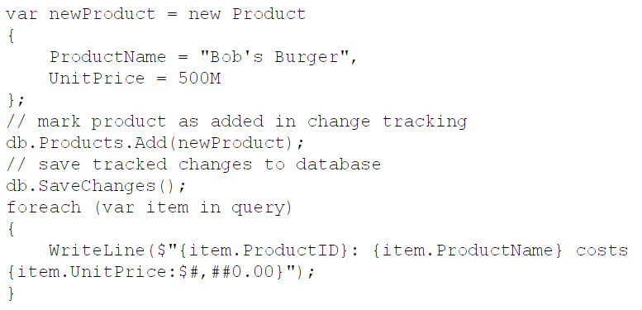
Entity Framework code first manipulating data
Inserting entities
Updating entities
Deleting entities
Querying entities

Slide 75
Entity Framework code first manipulating data
Inserting entities
Updating entities
Deleting entities
Querying entities

Slide 76
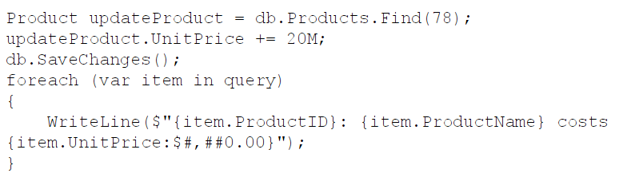
Entity Framework code first manipulating data
Inserting entities
Updating entities
Deleting entities
Querying entities

Slide 77
Entity Framework code first manipulating data
Inserting entities
Updating entities
Deleting entities
Querying entities

Slide 78

Entity Framework code first manipulating data
Inserting entities
Updating entities
Deleting entities
Querying entities

Slide 79
Entity Framework code first manipulating data
Inserting entities
Updating entities
Deleting entities
Querying entities

Slide 80
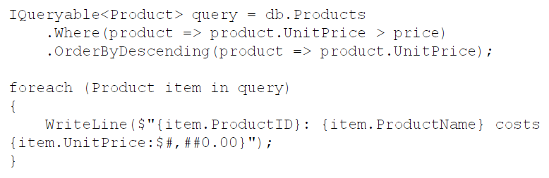
Entity Framework code first manipulating data
Inserting entities
Updating entities
Deleting entities
Querying entities

Slide 81
What’s next …
Entity Framework Core – part 2

Slide 82
One more thing…
Read the story from notes!!!!!

Slide 83
One more thing…
Read the story from notes!!!!!
Early one morning, a programmer asked the great master:
“I am ready to write some unit tests. What code coverage should I aim for?”
The great master replied:
“Don’t worry about coverage, just write some good tests.”
The programmer smiled, bowed, and left.
...
Notes:
Later that day, a second programmer asked the same question.
The great master pointed at a pot of boiling water and said:
“How many grains of rice should put in that pot?”
The programmer, looking puzzled, replied:
“How can I possibly tell you? It depends on how many people you need to feed, how hungry they are, what other food you are serving, how much rice you have available, and so on.”
“Exactly,” said the great master.
The second programmer smiled, bowed, and left.
...
Toward the end of the day, a third programmer came and asked the same question about code coverage.
“Eighty percent and no less!” Replied the master in a stern voice, pounding his fist on the table.
The third programmer smiled, bowed, and left.
...
After this last reply, a young apprentice approached the great master:
“Great master, today I overheard you answer the same question about code coverage with three different answers. Why?”
The great master stood up from his chair:
“Come get some fresh tea with me and let’s talk about it.”
After they filled their cups with smoking hot green tea, the great master began to answer:
“The first programmer is new and just getting started with testing. Right now he has a lot of code and no tests. He has a long way to go; focusing on code coverage at this time would be depressing and quite useless. He’s better off just getting used to writing and running some tests. He can worry about coverage later.”
“The second programmer, on the other hand, is quite experience both at programming and testing. When I replied by asking her how many grains of rice I should put in a pot, I helped her realize that the amount of testing necessary depends on a number of factors, and she knows those factors better than I do – it’s her code after all. There is no single, simple, answer, and she’s smart enough to handle the truth and work with that.”
“I see,” said the young apprentice, “but if there is no single simple answer, then why did you answer the third programmer ‘Eighty percent and no less’?”
The great master laughed so hard and loud that his belly, evidence that he drank more than just green tea, flopped up and down.
“The third programmer wants only simple answers – even when there are no simple answers … and then does not follow them anyway.”
The young apprentice and the grizzled great master finished drinking their tea in contemplative silence.

Slide 84
Questions
Do you have any other questions?

Slide 85
Thanks!
See you next time! ☺

