Slide 1
Introduction to .NET
Florin Olariu
“Alexandru Ioan Cuza”, University of Iași
Department of Computer Science

Slide 2
Entity Framework Core – part 2

Slide 3
Agenda
Entity Framework Core – Short recap
Entity Framework Core – Features
Entity Framework Core – Database providers support
Entity Framework Core - Building connection strings
Entity Framework Core - Managing migrations
Entity Framework Core - Managing navigation properties
Entity Framework Core - Using loading patterns in EF Core

Slide 4
Entity Framework Core - Short recap

Slide 5
Entity Framework Core - Short recap
Is a lightweight and extensible version of Entity Framework

Slide 6
Entity Framework Core - Short recap
Is a lightweight and extensible version of Entity Framework
It is based on ORM (Object Relational Mapper) which give us the possibility to work with databases using .NET objects

Slide 7
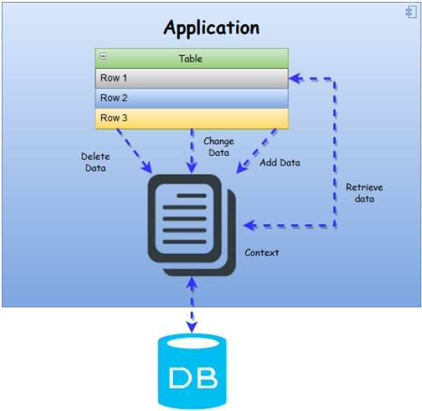
Entity Framework Core - Short recap

Slide 8
Entity Framework Core – Features
Notes:
Entity Framework Core supports the following features:

Slide 9
Entity Framework Core – Features
Modeling
Notes:
Modeling:

Slide 10
Entity Framework Core – Features
Modeling
Fluent API
Notes:
Modeling:
1. Fluent API: This allows us to configure our domain classes. It provides more functionality for configuration as compared to Data Annotation. This allows us to override “OnModelCreating” method of the context class to configure the model.

Slide 11
Entity Framework Core – Features
Modeling
Fluent API
Data annotations
Notes:
Modeling:
Fluent API: This allows us to configure our domain classes. It provides more functionality for configuration as compared to Data Annotation. This allows us to override “OnModelCreating” method of the context class to configure the model.
These are attributes that can be added to the entity classes to configure the model classes.

Slide 12
Entity Framework Core – Features
Modeling
Fluent API
Data annotations
Shadow properties
Notes:
Modeling:
Fluent API: This allows us to configure our domain classes. It provides more functionality for configuration as compared to Data Annotation. This allows us to override “OnModelCreating” method of the context class to configure the model.
These are attributes that can be added to the entity classes to configure the model classes.
Shadow Properties are properties which are not present in our entity model class. The values can be changed and maintained by the Change Tracker API. They can also participate in LINQ to Entity query, database migration, and Create/Update operations. Shadow properties can be referenced in LINQ queries via the EF.Property static method.

Slide 13

Entity Framework Core – Features
Modeling
Fluent API
Data annotations
Shadow properties
Notes:
Modeling:
Fluent API: This allows us to configure our domain classes. It provides more functionality for configuration as compared to Data Annotation. This allows us to override “OnModelCreating” method of the context class to configure the model.
These are attributes that can be added to the entity classes to configure the model classes.
Shadow Properties are properties which are not present in our entity model class. The values can be changed and maintained by the Change Tracker API. They can also participate in LINQ to Entity query, database migration, and Create/Update operations. Shadow properties can be referenced in LINQ queries via the EF.Property static method.

Slide 14
Entity Framework Core – Features
Modeling
Fluent API
Data annotations
Shadow properties
It maintains the relation between entities with help of navigation and foreign key properties
Notes:
Modeling:
Fluent API: This allows us to configure our domain classes. It provides more functionality for configuration as compared to Data Annotation. This allows us to override “OnModelCreating” method of the context class to configure the model.
These are attributes that can be added to the entity classes to configure the model classes.
Shadow Properties are properties which are not present in our entity model class. The values can be changed and maintained by the Change Tracker API. They can also participate in LINQ to Entity query, database migration, and Create/Update operations. Shadow properties can be referenced in LINQ queries via the EF.Property static method.

Slide 15
Entity Framework Core – Features
Modeling
Fluent API
Data annotations
Shadow properties
It maintains the relation between entities with help of navigation and foreign key properties
Change Tracking
Notes:
Change Tracking:
It includes many change tracking methods like Snapshot change tracking and Notification change tracking. We can also access the tracked state of entities via DbContext.Entry and DbContext.ChangeTracker. It has also introduced new API "DbContext.AttachGraph" which helps us re-attach entities to a context, in order to save new/modified entities.

Slide 16
Entity Framework Core – Features
Modeling
Fluent API
Data annotations
Shadow properties
It maintains the relation between entities with help of navigation and foreign key properties
Change Tracking
SaveChanges
Notes:
SaveChanges
This version of the EF supports basic save functionality with async support. It also supports Optimistic Concurrency to protect against overwriting changes made by other users. It provides the API to support "Transaction" feature.

Slide 17
Entity Framework Core – Features
Modeling
Fluent API
Data annotations
Shadow properties
It maintains the relation between entities with help of navigation and foreign key properties
Change Tracking
SaveChanges
Model validation
Notes:
Model validation It helps us in detecting invalid data into model properties and provides the error message to user.

Slide 18
Entity Framework Core – Features
Modeling
Fluent API
Data annotations
Shadow properties
It maintains the relation between entities with help of navigation and foreign key properties
Change Tracking
SaveChanges
Model validation
Query
Notes:
Query:
It supports LINQ to retrieve the data from the database. It supports the "NoTracking" feature which enables faster query execution because at this time, context is not required to monitor changes made in entities. This version also supports "Eager loading" and "Lazy Loading".

Slide 19
Entity Framework Core – Database providers support

Slide 20
Entity Framework Core – Database providers support
This version of Entity Framework Core 2.0 supports:

Slide 21
Entity Framework Core – Database providers support
This version of Entity Framework Core 1.0 supports:
SQL Server

Slide 22
Entity Framework Core – Database providers support
This version of Entity Framework Core 1.0 supports:
SQL Server
SQL Lite

Slide 23
Entity Framework Core – Database providers support
This version of Entity Framework Core 1.0 supports:
SQL Server
SQL Lite
Postgres

Slide 24
Entity Framework Core – Database providers support
This version of Entity Framework Core 1.0 supports:
SQL Server
SQL Lite
Postgres
SQL Compact

Slide 25
Entity Framework Core – Database providers support
This version of Entity Framework Core 1.0 supports:
SQL Server
SQL Lite
Postgres
SQL Compact
MySQL (Official and Pomelo)
In Memory (for testing)

Slide 26
Entity Framework Core – Database providers support
This version of Entity Framework Core 1.0 supports:
SQL Server
SQL Lite
Postgres
SQL Compact
MySQL (Official and Pomelo)
In Memory (for testing)

Slide 27
Entity Framework Core – Database providers support
This version of Entity Framework Core 1.0 supports:
SQL Server
SQL Lite
Postgres
SQL Compact
MySQL (Official and Pomelo)
In Memory (for testing)
Devart(MySQL, Oracle, PostgreSQL, SqlLite, DB2, Cloud apps)
Notes:
https://www.devart.com/dotconnect/#cloud

Slide 28
Entity Framework Core – Database providers support
This version of Entity Framework Core 1.0 supports:
SQL Server
SQL Lite
Postgres
SQL Compact
MySQL (Official and Pomelo)
In Memory (for testing)
Devart(MySQL, Oracle, PostgreSQL, SqlLite, DB2, Cloud apps)
MyCat
Notes:
https://www.devart.com/dotconnect/#cloud

Slide 29
Entity Framework Core - Building connection strings
Notes:
Most database providers require some form of connection string to connect to the database.
Sometimes this connection string contains sensitive information that needs to be protected.
You may also need to change the connection string as you move your application between environments, such as development, testing, and production.
Depending by application type we have 2 modalities to use a connection string
If we are working with Console Application the connection string should be used in OnConfiguring implementation in Context file like in the following example

Slide 30
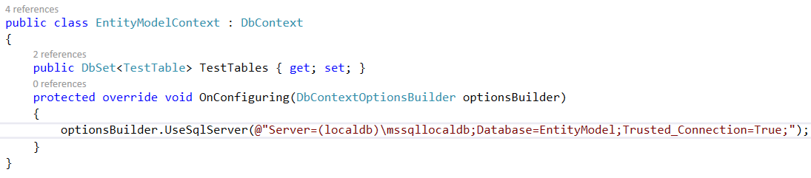
Entity Framework Core - Building connection strings
Notes:
Most database providers require some form of connection string to connect to the database.
Sometimes this connection string contains sensitive information that needs to be protected.
You may also need to change the connection string as you move your application between environments, such as development, testing, and production.
Depending by application type we have 2 modalities to use a connection string
If we are working with Console Application the connection string should be used in OnConfiguring implementation in Context file like in the following example
If we are using the Asp.Net Core application this connection string should be stored in appsettings.json as an environment variable like in the following sample

Slide 31
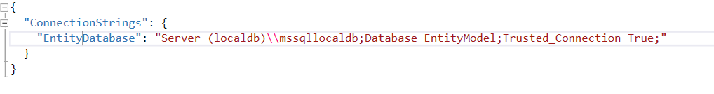
Entity Framework Core - Building connection strings
Notes:
Most database providers require some form of connection string to connect to the database.
Sometimes this connection string contains sensitive information that needs to be protected.
You may also need to change the connection string as you move your application between environments, such as development, testing, and production.
Depending by application type we have 2 modalities to use a connection string
If we are working with Console Application the connection string should be used in OnConfiguring implementation in Context file like in the following example
If we are using the Asp.Net Core application this connection string should be stored in appsettings.json as an environment variable like in the following sample
OBS: It will be configured later into Startup.cs file

Slide 32
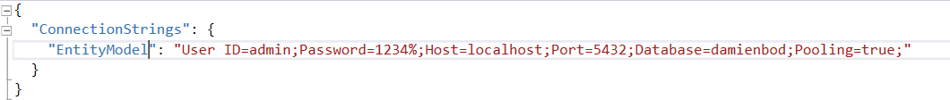
Entity Framework Core - Building connection strings
For Postgre SQL :
Nuget Package: Npqsql.EntityFrameCore.PostgreSQL(code first)
Nuget Package: Npqsql.EntityFrameCore.PostgreSQL.Design(database first)

Slide 33
Entity Framework Core - Building connection strings
For SQL local DB
Nuget Package: Microsoft.EntityFrameworkCore.SqlServer (code first)
Nuget Package: Microsoft.EntityFrameworkCore.SqlServer.Design (database first)

Slide 34
Entity Framework Core - Managing migrations
Notes:
Migrations:
The Migrations feature enables you to change the data model and deploy your changes to production by updating the database schema without having to drop and re-create the database.

Slide 35
Entity Framework Core - Managing migrations
Enable-Migrations
Notes:
(2) In EF Core we will receive this message if we will try to enable migrations:

Slide 36
Entity Framework Core - Managing migrations
Enable-Migrations
Generating & Running Migrations
Notes:
(3)It is used to store any changes within the entity. For the previous versions we should use this. Creates Migrations folder within the project.

Slide 37
Entity Framework Core - Managing migrations
Enable-Migrations
Generating & Running Migrations
Add-Migration
Notes:
Code First Migrations has two primary commands that you are going to become familiar with.
(4)Add-Migration will scaffold the next migration based on changes you have made to your model since the last migration was created

Slide 38
Entity Framework Core - Managing migrations
Enable-Migrations
Generating & Running Migrations
Add-Migration
Update-Database
Notes:
Code First Migrations has two primary commands that you are going to become familiar with.
Add-Migration will scaffold the next migration based on changes you have made to your model since the last migration was created.
(5)Update-Database will apply any pending migrations to the database.

Slide 39
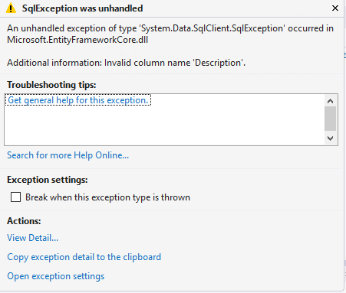
Entity Framework Core - Managing migrations
Enable-Migrations
Generating & Running Migrations
Notes:
Code First Migrations has two primary commands that you are going to become familiar with.
Add-Migration will scaffold the next migration based on changes you have made to your model since the last migration was created.
Update-Database will apply any pending migrations to the database.
(6)If we will change the structure of an entity(by adding a new property for instance) without creating migrations we will end up with the following error message:

Slide 40
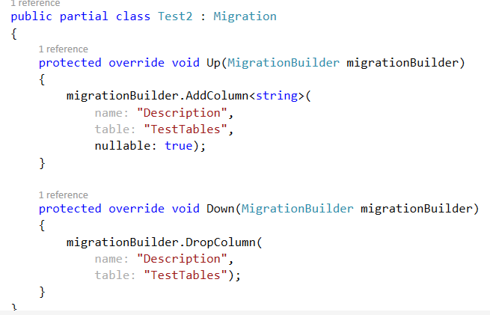
Entity Framework Core - Managing migrations
Enable-Migrations
Generating & Running Migrations
Notes:
Code First Migrations has two primary commands that you are going to become familiar with.
Add-Migration will scaffold the next migration based on changes you have made to your model since the last migration was created.
Update-Database will apply any pending migrations to the database.
(6)If we will change the structure of an entity(by adding a new property for instance) without creating migrations we will end up with the following error message:
(7)The migration file structure is presented in the following image. -> Up=>Used for Upgrade, Down=>Used for downgrade.

Slide 41
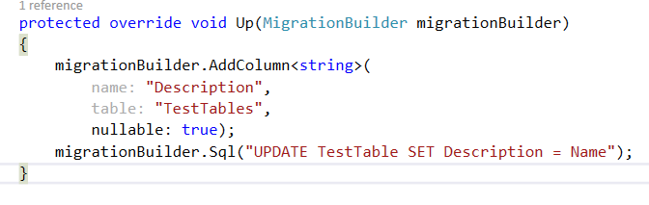
Entity Framework Core - Managing migrations
Enable-Migrations
Generating & Running Migrations
Notes:
Code First Migrations has two primary commands that you are going to become familiar with.
Add-Migration will scaffold the next migration based on changes you have made to your model since the last migration was created.
Update-Database will apply any pending migrations to the database.
(6)If we will change the structure of an entity(by adding a new property for instance) without creating migrations we will end up with the following error message:
(7)The migration file structure is presented in the following image.
(8) We can execute directly SQL Commands like the following into Up/Down methods:

Slide 42
Entity Framework Core - Managing navigation properties
Notes:
Entity Framework supports 3 types of relations (using navigation properties):

Slide 43
Entity Framework Core - Managing navigation properties
One to One => 1:1
Notes:
Entity Framework supports 3 types of relations (using navigation properties):
One to one

Slide 44
Entity Framework Core - Managing navigation properties
One to One => 1:1
One to Many => 1: many
Notes:
Entity Framework supports 3 types of relations (using navigation properties):
One to one
One to many

Slide 45
Entity Framework Core - Managing navigation properties
One to One => 1:1
One to Many => 1: many
Many to Many => many : many
Notes:
Entity Framework supports 3 types of relations (using navigation properties):
One to one
One to many
Many to many
Note: These 3 types are exactly like in relational database.

Slide 46
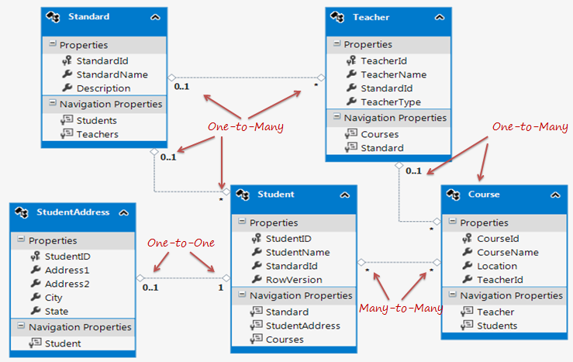
Entity Framework Core - Managing navigation properties
One to One => 1:1
One to Many => 1: many
Many to Many => many : many
Notes:
Entity Framework supports 3 types of relations (using navigation properties):
One to one
One to many
Many to many
Note: These 3 types are exactly like in relational database.

Slide 47
Entity Framework Core - Managing navigation properties
One to One relationship

Slide 48
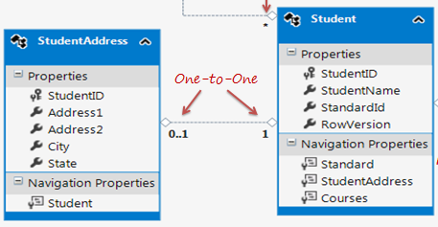
Entity Framework Core - Managing navigation properties
One to One relationship

Slide 49
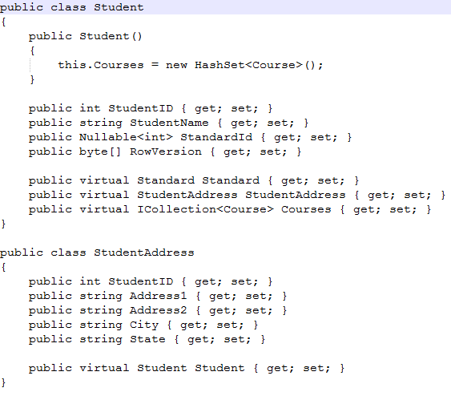
Entity Framework Core - Managing navigation properties
One to One relationship
Notes:
As you can see in the above figure, Student and StudentAddress have a One-to-One relationship (zero or one).
A student can have only one or zero address.
Entity framework adds Student navigation property into StudentAddress entity and StudentAddress navigation entity into Student entity.
Also, StudentAddress entity has StudentId property as PrimaryKey which makes it a One-to-One relationship.

Slide 50
Entity Framework Core - Managing navigation properties
One-to-Many relationship

Slide 51
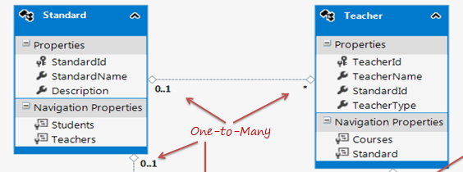
Entity Framework Core - Managing navigation properties
One-to-Many relationship

Slide 52
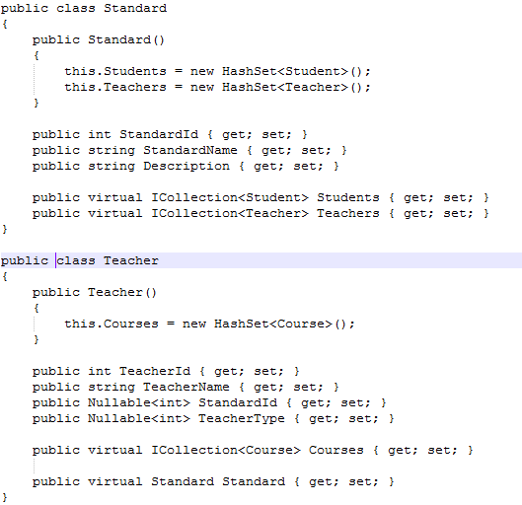
Entity Framework Core - Managing navigation properties
One-to-Many relationship
Notes:
The Standard and Teacher entities have a One-to-Many relationship marked by multiplicity where 1 is for One and * is for many.
This means that Standard can have many Teachers whereas Teacher can associate with only one Standard.
To represent this, The Standard entity has the collection navigation property Teachers (please notice that it's plural), which indicates that one Standard can have a collection of Teachers (many teachers).
And Teacher entity has a Standard navigation property (Not a Collection) which indicates that Teacher is associated with one Standard.
Also, it contains StandardId foreign key (StandardId is a PK in Standard entity). This makes it One-to-Many relationship.

Slide 53
Entity Framework Core - Managing navigation properties
Many-to-Many relationship

Slide 54
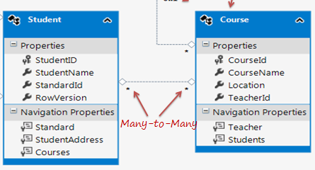
Entity Framework Core - Managing navigation properties
Many-to-Many relationship

Slide 55
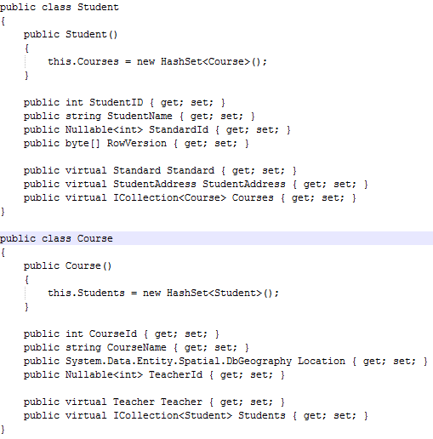
Entity Framework Core - Managing navigation properties
Many-to-Many relationship
Notes:
Student and Course have Many-to-Many relationships marked by * multiplicity.
It means one Student can enrol for many Courses and also, one Course can be be taught to many Students.
The database design includes StudentCourse joining table which includes the primary key of both the tables (Student and Course table).
Entity Framework represents many-to-many relationships by not having entityset for the joining table in CSDL, instead it manages this through mapping.
As you can see in the above figure, Student entity includes Courses property and Course entity includes Students property to represent many-to-many relationship between them.

Slide 56
Entity Framework Core - Using loading patterns in EF Core
Notes:
Entity Framework Core allows you to use the navigation properties in your model to load related entities.
There are three common O/RM patterns used to load related data.

Slide 57
Entity Framework Core - Using loading patterns in EF Core
Lazy loading
Notes:
Lazy loading: Means that the related data is transparently loaded from the database when the navigation property is accessed.

Slide 58
Entity Framework Core - Using loading patterns in EF Core
Lazy loading
Eager loading
Notes:
Eager loading : means that the related data is loaded from the database as part of the initial query.

Slide 59
Entity Framework Core - Using loading patterns in EF Core
Lazy loading
Eager loading
Explicit loading
Notes:
Explicit loading: means that the related data is explicitly loaded from the database at a later time.

Slide 60
Entity Framework Core - Using loading patterns in EF Core
Lazy loading
Notes:
Lazy loading: Means that the related data is transparently loaded from the database when the navigation property is accessed.

Slide 61
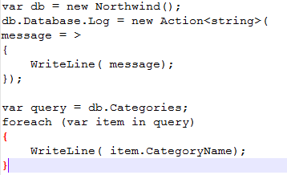
Entity Framework Core - Using loading patterns in EF Core
Lazy loading
Notes:
Lazy loading: Means that the related data is transparently loaded from the database when the navigation property is accessed.
Once the query is executed the following result might be showed:

Slide 62
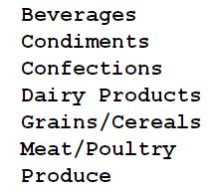
Entity Framework Core - Using loading patterns in EF Core
Lazy loading
Notes:
Lazy loading: Means that the related data is transparently loaded from the database when the navigation property is accessed.
Once the query is executed the following result might be showed:

Slide 63
Entity Framework Core - Using loading patterns in EF Core
Lazy loading
Let’s change the message from loop in order to show the products.
Notes:
Lazy loading: Means that the related data is transparently loaded from the database when the navigation property is accessed.
Once the query is executed the following result might be showed:
The message from foreach loop:

Slide 64
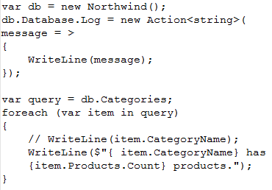
Entity Framework Core - Using loading patterns in EF Core
Lazy loading
Notes:
Lazy loading: Means that the related data is transparently loaded from the database when the navigation property is accessed.
Once the query is executed the following result might be showed:
The message from foreach loop:
The result will be:

Slide 65
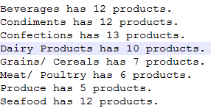
Entity Framework Core - Using loading patterns in EF Core
Lazy loading
Notes:
Lazy loading: Means that the related data is transparently loaded from the database when the navigation property is accessed.
Once the query is executed the following result might be showed:
The message from foreach loop:
The result will be:
Conlusion:You will notice that when the code accesses the Products property,
EF automatically checks to see whether they are loaded.
If not, EF loads them for us "lazily.“
Cons: The problem with lazy loading is that multiple round trips to the database server
are required to eventually fetch all the data.

Slide 66
Entity Framework Core - Using loading patterns in EF Core
Eager loading
Notes:
Eager loading: means that the related data is loaded from the database as part of the initial query.
Sometimes, it is better to disable lazy loading and manually specify that all the data is brought across the network immediately using eager loading (aka early loading).

Slide 67

Entity Framework Core - Using loading patterns in EF Core
Eager loading
Notes:
Eager loading: means that the related data is loaded from the database as part of the initial query.
Sometimes, it is better to disable lazy loading and manually specify that all the data is brought across the network immediately using eager loading (also known as early loading).
In this case the result for the latest query will be:

Slide 68
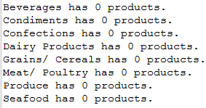
Entity Framework Core - Using loading patterns in EF Core
Eager loading
Notes:
Eager loading: means that the related data is loaded from the database as part of the initial query.
Sometimes, it is better to disable lazy loading and manually specify that all the data is brought across the network immediately using eager loading (also known as early loading).
In this case the result for the latest query will be:
In order to solve the problem we have to use “Include” as extension method.

Slide 69
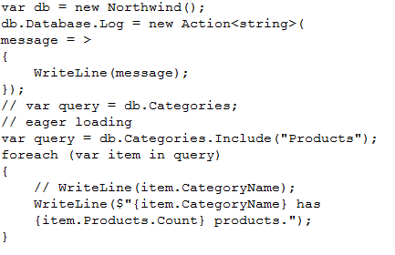
Entity Framework Core - Using loading patterns in EF Core
Eager loading

Slide 70
Entity Framework Core - Using loading patterns in EF Core
Explicit loading
Notes:
Explicit loading: means that the related data is explicitly loaded from the database at a later time.
It works similar to lazy loading, but you are in control of exactly which related data is loaded and when.

Slide 71
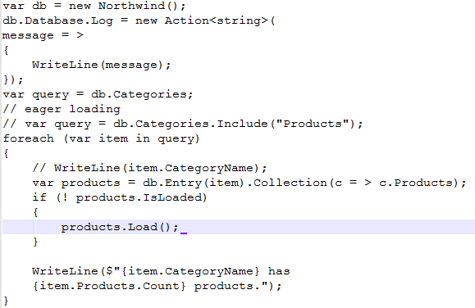
Entity Framework Core - Using loading patterns in EF Core
Explicit loading
Notes:
Explicit loading: means that the related data is explicitly loaded from the database at a later time.
It works similar to lazy loading, but you are in control of exactly which related data is loaded and when.

Slide 72
Entity Framework Core - Using loading patterns in EF Core
Tips
Notes:
Explicit loading: means that the related data is explicitly loaded from the database at a later time.
It works similar to lazy loading, but you are in control of exactly which related data is loaded and when.

Slide 73
Entity Framework Core - Using loading patterns in EF Core
Tips
Carefully consider which loading pattern is best for your code.
Notes:
Explicit loading: means that the related data is explicitly loaded from the database at a later time.
It works similar to lazy loading, but you are in control of exactly which related data is loaded and when.

Slide 74
Entity Framework Core - Using loading patterns in EF Core
Tips
Carefully consider which loading pattern is best for your code.
The default of lazy loading can literally make you into a lazy database developer!
Notes:
Explicit loading: means that the related data is explicitly loaded from the database at a later time.
It works similar to lazy loading, but you are in control of exactly which related data is loaded and when.

Slide 75
One more thing…(1/2)
Notes:
“You’ve probably noticed that I write a lot about Entity Framework, the Microsoft Object Relational Mapper (ORM) that’s been the prime .NET data access API since 2008.
There are other .NET ORMs out there but a particular category, micro-ORMs, gets a lot of notice for great performance. The micro-ORM I’ve heard mentioned most is Dapper.
What finally piqued my interest enough to take some time out to crack it open recently was various developers reporting that they’ve created hybrid solutions with EF and Dapper, letting each ORM do what it’s best at within a single application.” Julie Lerman – May 2016

Slide 76
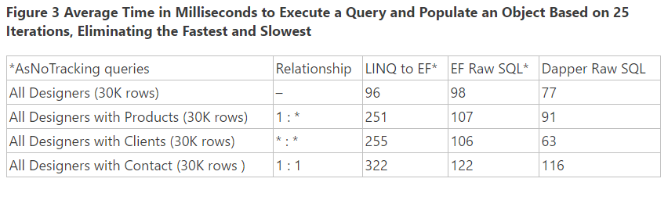
One more thing…(2/2)

Slide 77
Bibliography
Price, Mark. C# 6 and .NET Core 1.0: Modern Cross-Platform Development (Kindle). Packt Publishing. Kindle Edition.
https://msdn.microsoft.com/en-us/library/jj591621(v=vs.113).aspx
http://www.c-sharpcorner.com/article/introduction-to-entity-framework-core/
https://docs.efproject.net/en/latest/platforms/full-dotnet/new-db.html

Slide 78
Questions
Do you have any other questions?

Slide 79
Thanks!
See you next time! ☺

