Slide 1
Introduction to .NET
Florin Olariu
“Alexandru Ioan Cuza”, University of Iași
Department of Computer Science

Slide 2
ASP.NET Web API

Slide 3
Agenda
Demo : create an empty API project
Using middleware for building an API
Demystify MVC pattern
Demo: Adding ASP.NET Core MVC middleware
Demo : Returning resources (1)
Learning about routing
Demo : Returning resources (2)
Demo : Improving the architecture with model classes
The importance of status codes
Demo : Returning correct status codes
Summary

Slide 4
Demo : create an empty API project
Fix the compatibility issues using proper SDK’s(1.0 vs 1.1)

Slide 5
Using middleware for building an API
Notes:
In order to e able to build an API we have to add some extensions for the configure services into Startup.cs.
If we would do a step back to the previous versions:

Slide 6
Using middleware for building an API
ASP.NET Web API (Angular http services)
Notes:
We had in the previous versions a separation between Web API framework and MVC.
In .NET Core those are unified into one framework.

Slide 7
Using middleware for building an API
ASP.NET Web API (Angular http services)
ASP.NET MVC (client-facing web applications)
Notes:
We had in the previous versions a separation between Web API framework and MVC.
In .NET Core those are unified into one framework.

Slide 8
Using middleware for building an API
ASP.NET Web API (Angular http services)
ASP.NET MVC (client-facing web applications)
ASP.NET Core MVC
Notes:
We had in the previous versions a separation between Web API framework and MVC.
In .NET Core those are unified into one framework.
Now this is a rich framework meant to build web applications using MVC pattern => Model-View-Controller.

Slide 9
Demystify MVC pattern
Notes:
MVC is an acronym and stands from:

Slide 10
Demystify MVC pattern
Model-View-Controller
Notes:
It is an architectural software pattern for implementing user interfaces.

Slide 11
Demystify MVC pattern
Model-View-Controller
Architectural pattern
Notes:
It is an architectural software pattern for implementing user interfaces.

Slide 12
Demystify MVC pattern
Model-View-Controller
Architectural pattern
Used for: low coupling, separation of concerns
Notes:
The result are: testability and code reuse.

Slide 13
Demystify MVC pattern
Model-View-Controller
Architectural pattern
Used for: low coupling, separation of concerns
It is not a FULL APPLICATION ARCHITECTURE.
Notes:
Why is not full application architecture?
Because when we are speaking about a full architecture we have to keep in mind the following: business layer, data layer etc.

Slide 14
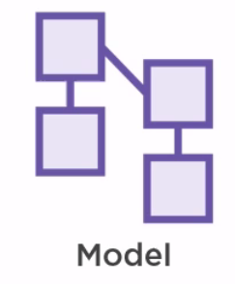
Demystify MVC pattern
Notes:
Model – handles the data for the application. In same application the model doesn’t contain any logic (behavior) => there is another component for this=> like business layer.

Slide 15
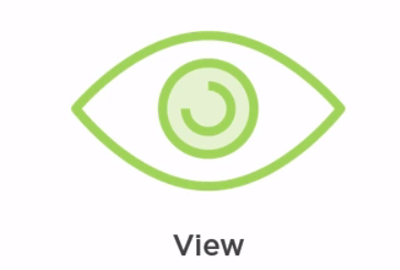
Demystify MVC pattern
Notes:
View – handles display of data. It might be html for instance.

Slide 16
Demystify MVC pattern
Notes:
View – handles display of data. It might be html for instance.

Slide 17
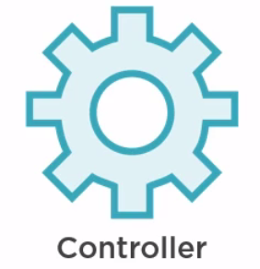
Demystify MVC pattern
Notes:
Controller -> handles the interaction between the view and the model including user input.

Slide 18
Demystify MVC pattern
Notes:
Controller -> handles the interaction between the view and the model including user input.
See dependencies. -> next slide.

Slide 19


Demystify MVC pattern
Notes:
Controllers and views depends on the model.
But …

Slide 20

Demystify MVC pattern
Notes:
Controller depends on the view as well.
But why we are discussing about MVC when the main subject is : Web API?
The answer is simple: an API is actually the “presentation of data”.
How an API works?

Slide 21
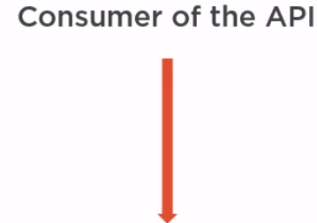
Demystify MVC pattern
Notes:
An consumer of API (another application) makes a request to the controller.

Slide 22
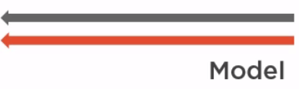

Demystify MVC pattern
Notes:
An consumer of API (another application) makes a request to the controller.
The controller return a model to the view.
The model is a Resource representation.

Slide 23
Demo: Adding ASP.NET Core MVC middleware

Slide 24
Demo : Returning resources (1)

Slide 25
Learning about routing
Notes:
What is routing?

Slide 26
Learning about routing
Matches request URI to controller method
Notes:
When a request is sent, the MVC parses the URI and tries to map the request to a controller method.
In order to solve this there 2 methods:

Slide 27
Learning about routing
Matches request URI to controller method
Convention based and attribute based routing

Slide 28
Learning about routing
Matches request URI to controller method
Convention based and attribute based routing
Convention based
app.UseMvc(routes =>
{
routes.MapRoute(
name: "default",
template: "{controller=Home}/{action=Index}/{id?}");
});
Notes:
For API, MVC team recommends not using convention based.
Instead the recommendation is attribute based routing.

Slide 29
Learning about routing
Matches request URI to controller method
Convention based and attribute based routing
Attribute based
Attributes at controllers/actions level
Notes:
Let’s have a look at the most common attributes.

Slide 30
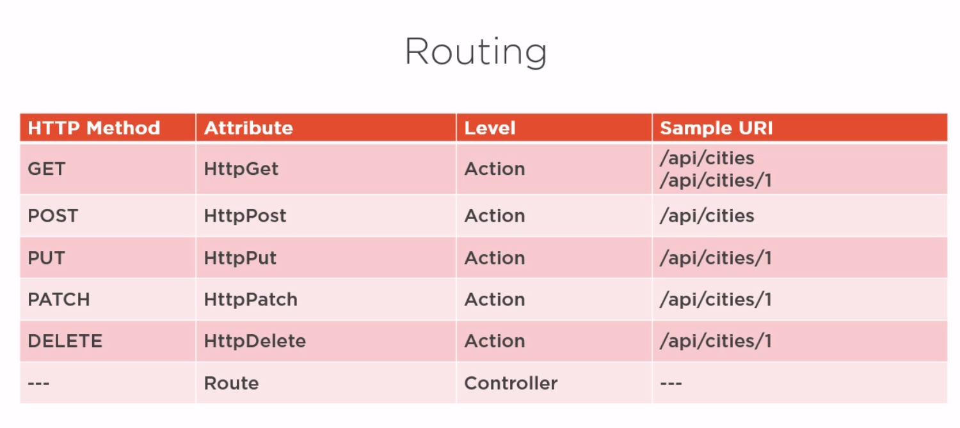
Learning about routing

Slide 31
Demo : Returning resources (2)

Slide 32
Demo : Improving the architecture with model classes

Slide 33
The importance of status codes
Notes:
What is status code?

Slide 34
The importance of status codes
Is a part of a response
Notes:
What is status code?

Slide 35
The importance of status codes
Is a part of a response
Provides information on:

Slide 36
The importance of status codes
Is a part of a response
Provides information on:
Whether or not the response worked as expected

Slide 37
The importance of status codes
Is a part of a response
Provides information on:
Whether or not the response worked as expected
Who is responsible for a failed request (consumer or our API)

Slide 38
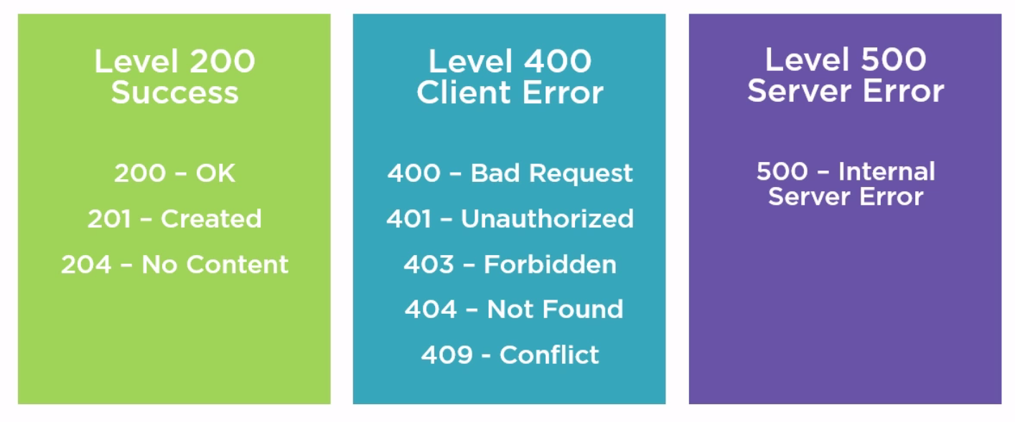
The importance of status codes

Slide 39
Demo : Returning correct status codes

Slide 40
One more thing…(1/2)
Notes:
Postel’s law.

Slide 41
One more thing…(2/2)
Postel’s Law:
“Be conservative in what you do, be liberal in what you accept from others.”
Notes:
Postel’s Law is a clever bit of social engineering.
Also known as the Robustness Principle.

Slide 42
Summary
Status codes
MVC
How to build a proper API
Routing

Slide 43
Bibliography
Pluralsight

Slide 44
Questions
Do you have any other questions?

Slide 45
Thanks!
See you next time! ☺

