Slide 1
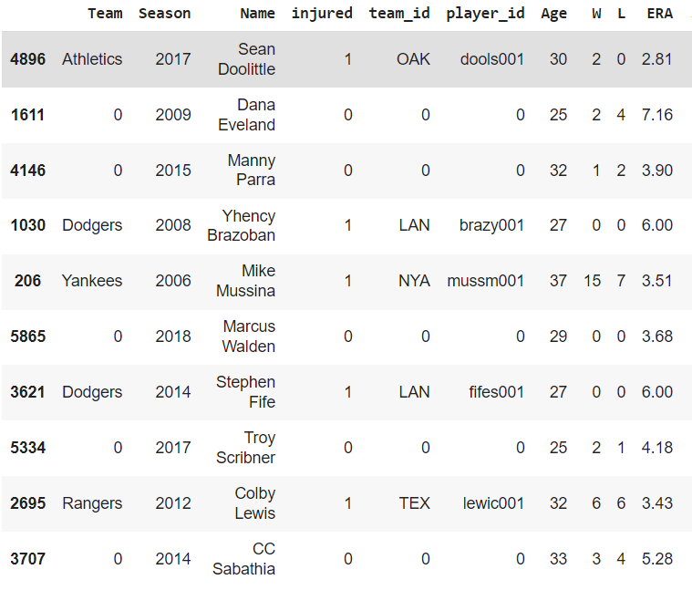
Apply machine learning in MLB Injury prediction
Data
Over 8000 injury and performance data from each player’s most recent season
300 features, mostly performance stats.
Output : injury prediction
Goal: Model Optimization
using the performance data for the current year to predict injuries in the subsequent year

Slide 2
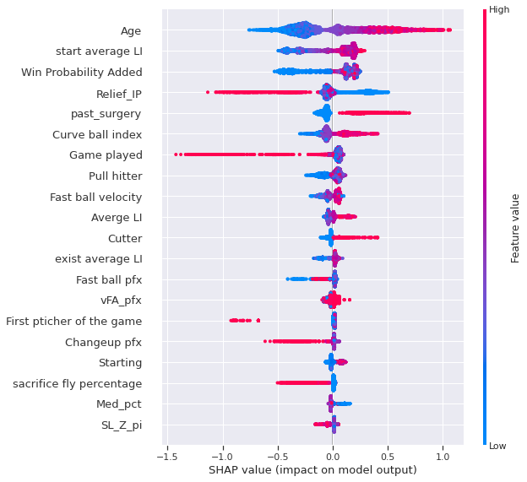
#1 Feature selection
SHAP scores
SHAP (Shapley Additive exPlanations ) scores
Feature importance graph by XGboost

Slide 3
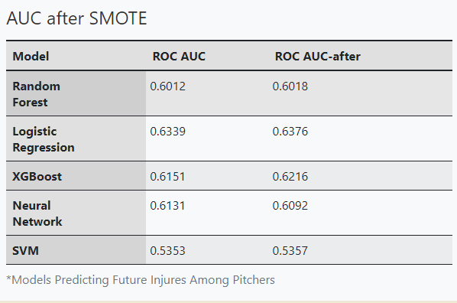
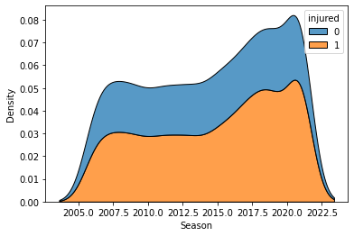
#2 SMOTE
Synthetic Minority Oversampling Technique (SMOTE)
Overcoming class imbalance
Improve the performance of weak learners
Evaluation metric : AUC

Slide 4
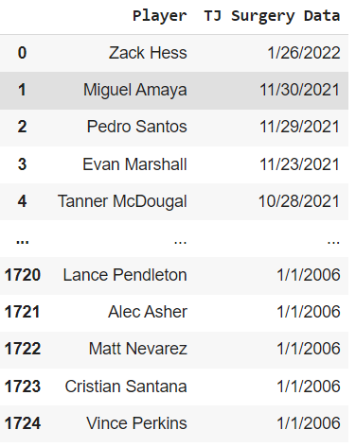
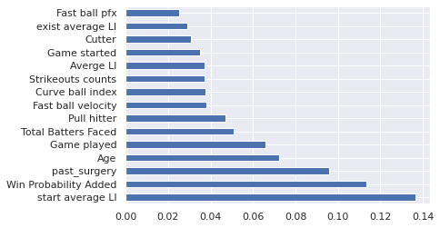
#3 Introduce New Features
Tommy john surgery
Information about player’s past surgery
Strong indicator for injury prediction

Slide 5
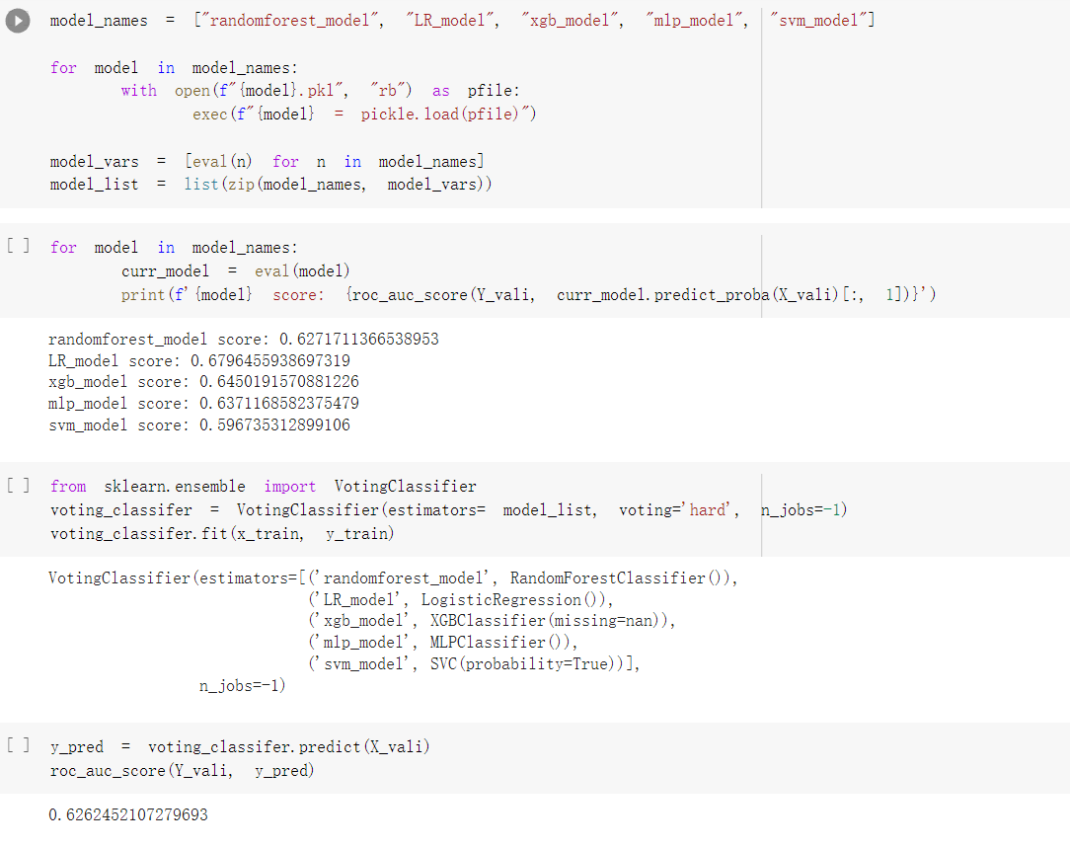
#4 Ensemble algorithm
MAX VOTING Classifier
Combine multiple machine learning models
Auc score = 0.6262
Xgboost = 0.6998

Slide 6
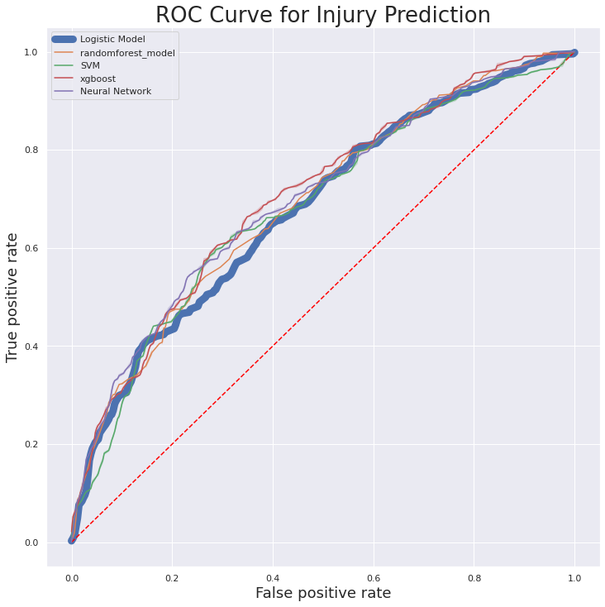
Test results
LR ROC AUC score = 0.6789
XGBoost ROC AUC score = 0.7035
RF ROC AUC score = 0.6900
SVM ROC AUC score = 0.6815
NN ROC AUC score = 0.6983

Slide 7
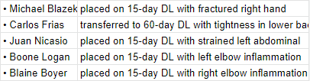
Future work
Disabled list provide the site of injury:
Knee/foot/ankle/shoulder/elbow/back
Prediction on each site of injury
Pros:
Great return if the added variables could give model more information to learn
We already have the data
Cons:
Time consuming.

