Slide 1
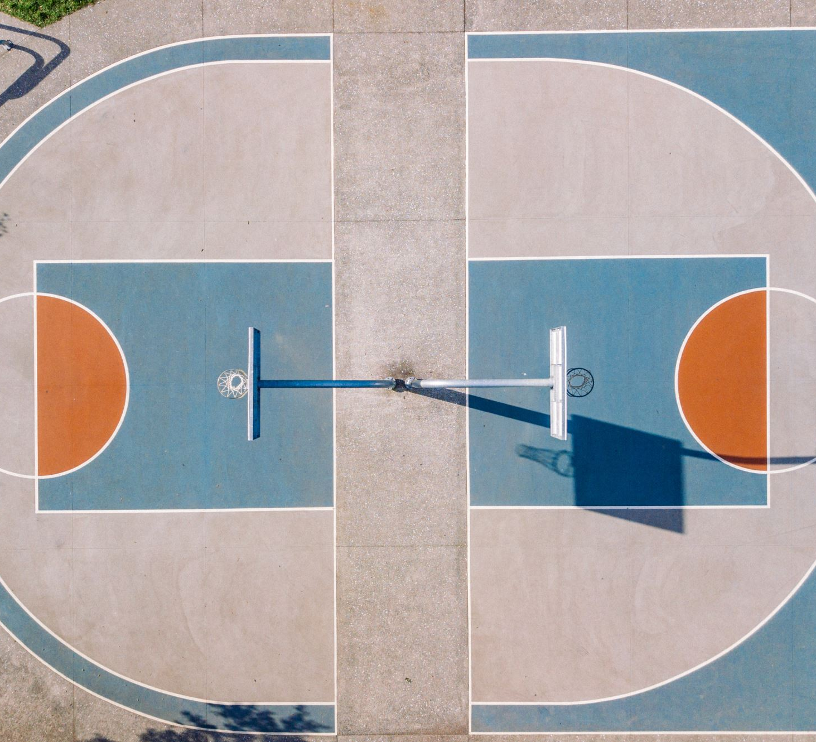
Apply machine learning into NBA shot prediction
Group 39
Fan Yang

Slide 2
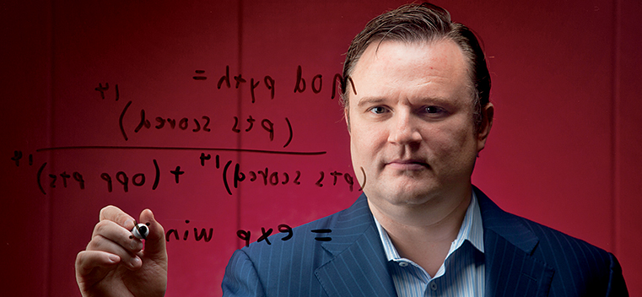
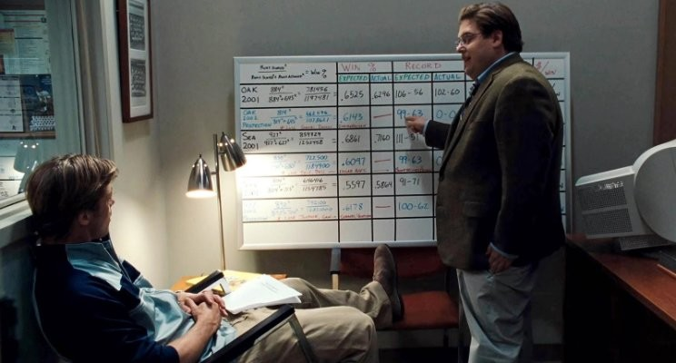
Moreyball – sports analytics

Slide 3
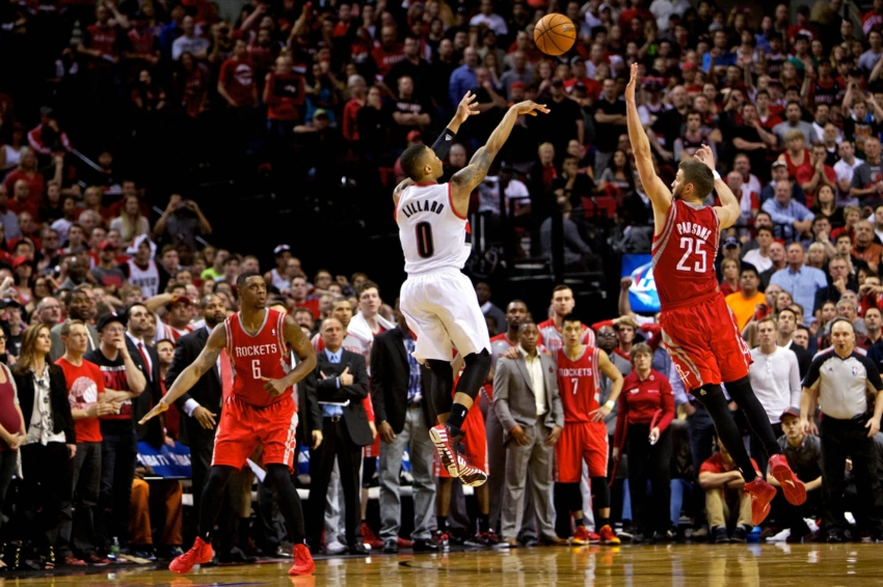
introduction
Shot selections
Purpose: Identifying the importance of features
Goal: Model Optimization
https://fansided.com/2014/07/30/chandler-parsons-damian-lillard-relive-shot/

Slide 4
Dataset
Shot Info | Time info | Side info | Defender’s info
Player id | Period | Dribbles | Closest defender
shot type | Game clock | Touch time | Closest defender distance
Shot distance | Shot clock | Pts made
Kaggle
130,000 shooting data
281 players
2014-2015

Slide 5
Data preprocessing
Convert feature values into something we could use for modeling
Game clock Seconds
Abnormal values NaNs
Shot types -> Categorical data
Scaling
Shot clock Standardization
Shot number, dribbles, touch time Robust Scaling
Period, shot distance Min-Max transformation
NaN values mean

Slide 6
Input & output
Home match
Shot number
Period
Game clock
Shot clock
Dribbles
Touch time
Shot distance
3 points shot
Outputs:
Hits

Slide 7
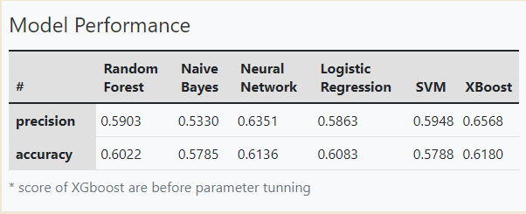
Modeling
Random forest
Naïve Bayes
Neural Network
Logistic Regression
XGboost
SVM

Slide 8
Parameter tuning
XGBoost | Precision | Accuracy
Before | 0.6568 | 0.6180
After | 0.6880 | 0.6223

Slide 9
K-fold cross validation
 | Random Forest | Naïve Bayes | Neural Network | Logistic Regression
Without validation | 0.6022 | 0.5785 | 0.6136 | 0.6083
With validation set | 0.6014 | 0.5803 | 0.5964 | 0.6097

Slide 10
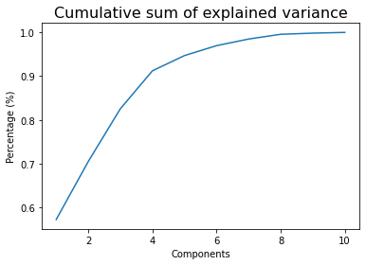
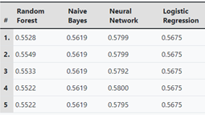
Principal components analysis

Slide 11
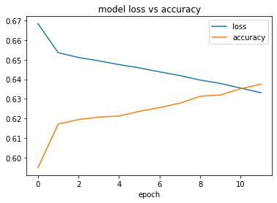
LSTM model
63.75%

Slide 12
Conclusion
Provide a detailed data processing method that could be used in future work
A discussion on proposing a solution to overfitting based on k-fold cross validation has been provided
Implement LSTM model and present its performance.
Testing the unnecessity of dimension reduction when facing datasets with relatively few variables.

Slide 13
Defenders' data
Introduce more defender’s information to the dataset
- Variables like heights, standing reach, wingspan.
Cons: Not all players plays defense while they are on the court.
 | defender | Good defense
1 | Serge Ibaka | 480
2 | Draymond Green | 450
3 | DeAndre Jordan | 414
4 | Pau Gasol | 400
5 | Paul Millsap | 393

Slide 14
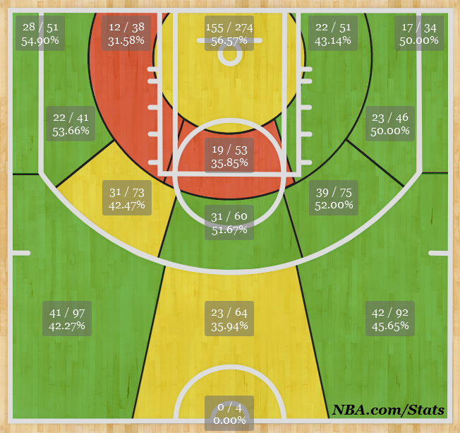
Hot zone
Introduce more spatial data such as the location (X, Y, Z) of each shot.
Cons: Spatial data is relatively hard to acquire.

Slide 15
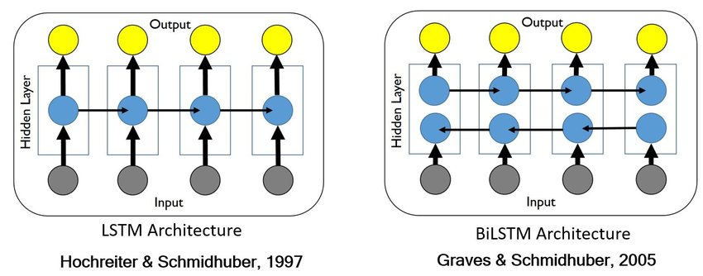
BiLSTm model

Slide 16

Thank You for you FOR you attention
-Fan Yang

