Slide 1

StudyOS Agent testing session
Install it, connect the demo model, then test whether another student can use it without developer help.
Output for the slot: installation notes, one completed task, and anonymous feedback.
StudyOS Agent tool test · 1
Tue-StudyOS/StudyOS_Agent

Slide 2
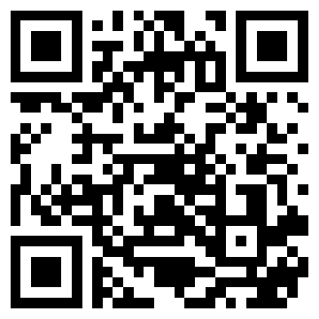
Start from the public install page
Scan the QR code or open the short URL. The same page links to the release assets.
01
Android phone
Download studyos-agent-1.0.0-1-android.apk, allow install from browser or file manager, then open it.
02
Laptop browser
Download studyos-agent-web-1.0.0-1.zip, unzip it, serve the folder, then open localhost.
03
Developer machine
Clone the repo, run flutter pub get, then run the app in Chrome from flutter_app.
tue-studyos.github.io/StudyOS_Agent/
StudyOS Agent tool test · 2
Tue-StudyOS/StudyOS_Agent

Slide 3
Pick the install route that matches your device
Keep the session focused by choosing the fastest route that can actually run on the tester's machine.
Android
Any OS
Source
Run: Release APK
Run: Web zip + local server
Run: flutter run -d chrome
Requires: Android device
Requires: Python 3 and browser
Requires: Flutter stable, Dart 3.12+
Watch for: Install prompts or blocked unknown-source setting
Watch for: Blank page, direct file open, or port conflict
Watch for: Missing SDK, pub get failure, or Chrome target failure
StudyOS Agent tool test · 3
Tue-StudyOS/StudyOS_Agent

Slide 4
Connect the shared lecture model
Use Custom assistant setup for the demo. The key is capped and expires after the lecture.
Settings -> Assistant setup -> Custom
Endpoint
https://openrouter.ai/api/v1/chat/completions
Model
nvidia/nemotron-3-ultra-550b-a55b:free
Demo API key
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
StudyOS Agent tool test · 4
Tue-StudyOS/StudyOS_Agent

Slide 5
Give every tester the same three tasks
The goal is comparable feedback, not a free-form demo.
01
Install and launch
Use the selected install route, open the app, and record the first blocker or time-to-first-screen.
02
Ask one tool-backed question
Example: “What vegan Mensa options are available this week?” Check whether the answer matches the Campus tab.
03
Test memory
Ask: “Remember that I prefer vegan lunch near Wilhelmstrasse.” Then ask: “What do you remember about my lunch preference?”
StudyOS Agent tool test · 5
Tue-StudyOS/StudyOS_Agent

Slide 6
Good prompts make the tools visible
Ask for actions that should leave evidence in the UI, trace, or local state.
Campus
What vegetarian or vegan meals are available this week?
Memory
Remember that I study best in the morning, then read that memory back.
Schedule
What is the next lecture in my cached timetable?
Mail
Do I have recent university mails that mention a deadline?
Android
Open YouTube and search for StudyOS demo, or create a reminder for tomorrow.
StudyOS Agent tool test · 6
Tue-StudyOS/StudyOS_Agent

Slide 7
Feedback should explain what failed or worked
SurveyHero is enough; make the form anonymous and short.
Ask for
Use the last five minutes
Installation blocker
Unclear setup step
First useful answer
Wrong or missing tool behavior
One improvement request
Compare blockers
Group repeated bugs
Decide one fix before the next meeting
Keep concept feedback separate from install bugs
Suggested feedback tool: https://www.surveyhero.com/
StudyOS Agent tool test · 7
Tue-StudyOS/StudyOS_Agent

