Slide 1
StudyOS
Plan your studies in one place
Ben Tischberger · Yonatan Dankner · Emre Sözbilir · Lena Binder
Presented by Ben and Yonatan

Slide 2
The problem
problem framing
Course info lives in ALMA, PDFs and spreadsheets
Timetables need manual cross-checking
Degree progress is guesswork

Slide 3
What students told us
user research
“ALMA is my only info source, but I hate the UI.”
“I plan with Excel and the PO PDF.”
“I check three sites before every semester.”
“Show me which courses fit my degree.”
“Let me search by professor.”
“One calendar with all my courses.”
“Tell me what I still need to graduate.”
“Just make it one page.”

Slide 4
What StudyOS can do
concept and solution
Catalog
Planner
All Informatik courses Filters and professor search Nine semesters of data
Weekly timetable Conflict check and tutorial groups Calendar export (ICS)
Progress
Beyond the app
Transcript PDF upload Exam regulations tracked See what is still open
GPT access via MCP Feedback built in German and English

Slide 5
Degree programs we cover
all PO 2021, official sources
Full curriculum
Progress tracking
every module, category and ECTS rule
transcript import and requirement check
B.Sc. Informatik (180 ECTS) M.Sc. Informatik (120 ECTS) M.Sc. Machine Learning (120 ECTS)
B.Sc. Bioinformatik (180 ECTS) B.Sc. Medieninformatik (180 ECTS) B.Sc. Medizininformatik (180 ECTS)

Slide 6
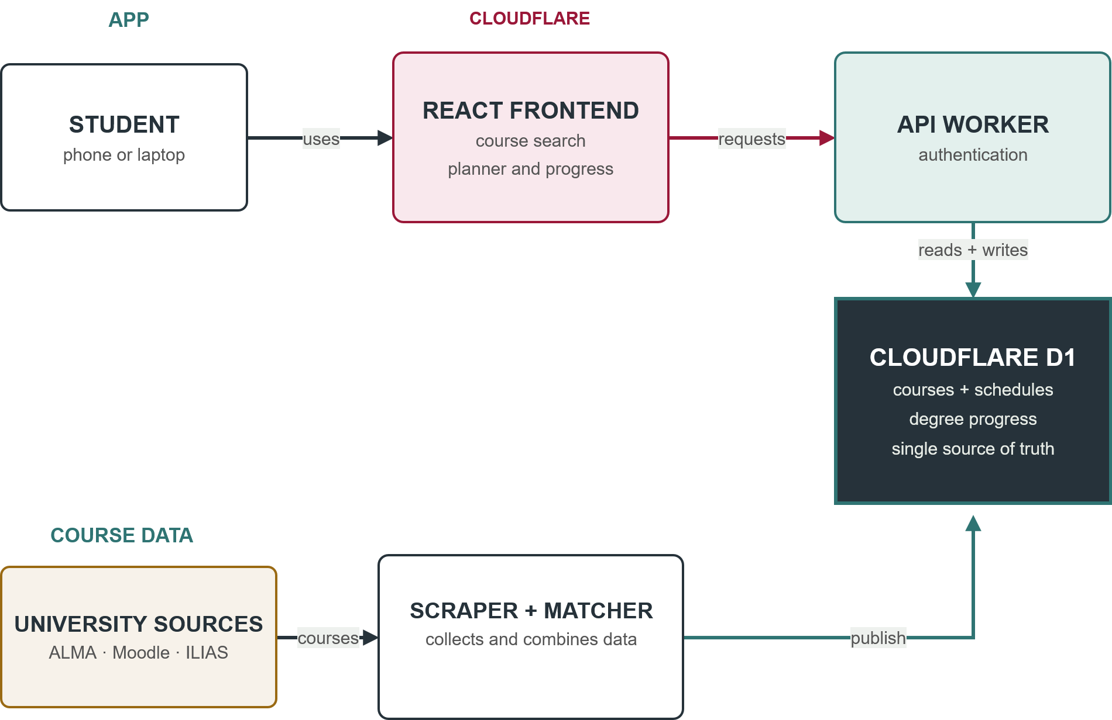
How the data flows
implementation

Slide 7

Runs on Cloudflare
implementation
Pages serves the frontend, Workers run the API
D1: SQLite at the edge, one database for catalog and accounts
Merge to main deploys automatically, config checked in CI
Free tier covers all of it

Slide 8
How we worked
practically everything is vibecoded
Claude
Cursor
Great at UI work. Expensive.
Cheap, solid code. UI taste is meh.
Codex / GPT
What we learned
The mix in between.
Every tool has a ceiling. Review everything, keep commits small.

Slide 9
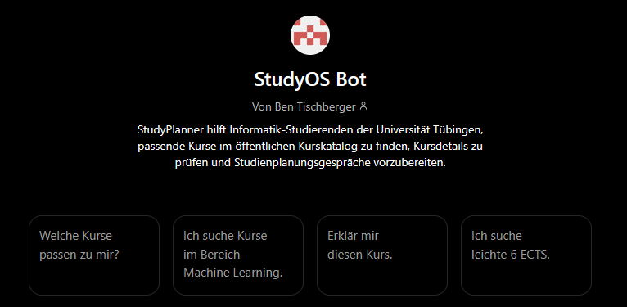
StudyOS Bot, our GPT
talks to the catalog over MCP, read-only, no account
Search courses, resolve one, get details
Works with ChatGPT, Claude, any MCP client
Endpoint: studyplaner.pages.dev/mcp
Open the StudyOS Bot

Slide 10
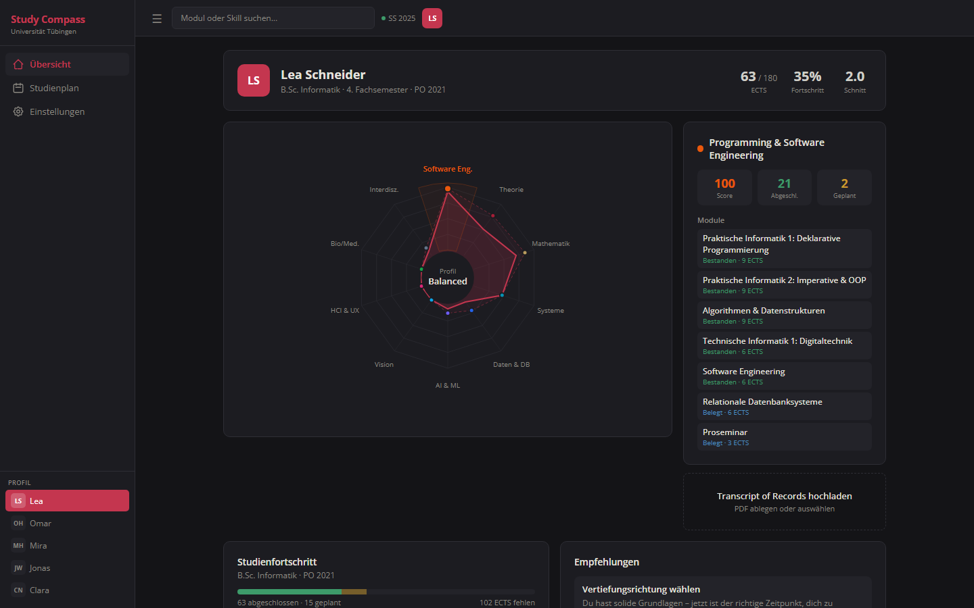

Slide 11
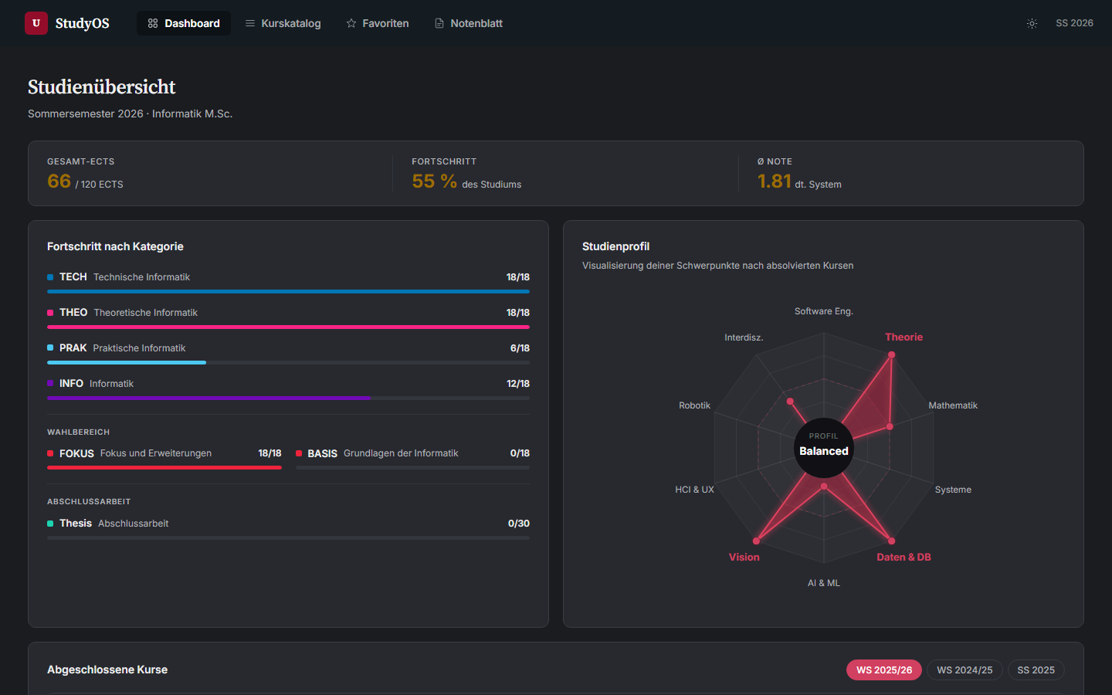

Slide 12
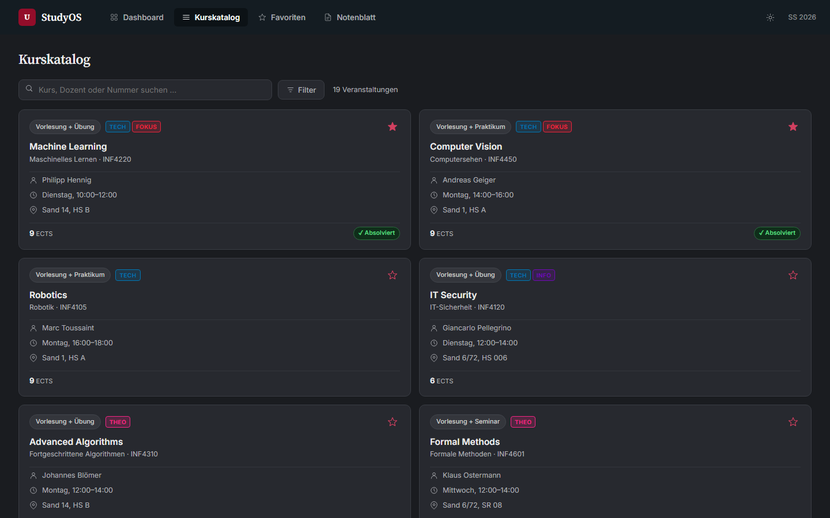

Slide 13
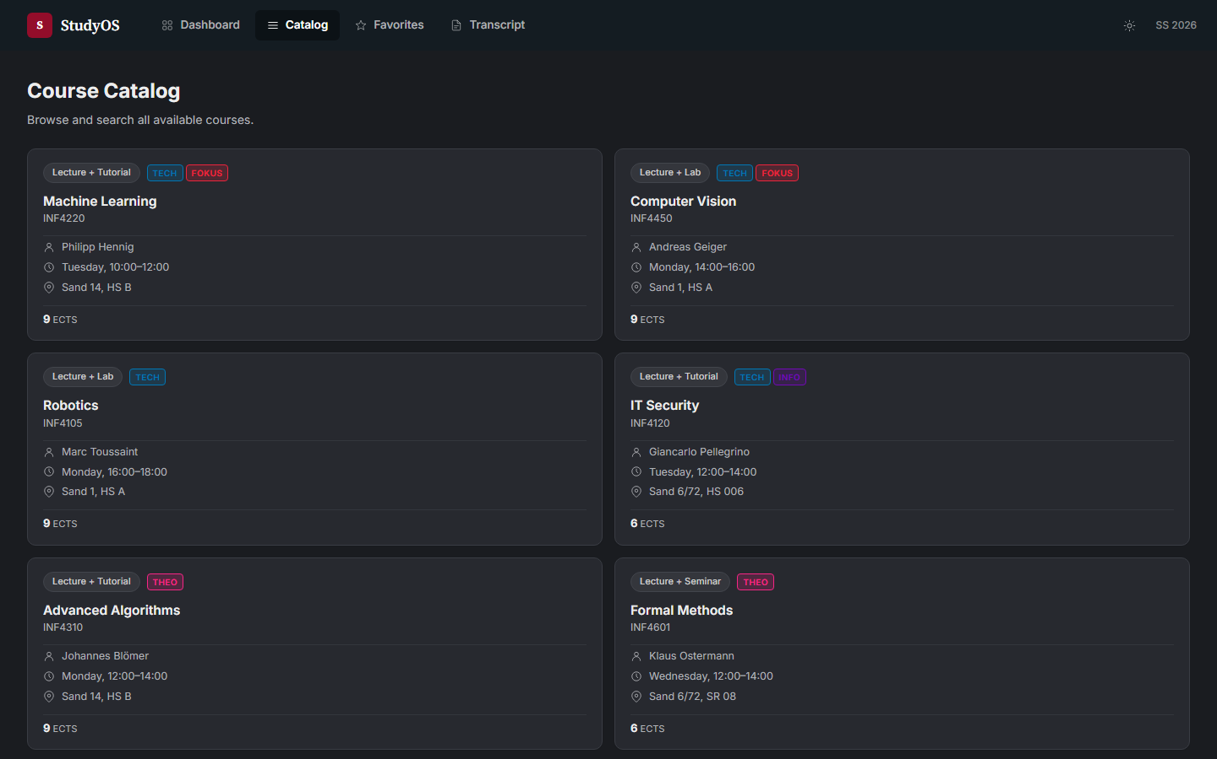

Slide 14
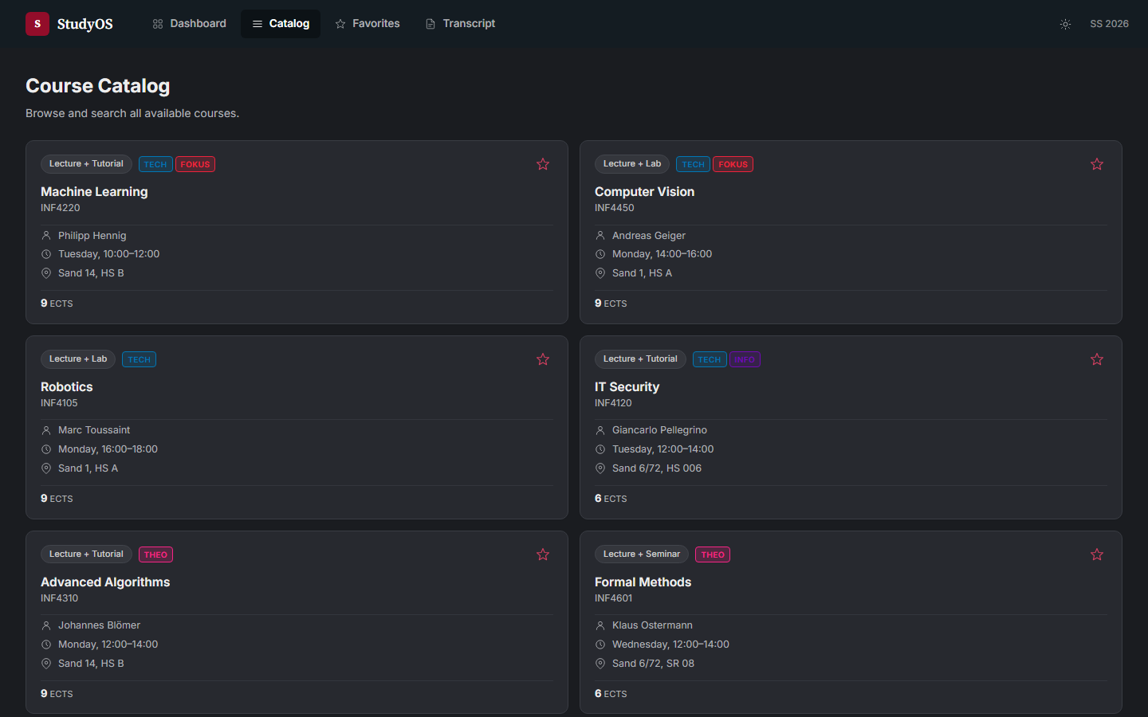

Slide 15
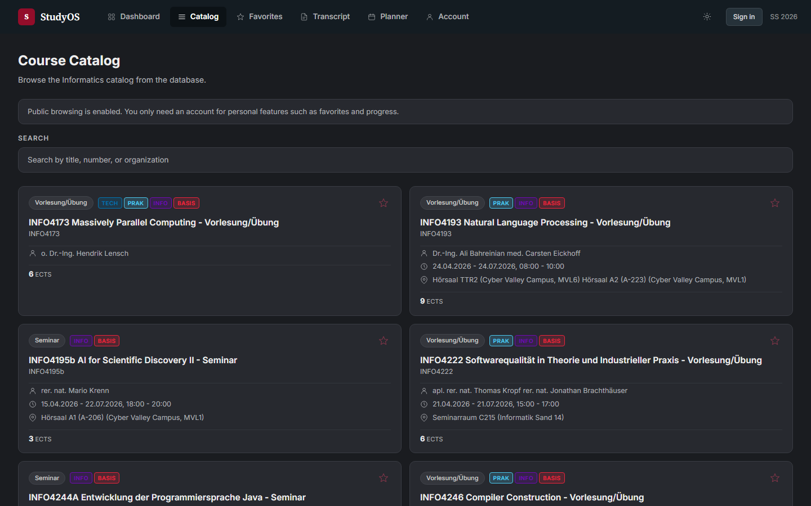

Slide 16
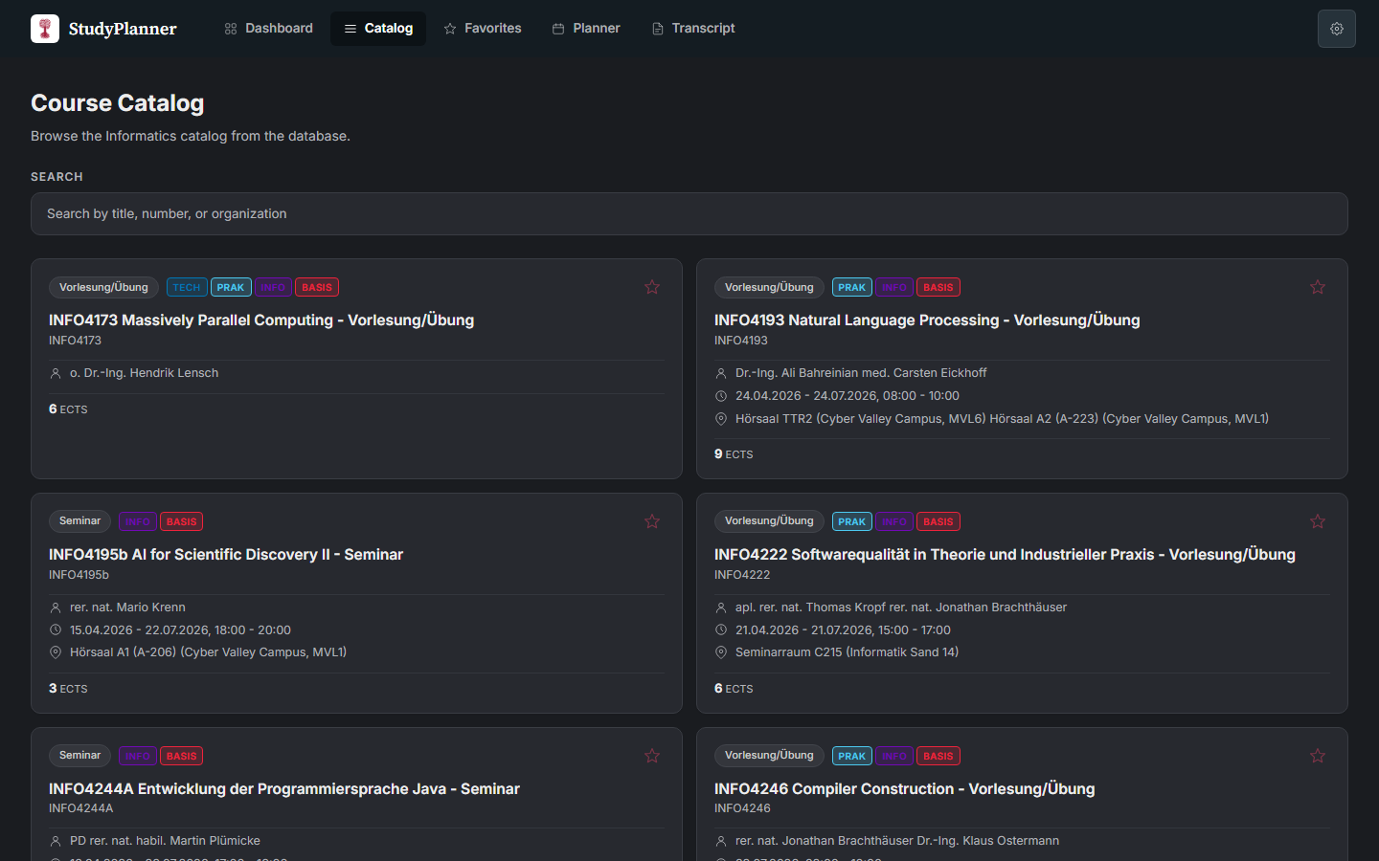

Slide 17
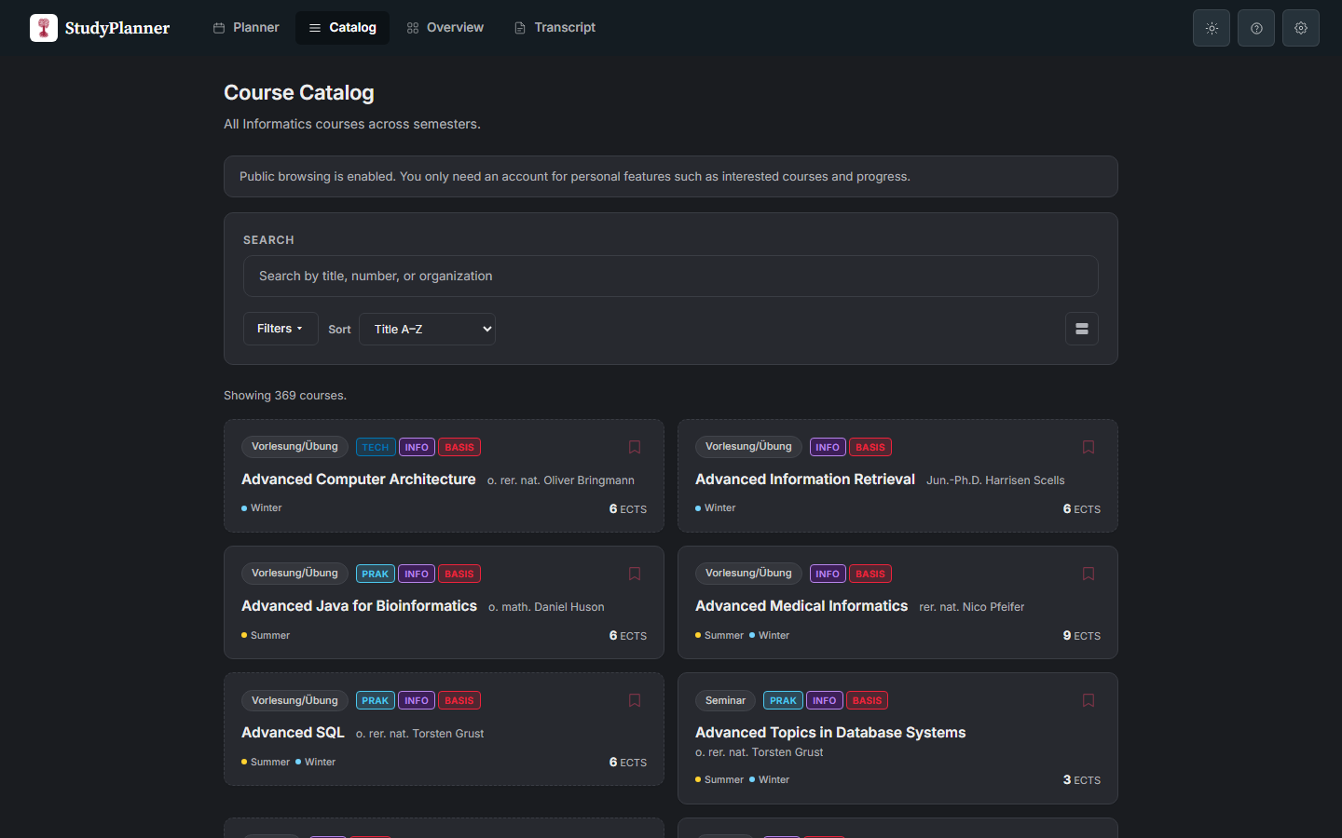

Slide 18
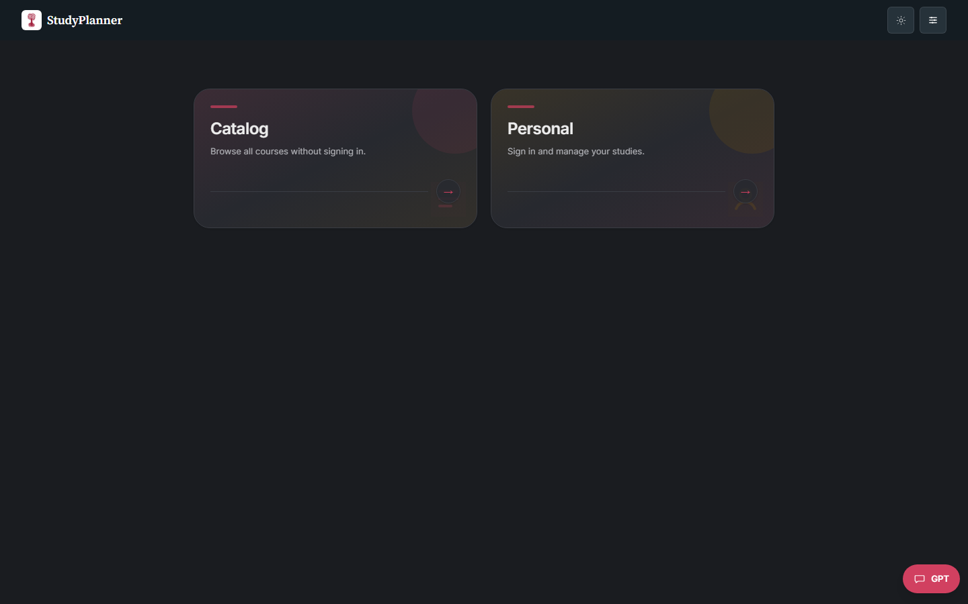

Slide 19
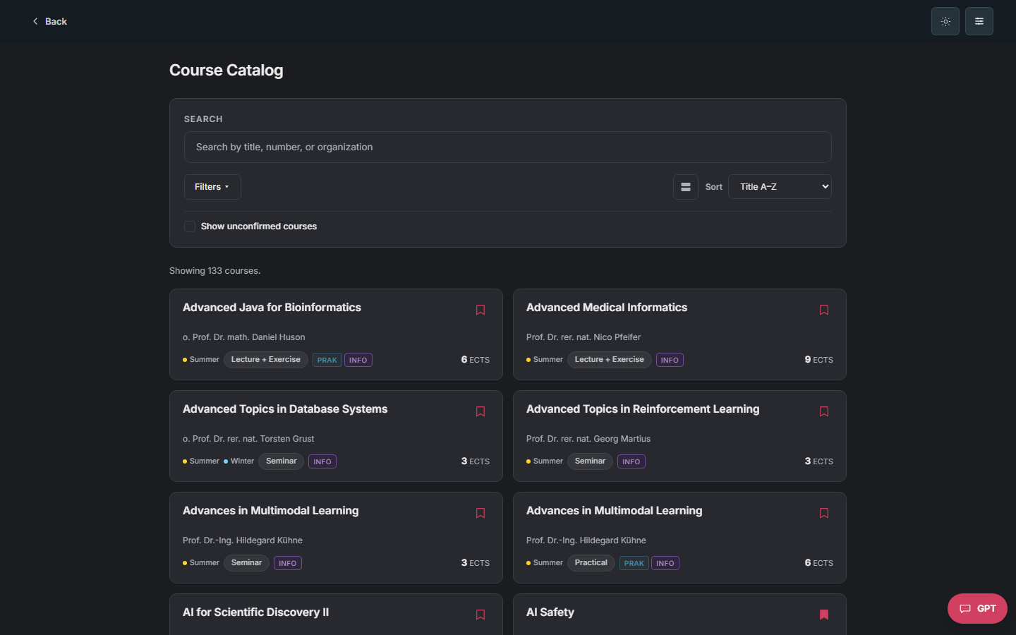

Slide 20
Feedback along the way
testing and iteration
“Icons for the semesters instead of writing them out.”
“Make more things clickable, let them set the filters.”
“Let me drag courses in and out of the calendar.”
“Delete looks like collapse, I lost my plan.”
“Why is everything red? Red means error.”
“Two lecture halls, but no real conflict.”

Slide 21
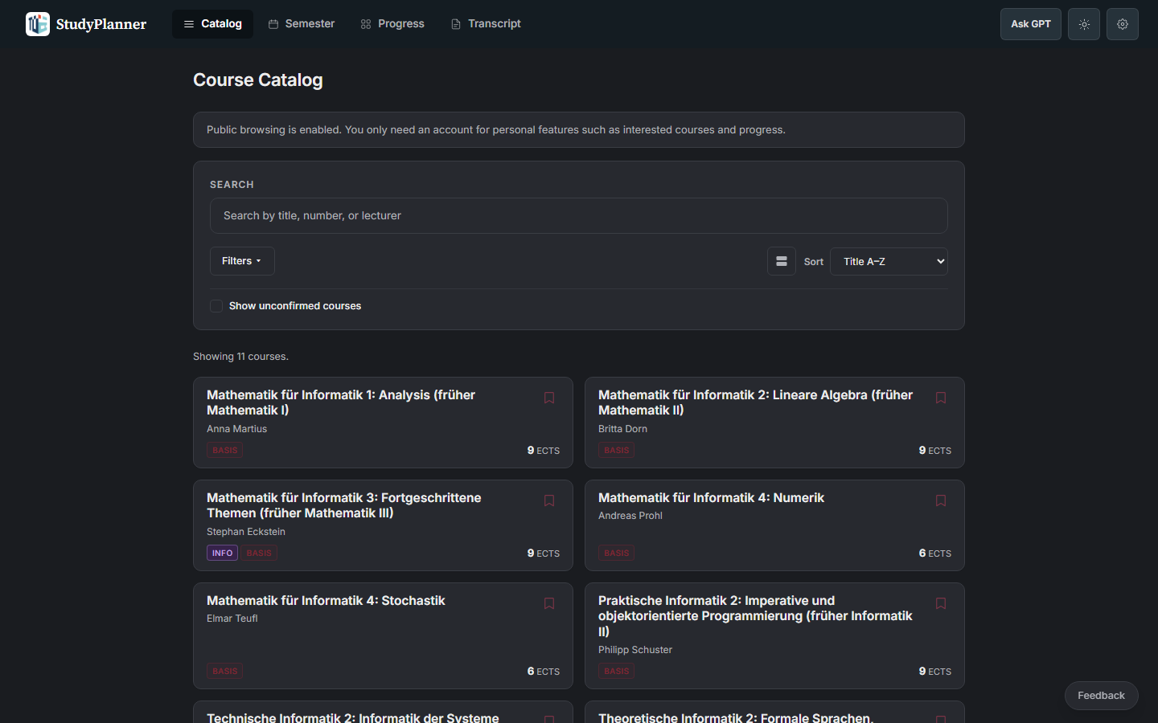

Slide 22
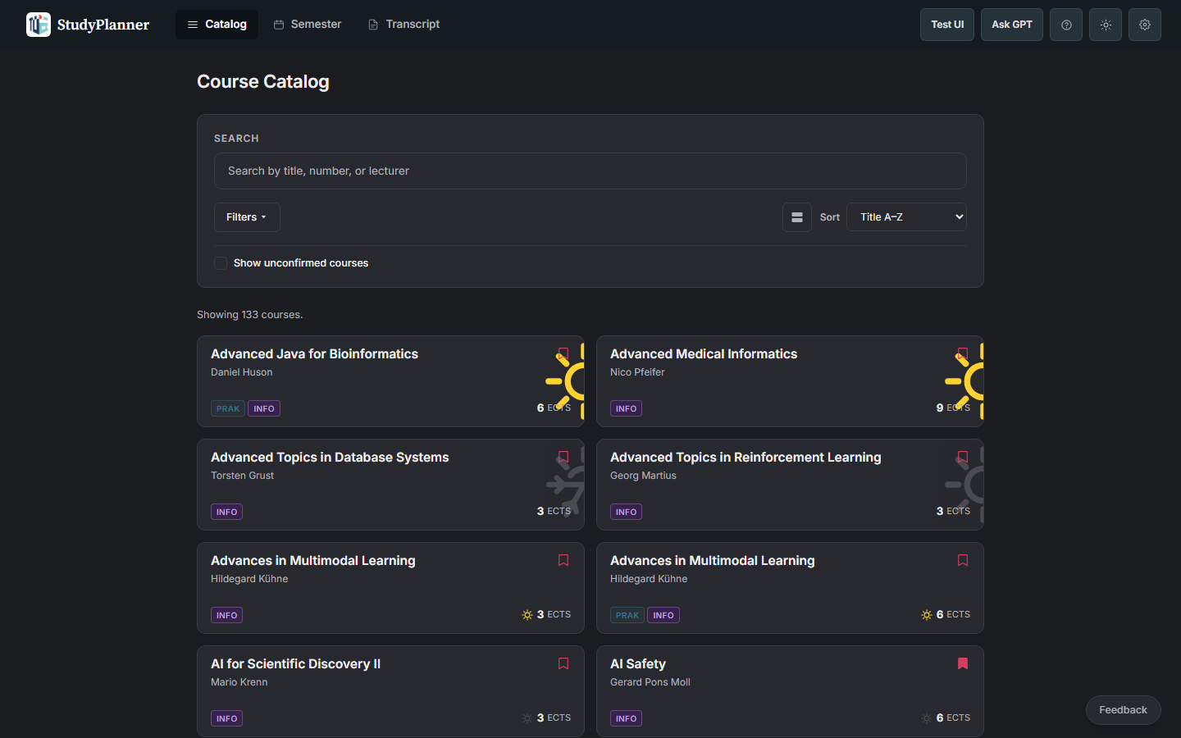

Slide 23
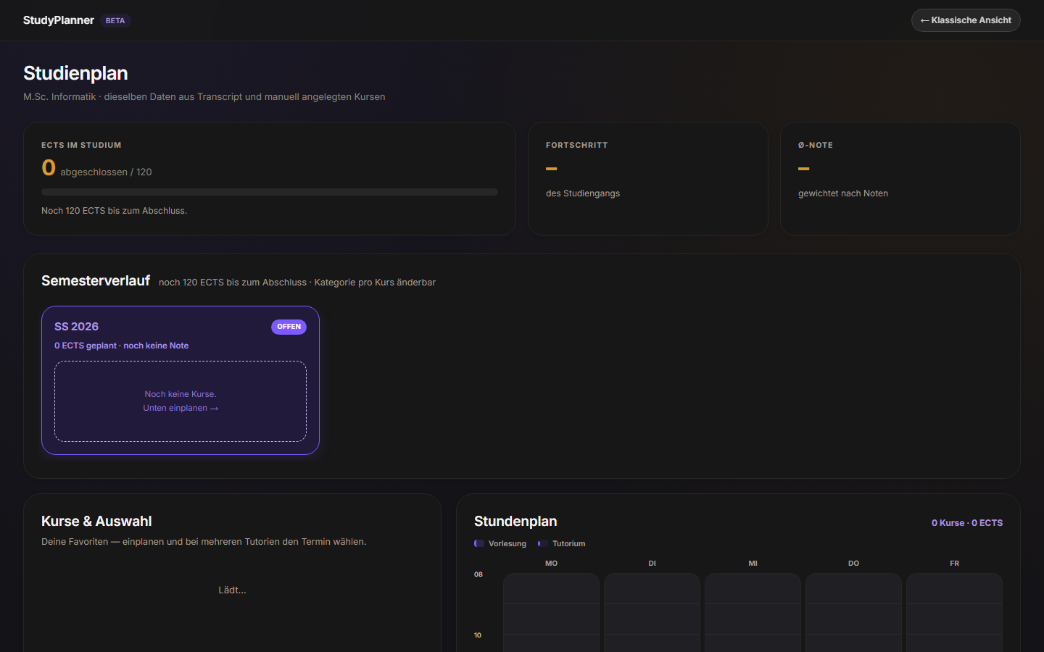

Slide 24
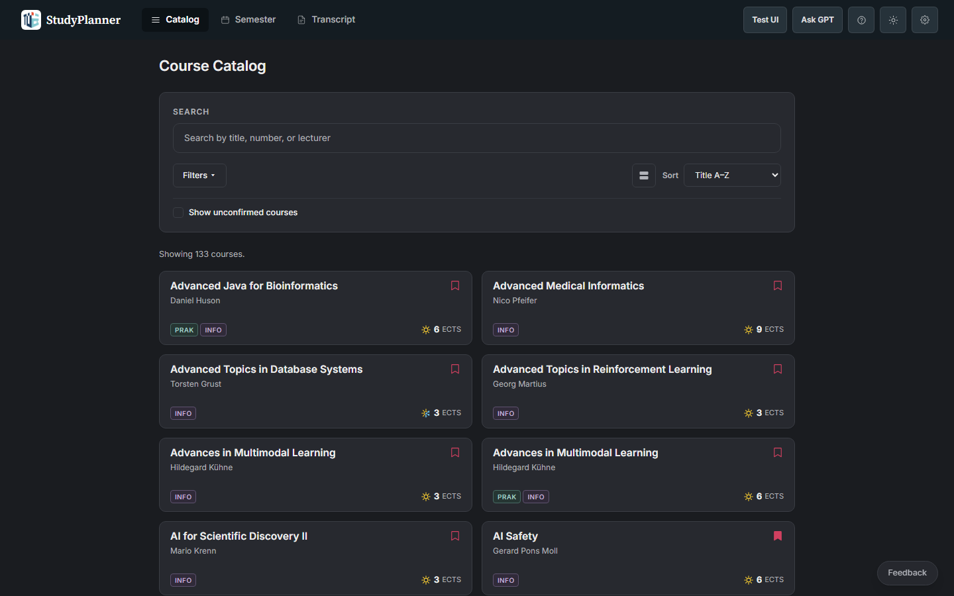

Slide 25
…and many more changes than fit in one deck.
Every round of feedback became a fix within days.

Slide 26
What we fixed
shipping
Favorites in terms with no offering
→
Availability check
Fake room conflicts
→
Fixed conflict logic
Delete looked like collapse
→
Clearer delete
Too much red
→
Red only for errors
Crowded planner
→
Decluttered layout

Slide 27
Where we are today
shipped
1,158 courses across 9 semesters, summer 2022 to summer 2026
Live at studyplaner.pages.dev, catalog public, account for plans and progress
Timetable with ICS export, transcript import, German and English

Slide 28
Live demo

Slide 29
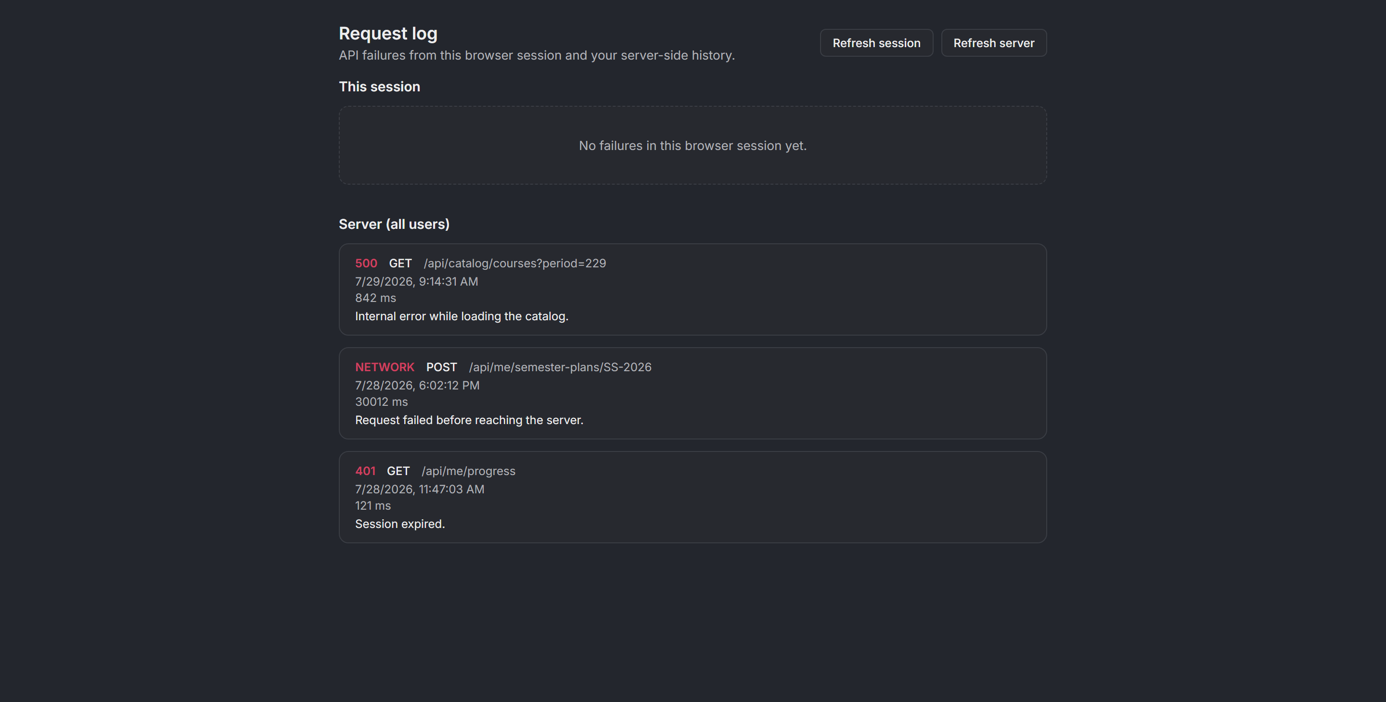
Idea: an agent watches this log and proposes a fix before anyone reports it.

Slide 30

What's next
it already runs without us
Scraping and deploys are automated, the app runs on its own
Codex-style automation on top: agents fix what the log reports
Missing piece: PO knowledge for programs we don't study ourselves
The same principle scales to more degree programs
The Fachschaft keeps it alive, Erstiheft and mailing list reach the students

Slide 31

Try it
studyplaner.pages.dev
The feedback button is in the app. Use it, we read everything.

