Slide 1
StudyOS
Plan your studies in one place
Ben Tischberger · Yonatan Dankner · Emre Sözbilir · Lena Binder
Presented by Ben and Yonatan
StudyOS Practical - P. Gehler - July 2026
1

Slide 2
Problem
problem framing and evolution
StudyOS Practical - P. Gehler - July 2026
2

Slide 3
Problem - What we solve
Course info lives in ALMA, PDFs and spreadsheets
Timetables need manual cross-checking
Degree progress is guesswork
X
Course planning is scattered across systems that don't talk to each other
Y
Informatik students in Tübingen, all six PO 2021 programs
Z
One app: catalog, weekly timetable and degree progress together
StudyOS Practical - P. Gehler - July 2026
3

Slide 4
Students
user research and evidence
StudyOS Practical - P. Gehler - July 2026
4

Slide 5
Students - What they told us
“ALMA is my only info source, but I hate the UI.”
“I plan with Excel and the PO PDF.”
“I check three sites before every semester.”
“Show me which courses fit my degree.”
“Let me search by professor.”
“One calendar with all my courses.”
“Tell me what I still need to graduate.”
“Just make it one page.”
StudyOS Practical - P. Gehler - July 2026
5

Slide 6

Product
concept and solution design
StudyOS Practical - P. Gehler - July 2026
6

Slide 7
Product - What StudyOS can do
Catalog
Planner
All Informatik courses
Filters and professor search
Nine semesters of data
Weekly timetable
Conflict check and tutorial groups
Calendar export (ICS)
Progress
Beyond the app
Transcript PDF upload
Exam regulations tracked
See what is still open
GPT access via MCP
Feedback built in
German and English
StudyOS Practical - P. Gehler - July 2026
7

Slide 8
Product - Degree programs
We support the PO 2021 exam regulations of six programs. Everything works for each of them.
Bachelor (180 ECTS)
Master (120 ECTS)
B.Sc. Informatik
B.Sc. Bioinformatik
B.Sc. Medieninformatik
B.Sc. Medizininformatik
M.Sc. Informatik
M.Sc. Machine Learning
StudyOS Practical - P. Gehler - July 2026
8

Slide 9
Build
implementation and prototype
StudyOS Practical - P. Gehler - July 2026
9

Slide 10
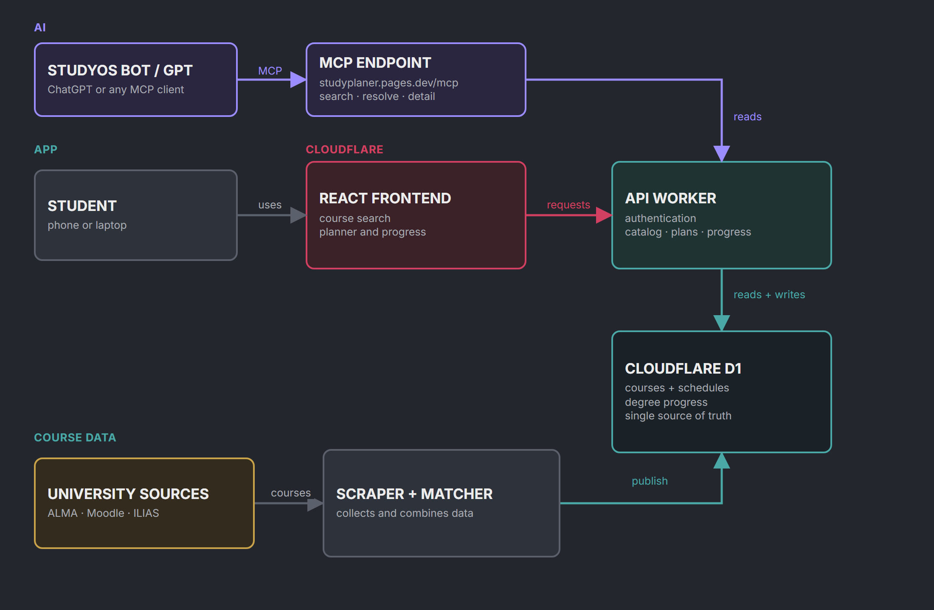
Build - How the data flows
StudyOS Practical - P. Gehler - July 2026
10

Slide 11

Build - Runs on Cloudflare
Pages serves the frontend, Workers run the API
D1: SQLite at the edge, one database for catalog and accounts
Merge to main deploys automatically, config checked in CI
Free tier covers all of it
StudyOS Practical - P. Gehler - July 2026
11

Slide 12




Build - How we worked
Claude
Cursor
Codex + Pi
Great at UI work. Expensive.
Cheap, solid code. UI taste is meh.
Both used with GPT.
→ Each tool has clear limits. We mixed them by task and reviewed everything.
StudyOS Practical - P. Gehler - July 2026
12

Slide 13
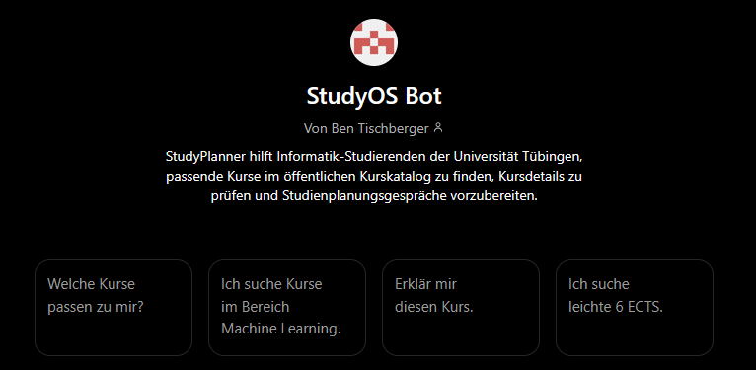
Build - StudyOS Bot, our GPT
Search courses, resolve one, get details
Works with ChatGPT, Claude, any MCP client
Endpoint: studyplaner.pages.dev/mcp
Open the StudyOS Bot
StudyOS Practical - P. Gehler - July 2026
13

Slide 14
Iterate
testing, iteration and shipping
StudyOS Practical - P. Gehler - July 2026
14

Slide 15
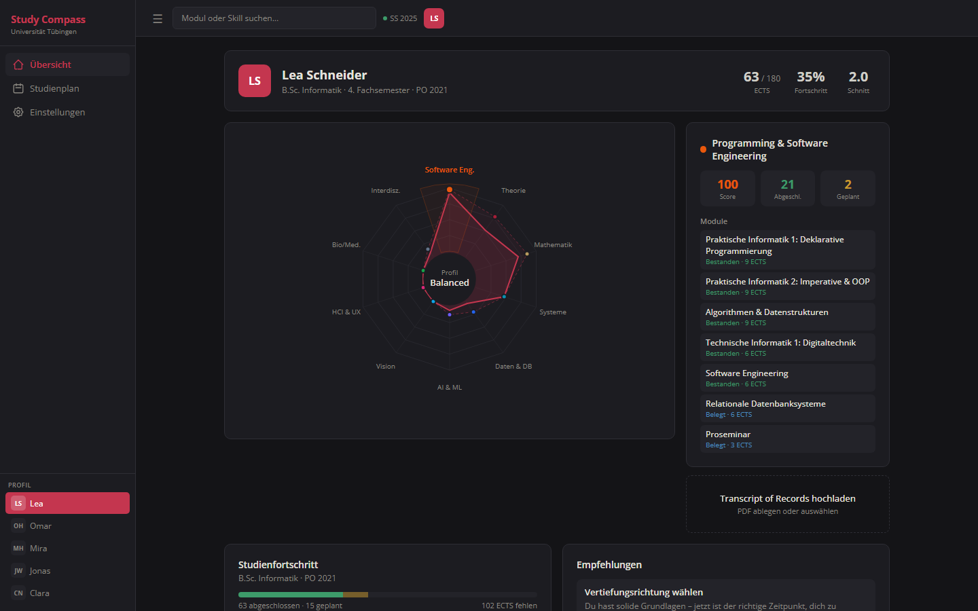

Slide 16
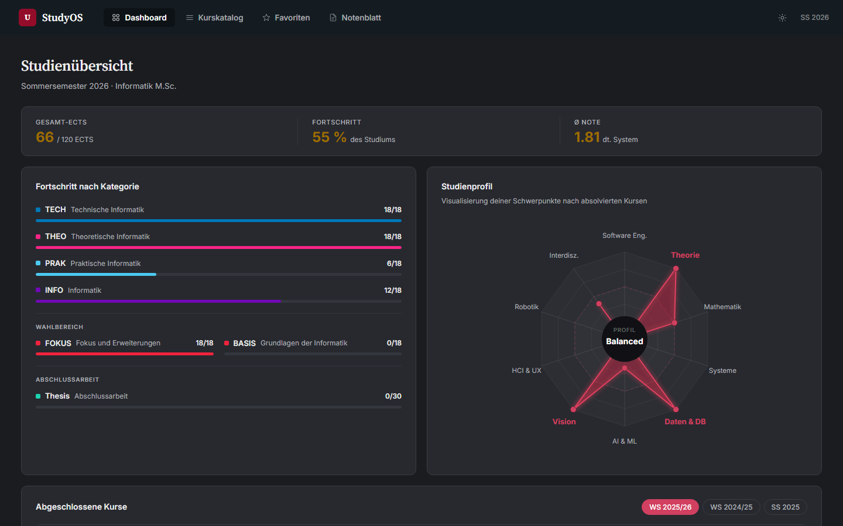

Slide 17
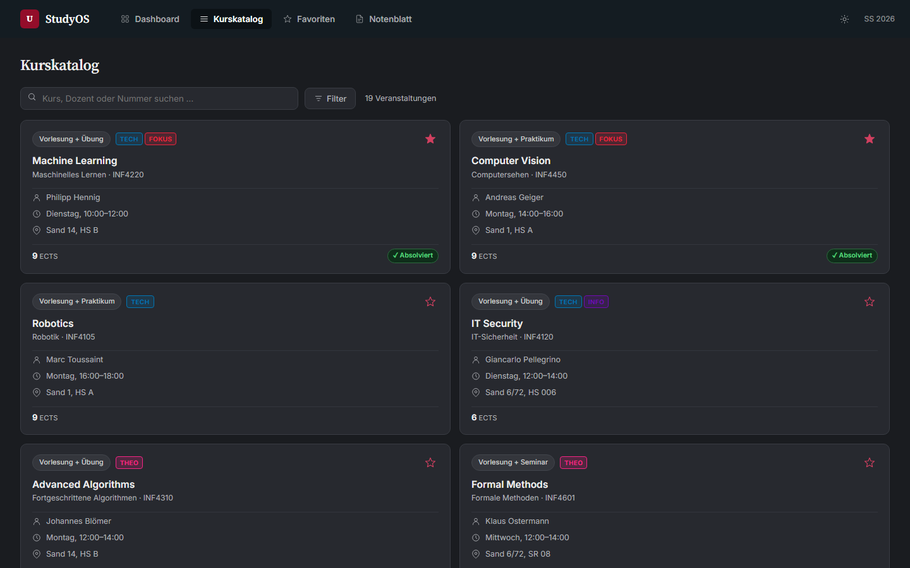

Slide 18
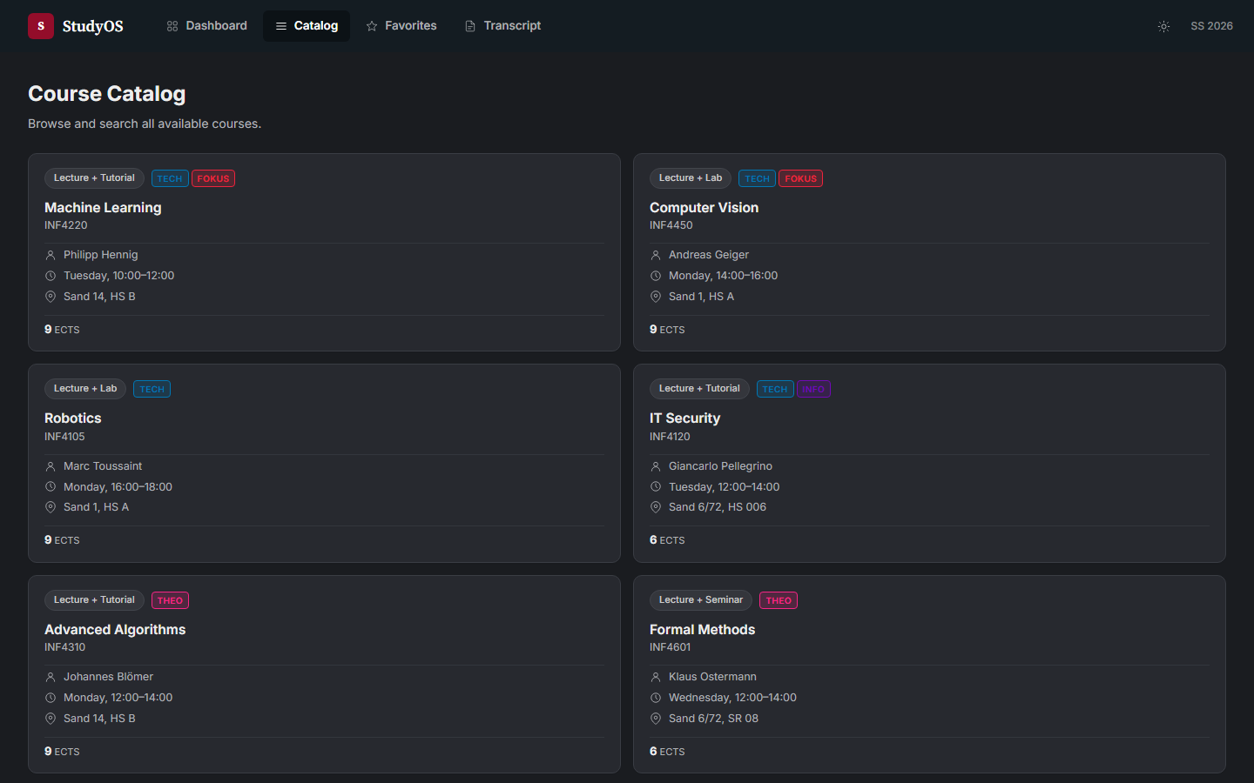

Slide 19
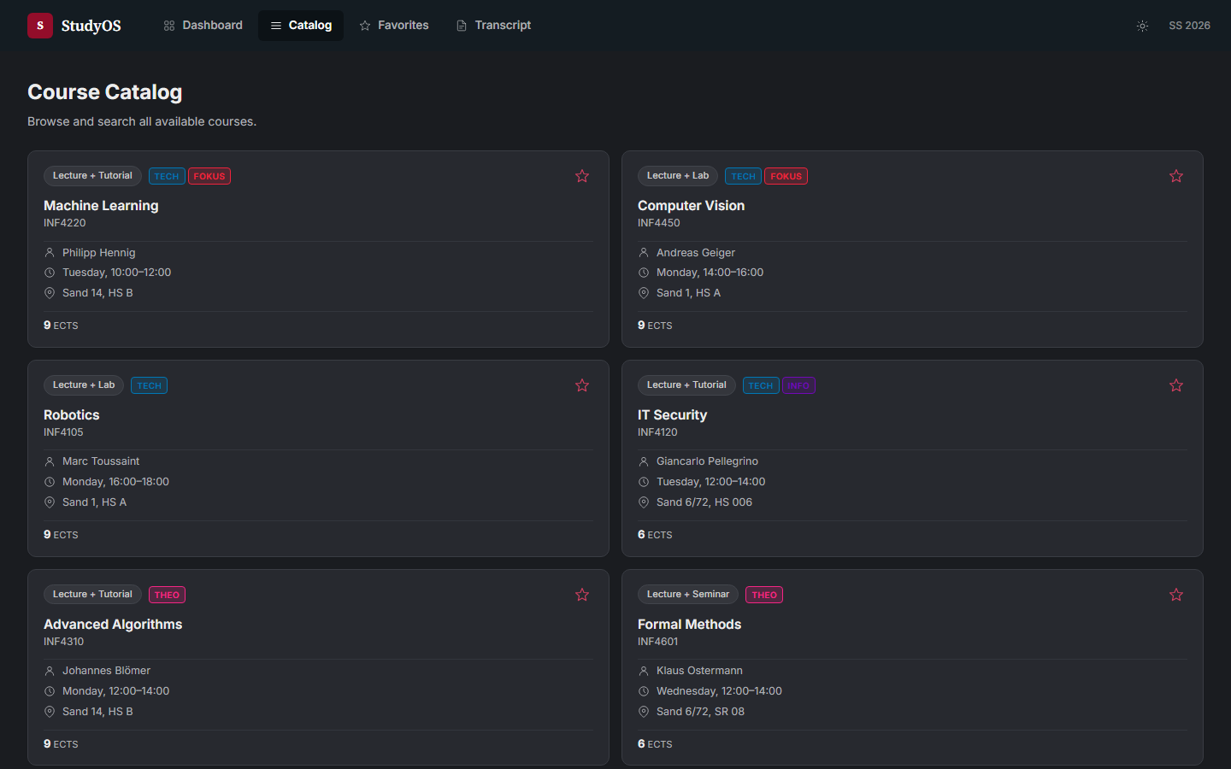

Slide 20
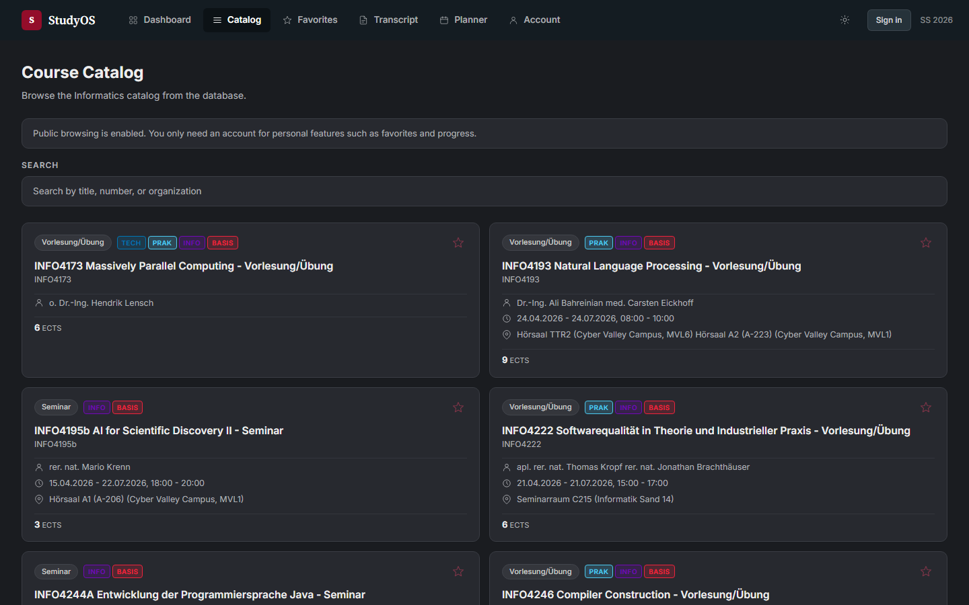

Slide 21
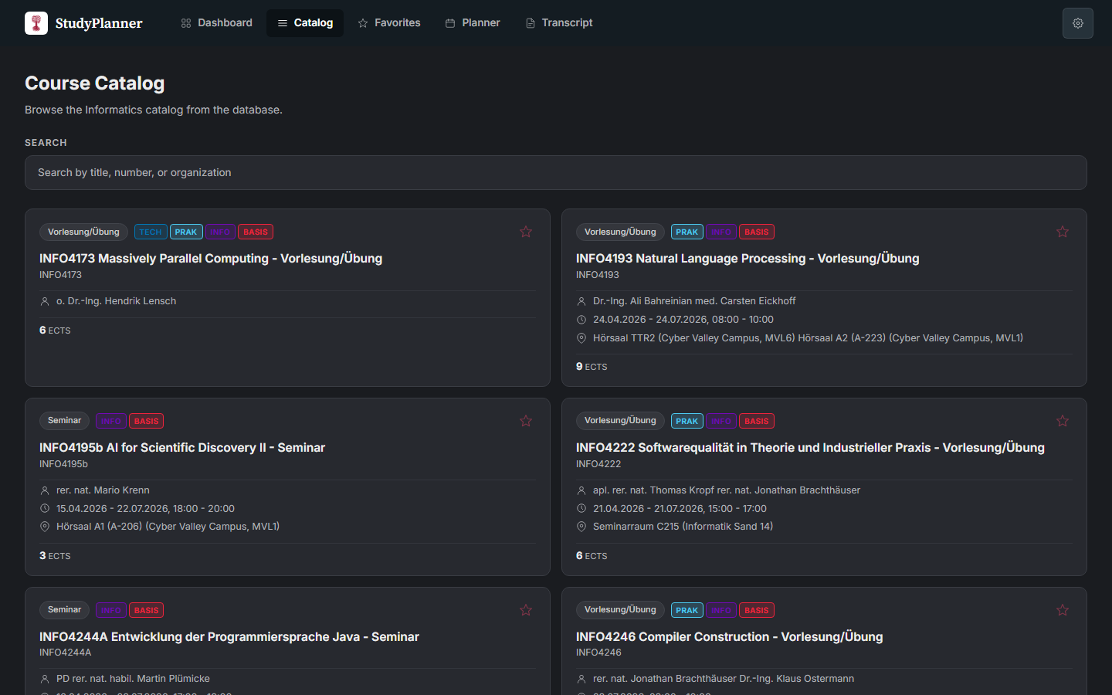

Slide 22
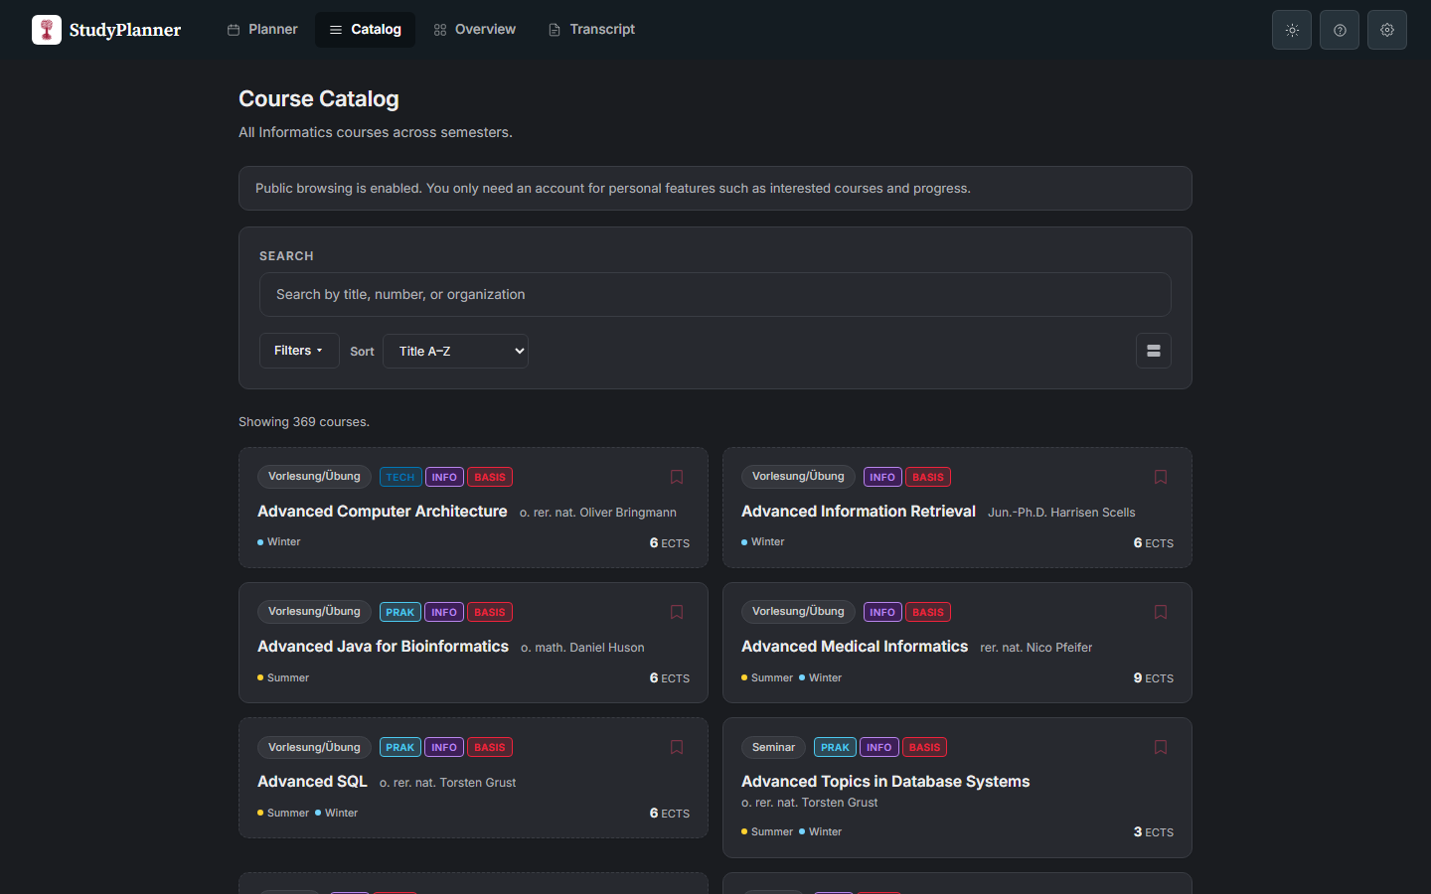

Slide 23
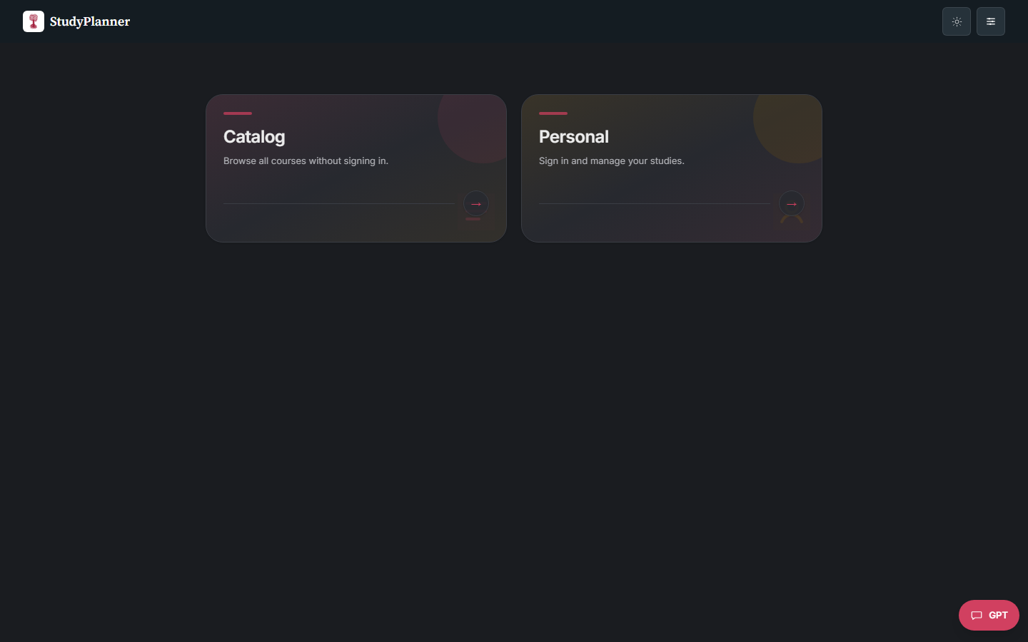

Slide 24
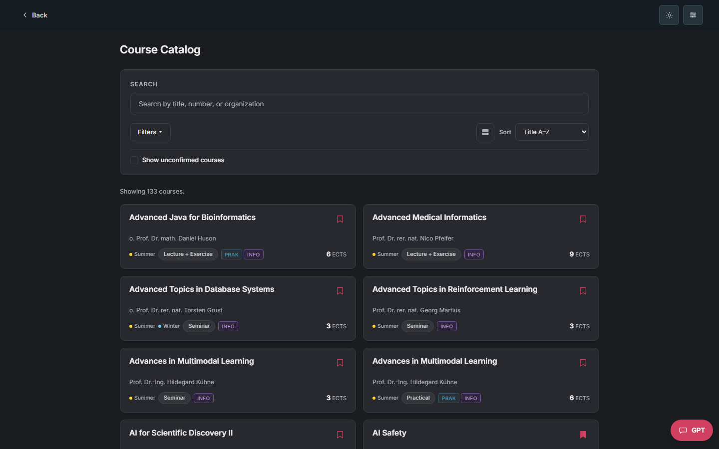

Slide 25
Iterate - Feedback along the way
“Icons for the semesters instead of writing them out.”
“Make more things clickable, let them set the filters.”
“Let me drag courses in and out of the calendar.”
“Delete looks like collapse, I lost my plan.”
“Why is everything red? Red means error.”
“Two lecture halls, but no real conflict.”
StudyOS Practical - P. Gehler - July 2026
25

Slide 26
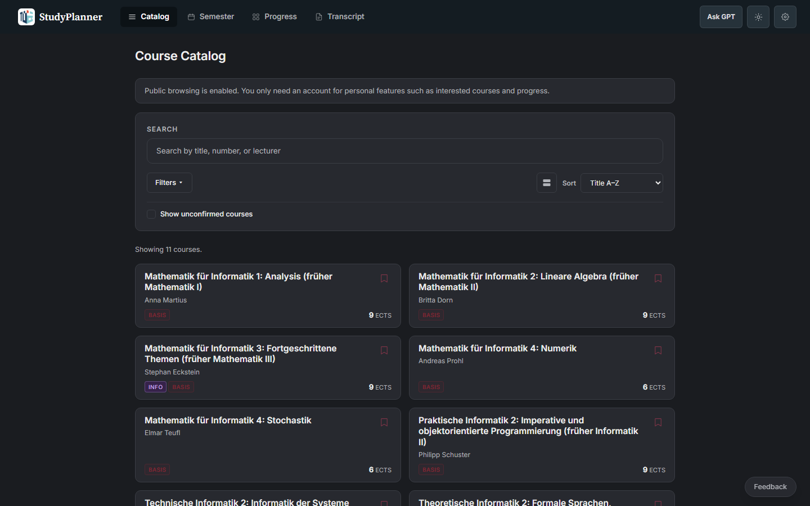

Slide 27
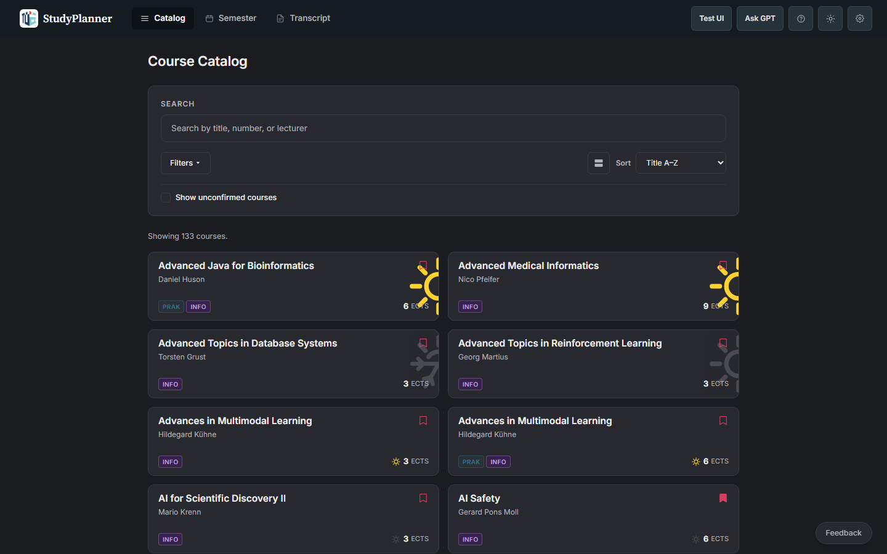

Slide 28
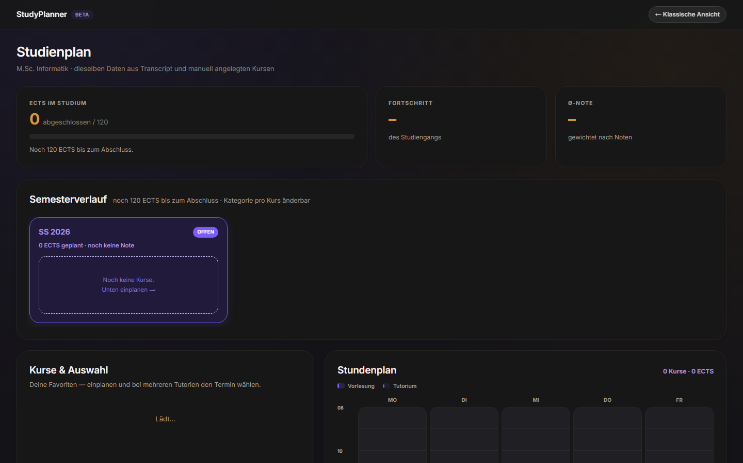

Slide 29
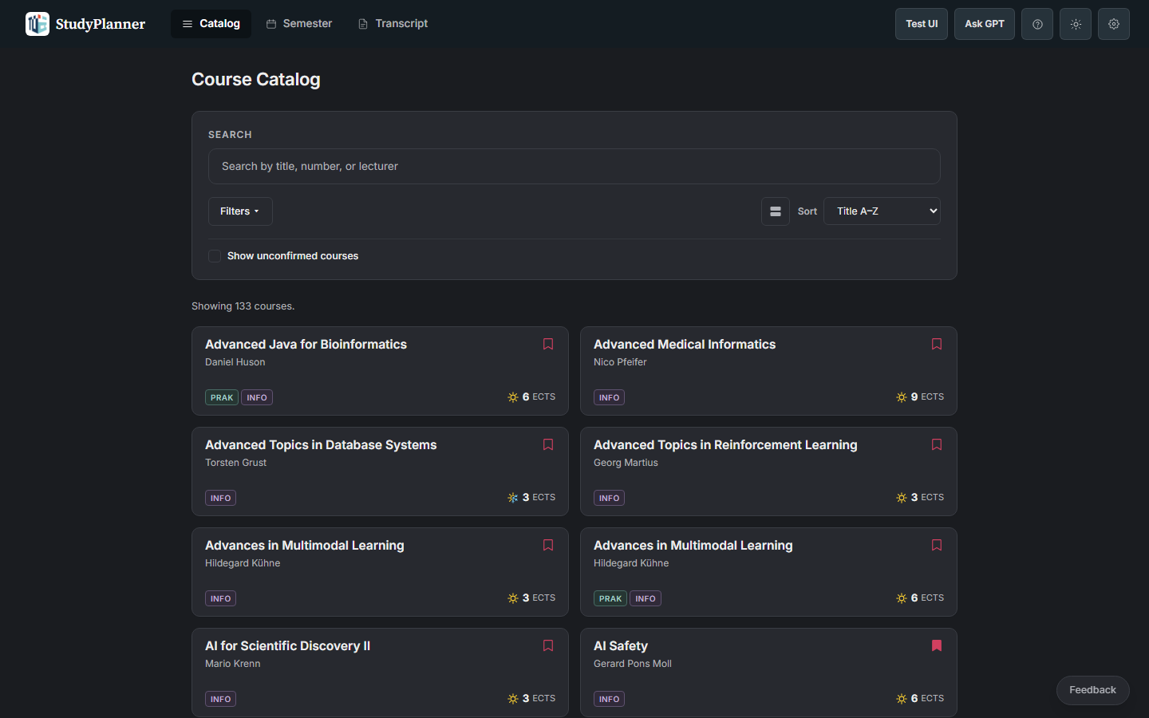

Slide 30
…and many more changes than fit in one deck.
StudyOS Practical - P. Gehler - July 2026
30

Slide 31
Iterate - What we fixed
Favorites in terms with no offering
→
Availability check
Fake room conflicts
→
Fixed conflict logic
Delete looked like collapse
→
Clearer delete
Too much red
→
Red only for errors
Crowded planner
→
Decluttered layout
StudyOS Practical - P. Gehler - July 2026
31

Slide 32
Iterate - Where we are today
1,158 courses across 9 semesters, summer 2022 to summer 2026
Live at studyplaner.pages.dev, catalog public, account for plans and progress
Timetable with ICS export, transcript import, German and English
StudyOS Practical - P. Gehler - July 2026
32

Slide 33
Live demo
StudyOS Practical - P. Gehler - July 2026
33

Slide 34
Future
ideas, maintenance, what could ship next
StudyOS Practical - P. Gehler - July 2026
34

Slide 35
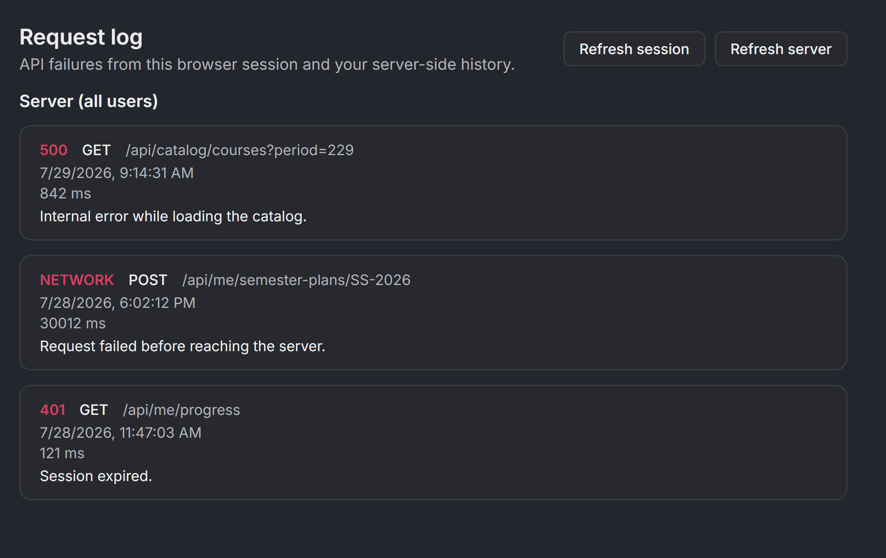
Future - Watch the log, ship the fix
The request log already captures failures
Agents can watch it and propose fixes
Scraping and deploys already run on their own
Missing: PO knowledge beyond our programs
StudyOS Practical - P. Gehler - July 2026
35

Slide 36

Future - Reach and handoff
Our hope: the Fachschaft takes it over, we are in contact
Erstiheft and the CS mailing list to reach new students
Maintenance stays light if scraping and deploys keep running
StudyOS Practical - P. Gehler - July 2026
36

Slide 37

Try it - Scan or click
studyplaner.pages.dev
The feedback button is in the app. Use it, we read everything.
StudyOS Practical - P. Gehler - July 2026
37

