Slide 1
DECORATOR PATTERN
Done by Asger AU612414, Jacob AU600629 and Tue Au618668
Group 15

Slide 2
Design pattern
One solution to a common problem
Different methods to different problems
We have worked with Decorator pattern

Slide 3

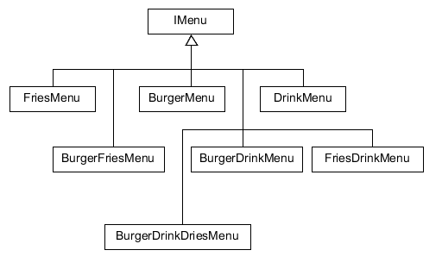

A simple problem
A burger menu maker
Many sub classes
If we wanted to add ”Dessert” to the IMenu we would end up with
Faktor !n
It can be done alot simpler

Slide 4

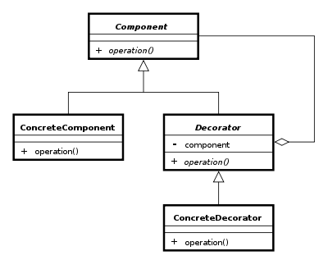
What is decorator pattern
Inherticane and composition
Add funciontality in runtime

Slide 5

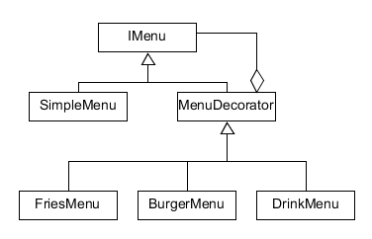
Why use decorator pattern
Simple way to implement same solution

Slide 6
Refrences
https://refactoring.guru/design-patterns/decorator

