Slide 2

Statistics Project: Average time and proportion of reading books estimation

Slide 3
Goal
Estimating interval of time that university students in Hanoi spend on books
Estimating interval of percentage that university students in Hanoi like books

Slide 4
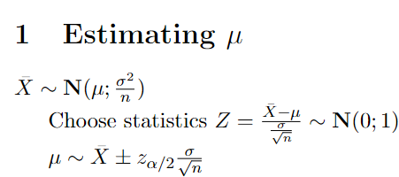
Important knowledge

Slide 5
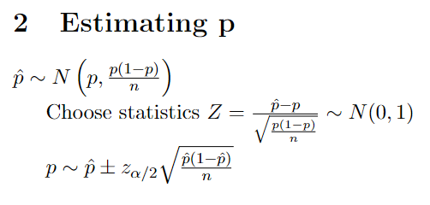
Important knowledge

Slide 6
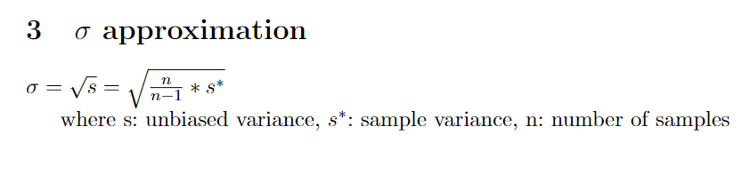
Important knowledge

Slide 7
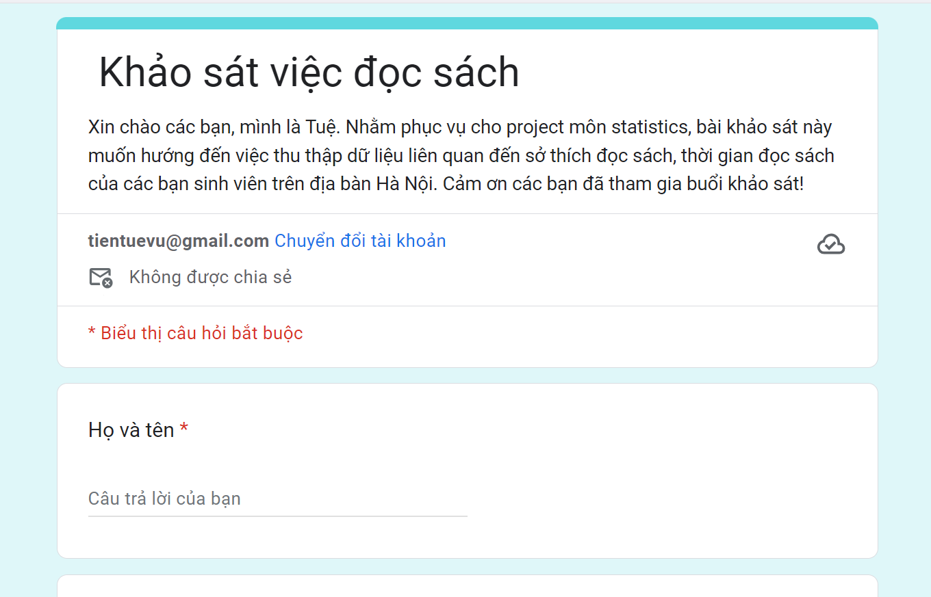
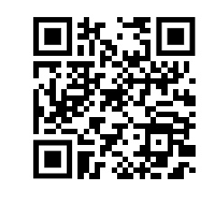
Methodology
1. Collecting data
Khảo sát việc đọc sách

Slide 8




Methodology
2. Processing data and data analysis
Python
numpy
scikit learn
scipy

Slide 9
Methodology
Details
Folder Project

Slide 10
Conclusion
Thanks to this project, I can improve:
Collecting data
Processing and analyzing data with python
Synthesizing ideas and presenting them to audiences

Slide 11
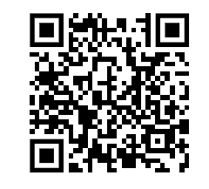
THANK YOU !
Link code and data:

Slide 12
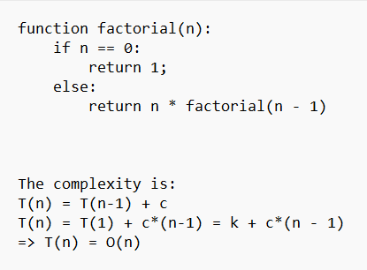
Recursive programming

Slide 13
Recursive programming

Slide 14
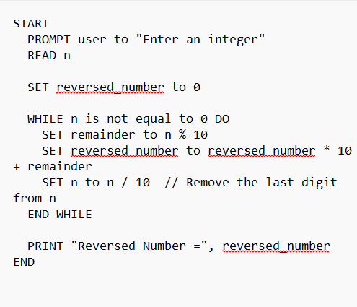
Reverse Algorithm

