Slide 2
Comparison of Shortest Path Algorithms
Minor - I
Mid-Term Presentation
on
Project Guide
Ms. Shahina Anwarul
Assistant Professor,
School of Computer Science (Department of Systemics)

Slide 3
Team Members & Role
NAME | ENROLL NO. | ROLE
KANWAR SUMEER MANKOTIA | R134217068 | Coding, Implementation, Documentation
KARTIK CHAUHAN | R134217069 | Coding, Implementation, Documentation
ANSHUMAAN SINGH RAWAT | R134217032 | Coding, Implementation, Documentation
ARTH GUPTA | R134217037 | Coding, Implementation, Documentation
Branch : B.Tech – Computer Science with specialization in Cyber Security and Forensics

Slide 4

Shortest Path First Algorithms
Dijkstra’s Algorithm
Bellman-Ford’s Algorithm
Floyd-Warshall’s Algorithm

Slide 5
DIJKSTRA ALGORITHM
Dijkstra's algorithm is an algorithm for finding the shortest paths between nodes in a graph. It was conceived by computer scientist Edsger W.
For a given source node in the graph, the algorithm finds the shortest path between that node and every other.
For example, if the nodes of the graph represent cities and edge path costs represent driving distances between pairs of cities connected by a direct road (for simplicity, ignore red lights, stop signs, toll roads and other obstructions), Dijkstra's algorithm can be used to find the shortest route between one city and all other cities.

Slide 6
LITERATURE REVIEW
The earlier studies presented four shortest path algorithms namely Dijkstra’s Algorithm, Floyd-Warshall Algorithm, Bellman-Ford Algorithm.
. In addition, the earlier study finding shortest path from one node to all other nodes can be derived quickly by using the shortest path algorithm. Further, the earlier study have analyzed dynamic path of all-pairs using shortest path problem for recalculation shortest paths after changing the weight of any single edge.
Moreover the earlier study discussed the shortest path between two points in a city road net based on the geographic relevance relationship among roads in the road net.

Slide 7
PROBLEM STATEMENT
To determine the shortest path among various paths for a single destination.
Implementing various shortest path algorithms for determining the shortest path between two nodes.

Slide 8
OBJECTIVE
To determine and analyse the shortest path between two different nodes.
To implement the various algorithms for calculating shortest path.
Sub-objective
To determine the efficiency of various algorithms on the basis of time complexity.

Slide 9
APPLICATIONS
It is used in finding Shortest Path.
It is used in geographical Maps.
To find locations of Map which refers to vertices of graph.
Distance between the location refers to edges.
It is used in IP routing to find Open shortest Path First.
It is used in the telephone network.

Slide 10
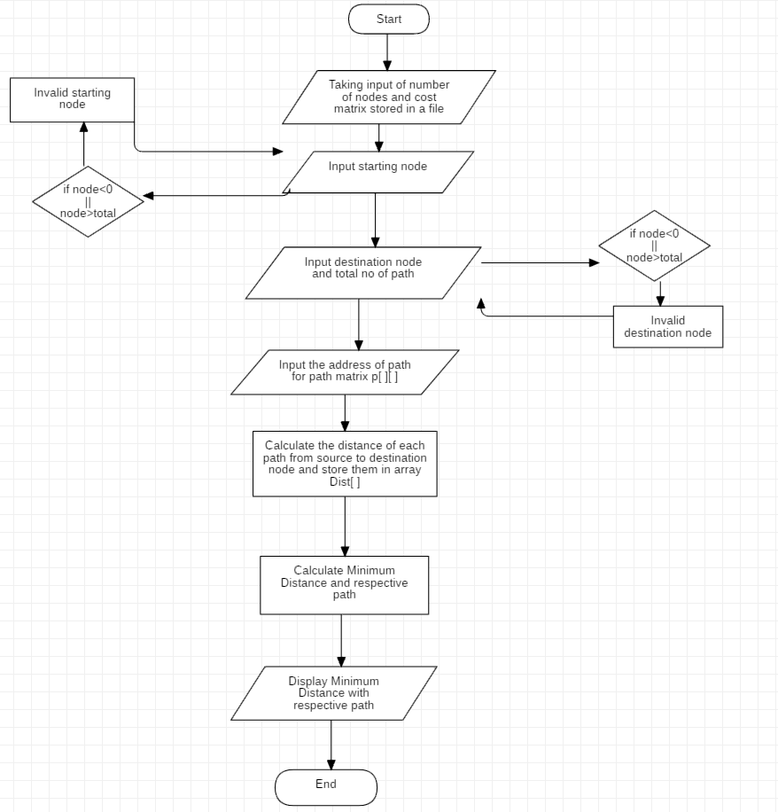
FLOW CHART

Slide 11
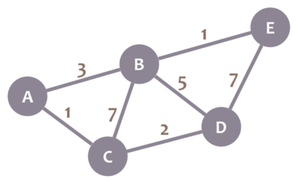
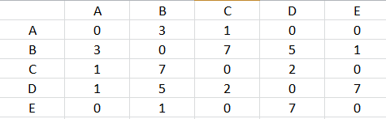
Cost matrix

Slide 12
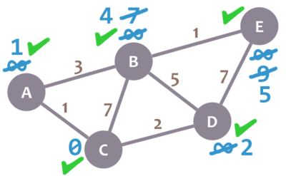

Minimum Cost of each node from initial vertex C

