Slide 1
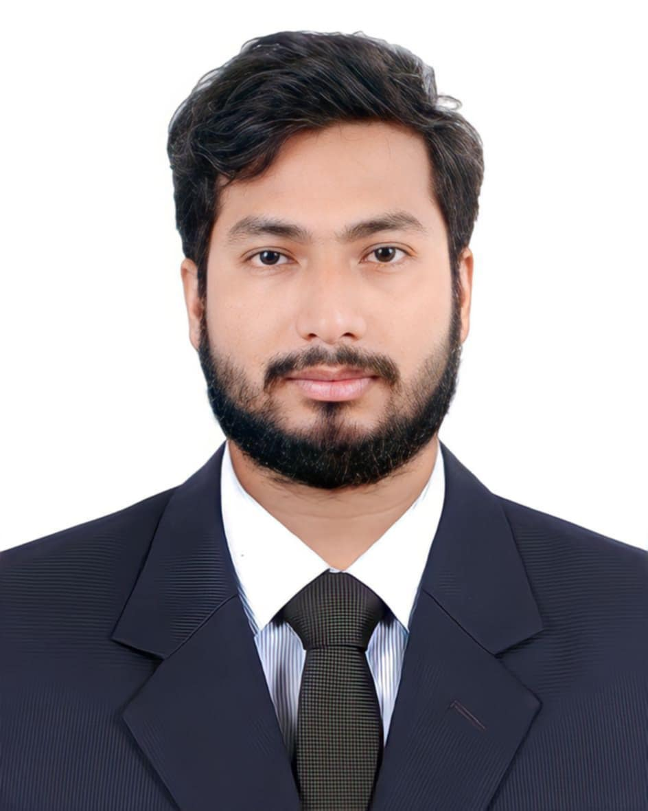
Personal Information
Name: Tufail Ahmed
Fathers Name: Md. Fazlul Hoque
Mothers Name: Parvin Akter
Village: Kunabakhail
Thana: Trishal
Dist: Mymensingh
Division: Mymensingh

Slide 2
Education Background
SSC(Science) Kandania High School
HSC(Science) Royal Media College
B.Sc(CSE) SUST

Slide 3
Skills
C
C+
Python
Java
Data Structure
SQL
SQA
JavaFx

Slide 4
Volunteering Experience
General Secretary CSE Society , SUST
General Secretary , Mymensingh Students Association
General Secretary , Kunabakhails Students Association
General Secretary, SUST ACM Students Chapter

Slide 5
THANK YOU

