Slide 1
LOAN PORTFOLIO PROFITABILITY AND RISK ANALYSIS
From Portfolio Loss
to Management Action
PORTFOLIO SNAPSHOT
−₹36.05L
Net Bank Profit — loss-making
−2.83%
A business-focused analysis of pricing, tenure, product mix,
regional performance and loan exposure.
Profit margin on the loan book
500 LOANS
₹12.74 Cr principal deployed
across Car, Bike, Laptop & Mobile
Advanced Excel Project
Tufan Bera , Spriha Sahu , Sumit Singh

Slide 2
Executive Summary
2
The portfolio has a clear profitability problem — and a clear place to start.
TOTAL LOANS
LOAN PRINCIPAL
TOTAL REVENUE
TOTAL COST
NET BANK PROFIT
500
₹12.74 Cr
₹3.32 Cr
₹3.68 Cr
−₹36.05 L
THE BUSINESS ISSUE
WHERE THE LOSS SITS
WHAT MANAGEMENT SHOULD DO
Revenue is not covering total portfolio cost. The current economics mean that adding more loans is not automatically value-creating.
Car loans account for the dominant product loss, with the problem concentrated in lower-rate and longer-tenure lending.
Fix Car-loan economics first: pricing, tenure and exposure controls. Protect products that are already profitable.

Slide 3
Portfolio Economics
3
The gap between income and cost is the first management problem to solve.
REVENUE
COST OF FUNDS
DEFAULT LOSS
PROFIT MARGIN
₹3.32 Cr
₹3.52 Cr
₹15.86 L
−2.83%
Interest income + processing fee
Funding cost alone
Additional credit loss
Net profit / principal
− ₹36.05 L
₹3.32 Cr
− ₹3.68 Cr
Revenue
Total cost
Net bank loss
BUSINESS IMPLICATION
Default recovery matters, but it cannot solve the core issue by itself. Funding cost is already above revenue, so management must improve loan-level economics through pricing and portfolio mix.

Slide 4
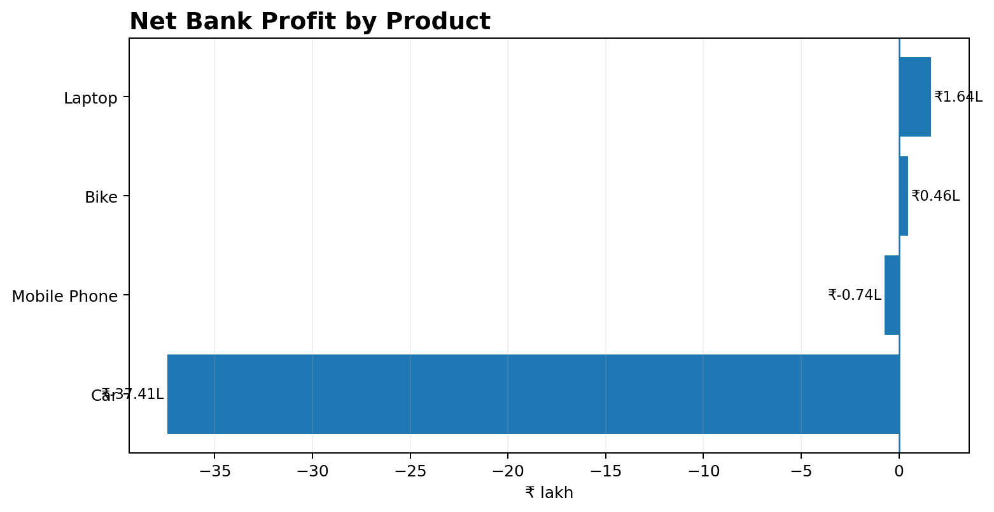
Product Profitability
4
The portfolio is not uniformly weak — one segment is driving the outcome.
PRIMARY LOSS DRIVER
Car: −₹37.41 lakh. It is large enough to erase the gains from Laptop and Bike.
PROFITABLE POCKETS
Laptop: +₹1.64 lakh Bike: +₹0.46 lakh
DECISION
Do not apply a portfolio-wide restriction. Review Car separately and preserve the economics of profitable products.

Slide 5
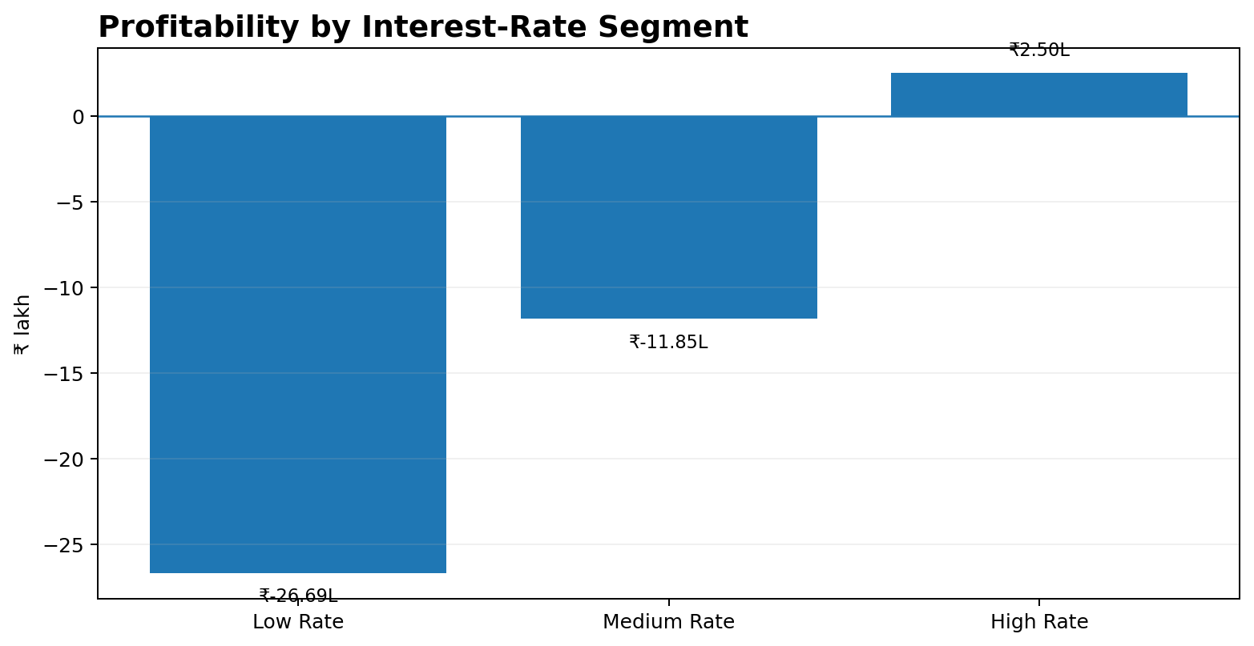
Pricing Is a Core Driver
5
Lower-rate lending is where the economics deteriorate fastest.
LOW RATE
−₹26.69 lakh Largest rate-segment loss.
MEDIUM RATE
−₹11.85 lakh Still below an acceptable return.
MANAGEMENT RESPONSE
Introduce a pricing floor based on funding cost and expected loss — not a blanket rate increase.

Slide 6
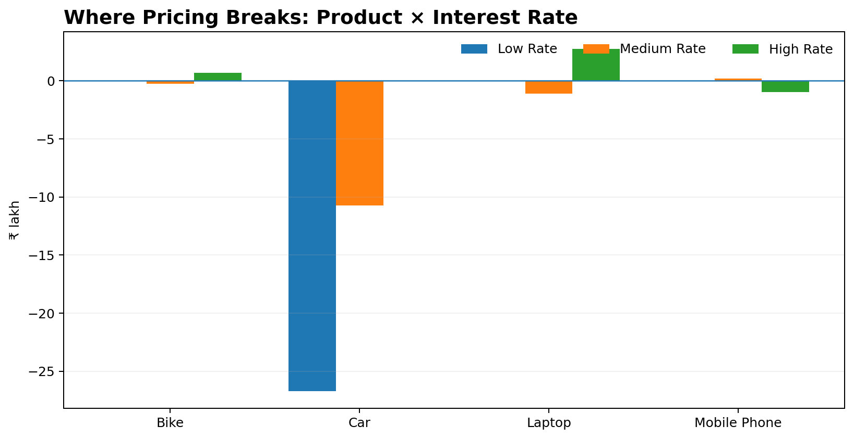
Pinpointing the Pricing Problem
6
The rate issue is concentrated — especially inside Car lending.
CAR + LOW RATE
−₹26.69 lakh Largest product-rate loss.
CAR + MEDIUM RATE
−₹10.72 lakh Second major loss pocket.
DECISION
Target Car pricing and approval rules first. Avoid unnecessary repricing of products already generating positive returns.

Slide 7
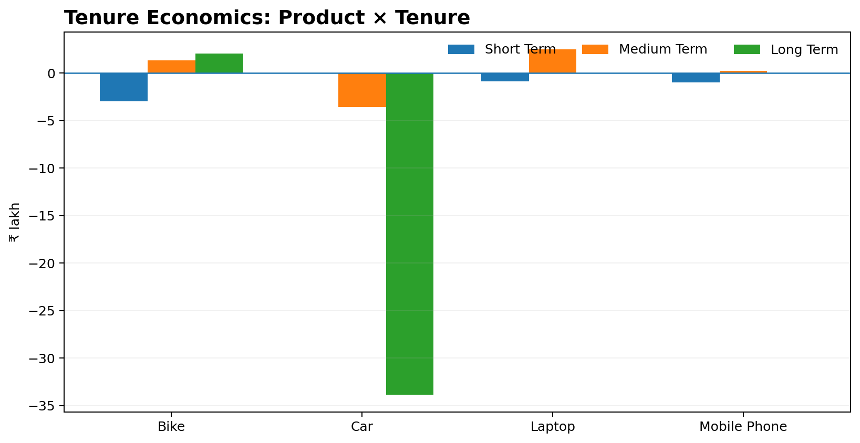
Tenure Is Amplifying the Car Problem
7
Longer duration is particularly damaging when pricing is not high enough.
CAR + LONG TERM
−₹33.82 lakh Dominant tenure-related loss.
WHY IT MATTERS
Longer tenure keeps capital committed longer. If the rate does not compensate for funding and risk, return is diluted.
DECISION
Review maximum Car tenure or apply additional pricing to longer-term loans.

Slide 8
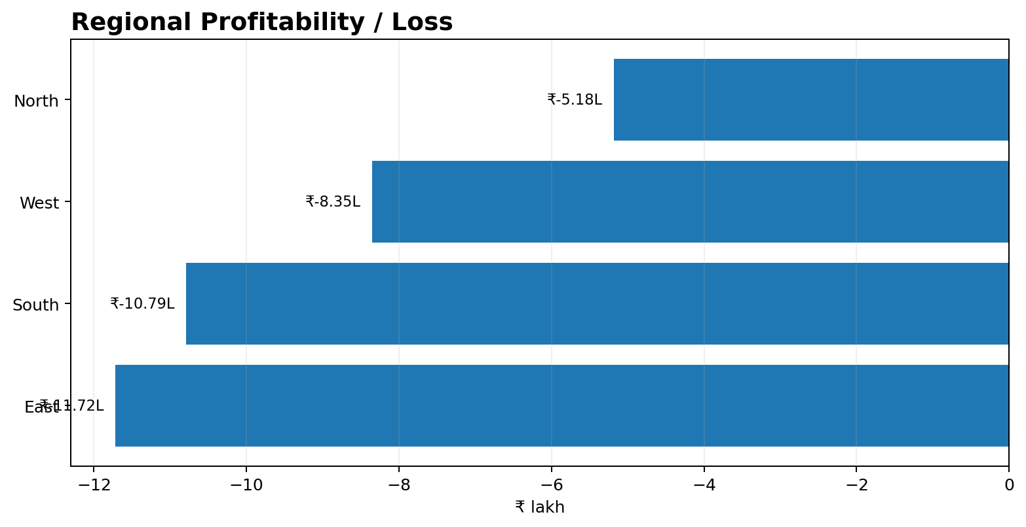
The Loss Is Not a Single-Region Problem
8
Every region is loss-making; geography alone is not the root cause.
LARGEST REGIONAL LOSS
East: −₹11.72 lakh
WHAT NOT TO DO
Do not simply withdraw from the weakest region. That could remove volume without fixing the economics.
BETTER DECISION
Break each region down by product, rate and tenure before changing geographic policy.

Slide 9
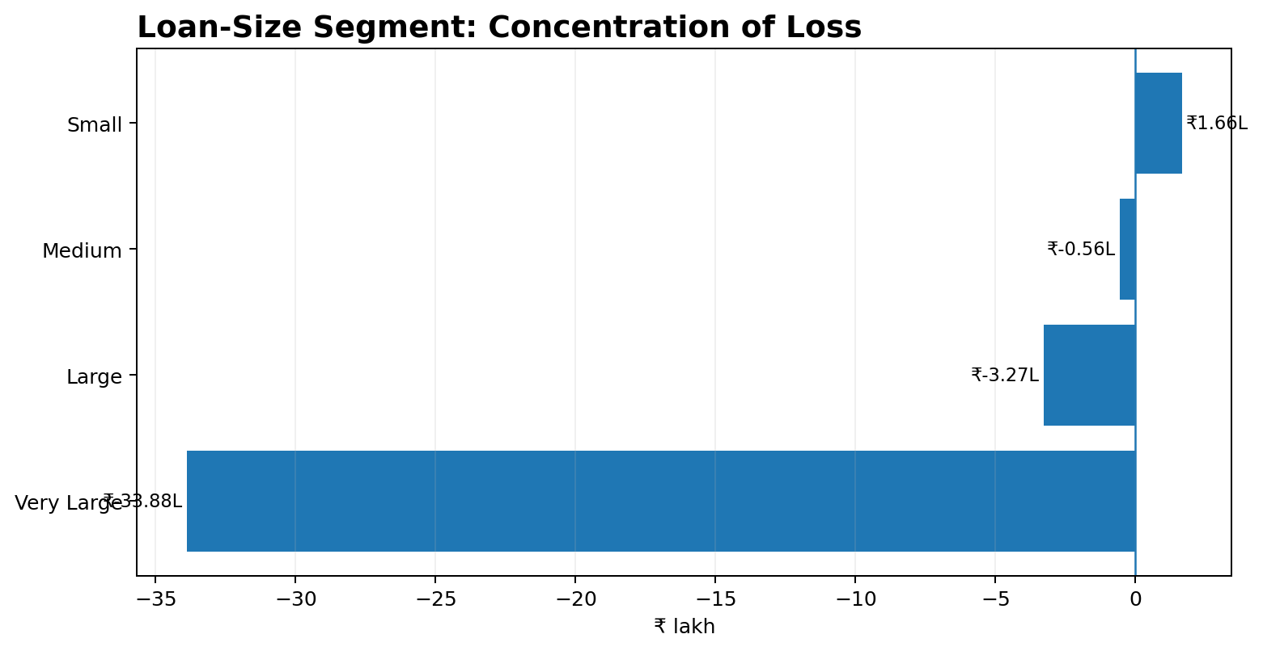
Exposure Concentration Adds Another Risk
9
Very-large loans are creating a disproportionate share of the loss.
VERY-LARGE EXPOSURES
−₹33.88 lakh across 100 loans.
BUSINESS RISK
A small number of large exposures can create concentrated downside when pricing or credit assumptions are weak.
DECISION
Use stronger approval, exposure limits and expected-return checks for very-large loans.

Slide 10
Management Action Plan
10
Prioritise changes that improve unit economics without damaging healthy segments.
1
Fix Car-loan economics
Review pricing, tenure, loan size, funding cost and expected loss together.
2
Set a pricing floor
Approve low-rate loans only when expected return remains economically viable.
3
Control long-term Car lending
Shorten maximum tenure or add risk/tenure-based pricing.
4
Control large exposures
Strengthen approval and exposure limits where loss concentration is high.
5
Protect profitable products
Laptop and Bike are positive contributors; pursue controlled growth.
6
Review regional mix
Start with East, but diagnose product/rate/tenure mix before changing geography.

Slide 11
THE MANAGEMENT MESSAGE
Loan growth is not the objective.
Profitable loan growth is.
The analysis points to one practical starting point: fix the economics of Car loans — especially lower-rate, longer-tenure lending — while protecting profitable segments.
1
START WITH
2
CHANGE
3
PROTECT
Car Economics
Pricing + Tenure
Profitable Mix
Rate, tenure & loan-size rules
Set a practical minimum floor
Grow Laptop & Bike carefully

