Slide 1
Automating Container Builds with GitHub Actions: From Code to Docker Hub
Yucheng Zhang
yucheng.zhang@tufts.edu
Senior Bioinformatics Engineer
TTS Research Technology
Notes:
Good afternoon. My name is Yucheng Zhang, and I am a Senior Bioinformatics Engineer with TTS Research Technology. Today I will introduce how we can use GitHub Actions to automate Docker container builds and publish container images to Docker Hub. The goal is to show a practical workflow that can reduce manual work, improve reproducibility, and make container maintenance easier for research computing environments.

Slide 2
Agenda
Containers
CI/CD & GitHub Actions
GitHub Actions for Docker builds
Demo
Notes:
Here is the plan for today. I will start with a short overview of containers and why they matter. Then I will introduce CI/CD and GitHub Actions. After that, we will look at how GitHub Actions can build and publish Docker images automatically. At the end, I will walk through a demo repository so you can see the workflow in action.

Slide 3
01 Containers
Notes:
The first section is about containers. Before we talk about GitHub Actions, it is important to understand what we are trying to automate. In our case, the artifact we are building is a container image, so we need to know what a container is and why it is useful.

Slide 4
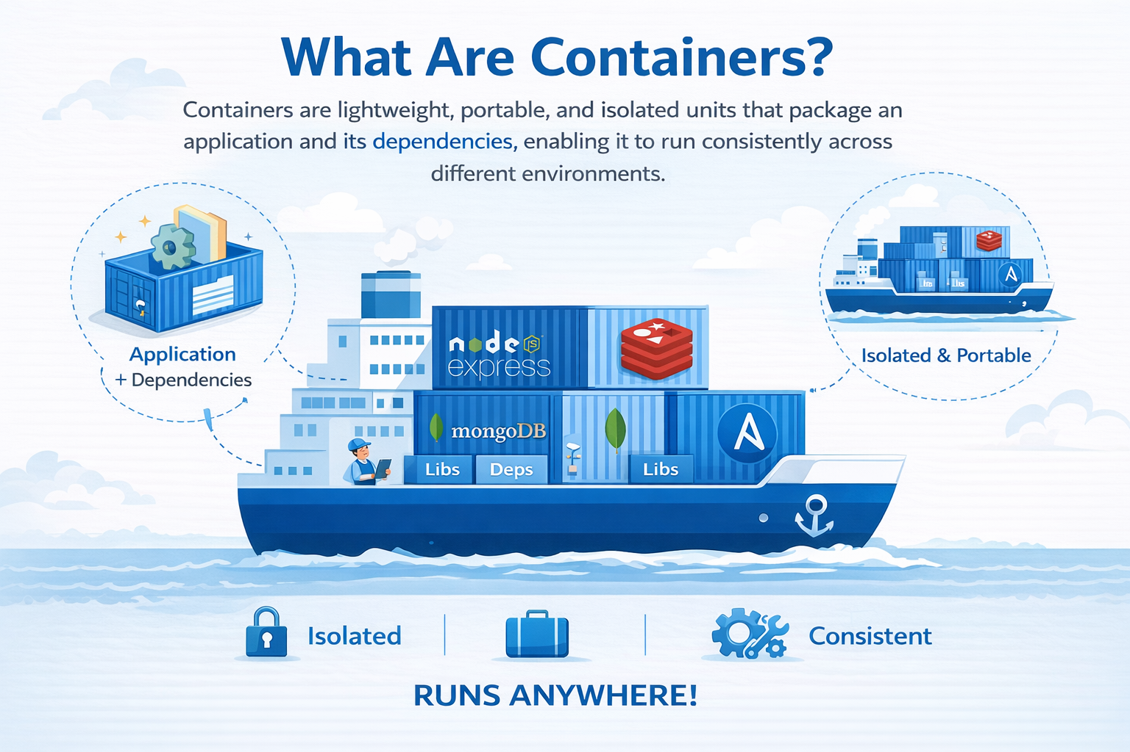
Notes:
A container packages an application together with the software environment it needs to run. That includes dependencies, libraries, runtime tools, and configuration. The main idea is portability. Instead of saying, “This works only on my laptop,” we want the same software environment to run consistently on a laptop, a server, the cloud, or an HPC system.

Slide 5
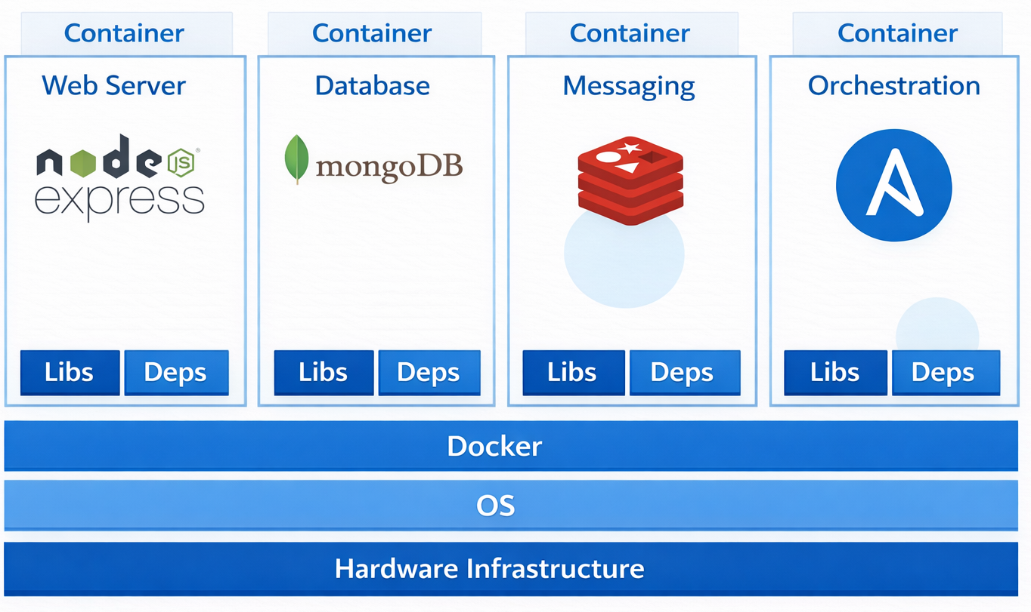
What can container do?
Containerize applications
Run each service/application with its own dependencies in separate containers
Notes:
Containers allow us to package applications separately from the host operating system. Each application can have its own dependencies without interfering with other applications. For example, one container can run a web server, another can run a database, and another can run a workflow tool. This isolation makes software easier to deploy, test, and maintain.

Slide 6
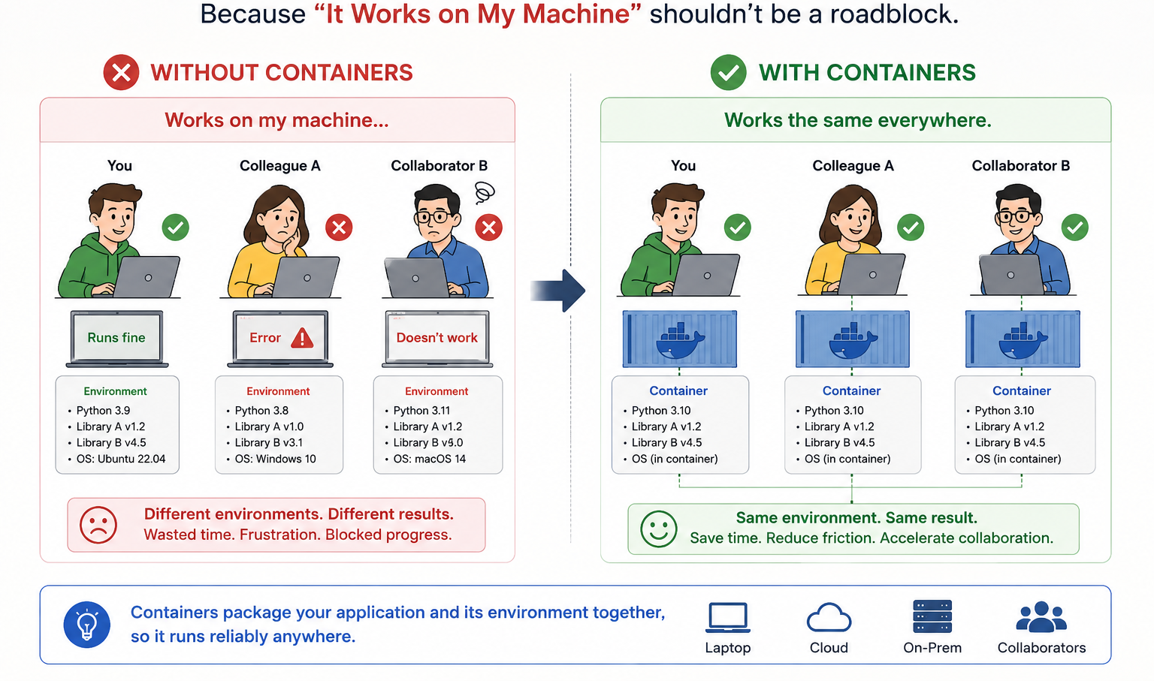
Why Use Containers?
Notes:
One of the most common problems in research computing is “it works on my machine.” Different users may have different operating systems, Python versions, library versions, or system packages. Containers help solve this by packaging the application and its environment together. This improves reproducibility and reduces the amount of time spent debugging environment problems.

Slide 7
What do containers mean for Tufts HPC?
Containers are a core part of the Tufts HPC ecosystem. They support a large share of the software and workflows used across research, teaching, and AI computing.
Singularity, the container runtime, is the most heavily used application on the HPC system.
All AI tools running on the HPC system are delivered through containers.
Most applications that support NVIDIA GPUs are container-based.
Bioinformatics software stacks are built on containers.
Course computing environments that rely on HPC are provided through containers.
R, RStudio, Jupyter Notebook, and many other commonly used applications run in containers.
And much more.
Notes:
For Tufts HPC, containers are not just a convenience. They are a core part of how we deliver software. Many AI tools, GPU applications, bioinformatics software stacks, course environments, RStudio, Jupyter Notebook, and other applications are delivered through containers. This means container management is directly connected to user productivity on the cluster. If we can automate container builds, we can make software delivery faster and more reliable.

Slide 8
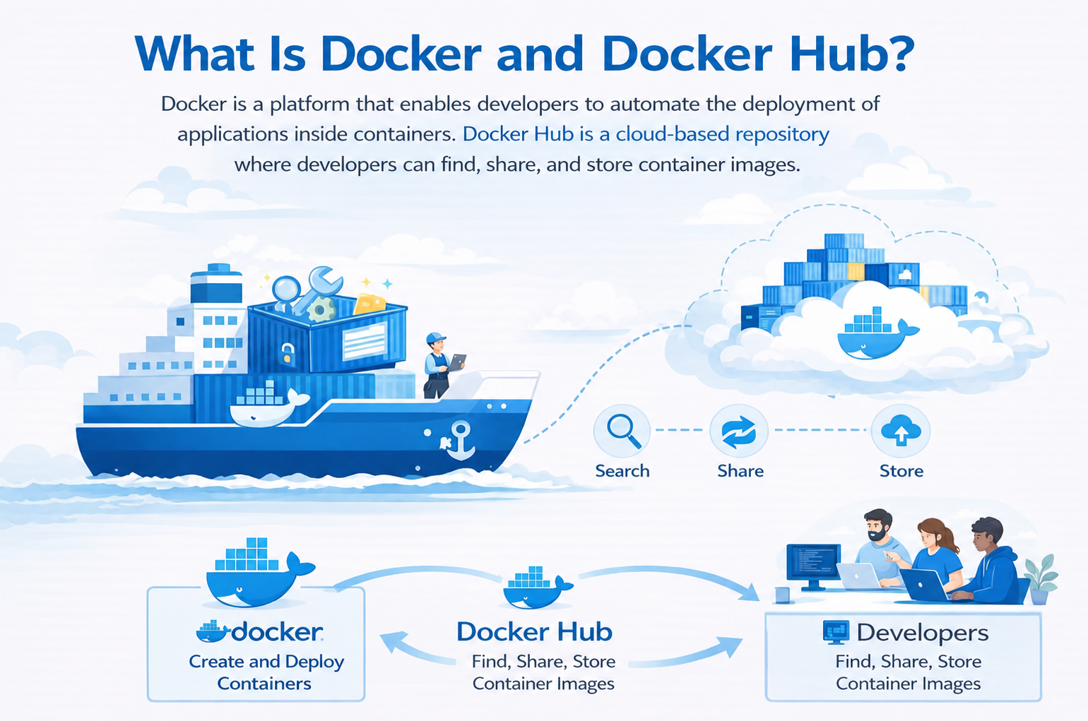
Notes:
Docker is one of the most widely used platforms for building and managing containers. Docker Hub is a public container registry where images can be stored, shared, and downloaded. In our workflow, GitHub Actions builds the Docker image, and then pushes the finished image to Docker Hub so that it can be reused by users, admins, or downstream systems.

Slide 9
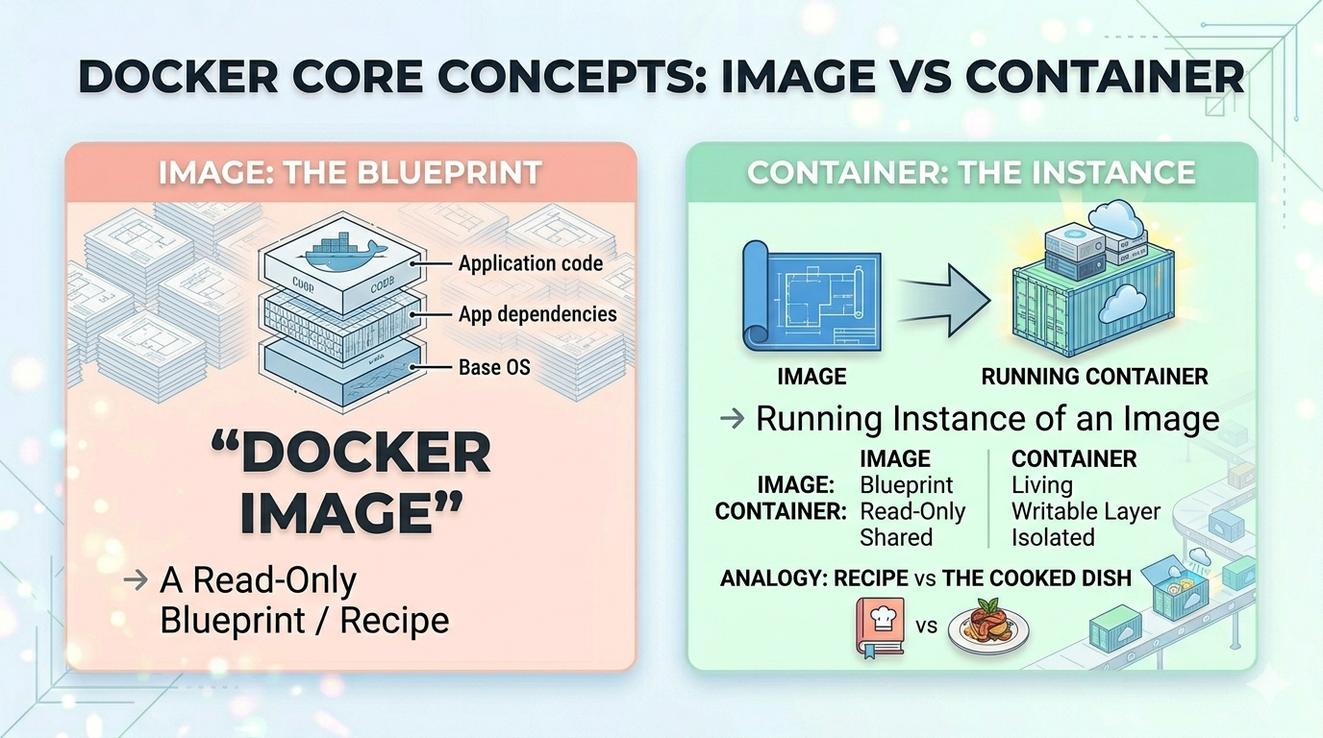
Notes:
It is important to distinguish between an image and a container. A Docker image is like a blueprint or recipe. It contains the application, dependencies, and filesystem layers. A container is a running instance of that image. So we build an image once, publish it, and then users can run containers from that image many times.

Slide 10
Essential Docker Commands
build, run, and push
# Build an image
docker build -t myanalysis:v1.0 .
# Run a container interactively
docker run --rm -it myanalysis:v1.0 bash
docker run --rm -v $(pwd)/data:/app/data myanalysis:v1.0
# Share your image
docker push yourusername/myanalysis:v1.0
Build, run, and share images with these core commands.
Always tag with a version;
use --rm to auto-remove containers after use.

Slide 11
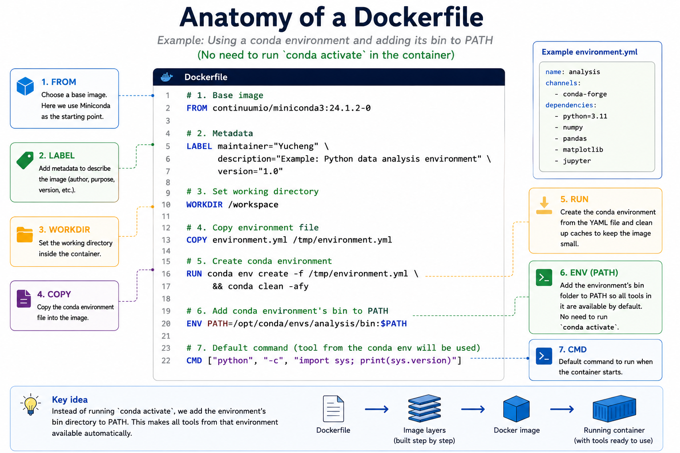
16

Slide 12
02 GitHub Actions
Notes:
Now that we have covered containers, the next question is: how do we automate the process of building them? This is where GitHub Actions comes in. GitHub Actions lets us define automated workflows directly inside a GitHub repository.

Slide 13
What is CI/CD?
Continuous Integration
Continuous Delivery
Methods for automating app development & deployment
Code changes are automatically built, tested & merged with existing codes
After integration, new app or package versions are published automatically
Notes:
CI/CD stands for Continuous Integration and Continuous Delivery or Deployment. Continuous Integration means code changes are automatically built and tested. Continuous Delivery means that after the build and test steps succeed, a new version of the application or package can be published automatically. For containers, this means that when we update the Dockerfile or source code, a workflow can automatically build and publish a new container image.

Slide 14
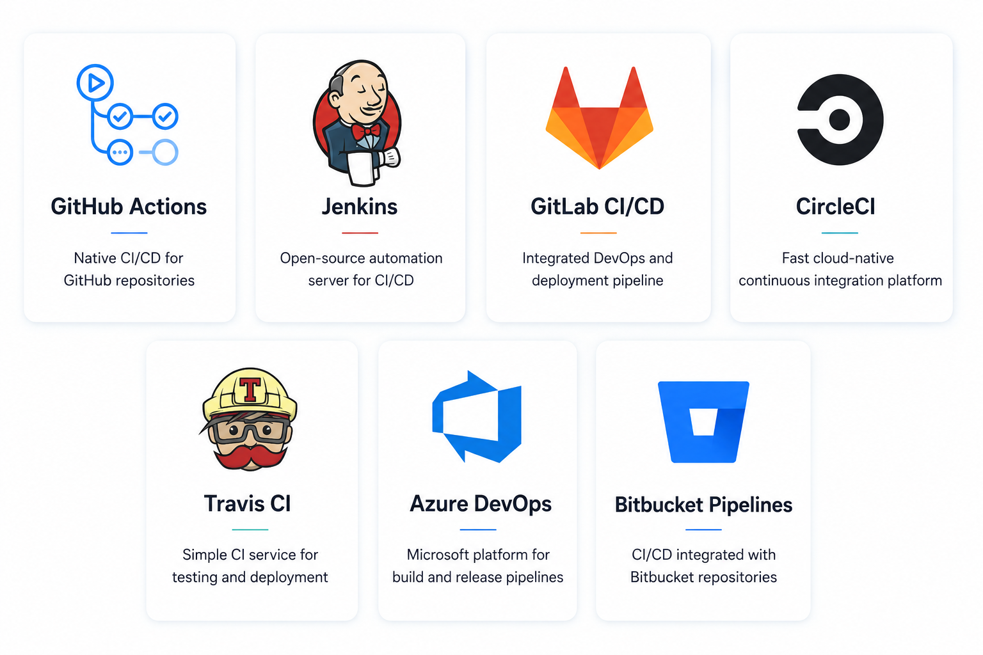
Top CI/CD platforms
Notes:
There are many CI/CD platforms, including GitHub Actions, Jenkins, GitLab CI/CD, CircleCI, Travis CI, Azure DevOps, and Bitbucket Pipelines. Today we focus on GitHub Actions because many of our container definitions and code repositories are already hosted on GitHub, so the automation can live directly next to the code.

Slide 15
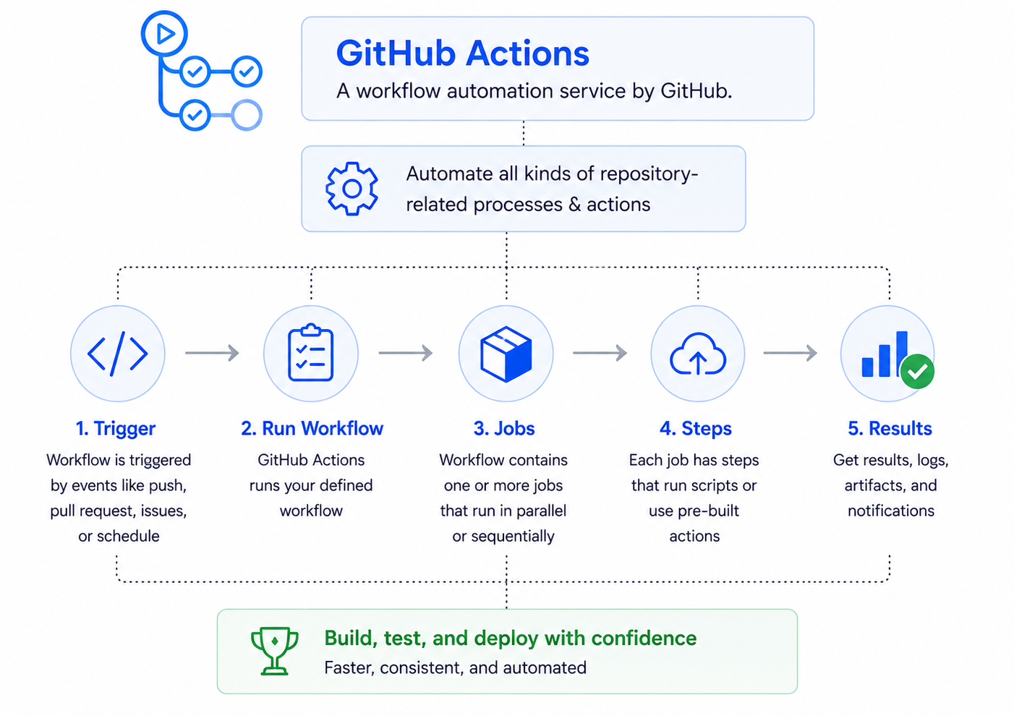
What is GitHub Actions
Notes:
GitHub Actions is GitHub’s built-in automation platform. A workflow starts when something happens in the repository, such as a push, pull request, release, schedule, or manual trigger. The workflow runs jobs, and each job contains steps. Those steps can run shell commands or reusable actions from the GitHub Actions marketplace.

Slide 16
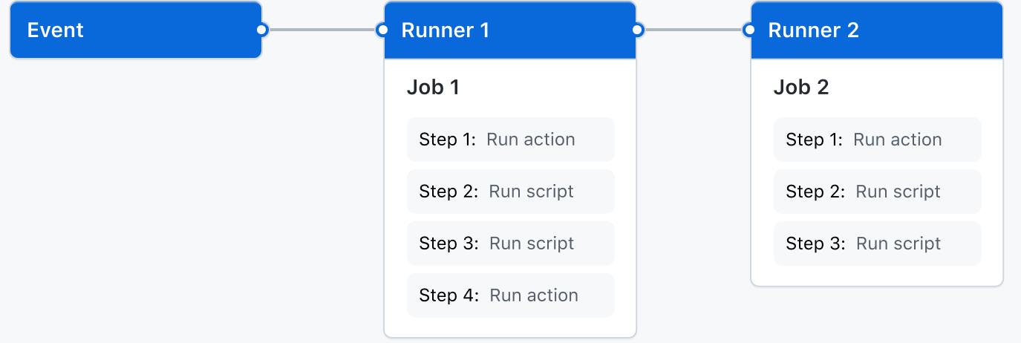
Components of GitHub Actions
GitHub Actions workflows run automatically when events happen in your repository.
A workflow contains jobs that run on virtual machines or containers, with steps that execute scripts or reusable actions.
Notes:
This diagram shows the basic components. An event triggers a workflow. The workflow contains one or more jobs. Jobs run on runners, which are machines provided by GitHub or managed by us. Each job is made up of steps. For a Docker build workflow, these steps usually include checking out the code, logging in to Docker Hub, building the image, and pushing the image.

Slide 17
Components of GitHub Actions
Workflows
A workflow is a configurable automated process that will run one or more jobs.
Workflows are defined by a YAML file checked in to your repository and will run when triggered by an event in your repository, or they can be triggered manually, or at a defined schedule.
Workflows are defined in the .github/workflows directory in a repository. A repository can have multiple workflows
Notes:
A workflow is defined in a YAML file inside the .github/workflows directory of a repository. A repository can have multiple workflows. For example, one workflow might run tests, another might build documentation, and another might build and publish a Docker image. The workflow file defines when the workflow runs and what jobs and steps it should execute.

Slide 18
Components of GitHub Actions
Events
An event is a specific activity in a repository that triggers a workflow run.
You can also trigger a workflow to run on a schedule, by posting to a REST API, or manually.
Examples
push: fires on every push; filter by branches, tags, or paths
pull_request :fires on PR activity (opened, synchronize, closed)
schedule: cron-based (e.g. nightly rebuilds to pick up base image patches)
release: fires when a GitHub Release is published.
Notes:
Events are what trigger a workflow. A push event can run a workflow every time code is pushed. A pull request event can run tests before code is merged. A schedule event can run a workflow nightly or weekly. A release event can run when a GitHub Release is published. For production container builds, release-based triggers are often useful because they tie the container version to a formal software release.

Slide 19
Components of GitHub Actions
Runners
GitHub-hosted runners: free Ubuntu, Windows, and macOS VMs, but its usage has limits.
Self-hosted runners: install the actions-runner agent on any machine; useful for GPU builds, large datasets.
When to use self-hosted: image builds exceed 6 hours, require NVIDIA GPUs.
Labels: target a self-hosted runner with runs-on: [self-hosted, gpu] in your workflow
Notes:
A runner is the machine where the workflow runs. GitHub-hosted runners are temporary virtual machines provided by GitHub. They are convenient and work well for many builds. Self-hosted runners are machines we manage ourselves. They are useful when builds require special hardware, large storage, GPUs, or access to internal infrastructure. For standard Docker builds, GitHub-hosted runners are usually enough. For HPC-specific testing or deployment, self-hosted runners can be very useful.

Slide 20
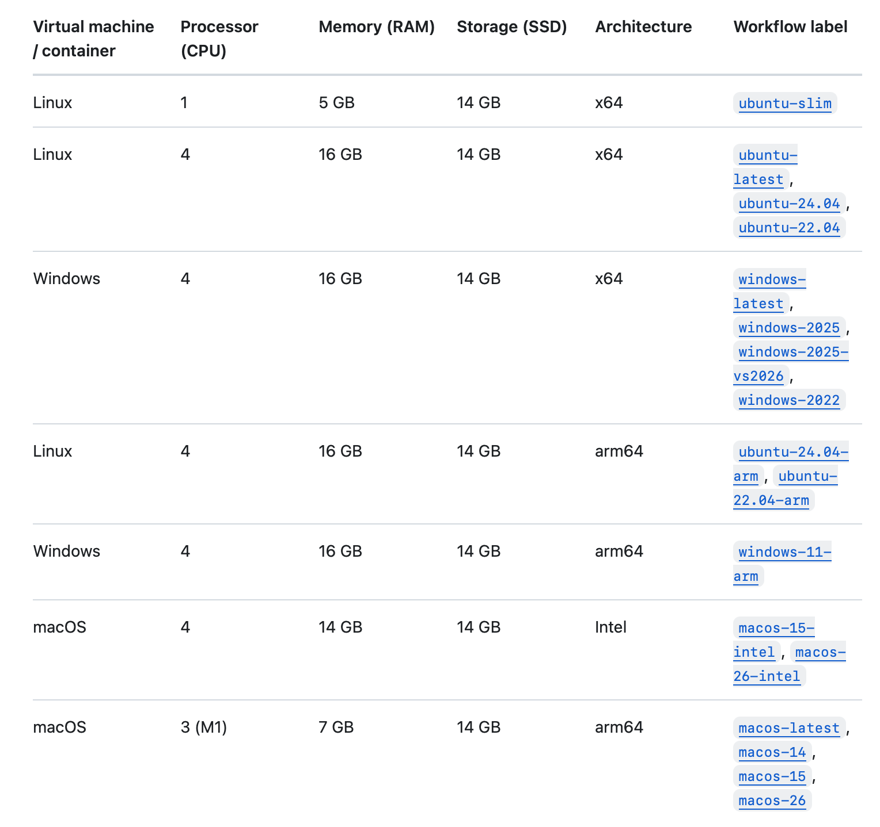
Standard GitHub-hosted runners for public repositories
https://docs.github.com/en/actions/reference/runners/github-hosted-runners#standard-github-hosted-runners-for-public-repositories
Notes:
This slide shows the standard GitHub-hosted runner options. The important point is that these runners have limited CPU, memory, disk space, and runtime. For small or medium Docker images, this is usually fine. But for very large scientific containers, especially containers with large software stacks, we need to pay attention to build time, disk usage, and cache strategy.

Slide 21
03 GitHub actions & Docker builds
Notes:
Now we move to the main technical part: using GitHub Actions to build Docker images. The goal is to replace a manual process with an automated workflow. Instead of building and pushing images from an admin’s local machine, the repository itself can build and publish the image when the right event happens.

Slide 22
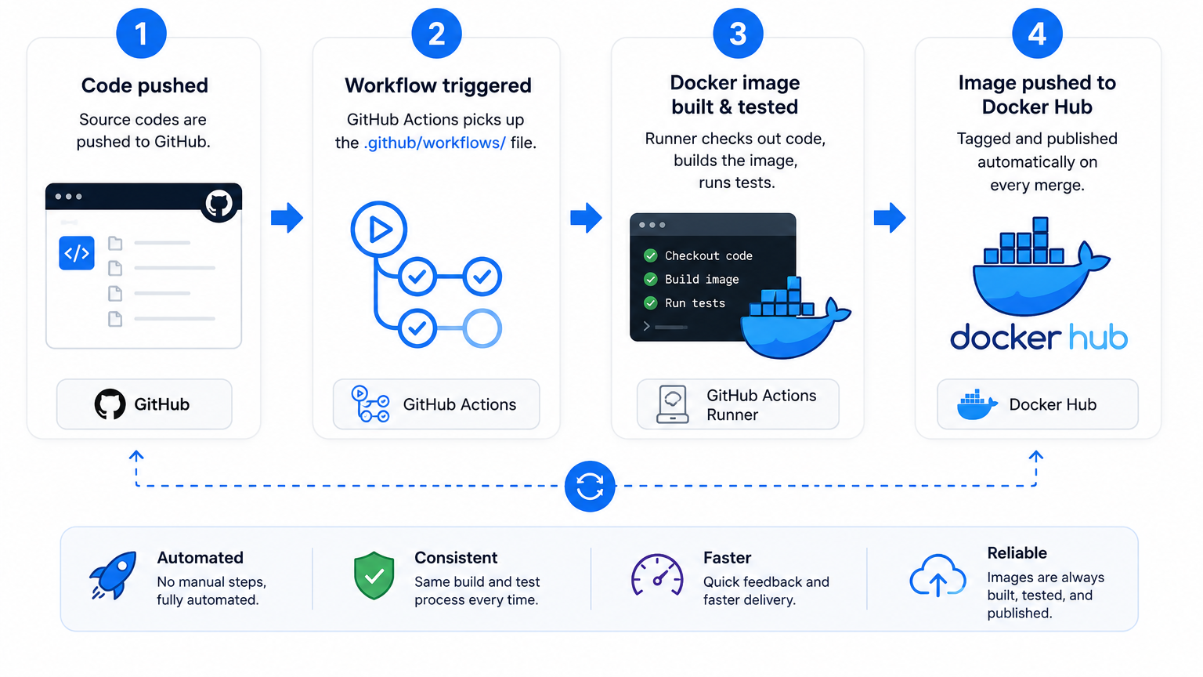
GitHub Actions for Docker Containers
GitHub Actions automates every stage of your container lifecycle, from code commit to a published, versioned image on Docker Hub.
Notes:
This is the high-level workflow. First, code is pushed or a release is published. Second, GitHub Actions detects the event and starts the workflow. Third, the Docker image is built and tested on the runner. Fourth, the image is tagged and pushed to Docker Hub. The result is a published, versioned container image that can be pulled and used elsewhere.

Slide 23
Anatomy of a Workflow File
name: Build & Publish Docker Image
on:
release:
types: [published]
jobs:
push-to-dockerhub:
runs-on: ubuntu-latest
permissions:
packages: write
contents: read
steps:
- uses: actions/checkout@v4
- name: Login to Dockerhub
uses: docker/login-action@v3
with:
username: ${{ vars.DOCKERHUB_USERNAME }}
password: ${{ secrets.DOCKERHUB_PASSWORD }}
- name: Extract Metadata
id: metadata
uses: docker/metadata-action@v4
with:
images: |
tuftsttsrt/rserver
tags: type=semver,pattern={{version}}
- name: Build & Publish Docker Image
uses: docker/build-push-action@v5
with:
context: .
file: ./Dockerfile
push: true
tags: ${{ steps.metadata.outputs.tags }}
labels: ${{ steps.metadata.outputs.labels }}
Copy this into .github/workflows/docker.yml to get an automated, production-ready build pipeline.
▶ Trigger
Fires when a GitHub Release is published.
▶ Runner
GitHub-hosted Ubuntu VM.
▶ Secrets & Variables
Referenced with ${{ vars.NAME }} and ${{ secrets.NAME }}. Never printed in logs.
▶ Steps
Run in order. A failing step stops the job.
Checkout: pulls your repo code into the runner
Login: authenticates to Docker Hub using your stored credentials
Extract Metadata: derives the image tag from the release version and attaches standard OCI labels
Build & Publish: builds the image from ./Dockerfile and pushes to tuftsttsrt/rserver with the extracted tag
Notes:
Here is a real example of a workflow file. This workflow is triggered when a GitHub Release is published. It runs on an Ubuntu GitHub-hosted runner. It checks out the repository, logs in to Docker Hub, extracts metadata from the release version, and builds and publishes the Docker image. Notice that credentials are not written directly in the YAML file. They are referenced through GitHub variables and secrets.

Slide 24
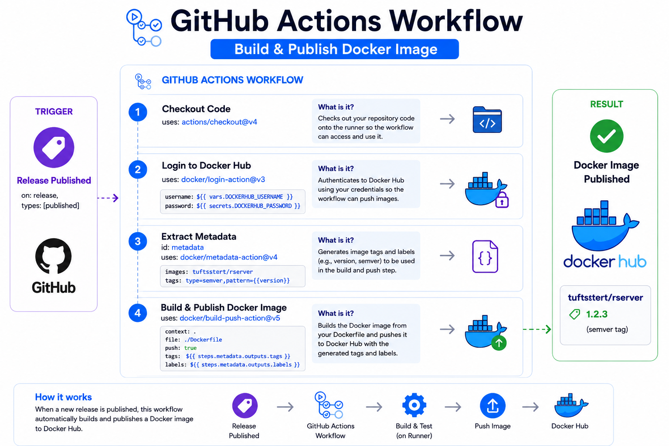
Notes:
This diagram summarizes the same workflow visually. A release is published in GitHub. That release triggers the GitHub Actions workflow. The workflow checks out the code, logs in to Docker Hub, generates the image tag, builds the image, and pushes it to Docker Hub. The final result is a published image with a version tag, such as v1.2.3.

Slide 25
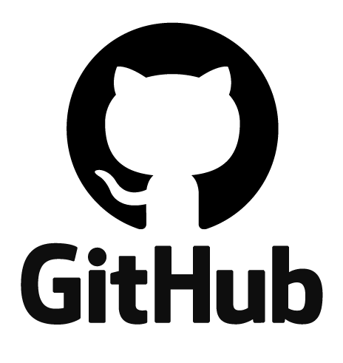
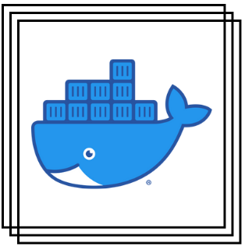
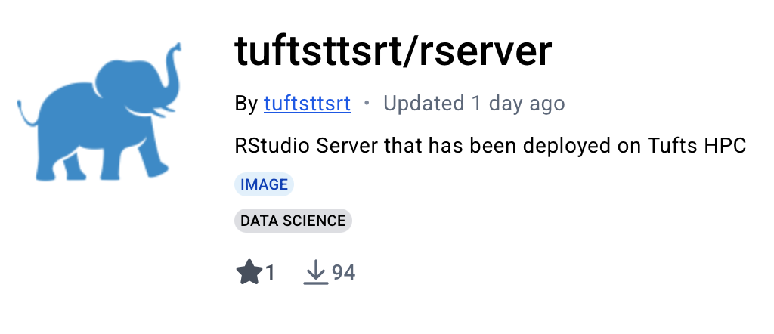
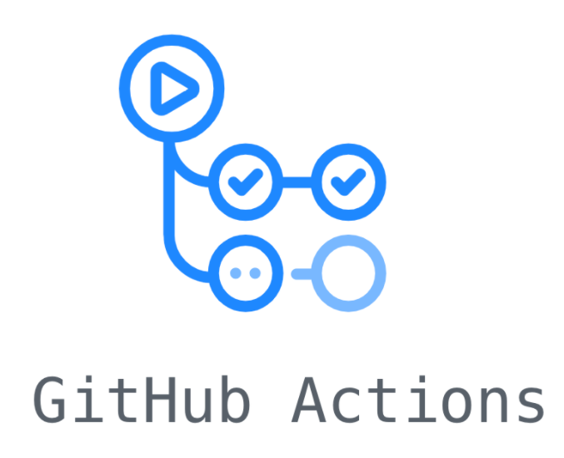

How TTS Research Technology use it?
Before: admin manually builds and pushes images After: GitHub Actions builds, tags, and publishes images automatically
docker build
docker push
Dockerfile
Pull
Push
Image
System admin
Notes:
This slide shows how TTS Research Technology uses this workflow. Previously, a system administrator might manually build an image from a Dockerfile and then manually push it to Docker Hub. With GitHub Actions, the repository can handle that process automatically. The admin updates the Dockerfile or publishes a release, and GitHub Actions performs the build and push steps in a repeatable way. This reduces manual work and makes the build process easier to audit.

Slide 26
What this means for tufts HPC?
• Faster and more repeatable container updates
• Less manual build and push work for admins
• Dockerfile in GitHub documents exactly how each image is built
• Versioned images support reproducible research
• GitHub history gives traceability: who changed what, when, and why
• Foundation for future Apptainer/Singularity deployment
Notes:
For HPC, this workflow is not just about convenience. It also improves documentation and transparency. When the Dockerfile is stored in GitHub, we have a clear record of how the container was built: which base image was used, which packages were installed, and what commands were run. The Git history also shows who changed the container definition, when it changed, and why. That makes the container easier to maintain, easier to reproduce, and easier to troubleshoot later.

Slide 27
Setting Up Secrets & Credentials
Secrets keep sensitive credentials out of your code and safely stored in GitHub — never hardcode passwords or tokens in your workflow files.
Why secrets matter: never hardcode credentials — leaked tokens can compromise your Docker Hub account and any connected infrastructure
Adding Docker Hub credentials to GitHub Secrets: go to Settings → Secrets and variables → Actions, then add DOCKERHUB_USERNAME and DOCKERHUB_PASSWORD
Notes:
Credentials are one of the most important parts of this workflow. We should never hardcode Docker Hub usernames, passwords, or tokens directly in a workflow file. Instead, we store them in GitHub Secrets or variables. The workflow can use those values at runtime, but they are not exposed in the repository. For Docker Hub, it is better to use an access token instead of a normal account password.

Slide 28
What Is Layer Caching?
Each Docker instruction creates a layer. Caching saves those layers so repeated builds only redo what actually changed.
⚠ The Problem
Every GitHub Actions run starts on a brand-new virtual machine — there is no leftover cache from the previous run.
Without caching, every build reinstalls all dependencies and rebuilds all layers from scratch — even if only one file changed.
✔ The Solution
Add two lines to build-push-action to save layers to GitHub’s cache and pull them back on the next run:
cache-from: type=gha
cache-to: type=gha,mode=max
How Layers Work
• Each Dockerfile instruction (FROM, RUN, COPY) creates one layer
• Docker reuses cached layers until the first instruction that changed
• Everything after the changed instruction gets rebuilt
Where Are Layers Stored?
• type=gha: GitHub’s own cache servers (10 GB, 7-day expiry) , easiest, no setup
• type=registry: Docker Hub (persists longer, uses registry storage)
• type=local: runner disk (self-hosted runners only)
Notes:
Docker images are built in layers. Each Dockerfile instruction creates a layer. If nothing changes in an earlier layer, Docker can reuse that layer instead of rebuilding it. The challenge with GitHub-hosted runners is that every run starts on a fresh virtual machine, so the local cache is gone. To solve this, we can use the GitHub Actions cache with cache-from: type=gha and cache-to: type=gha,mode=max. This can make repeated builds much faster.

Slide 29
CPU architecture matters
When using a container, you must choose an image built for the correct CPU architecture of your system, such as x86_64/amd64 or arm64.
A container does not ignore hardware differences. If the image was built for the wrong architecture, it may fail to start or run much more slowly through emulation.
For example, a container built for amd64 may not run natively on an Apple Silicon Mac, which uses arm64.
Notes:
CPU architecture matters when building and running containers. An image built for amd64 is not the same as an image built for arm64. Most HPC systems, including Tufts HPC, typically run amd64 images. Apple Silicon Macs use arm64. If users pull an image built for the wrong architecture, it may fail to run or may run slowly through emulation. So when we publish images, we need to be clear about which architectures are supported.

Slide 30
Building Multi-Architecture Images
One image manifest, two architectures: users on Apple Silicon, AWS Graviton, and x86 servers all pull the right variant automatically.
Why It Matters
• Apple Silicon Macs run ARM natively, an amd64-only image runs slowly under emulation
• Tufts HPC and PC can only run amd64 images.
• Docker Hub serves the correct variant automatically via a manifest list
Add to Your Workflow
# Step 1 — add before setup-buildx
- uses: docker/setup-qemu-action@v4
# Step 2 — add to build-push-action
platforms: linux/amd64,linux/arm64
How It Works
• QEMU emulates ARM64 on the x86 runner so both architectures can be built in one job
• Buildx builds both variants and pushes them as a single multi-arch manifest to Docker Hub
• docker pull automatically fetches the right variant for the host platform
Trade-offs
• ARM build under QEMU emulation is 4–8× slower than native, a 5 min build may take 30–40 min
• For faster ARM builds, use a native ARM self-hosted runner (e.g. Apple M-series or AWS Graviton) with runs-on: [self-hosted, arm64]
Notes:
Multi-architecture images allow one image name to support multiple CPU architectures. For example, the same Docker Hub image tag can contain both linux/amd64 and linux/arm64 variants. Docker will automatically pull the correct one for the user’s machine. This is helpful if users develop on Apple Silicon Macs but deploy to x86 servers. The trade-off is that building ARM images through QEMU emulation can be much slower. For production HPC images, we should always make sure the amd64 image is built and tested.

Slide 31
Key Takeaways
Containers make research software more portable and reproducible
GitHub repositories document how containers are built through Dockerfiles and workflow history
GitHub Actions turns manual build, tag, and push steps into a repeatable automated workflow
Versioned Docker images make updates easier to track, test, and roll back

Slide 32
04 Demo
https://github.com/TuftsHPCbioinfo/GitHubActionDemo
cd Downloads
git clone https://github.com/TuftsHPCbioinfo/GitHubActionDemo
docker run --rm \
-p 8787:8787 \
-e DISABLE_AUTH=true \
-v ~/Downloads/GitHubActionDemo:/home/rstudio/workshop_demo \
tuftsttsrt/rstudio:4.6.0
Notes:
For the demo, I will use this GitHub repository: TuftsHPCbioinfo/GitHubActionDemo. I will clone the repository, run the provided Docker image, and show how the workflow is connected to the repository. The example runs an RStudio container and mounts the demo repository into the container. This gives us a simple way to demonstrate how a containerized environment can be built, published, and used.

Slide 33
Questions?
Notes:
That concludes the presentation. The main takeaway is that GitHub Actions can turn container builds from a manual process into a repeatable automated workflow. For research technology and HPC, this helps us deliver software environments more reliably, reduce manual maintenance, and create a foundation for more complete CI/CD workflows in the future. I am happy to take questions.

