Slide 1
RNA-Seq analysis on Tufts HPC Part1 : HPC, Nextflow and nf-core
Yucheng Zhang
Senior Bioinformatics Engineer
TTS Research Technology
yucheng.zhang@tufts.edu
Notes:
Welcome, everyone. This week we are taking a major step: from running things on your laptop, to using a shared computing cluster.
By the end of today you will have connected to a real HPC cluster, transferred a file, and submitted your first batch job.
If you are off campus, please make sure you are connected to the Tufts VPN before the hands-on section.

Slide 2
Agenda
Architecture of Tufts HPC
Walk through Tufts Open OnDemand platform
Connect to Tufts HPC and transfer files
Submit, monitor, and cancel a simple SLURM job
Request appropriate compute resources
Introduction to Nextflow & nf-core
RNA-Seq analysis with nf-core rnaseq pipeline on Tufts Open OnDemand
Notes:
Five things to learn today. The first two are conceptual — understanding what a cluster IS and how it works. These concepts apply to any HPC system, not just Tufts.
The last three are practical — actually doing things on the cluster. Both matter equally.

Slide 3
Why Do We Need Clusters?
A single machine has hard limits:
CPU cores: typically 8-32 on a workstation
RAM: typically 16-64 GB
Runtime: long jobs tie up your machine
Modern bioinformatics regularly exceeds those limits:
Human genome alignment: 30-60 GB RAM, hours of CPU time
50 RNA-seq samples: 50 independent alignment runs
A cluster pools hundreds of machines' resources and lets many researchers share them simultaneously.
Notes:
Start here before showing any HPC diagrams. Students from biology backgrounds often do not know why you would use a cluster.
The key insight: it is not that a cluster is faster per-se — it is that it has resources a single machine physically cannot have. And it can run many jobs at the same time.
Ask the class: has anyone run a script that took more than 30 minutes on their laptop? What happened to their computer while it ran?

Slide 4
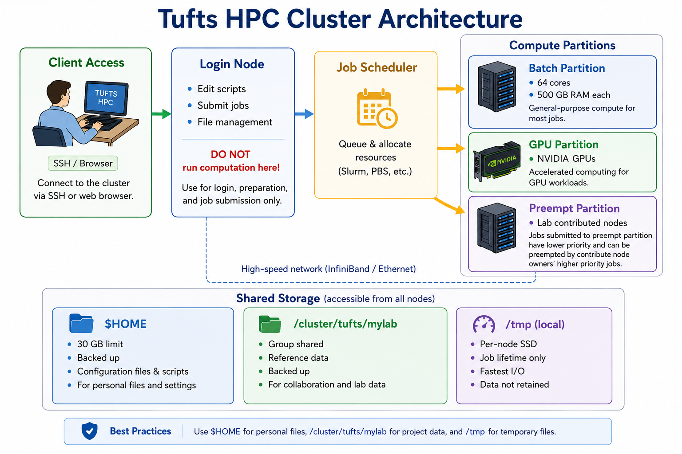
Notes:
This is the architecture of a typical HPC cluster. Walk through each component:
- Client access: SSH or web browser. You connect here.
- Login node: where you land. Light work only — it is shared by everyone.
- Job scheduler (SLURM on many systems): the traffic controller. You request resources, it decides when and where your job runs.
- Compute partitions: the actual machines doing the work. Standard, high-memory, GPU.
- Shared storage: all nodes can see the same files. You copy data once and any compute node can access it.
This same pattern — login, scheduler, compute, shared storage — applies to Tufts HPC, national supercomputers like XSEDE, and cloud HPC systems like AWS ParallelCluster.

Slide 5
The Key Components
1. Login node:
Where you SSH in. Shared by all users. Never run analysis here.
2. Scheduler (slurm):
Accepts resource requests, queues jobs, allocates compute nodes
3. Compute nodes:
Many CPUs, lots of RAM. Allocated exclusively while your job runs.
4. Shared storage:
Same filesystem visible from all nodes. Copy data once, use from anywhere.
These four components appear on every HPC system.
Notes:
Reinforce the architecture with concrete roles. The scheduler name varies — Tufts uses SLURM, other institutions use PBS/Torque, or LSF, but the concept is identical.
Emphasize shared storage: this is a major difference from your laptop. On a cluster, files live in one place accessible from everywhere. You do not copy data to each compute node — the compute node reads from shared storage.
Ask: what happens if two people try to run on the same compute node at the same time without a scheduler? (Answer: chaos — both jobs compete for RAM and CPU, both run slowly.)

Slide 6
Connecting to Tufts HPC
Tool | What it is | When to use it
SSH | Encrypted terminal connection to the cluster | Login cluster, edit files and submit jobs
rsync | copy and synchronize files/folders between locations. | Transfer or sync many files, large files, or interrupted transfers between cluster and your computer.
sftp | Interactive file transfer over SSH | Transfer files interactively between your computer and cluster.
Notes:
Now we get practical. We will cover the three tools you need to get onto the cluster and move files around.
SSH for the terminal connection, SFTP and rsync for file transfers, and where to put your files.

Slide 7
Two Ways to Access Tufts HPC
OnDemand Web Portal:
Browser-based — good for Jupyter, RStudio, exploring
URL: ondemand-prod.pax.tufts.edu
SSH Terminal:
Direct command-line access from your laptop
Required for SLURM job submission and scripting
ssh your_utln@login-prod.pax.tufts.edu
Off campus: connect to Tufts VPN first.
Notes:
Tufts gives you two front doors. OnDemand is great for interactive work in a browser. SSH is what you will use for everything else — submitting jobs, writing scripts, transferring files.
VPN reminder: if the SSH command just hangs, the most common reason is that the student is off campus without VPN.

Slide 8
What is SSH?
SSH = Secure Shell
Encrypted terminal connection to a remote computer
Already installed on Mac and Linux
Windows: Git Bash, WSL, or PowerShell
Tufts HPC login address: login-prod.pax.tufts.edu
Notes:
SSH is the standard way to connect to any remote machine securely. It has been around since the 1990s and is used everywhere — from HPC clusters to cloud servers to Raspberry Pis.
Important framing: SSH is not Tufts-specific. The same command (ssh user@hostname) works for any SSH server anywhere in the world.

Slide 9
Connecting via SSH
# From your laptop terminal:
$ ssh your_utln@login-prod.pax.tufts.edu
# First time: confirm the host fingerprint — type 'yes'
# Enter your Tufts password + 2FA
# Your prompt changes to:
[your_utln@login-prod-01 ~]$
# 'login-prod' in the prompt = you are on the LOGIN NODE
# Check your location:
$ pwd # /cluster/home/your_utln
Notes:
Have students follow along and run this command.
First-time connection: SSH will show a host fingerprint and ask if you trust it — just type yes.
The hostname in the prompt tells you exactly where you are. 'login-prod' means login node. When we submit a job successfully, the job will run on something like 'compute-1-23'.

Slide 10
The Login Node Rule
You land on the LOGIN NODE when you SSH in.
Login nodes are SHARED by everyone connected.
OK on login nodes:
Edit files, submit jobs, check job status, light commands
Never run jobs or heavy commands on login nodes
If you violate this, you do not just slow yourself down. You slow down everyone else on that login node. Admins will kill your job and warn you.
All real computation → SLURM → compute nodes.
Notes:
This is the most important rule for HPC. Login nodes are shared by potentially hundreds of users at the same time.
Analogy: the login node is the lobby of a building. You do not set up your desk in the lobby. You use it to get where you are going.
If you violate this, you do not just slow yourself down — you slow down everyone else on that login node. On some clusters, admins will kill your job and warn you. On Tufts, please be respectful.

Slide 11
Transferring Projects: rsync
For whole project directories, use rsync.
Why rsync over SFTP?
Transfers entire directory trees
Shows progress and can RESUME interrupted transfers
Smart: only copies files that have changed
Run rsync from your LAPTOP, not from inside SSH.
rsync works over SSH — same security, better for bulk transfers.
Notes:
rsync is the tool to use when you have more than a few files. Its resume feature is especially useful for large genomics datasets — if your connection drops halfway through a 50 GB transfer, rsync will pick up right where it left off.
Critical: run rsync from your laptop terminal, not from inside your SSH session.

Slide 12
rsync: Upload and Download
# Upload a project to the cluster (run from your laptop):
$ rsync -avzP ~/bio196/project/ \
your_utln@login-prod.pax.tufts.edu:/cluster/home/your_utln/project/
# Download results from cluster to laptop:
$ rsync -avzP \
your_utln@login-prod.pax.tufts.edu:/cluster/home/your_utln/project/results/ \
~/bio196/project/results/
# Flags: -a archive -v verbose -z compress -P progress+resume
# TRAILING SLASH matters:
# project/ -> copies CONTENTS
# project -> copies the folder itself (creates nested dir)
Notes:
These two commands are ones students will use constantly this semester. The avzP flag combination is a solid default for bioinformatics.
The trailing slash is a consistent stumbling block — emphasize it and show the difference if possible.

Slide 13
What is a Job?
A job contains two things:
Resource request
partition
CPUs
GPUs (optional)
memory
runtime
Commands to execute
Notes:
A SLURM job is two things combined: a resource request (how many CPUs, how much RAM, how long) and a list of commands to run.
You put these together in a shell script, submit it with sbatch, and SLURM runs it on a compute node when resources are available.
We will go deep on script writing in Lecture 2. Today, we want to submit our first job.

Slide 14
Interactive Job
Login nodes have limited CPU and memory resources and should not be used to run jobs.
Please request the appropriate resources and run your jobs on compute nodes using an interactive or batch job.
To start an interactive job:
$ srun -p batch -t 2:00:00 -N 1 -n 1 -c 2 --mem=8G --pty bash
More details can be found here:
https://rtguides.it.tufts.edu/hpc/slurm/interactive.html
Notes:
Every job must specify these four things. They determine where and when the scheduler can run your job.
CPU cores: only request as many as your tool can actually use. Memory: get this wrong and your job crashes. Walltime: SLURM kills your job if it runs past this. Partition: which group of nodes — batch for general CPU, gpu if you need a GPU.
These same parameters exist on every scheduler, just with slightly different names.

Slide 15
Key SLURM Commands
sbatch script.sh | Submit a batch job
squeue -u $USER | Show your queued and running jobs
scancel JOBID | Cancel a job
sacct -j JOBID | Check what happened to a completed job
srun -p batch | Interactive compute session
sinfo | Show available partitions and node status
Notes:
Six commands you will use throughout this course. sbatch submits, squeue monitors, scancel kills, sacct checks results after.
srun is your best friend for debugging — it drops you onto a compute node interactively so you can test commands before writing a script.

Slide 16
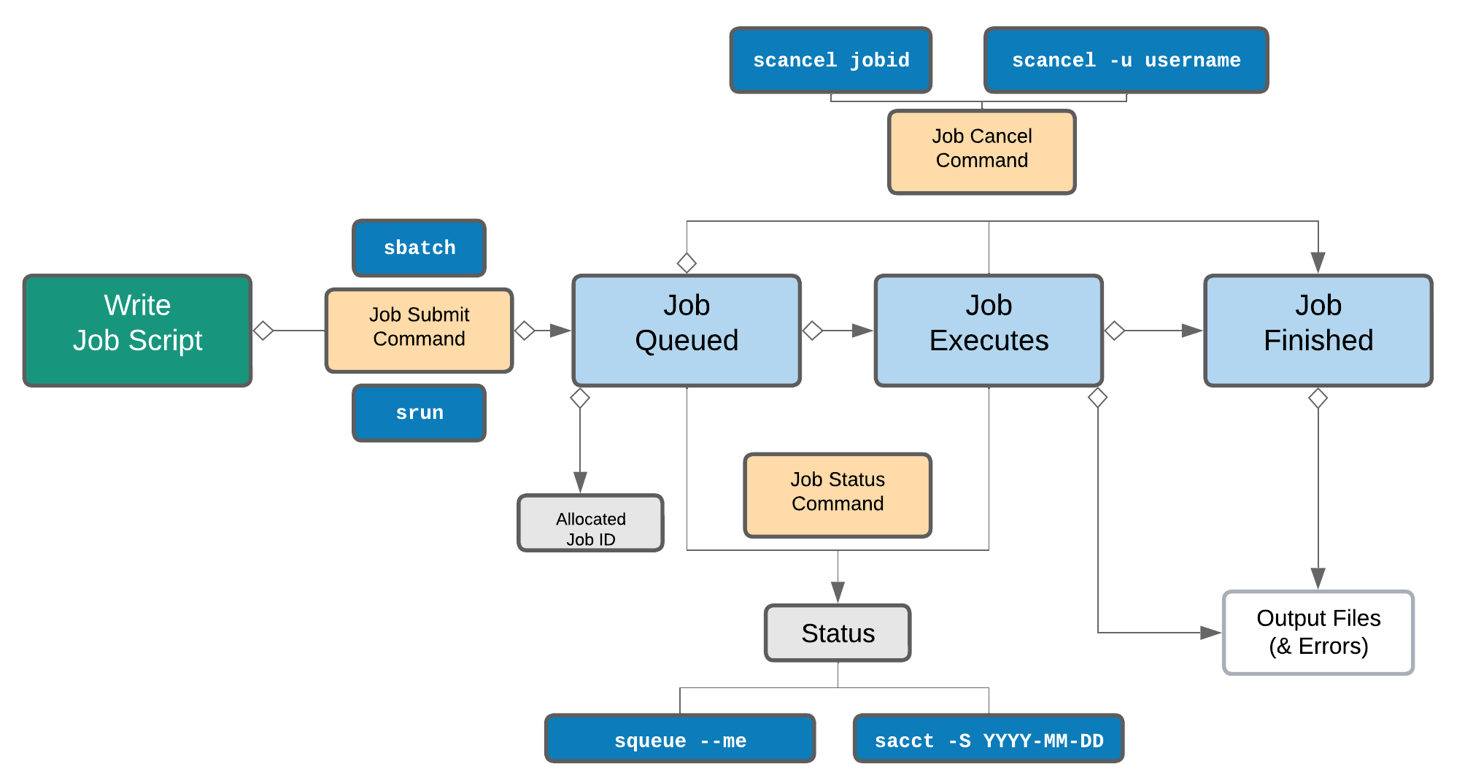
Life cycle of a slurm job
Notes:
This diagram shows the full lifecycle of a SLURM job. You write a script, submit with sbatch, it enters the queue (PENDING), SLURM finds resources, the job runs (RUNNING), and when done you review the output with sacct.
This loop — Write, Submit, Queue, Run, Review — is what you will do hundreds of times in this course. Once this pattern is automatic, HPC feels much less intimidating.

Slide 17
Slurm job script
#!/bin/bash
#SBATCH -p batch # Partition to submit to, batch is the standard CPU partition
#SBATCH -N 1 # Number of nodes requested (1 node)
#SBATCH -n 1 # Number of tasks (processes)
#SBATCH -c 8 # Number of CPU cores per task (8 cores total here)
#SBATCH --mem 24G # Total memory allocated for the job (24 GB RAM)
#SBATCH -t 24:00:00 # Wall-clock time limit (HH:MM:SS): job killed after 24 hours
#SBATCH -J my_job_name # Job name (shows in queue; used as %x in log filenames)
#SBATCH --error=%x-%J.err # stderr log file: %x=job name, %J=job ID
#SBATCH --output=%x-%J.out # stdout log file — %x=job name, %J=job ID
module load nextflow
nextflow run nf-core/rnaseq -r 3.26.0 -profile tufts \
--input samplesheet.csv \
--outdir results_rnaseq_test \
--aligner star_salmon --gtf genes.gtf --fasta genome.fasta
sbatch rnaseq_script.sh # submit the job to slurm
Notes:
Walk through each SBATCH directive with students as they type it. These directives are the focus of Lecture 2, but a first look here is useful.
Save with Ctrl+X, Y, Enter. Then sbatch. They should see 'Submitted batch job XXXXXXX'. Record that number.

Slide 18
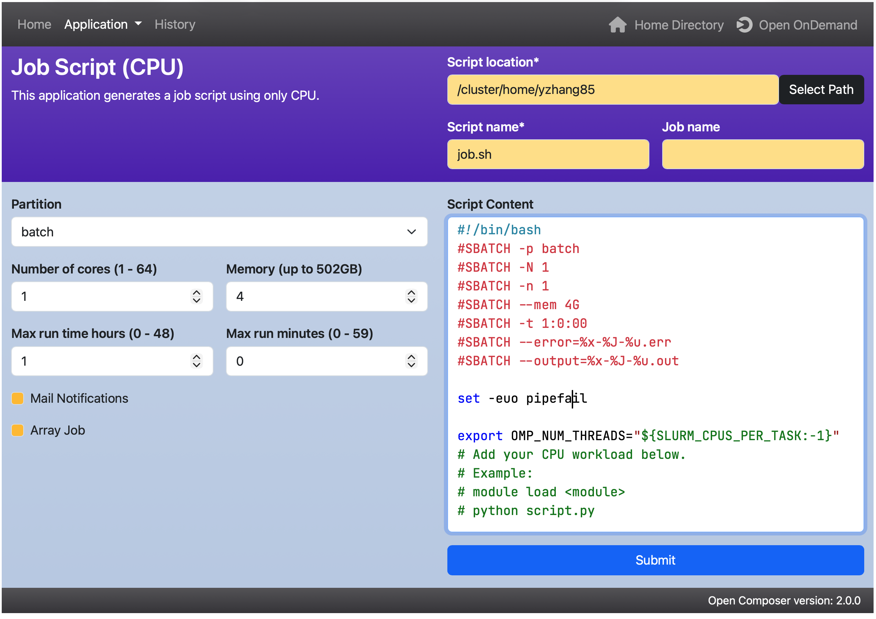
Compose a script with Open Composer

Slide 19
Why biologist need workflow managers
They turn fragile command histories into repeatable, shareable analyses.
Without a workflow manager
With a workflow manager
trim.sh
FASTQ
Each step knows its inputs, outputs, software, and resources.
align_v2.sh
describe
the workflow
QC / trim
variants_final_final.sh
align
manual notes + guesses
Hard to restart • hard to share • easy to miss a step
variants
rerun only what changed

Slide 20
What is nextflow?
A scripting language built specifically for connecting analysis steps
A workflow manager designed for bioinformatics: you describe the steps and the dependencies, and Nextflow figures out what to run in parallel, where to run it, and how to restart on failure.

Slide 21
Hello, nextflow
LIVE DEMO
Run your first pipeline
# Load module
module load nextflow
# Built-in example — nothing to download
nextflow run hello
# Your own hello world:
nextflow run hello.nf --greeting "Hi from HPC"
# Use a real community pipeline
nextflow run nf-core/demo -r 1.1.0 -profile test,singularity --outdir demo_output

Slide 22
-resume · the killer feature
Pipeline crashed at step 5 of 6? Fix the bug. Rerun with -resume.
→ rerun everything
→ pick up where you left off
nextflow run main.nf -profile slurm -resume
Nextflow caches every task in work/ by a hash of its inputs + script. Unchanged tasks are reused.

Slide 23
What is nf-core?
A community, a standard, and a pipeline catalog — all in one
nf-core is a community-driven project that provides a curated set of open-source, peer-reviewed bioinformatics pipelines built on Nextflow. Every pipeline follows the same standards for code, documentation, testing, and reproducibility.
150+
13,000+
100%
curated pipelines
community members
open source
nf-co.re · github.com/nf-core · Slack with 14k+ researchers

Slide 24
The nf-core catalog
Some of the most-used pipelines — chances are your analysis is here
Bulk sequencing
Single cell
Other omics
nf-core/rnaseq
nf-core/scrnaseq
nf-core/ampliseq
Bulk RNA-seq ★
Single-cell RNA-seq
16S / amplicon
nf-core/sarek
nf-core/scnanoseq
nf-core/mag
Germline + somatic variants
Single-cell nanopore
Metagenomics
nf-core/chipseq
nf-core/methylseq
ChIP-seq
Bisulfite / methylation
nf-core/atacseq
nf-core/proteinfold
ATAC-seq
AlphaFold2 / ColabFold
Browse all 150+ at nf-co.re/pipelines — search by keyword, organism, or data type

Slide 25
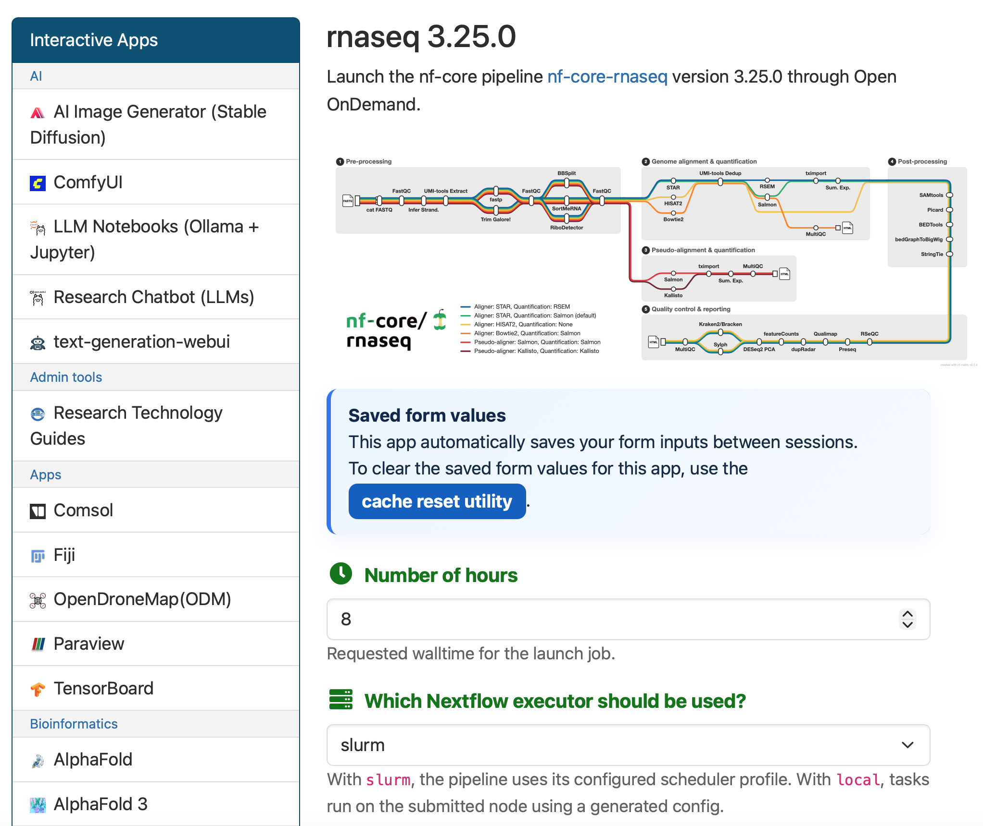
Three ways to launch
Pick whichever fits your workflow — all produce the same run
nextflow run
nf-core launch
Open OnDemand
what you already know
interactive CLI wizard
web UI (tufts specific)
nextflow run nf-core/rnaseq \
-profile test,singularity \
--outdir results
module load nf-core
nf-core pipelines launch \
rnaseq -r 3.25.0
# Point & click
# cloud.seqera.io
# (formerly Nextflow Tower)
Direct, scriptable. What we'll use today.
Prompts you through every parameter. Great for first-time use.
GUI, monitoring, dashboards

Slide 26
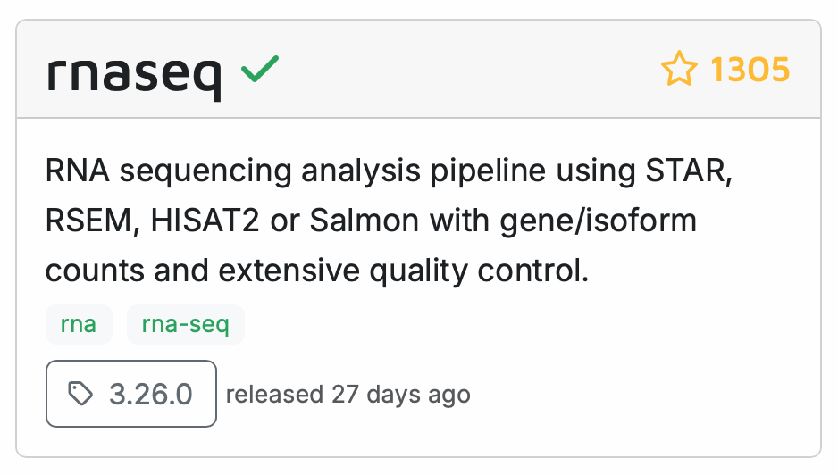
nf-core/rnaseq
The most-used bulk RNA-seq pipeline in biology
The standard
end-to-end bulk
RNA-seq pipeline

Slide 27
The samplesheet
This one file tells the pipeline what to analyze
sample,fastq_1,fastq_2,strandedness
CTRL_REP1,/scratch/$USER/data/ctrl_r1_R1.fq.gz,/scratch/$USER/data/ctrl_r1_R2.fq.gz,auto
CTRL_REP2,/scratch/$USER/data/ctrl_r2_R1.fq.gz,/scratch/$USER/data/ctrl_r2_R2.fq.gz,auto
CTRL_REP3,/scratch/$USER/data/ctrl_r3_R1.fq.gz,/scratch/$USER/data/ctrl_r3_R2.fq.gz,auto
TREAT_REP1,/scratch/$USER/data/treat_r1_R1.fq.gz,/scratch/$USER/data/treat_r1_R2.fq.gz,auto
TREAT_REP2,/scratch/$USER/data/treat_r2_R1.fq.gz,/scratch/$USER/data/treat_r2_R2.fq.gz,auto
TREAT_REP3,/scratch/$USER/data/treat_r3_R1.fq.gz,/scratch/$USER/data/treat_r3_R2.fq.gz,auto
sample
fastq_1 / fastq_2
strandedness
Free-form ID. Repeat the same ID if you have multiple lanes — they'll be merged.
Absolute paths (or URLs) to R1 / R2 FASTQ files. Leave fastq_2 blank for single-end.
auto (recommended) — or forward / reverse / unstranded if you know it.

Slide 28
The parameters you'll actually set
Full schema at nf-co.re/rnaseq/parameters — here are the essentials
--input
Path to samplesheet.csv (above)
required
--outdir
Where results go
required
--genome
Reference shortcut ( GRCh38, GRCm39, …) — auto-downloads
Do not use
--fasta / --gtf
OR your own reference FASTA + annotation — skip --genome
--aligner
star_salmon (default) | star_rsem | hisat2 | bowtie2_salmon
--skip_<step>
e.g. --skip_markduplicates to speed up / save space
-profile
Environment: test, singularity, tufts
--genome uses the genome annotations in iGenomes, which are extremely out of date. For this reason, its use is not recommended.

Slide 29
Putting it all together
One command submits every step to SLURM
-profile singularity
## -profile tufts can also be used
nextflow run nf-core/rnaseq \
-profile singularity \
--input samplesheet.csv \
--outdir results_rnaseq \
--fasta genome.fa \
--gtf genes.gtf \
--aligner star_salmon
-resume
use containers (reproducibility)
-profile tufts
profile designed for tufts hpc
--fasta genome.fa
genome sequence in fasta format
--gtf genes.gtf
genome annotation in gtf format
-resume
skip cached tasks on re-run
For real runs: wrap this in a small sbatch script. Don't run long pipelines on a login node.

Slide 30
The MultiQC report · your first stop
One HTML file, every QC metric. Open it locally in a browser
Red flags to look for
General Statistics
FastQC
Per-sample table — %Dups, %GC, M reads, % aligned, M assigned.
Per-base quality, adapter content, duplication, overrepresented sequences.
⚠
< 70% unique alignment rate
⚠
High rRNA % (> 10% for polyA-seq)
⚠
Very uneven read counts per sample
STAR alignment
Salmon / Qualimap
⚠
Obvious adapter contamination post-trim
Uniquely-mapped %,
multi-mapped, unmapped, mismatch rate.
Quantification summary, gene body coverage, rRNA fraction.
⚠
5'/3' coverage bias (RNA degradation)
⚠
Unexpected strandedness inference

Slide 31
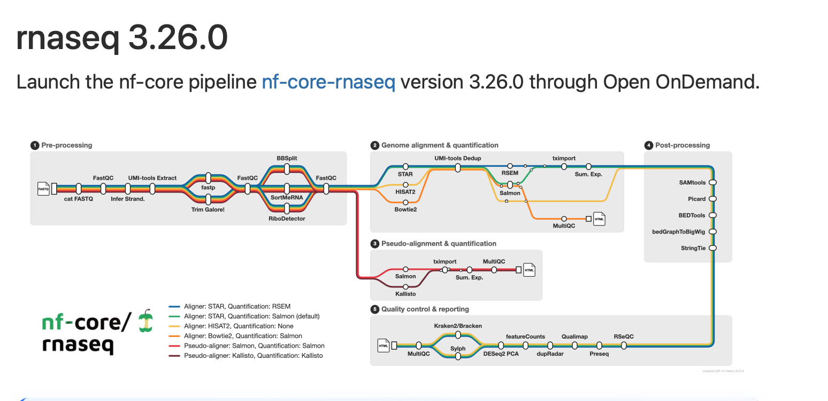
rnaseq in a browser
Hands On
Same pipeline. Same SLURM. Zero terminal.
https://ondemand-prod.pax.tufts.edu

Slide 32

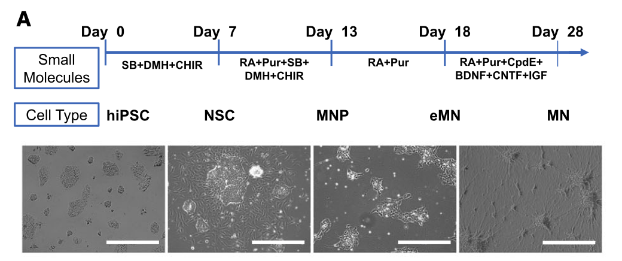
Data used in Demo
SRR11994167- SRR11994181

