Slide 1
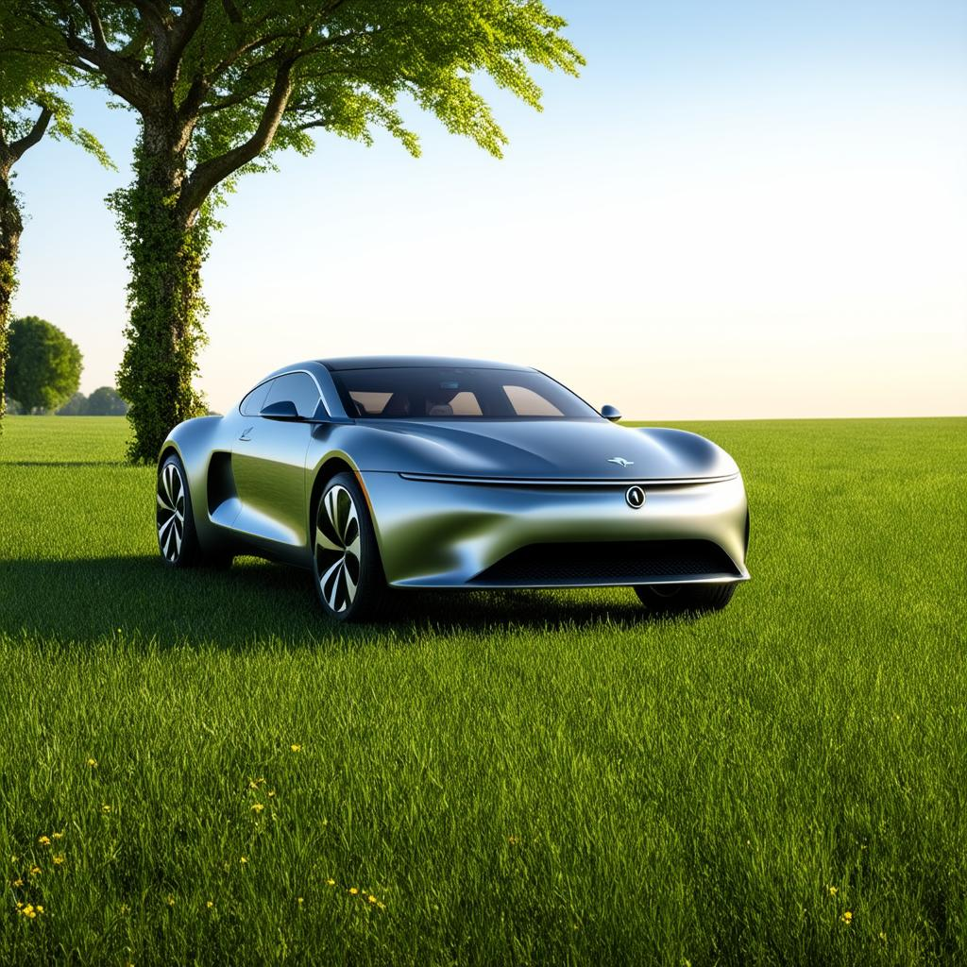
Introduction to EVs
Electric vehicles are a sustainable alternative to traditional gas-powered vehicles, reducing carbon emissions and environmental impact.
Notes:
Electric Vehicles (EVs) have gained significant attention in recent years due to their potential to reduce greenhouse gas emissions and dependence on fossil fuels. As shown on this slide, EVs are powered by electric motors, which are driven by batteries charged from an external power source. The primary components of an EV include the battery pack, electric motor, power electronics, and control systems.
There are two main types of EVs: Battery Electric Vehicles (BEVs) and Plug-in Hybrid Electric Vehicles (PHEVs). BEVs are powered solely by batteries and have zero tailpipe emissions, while PHEVs have a combination of electric and gasoline powertrains. PHEVs can run on electric power for a certain distance before switching to gasoline.
The benefits of EVs include lower operating costs, reduced emissions, and improved performance. EVs also have fewer moving parts than traditional gasoline-powered vehicles, which can lead to lower maintenance costs. However, the high upfront cost of EVs remains a significant barrier to adoption.

Slide 2
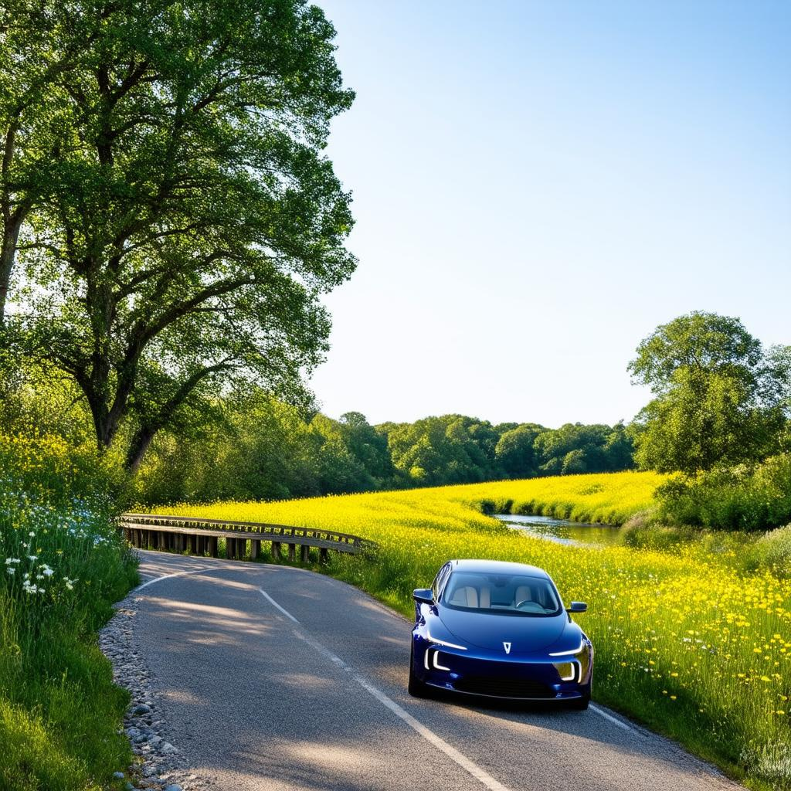
Benefits of EVs
Electric vehicles offer numerous benefits, including reduced emissions, lower operating costs, and improved energy efficiency.
Notes:
Zero Emissions: Electric vehicles (EVs) produce no tailpipe emissions, reducing greenhouse gas emissions and air pollution in urban areas. This contributes to cleaner air and a healthier environment for residents.
Lower Operating Costs: EVs are generally cheaper to run, with lower fuel costs and reduced maintenance needs. They require less frequent oil changes and have fewer moving parts than traditional internal combustion engines.
Increased Energy Efficiency: EVs convert about 60-70% of the electrical energy from the grid to power the wheels, while gasoline-powered vehicles only convert about 20% of the energy in gasoline to power the wheels.
Government Incentives: Many governments offer incentives for purchasing EVs, such as tax credits, rebates, and exemptions from certain fees. These incentives can help offset the higher upfront cost of EVs.
Reduced Dependence on Fossil Fuels: EVs are powered by electricity, which can be generated from a variety of sources, including renewable energy sources like solar and wind power. This reduces our dependence on fossil fuels and helps to mitigate climate change.

