Slide 1
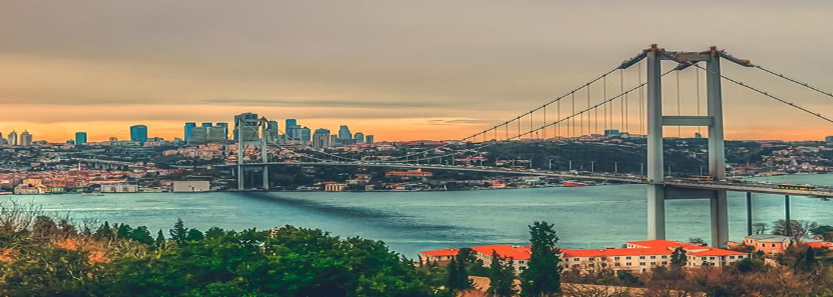
Analysis of Istanbul's Districts According to the Average House Sales Price and Venues

Slide 2
Background & Problem
Istanbul is the most populous city in Turkey.
This city, which has a high population density due to its small surface area relatively its population, consists of 39 districts.
There are people of all income levels. It offers different opportunities to people with different income distributions.
Social and cultural structuring in the districts of Istanbul reflects these differences.
This study aims to be a guide for people who want to settle in İstanbul and having own real estate there.

Slide 3
Data Acquisition and Cleaning
District Data: It is obtained from Wikipedia https://en.wikipedia.org/wiki/List_of_districts_of_Istanbul
Coordinates: Latitude and longitude information are obtained using GeoPy library.
Average House Sales Price Data: It is obtained from local real estate sales web page.
https://www.mahalligundem.com/hurriyet-emlak-2021-endeksi- aciklandi/47283/
It is cleaned and converted to csv file to use. https://github.com/TugceKaragol/Coursera_Capstone/blob/6f276377cbf42239dd622efedce673b1251fb3f4/Avg_House_Sales_Price.csv
Venues Data: Foursquare API is used to get the most common venues of Districts of Istanbul.

Slide 4
Methodology
District data was collected from the webpage, cleaned, and processed into a dataframe.
Latitude and Longitude information was obtained using the GeoPy module.
Folium library was used to visualize districts.
Foursquare API was used to explore venues in districts and get information about them.
Matplotlib library was used to understand better the analysis results.
As a clustering method, the K-means algorithm method was used to cluster districts.

Slide 5
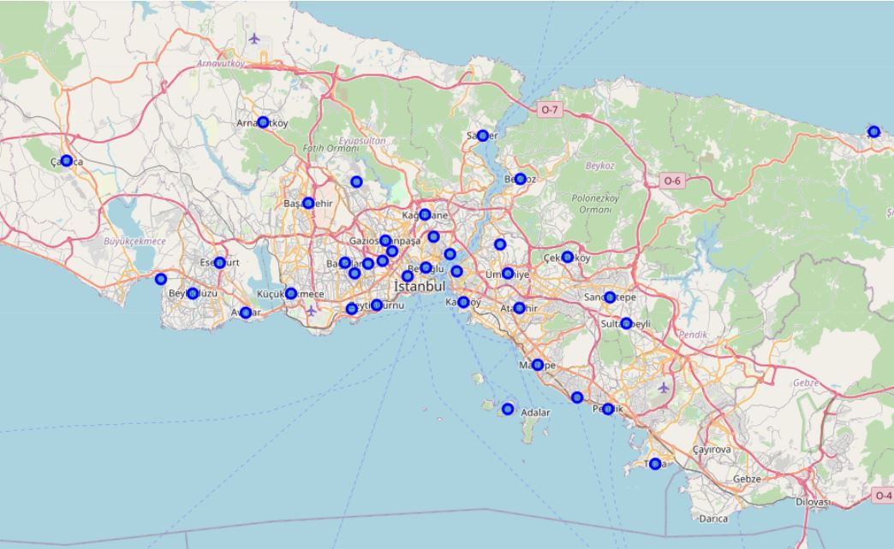
Creating an Istanbul map and visualizing districts on the map.

Slide 6
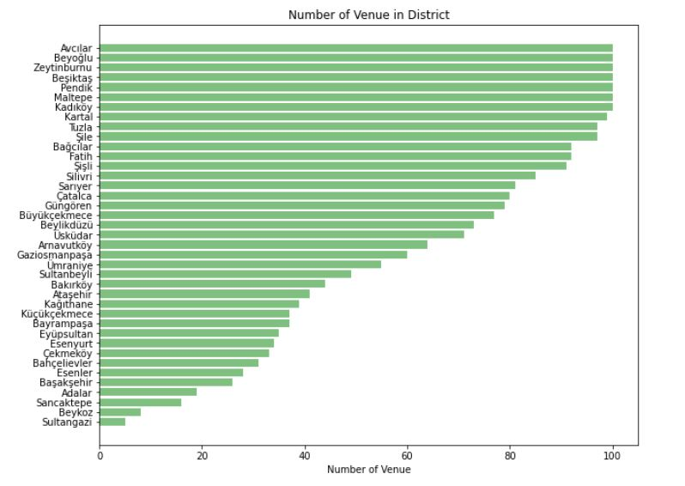
Exploring venues in each district using Foursquare API
7 districts which are Avcılar, Beyoğlu, Zeytinburnu, Beşiktaş, Pendik, Maltepe and Kadıköy reach 100 limit.
4 Districts - Adalar, Sancaktepe, Beykoz, Sultangazi- are below 20 venues.
The number of venues change between 20 and 90 in the other districts.

Slide 7
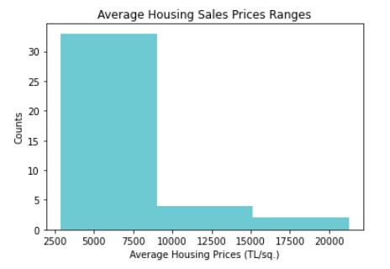
Average house sales price clusters
Low Level
The average house sales price < 9000
Medium Level
The average house sales price btw. 9000 – 15000
High Level
The average house sales price > 15000

Slide 8
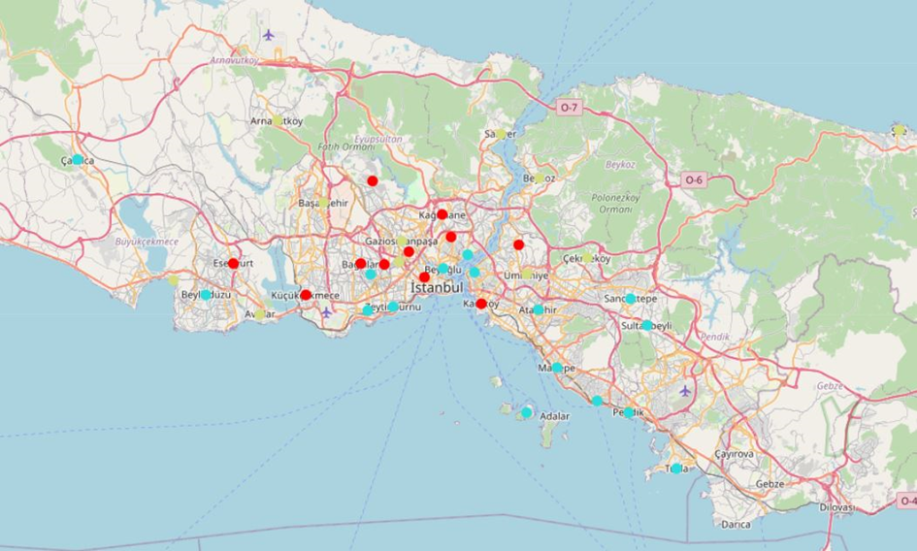
Creating an Istanbul map to visualize the analysis results.
Districts clustered according to house prices and locations are shown on the map.

Slide 9
Conclusion
Can be a guide to decide the district for people who intend to settle and have their own house in İstanbul.
The content of the study can be expanded by adding different parameters and advanced models can be created.
The quality of the study can be increased by using different methods and values than those used.

