Slide 1
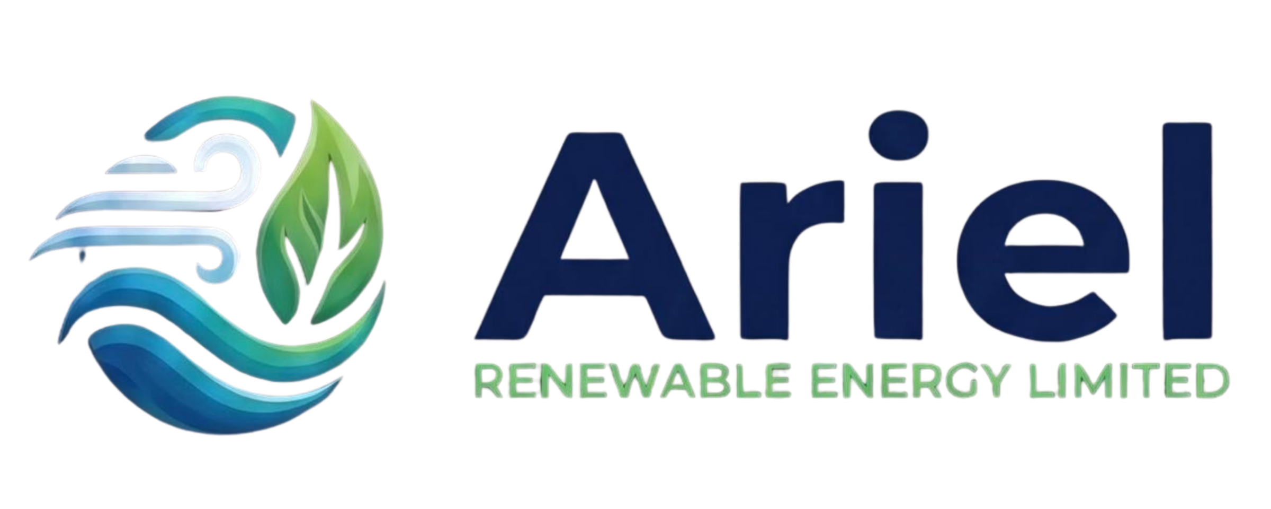
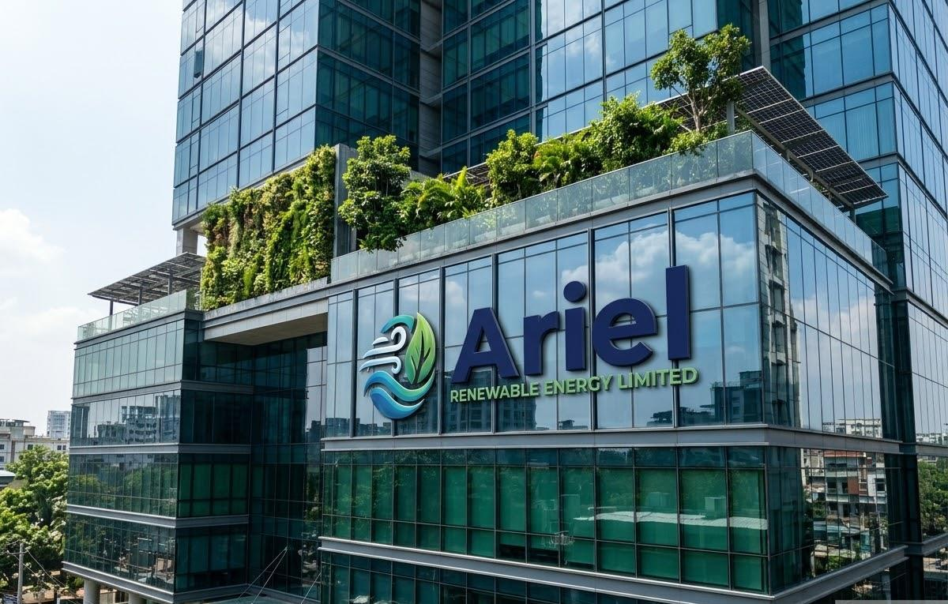
Ariel Renewable Energy Limited
Sovereign Green Infrastructure & Industrial Decarbonization
A Member of the ArielMC Enterprise Eco-System
TURNKEY ROOFTOP SOLAR EPC & SREDA NET-METERING
Boardroom Strategic Decarbonization & 25-Year Energy Cost Insulation Pitchbook
CLASSIFICATION: Strictly Private & Confidential | Boardroom Submittal
ISSUING ENTITY: Ariel Renewable Energy Limited (ArielMC Group)
TARGET: Board of Directors / Chairman / Managing Director / CEO
FINANCING: Bangladesh Bank 4.5% Green Refinancing (80% Debt)
COMMAND HUB: energy.arielmc.com | crm.arielmc.com | Nov 2026

Slide 2
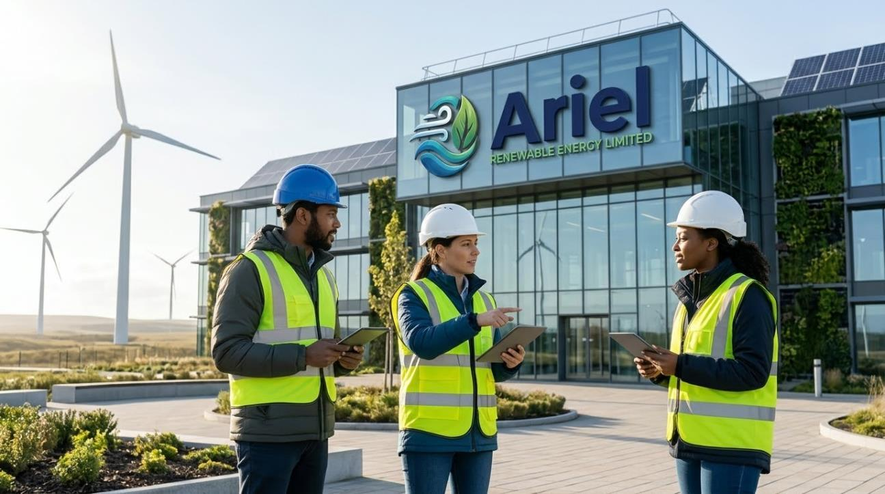
ARIEL RENEWABLE ENERGY LIMITED | SOVEREIGN GREEN INFRASTRUCTURE & INDUSTRIAL DECARBONIZATION
Sovereign Industrial Heritage Meets Turnkey Clean Energy
A Message from the Managing Director to the Board:
As Bangladesh navigates rapid industrial transformation, energy cost and grid reliability have become the single most decisive determinants of export competitiveness and enterprise profitability.
Over the past 36 months, bulk industrial electricity tariffs have escalated continuously, while fossil-fuel supply shocks and captive diesel generation costs (Tk 32–36/kWh) place unprecedented strain on operating margins.
Concurrently, European buyers are strictly enforcing decarbonization mandates. The EU Carbon Border Adjustment Mechanism (CBAM) and LEED Platinum audits mean that clean power is no longer an optional luxury—it is an existential commercial requirement to protect export volume.
Your vacant roof is an unharvested goldmine. Ariel Renewable Energy Limited, backed by the ArielMC generational enterprise, assumes 100% turnkey responsibility: 3D LiDAR drone surveying, civil structural engineering, SREDA Net-Metering approvals, Tier-1 EPC installation, and 25 years of guaranteed O&M.
CORE GUARANTEES FOR CLIENT BOARDS:
• Amortized Solar LCOE: Tk 3.20/unit (vs. Tk 11.50+ grid)
• 15-Year 100% Water-Tight Non-Penetrative Guarantee
• 80% Concessionary Debt via Bangladesh Bank (4.5% Rate)
• Contractual 25-Year Performance Ratio Guarantee (PR ≥ 80%)
Ariel Renewable Energy Limited • Sovereign Green Infrastructure & Industrial Decarbonization • energy.arielmc.com • Slide 2 of 12

Slide 3
ARIEL RENEWABLE ENERGY LIMITED | SOVEREIGN GREEN INFRASTRUCTURE & INDUSTRIAL DECARBONIZATION
The Bangladesh Energy Paradigm: Escalating Grid vs. Solar LCOE
REB / DESCO INDUSTRIAL
Tk 10.80 – 12.20 / unit
Trend: +8% to +12% / Year
Fossil-Heavy; Subject to Grid Load Shedding
COMMERCIAL PEAK TARIFF
Tk 13.80 – 15.20 / unit
Trend: +10% to +14% / Year
Highest Tariff in Bangladesh; Peak AC Penalty
CAPTIVE DIESEL BACKUP
Tk 32.00 – 38.00 / unit
Trend: Volatile Crude Imports
Severe Smoke Emissions; Heavy Engine Wear
ARIEL TURNKEY SOLAR
Tk 3.20 / unit (LCOE)
Trend: FIXED for 25 Years
100% Green; Zero Fuel Cost; SREDA Net-Metered
THE SREDA NET-METERING ENGINE: Every exported unit during daylight offsets peak night consumption on a 1:1 bi-directional billing credit, eliminating energy inflation risks for the next 25 years.
Ariel Renewable Energy Limited • Sovereign Green Infrastructure & Industrial Decarbonization • energy.arielmc.com • Slide 3 of 12

Slide 4
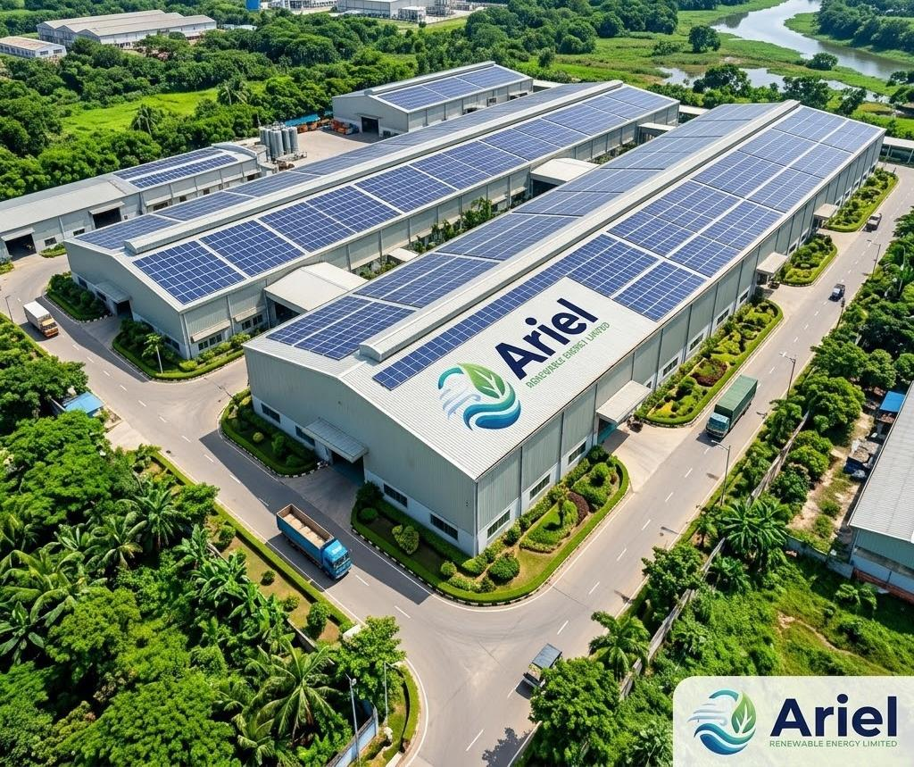
ARIEL RENEWABLE ENERGY LIMITED | SOVEREIGN GREEN INFRASTRUCTURE & INDUSTRIAL DECARBONIZATION
How SREDA Net-Metering Powers Your Balance Sheet
Operational Mechanics of Net-Metering:
1. Daytime Generation (9 AM – 3:30 PM): High-efficiency Tier-1 bifacial modules harvest daylight and feed active operating machinery directly.
2. Zero-Loss Local Consumption: Factory internal loads consume solar power first, reducing grid draw from REB/DESCO to near zero during peak sunshine.
3. Automatic Grid Export of Surplus: On weekends, holidays, or light load shifts, surplus generation automatically exports into the national grid via bi-directional meter.
4. 1:1 Financial Energy Credit: Distribution utilities credit every exported unit against night-time or peak-hour power consumption on your monthly billing invoice.
5. Indefinite Credit Rollover: Unused export credits roll over continuously into future billing cycles.
Ariel Renewable Energy Limited • Sovereign Green Infrastructure & Industrial Decarbonization • energy.arielmc.com • Slide 4 of 12

Slide 5
ARIEL RENEWABLE ENERGY LIMITED | SOVEREIGN GREEN INFRASTRUCTURE & INDUSTRIAL DECARBONIZATION
Engineered Packages: Category 1 — C&I Factory Rooftop
PACKAGE F1: INDUSTRIAL OFFSET
300 kWp
• Roof Footprint: ~24,000 sq ft Roof
• Monthly Generation: 36,000 – 39,000 kWh/mo
• Turnkey CapEx: Tk 1.56 Cr ($130k)
• Simple Payback: 3.2 Years Payback
• Target Profile: Washing, dyeing, leather finishing, medium industrial sheds.
PACKAGE F2: MEGAWATT FLAGSHIP
1,000 kWp (1.0 MWp)
• Roof Footprint: ~78,000 sq ft Roof
• Monthly Generation: 125,000 – 135,000 kWh/mo
• Turnkey CapEx: Tk 4.90 Cr ($408k)
• Simple Payback: 3.0 Years Payback
• Target Profile: Composite RMG, spinning mills, export footwear, ceramics.
PACKAGE F3: HEAVY INDUSTRIAL
2,500 kWp (2.5 MWp)
• Roof Footprint: ~200,000+ sq ft Campus
• Monthly Generation: 315,000 – 340,000 kWh/mo
• Turnkey CapEx: Tk 11.87 Cr ($989k)
• Simple Payback: 2.85 Years Payback
• Target Profile: Heavy multi-shed industrial parks, steel re-rolling, EPZ anchors.
Ariel Renewable Energy Limited • Sovereign Green Infrastructure & Industrial Decarbonization • energy.arielmc.com • Slide 5 of 12

Slide 6
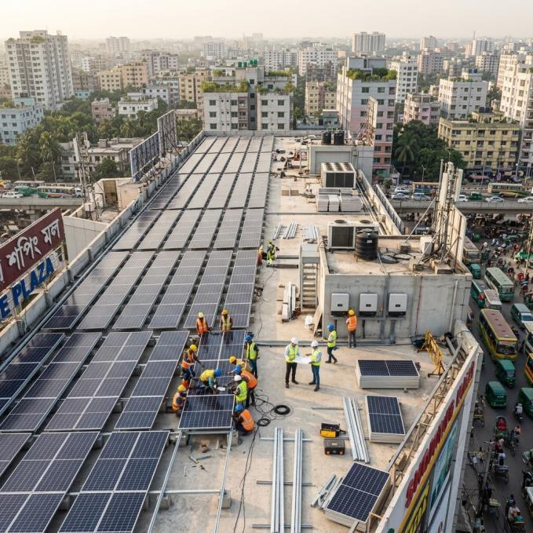
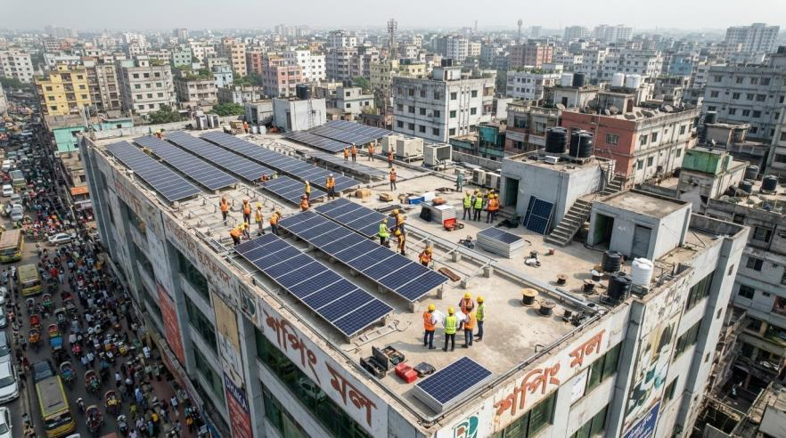
ARIEL RENEWABLE ENERGY LIMITED | SOVEREIGN GREEN INFRASTRUCTURE & INDUSTRIAL DECARBONIZATION
Commercial Buildings & Residential Real Estate
CATEGORY 2: COMMERCIAL BUILDINGS
C1: Corporate Office Tower (75 kWp)
• ~6,000 sq ft RCC rooftop pergola (Gulshan / Motijheel)
• Turnkey CapEx: Tk 46.50 Lakh ($38,750) | 3.1-Year Payback
• Slashes high-tariff peak daytime chiller cooling bills.
C2: Retail Mall & Hospital (200 kWp)
• ~16,000 sq ft roof slab | 25,000 – 27,000 kWh/month
• Turnkey CapEx: Tk 1.16 Crore ($96,600) | 2.9-Year Payback
• Fastest ROI due to highest commercial peak grid rates.
CATEGORY 3: RESIDENTIAL & APARTMENTS
• H1: Urban Villa (10 kWp Grid-Tied): Tk 7.50 Lakh ($6,250)
• H2: Luxury Hybrid (20 kWp + 15kWh LFP Battery): Tk 22 Lakh ($18,300)
• H3: Apartment Society (40 kWp Common Power): Tk 27.20 Lakh ($22,600) — slashes monthly building service charges by 40–55%.
Ariel Renewable Energy Limited • Sovereign Green Infrastructure & Industrial Decarbonization • energy.arielmc.com • Slide 6 of 12

Slide 7
ARIEL RENEWABLE ENERGY LIMITED | SOVEREIGN GREEN INFRASTRUCTURE & INDUSTRIAL DECARBONIZATION
Technical Architecture: Tier-1 BloombergNEF Hardware
SOLAR PV MODULES
Jinko Tiger Neo / LONGi 620W
• N-Type TOPCon Bifacial Dual-Glass
• Efficiency: 22.8% | Linear degradation ≤ 0.40%/yr
• 12 Years Workmanship, 30 Years Performance Guarantee
• IEC 61215 & IEC 61730 Certified
GRID STRING INVERTERS
Huawei SUN2000 / Sungrow SG
• Multi-MPPT Smart String Architecture (98.8% eff)
• AI-Powered AFCI: Extinguishes DC fire arcs in 2.5s
• Smart IV Curve Diagnosis & Cloud Telemetry
• 5-10 Years Manufacturer Warranty
MOUNTING SUBSTRUCTURES
Aluminium 6005-T5 Anodized / HDG
• 100% Non-Penetrative Standing Seam Clamps (Zero Drill)
• Certified to BNBC 2020 Cyclone Code (180 km/h wind gusts)
• Marine C5-M Corrosion Resistance
• 15-Year Structural Water-Tight Guarantee
SWITCHGEAR & TELEMETRY
ABB / Schneider + Ariel-SaaS™
• Class-A DC/AC SPDs & Motorized MCCBs
• Class 0.2S Bi-directional SREDA Net-Meter
• Deep Earth Chemical Boreholes (< 1.0 Ohm)
• 24/7 Ariel-SaaS Cloud Monitoring Gateway
Ariel Renewable Energy Limited • Sovereign Green Infrastructure & Industrial Decarbonization • energy.arielmc.com • Slide 7 of 12

Slide 8
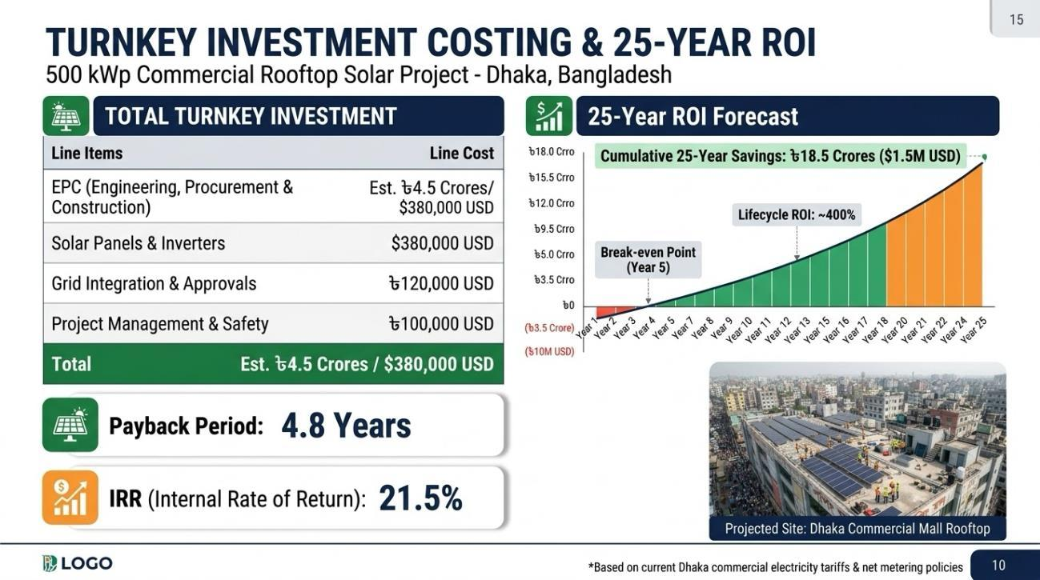
ARIEL RENEWABLE ENERGY LIMITED | SOVEREIGN GREEN INFRASTRUCTURE & INDUSTRIAL DECARBONIZATION
Turnkey CapEx Investment & 25-Year Financial Yield
Turnkey EPC Benchmarks (All-Inclusive):
• 300 kWp Factory (F1): Tk 1.56 Cr ($130,000) — 3.2 Yrs
• 1.0 MWp Flagship (F2): Tk 4.90 Cr ($408,300) — 3.0 Yrs
• 2.5 MWp Multi-Roof (F3): Tk 11.87 Cr ($989,500) — 2.85 Yrs
• 75 kWp Office Tower (C1): Tk 46.50 Lakh ($38,750) — 3.1 Yrs
• 200 kWp Mall/Hospital (C2): Tk 1.16 Cr ($96,600) — 2.9 Yrs
Detailed BOQ Percentage Breakdown:
43% PV Modules | 18% Inverters & Switchgear | 12% Structures | 8% DC/AC Cables | 6% Substation Sync | 7% Civil Rigging | 6% SREDA Engineering
Ariel Renewable Energy Limited • Sovereign Green Infrastructure & Industrial Decarbonization • energy.arielmc.com • Slide 8 of 12

Slide 9
ARIEL RENEWABLE ENERGY LIMITED | SOVEREIGN GREEN INFRASTRUCTURE & INDUSTRIAL DECARBONIZATION
Zero Working Capital Strain: Bangladesh Bank 4.5% Green Debt
80% CONCESSIONARY DEBT
4.5% Interest Rate
Under the Bangladesh Bank Green Transformation Fund (GTF), qualifying manufacturing exporters finance 80% of project CapEx at a 4.5% concessionary rate over 5 to 7 years.
POSITIVE NET CASHFLOW
Month 1 Surplus
Because monthly grid electricity savings surpass monthly debt installments, the plant deposits positive net operational cashflow into your balance sheet from the very first month.
ACCELERATED TAX BENEFIT
Depreciation Shelter
Industrial solar investments qualify for rapid corporate tax depreciation write-offs, maximizing retained earnings and lowering annual corporate income tax liability.
Ariel Renewable Energy Limited • Sovereign Green Infrastructure & Industrial Decarbonization • energy.arielmc.com • Slide 9 of 12

Slide 10
ARIEL RENEWABLE ENERGY LIMITED | SOVEREIGN GREEN INFRASTRUCTURE & INDUSTRIAL DECARBONIZATION
Civil & Structural Protection: Eliminating Factory Owner Risks
ZERO ROOF LEAKAGE RISK — 15-Year Water-Tight EPC Guarantee
100% non-penetrative aluminium seam clamps for standing seam roofs—zero sheet drilling. EPDM gaskets with Sikaflex UV sealant on trapezoidal metal.
180 KM/H CYCLONIC WIND LOADS — BNBC 2020 Structural Load Vetting
Mounting structures engineered in full compliance with Bangladesh National Building Code (BNBC 2020). Structural vetting stamp provided by certified BUET civil engineers.
FIRE & ELECTRICAL ARCS — AI Arc Fault Circuit Interrupters (AFCI)
Inverters continuously scan for micro DC arcs and extinguish them within 2.5 seconds (NFPA 855 / IEC 62109 fire safety compliance).
LIGHTNING & TROPICAL SURGES — True Dry Earthing Isolation (< 1.0 Ohm)
Dedicated copper Franklin interception rods and chemical earth boreholes isolate the solar plant completely from factory machinery.
Ariel Renewable Energy Limited • Sovereign Green Infrastructure & Industrial Decarbonization • energy.arielmc.com • Slide 10 of 12

Slide 11
ARIEL RENEWABLE ENERGY LIMITED | SOVEREIGN GREEN INFRASTRUCTURE & INDUSTRIAL DECARBONIZATION
25-Year O&M Service Level Agreement: Protecting Asset Yield
PERFORMANCE RATIO (PR) GUARANTEE
Guaranteed PR ≥ 80.0%
Continuous real-time verification against calibrated on-site pyranometers. Contractual liquidated compensation for generation shortfalls.
QUARTERLY DRONE THERMOGRAPHY
Radiometric Hotspot Scans
Autonomous drone flights conduct thermal imaging of all panels to detect micro-cracks, diode anomalies, and PID degradation before output drops.
BI-MONTHLY PANEL WASHING
Demineralized Water Protocols
Scheduled washing during dawn/dusk hours using low-TDS demineralized water keeps soiling losses strictly below 2.5% in dry winter months.
24/7 CLOUD TELEMETRY & DISPATCH
4-Hour Emergency Response SLA
Ariel-SaaS™ Cloud Gateway tracks every inverter string. Any fault triggers automated dispatch of certified solar engineers to your site.
Ariel Renewable Energy Limited • Sovereign Green Infrastructure & Industrial Decarbonization • energy.arielmc.com • Slide 11 of 12

Slide 12
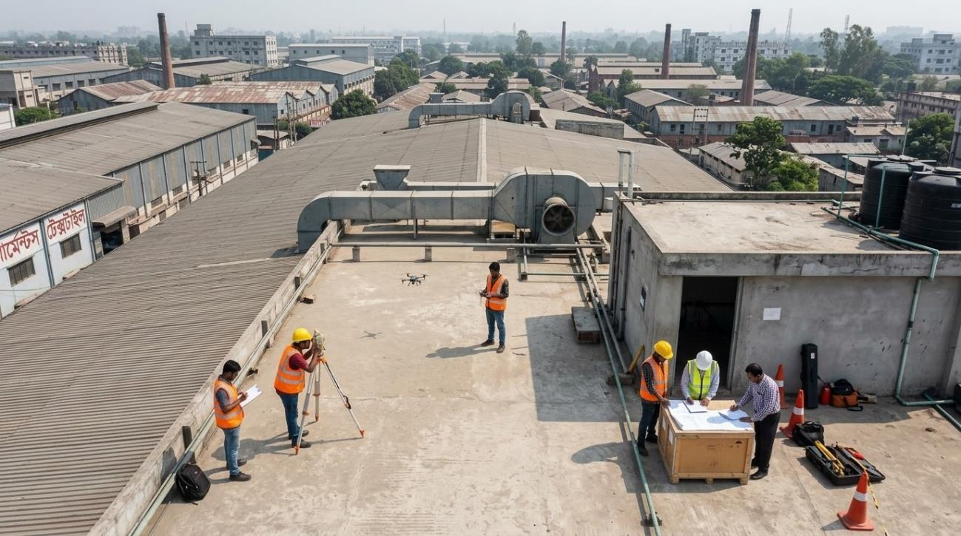
ARIEL RENEWABLE ENERGY LIMITED | SOVEREIGN GREEN INFRASTRUCTURE & INDUSTRIAL DECARBONIZATION
Next Step: Complimentary 3D Drone Feasibility Audit (Zero Cost)
Authorizing a Zero-Cost Preliminary Audit:
• Non-Binding & 100% Free: Authorizing a site visit carries zero financial commitment.
• 3D Drone Aerial LiDAR Mapping: High-precision aerial photogrammetry scans usable roof area, skylights, vents, and obstacle shading.
• Structural Load & Substation Audit: Certified BUET civil checks rafters & purlins; electrical engineers inspect transformer kVA & busbars.
• Deliverable in 5 Working Days: A customized 4-Page Bankable Feasibility Dossier with PVsyst 3D layout, guaranteed generation, and bank loan model.
EXECUTIVE CONTACT & AUDIT BOOKING:
Syed Akramul Hassan — Managing Director & CEO
Ariel Renewable Energy Limited | ArielMC Enterprise Eco-System
Direct Hotline / WhatsApp: +880 1819 273458
Email: energy@arielmc.com | Web Portal: energy.arielmc.com
Ariel Renewable Energy Limited • Sovereign Green Infrastructure & Industrial Decarbonization • energy.arielmc.com • Slide 12 of 12

