Slide 1
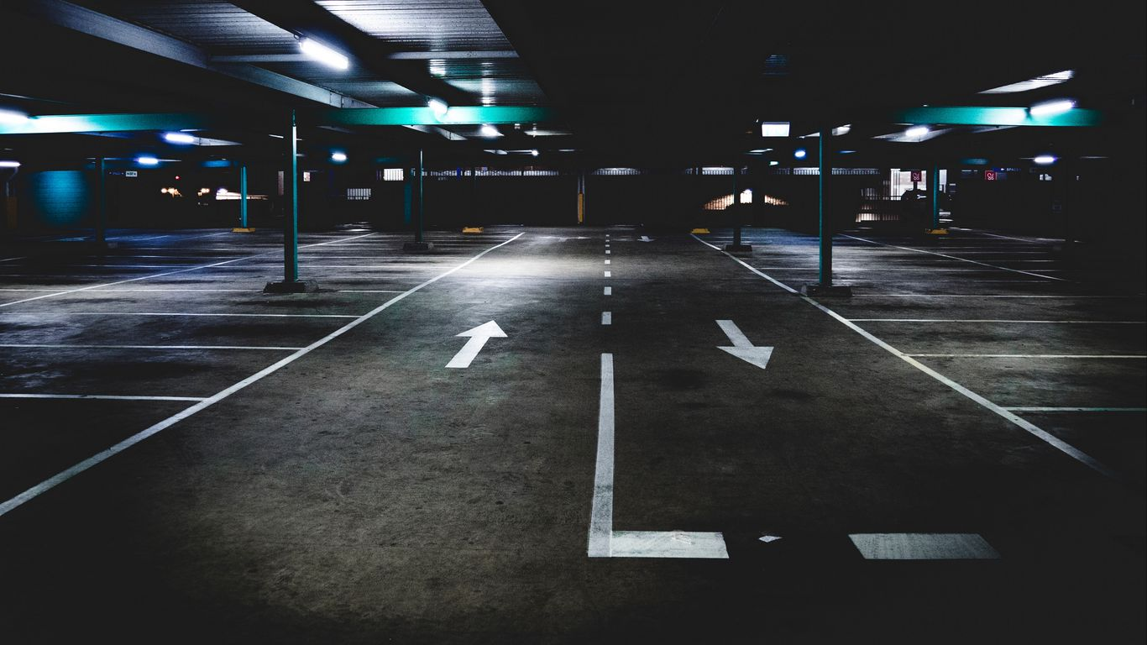
Digital Parking System
Project Title

Slide 2
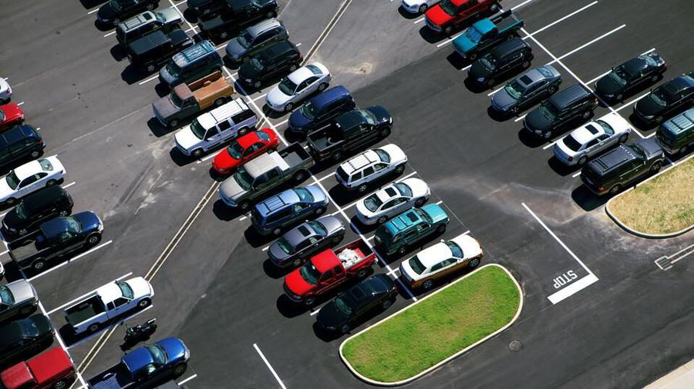
01
02
ID : 18-37968-2
TANVIR AHAMED
03
04
ID : 18-39074-3
MD.TUHIN REZA
ID : 19-39430-1
ID : 19-39994-1
MD. MEHEDI MUHTASIM
INZAMAMUL FARIDEE NUR
Group Member

Slide 3
A parking lot is a dedicated cleared area that is intended for parking vehicles. In most countries where vehicle are a major mode of transportation, parking lots are a feature of every city and suburban area. Shopping malls, sports stadiums, megachurche , and similar venues often feature parking lots over large areas.
Parking Details

Slide 4
For customers
1
No need to search for available parking spaces
2
No need to walk through the parking garage
3
Time saving
4
Consistent parking experience
5
parked safe and secure
Objective/Motivation-1

Slide 5
For municipalities / Property owners
1
Space efficiency
2
Environment friendliness
3
Visual impact increased
4
Increases public safety
5
Money saving advantages
Objective/Motivation-2

Slide 6
System
To display messages on different info panels, as well as assigning and removing a vehicle from a parking spot. The system should support parking for different types of vehicles like car, truck, van, motorcycle, etc.
Each parking floor should have a display board showing any free parking spot for each spot type
The system should support a per-hour parking fee model. For example, customers have to pay $4 for the first hour, $3.5 for the second and third hours, and $2.5 for all the remaining hours. The system should not allow more vehicles than the maximum capacity of the parking lot. If the parking is full, the system should be able to show a message at the entrance panel and on the parking display board on the ground floor.
System
To display messages on different info panels, as well as assigning and removing a vehicle from a parking spot. The system should support parking for different types of vehicles like car, truck, van, motorcycle, etc.
Each parking floor should have a display board showing any free parking spot for each spot type
The system should support a per-hour parking fee model. For example, customers have to pay $4 for the first hour, $3.5 for the second and third hours, and $2.5 for all the remaining hours. The system should not allow more vehicles than the maximum capacity of the parking lot. If the parking is full, the system should be able to show a message at the entrance panel and on the parking display board on the ground floor.
Parking attendant
Parking attendants can do all the activities on the customer’s behalf, and can take cash for ticket payment. This class will encapsulate all the operations that an attendant can perform, like scanning tickets and processing payments.
Customer
All customers can get a parking ticket and pay for it. Customers can pay the tickets at the automated exit panel or to the parking attendant.
Customers can pay via both cash and credit cards.
Customers should also be able to pay the parking fee at the customer’s info portal on each floor. If the customer has paid at the info portal, they don’t have to pay at the exit.
D
C
Admin
Mainly responsible for adding and modifying parking floors, parking spots, entrance, and exit panels, adding/removing parking attendants, etc.
C
B
A
User Details

Slide 7




A
C
S
A
N
Name
Id
Contact no
Email
Blood group
Post
Name
Id
Contact no
Email
Vehicle type
Vehicle size
Date of birth
Day
Month
Time
National id
Name
Id
Contact no
Email
Blood group
Post
Name
Id
Contact no
Email
Blood group
Post
User Attribute

Slide 8
A
Add/Modify parking floor
B
Add/Modify parking spot
Admin
C
Add/Remove parking attendants
Add/Modify parking rate
D
A
Add entrance/exit panel
E
Functionalities-1

Slide 9
A
Login/Sign up
B
Take Ticket
Customer
C
Scan Ticket
D
Pay ticket
E
Payment
Functionalities-2

Slide 10
A
Assign a parking
Spot to a vehicle
B
Remove a vehicle from a parking spot
System
C
Show a parking full message
Show available par-
King spot message
D
E
Payment
Functionalities-3

Slide 11
A
Login
B
View Account
Attendant
C
Update Account
D
Cash Payment
E
Payment
Functionalities-4

Slide 12
ADMIN
1
MD. TUHIN REZA
2
P.Attendant
TANVIR AHAMED
CUSTOMER
3
MD. MEHEDI MUHTASIM
System
4
INZAMAMUL FARIDEE NUR
Contribution

Slide 13
Our project’s main purpose is that to create such a system where we can use minimum number of employees in a parking system and a customer can use the system very comfortably. A customer can book a parking slot and parking time as his/her own will. The customer can book the time and slot through online. Here we want to use a system where the system will do the necessary work such as parking time and slot and there will be no human interactions while booking the parking. The minimum criteria of booking a parking slot is not less than a hour.
Project Proposal

Slide 14
We also want to implement a system where the system will set the current time when a person will go for park and the gate will open automatically if the booking time and entry current time is same. If the person comes before his booked entry time, the door will not open. He/she have to wait for the booked entry time. The door will open if the person gets late. There will be no fine. But if the person extends his booked exit time, he will be fined.
But we can’t implement the current time because if we do so, we can’t check the system properly.
Faces Problem

Slide 15
1. www.codegrepper.com
2. www.c-sharpcorner.com
3. www.guru99.com
4. www.codeproject.com
5. www.w3schools.com
Using Website

Slide 16
In future there are chances where we can make changes. There is a change where the part of parking attendant can be removed and all the works will be done automatically by the system. The parking system of the future must integrate the use of technology to reduce the challenges experienced today and what’s to come in the future. These technologies can be used to automate parking, vehicle charging, vehicle location, and security. Currently, multi storey vehicle parks are being designed to use lifts which carry vehicles to specific floors within the building. This process can become more effective if the lifts are automated to handle the tasks with less input from humans.
Future Plan

Slide 17
The future of vehicle park design will be defined by the challenges we currently face, the adoption of new transportation solutions and technology. The ability to maximize public space will leave more land for building human dwellings or commercial spaces while simplifying the parking process will leave us with more time to use as we choose.
Conclusion

Slide 18



Thank You
End

