Slide 1
PIZZA STORE DATA ANALYSIS PROJECT

Slide 2
OVERVIEW
This project involves analysing the sales and customer data of a pizza store to derive meaningful insights that can help in decision-making and business optimization. The analysis is performed using SQL queries on various datasets.

Slide 3
Key Insights
Total Orders Placed: Calculated the total number of orders placed to gauge sales volume.
Revenue Analysis: Determined the total revenue generated from pizza sales.
Highest Priced Pizza: Identified the highest-priced pizza in the menu.
Most Common Pizza Size: Analysed the most commonly ordered pizza size.
Top 5 Pizza Types: Listed the top 5 most ordered pizza types along with their quantities.

Slide 4
Questions & SQL Queries

Slide 5

Query
-- 1Q:Retrieve the total number of orders placed?
SELECT COUNT (order_id) AS total_orders FROM orders;

Slide 6

Query
--2 Q:Calculate the total revenue generated from pizza sales?
SELECT ROUND (SUM(p.price*od.quantity),2) As total_revenue
FROM order_details AS od
INNER JOIN
pizzas AS p
ON p.pizza_id = od.pizza_id;

Slide 7

Query
-- 3Q:Identify the highest-priced pizza?
SELECT pt.name As pizza_name,p.price As pizza_price FROM pizzas AS p
INNER JOIN
pizza_types AS pt
ON p.pizza_type_id = pt.pizza_type_id
ORDER BY pizza_price DESC LIMIT 1;

Slide 8
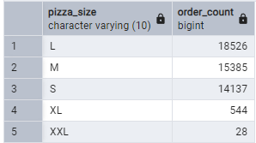
Query
-- 4Q:Identify the most common pizza size ordered?
SELECT p.size AS pizza_size,COUNT(od.order_id) AS order_count FROM pizzas AS p
INNER JOIN
order_details AS od
ON p.pizza_id = od.pizza_id
GROUP BY p.size
ORDER BY order_count DESC;

Slide 9
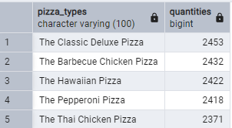
Query
-- 5Q:List the top 5 most ordered pizza types along with their quantities?
SELECT pt.name AS pizza_types,SUM(od.quantity) AS quantities
FROM pizzas AS p
INNER JOIN
order_details AS od
ON p.pizza_id = od.pizza_id
INNER JOIN
pizza_types AS pt
ON pt.pizza_type_id = p.pizza_type_id
GROUP BY pizza_types
ORDER BY quantities DESC
LIMIT 5;

Slide 10
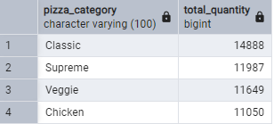
Query
-- 6Q:Join the necessary tables to find the total quantity of each pizza category ordered?
SELECT pt.category AS pizza_category,SUM(od.quantity) AS total_quantity
FROM pizzas AS p
INNER JOIN
pizza_types AS pt
ON p.pizza_type_id = pt.pizza_type_id
INNER JOIN
order_details AS od
ON p.pizza_id = od.pizza_id
GROUP BY pizza_category
ORDER BY total_quantity DESC;

Slide 11
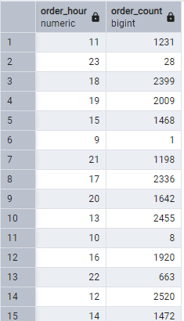
Query
-- 7Q:Determine the distribution of orders by hour of the day?
SELECT
EXTRACT(HOUR FROM order_time) AS order_hour,
COUNT (order_id) AS order_count
FROM orders
GROUP BY order_hour;

Slide 12
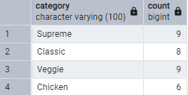
Query
-- 8Q:Join relevant tables to find the category-wise distribution of pizzas?
SELECT category, COUNT(name) FROM pizza_types
GROUP BY category;

Slide 13
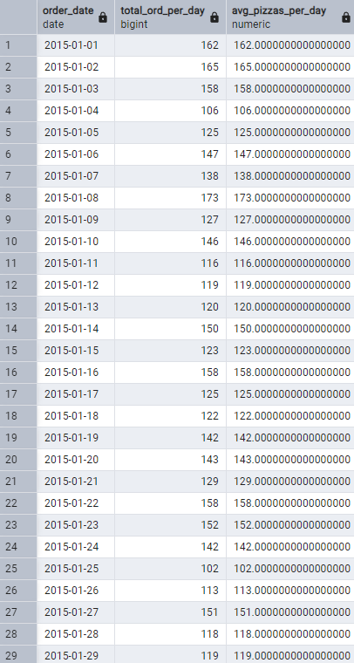
Query
-- 9Q:Group the orders by date and calculate the average number of pizzas ordered per day?

Slide 14
Query
Solution 1: Using sub query
SELECT
order_date,
ROUND(AVG(total_pizzas),2) AS avg_pizzas_per_day
FROM (
SELECT
o.order_date,
SUM(od.quantity) AS total_pizzas
FROM
orders o
JOIN
order_details od ON o.order_id = od.order_id
GROUP BY
o.order_date
)
GROUP BY
order_date
ORDER BY
order_date;

Slide 15
Query
Solution 2: Using CTE & Window Function
WITH daily_pizza_orders AS (
SELECT
o.order_date,
SUM(od.quantity) AS total_ord_per_day
FROM
orders o
JOIN
order_details od ON o.order_id = od.order_id
GROUP BY
o.order_date
)
SELECT
order_date,
total_ord_per_day,
AVG(total_ord_per_day) OVER (PARTITION BY order_date) AS avg_pizzas_per_day
FROM
daily_pizza_orders
ORDER BY
order_date;

Slide 16
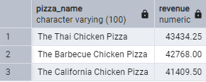
Query
-- 10Q:Determine the top 3 most ordered pizza types based on revenue.
SELECT
pt.name As pizza_name,
SUM(p.price*od.quantity)AS revenue
FROM pizza_types AS pt
INNER JOIN
pizzas AS p
ON p.pizza_type_id = pt.pizza_type_id
INNER JOIN
order_details AS od
ON p.pizza_id = od.pizza_id
GROUP BY pizza_name
ORDER BY revenue DESC
LIMIT 3;

Slide 17
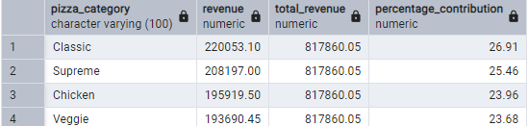
Query
-- 11Q:Calculate the percentage contribution of each pizza type to total revenue?
WITH each_category_revenue AS(
SELECT
pt.category aS pizza_category ,
SUM(p.price*od.quantity)AS revenue
FROM pizza_types AS pt
INNER JOIN
pizzas AS p
ON p.pizza_type_id = pt.pizza_type_id
INNER JOIN
order_details AS od
ON p.pizza_id = od.pizza_id
GROUP BY pizza_category
),
total_revenue AS(
SELECT SUM(revenue) As total_revenue
FROM each_category_revenue
)
SELECT
ecr.pizza_category,
ecr.revenue,
tr. total_revenue,
ROUND((ecr.revenue/tr. total_revenue)*100,2) As percentage_contribution
FROM
each_category_revenue AS ecr
CROSS JOIN
total_revenue AS tr
ORDER BY percentage_contribution DESC;

Slide 18
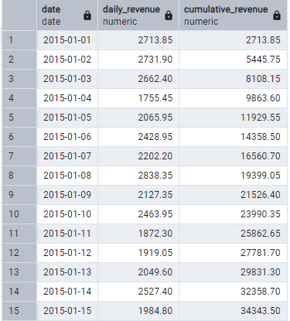
Query
-- 12Q: Analyze the cumulative revenue generated over time?
SELECT
o.order_date AS date,
SUM(p.price * od.quantity) AS daily_revenue,
SUM(SUM(p.price * od.quantity)) OVER (ORDER BY o.order_date) AS cumulative_revenue
FROM pizza_types AS pt
INNER JOIN pizzas AS p ON p.pizza_type_id = pt.pizza_type_id
INNER JOIN order_details AS od ON p.pizza_id = od.pizza_id
INNER JOIN orders AS o ON o.order_id = od.order_id
GROUP BY o.order_date
ORDER BY o.order_date;

Slide 19
Query
--13Q: Determine the top 3 most ordered pizza types based on revenue for each pizza category.
WITH revenue_per_pizza AS (
SELECT
pt.category AS pizza_category,
pt.name AS pizza_name,
SUM(p.price * od.quantity) AS revenue
FROM pizza_types AS pt
INNER JOIN pizzas AS p ON p.pizza_type_id = pt.pizza_type_id
INNER JOIN order_details AS od ON p.pizza_id = od.pizza_id
GROUP BY pt.category, pt.name
),
ranked_pizzas AS (
SELECT
pizza_category,
pizza_name,
revenue,
RANK() OVER (PARTITION BY pizza_category ORDER BY revenue DESC) AS ranking
FROM revenue_per_pizza
)
SELECT
pizza_category,
pizza_name,
revenue,
ranking
FROM ranked_pizzas
WHERE ranking <= 3
ORDER BY pizza_category, ranking;

