Slide 1
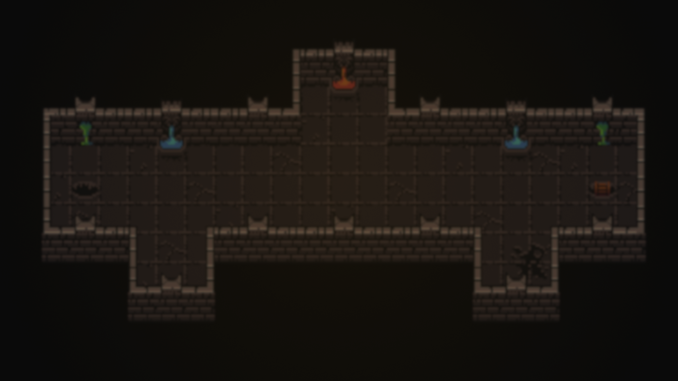
Castle Thingy
A roguelike where you move in tiles and defeat enemies.

Slide 2
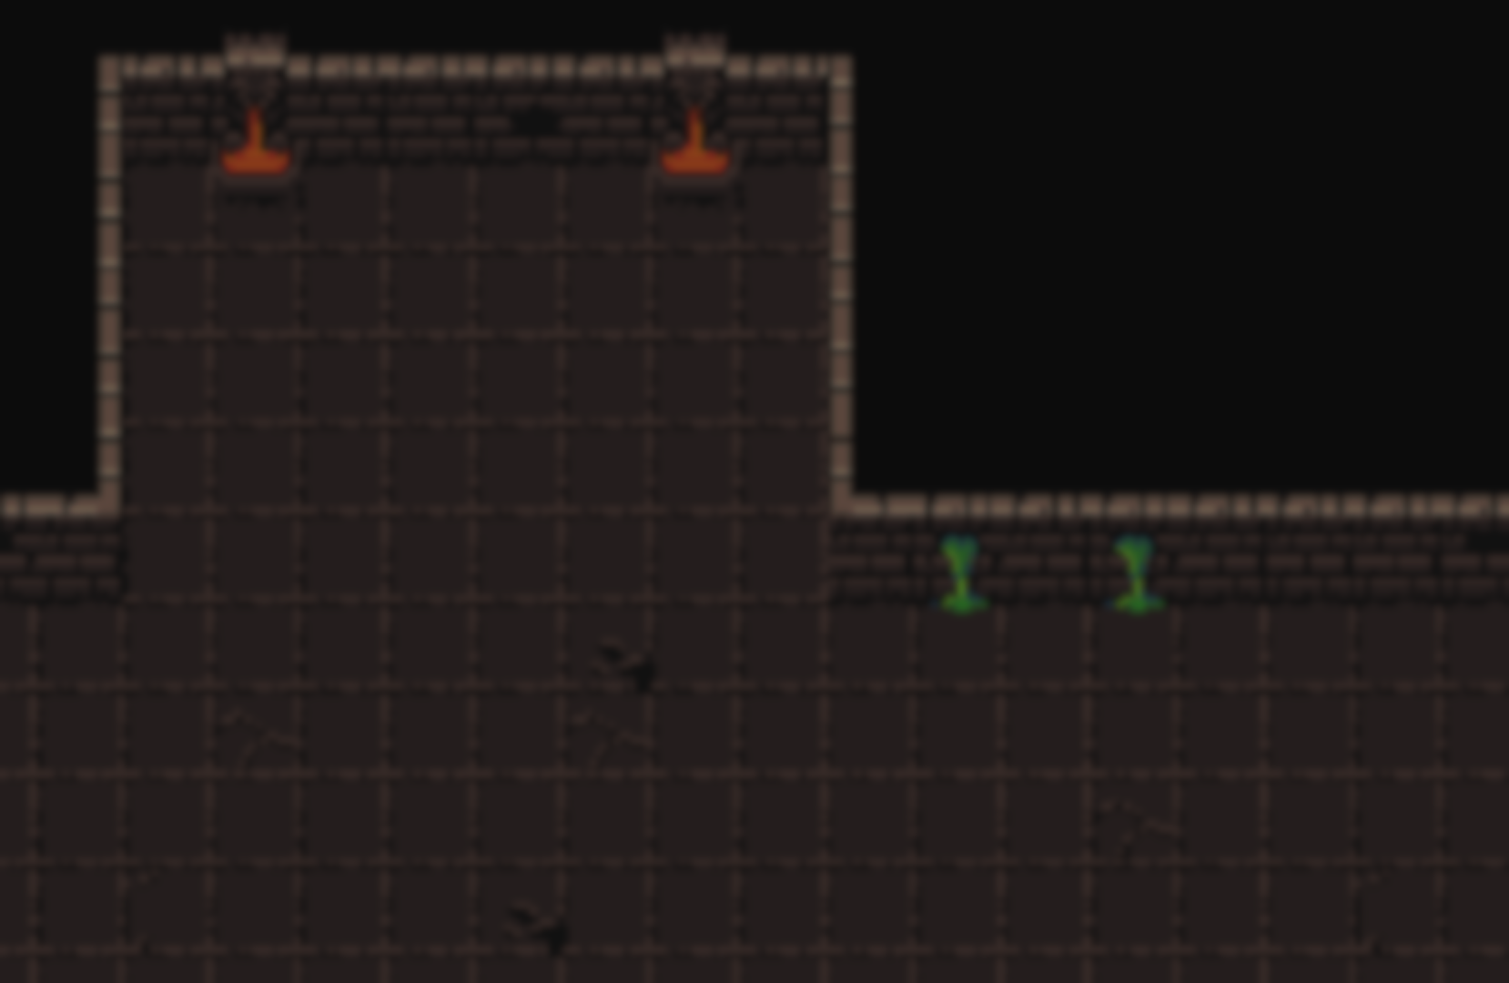
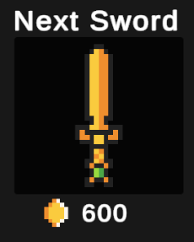
Idea
The idea of the game is, that you need to finish levels by taking turns.
A turn means moving the player by 1 tile or to attack an enemy.
Always when you take a turn, the enemies do too.
You can progress by buying new swords, that do more damage.

Slide 3
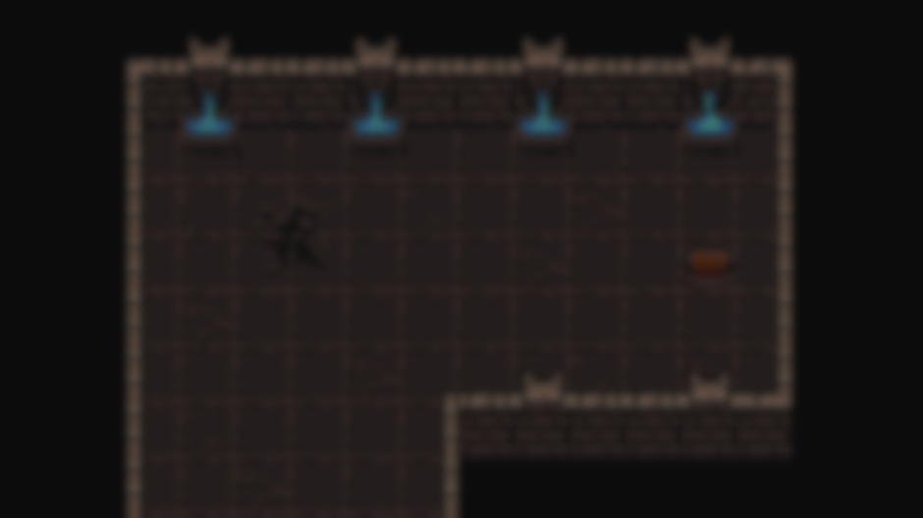
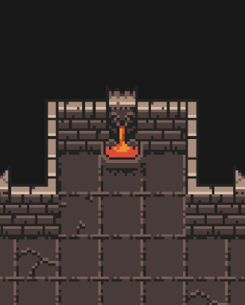
Core Mechanics
You take turns to move or attack by left clicking a tile next to you, and the enemies do turns at the same time.
You finish a level by going to the stairs tile.
Difficulty should increase by time.
Get coins from the map and buy new swords with them.

